Slide 1
Nenana river ice from daily VIIRS
Runs 17-20: unmixing, whole-image states, and four river / land states on the river with and without a buffer. RF, UNet++ and a 2D CNN; labels from the run 16 Landsat maps.

Slide 2
VIIRS can map the river state on days Landsat cannot
0.794
0.731
0.759
run 19 RF accuracy, river + buffer, rule50 (unseen days)
run 20 RF accuracy, river only, rule50 (unseen days)
run 18 RF accuracy, whole image, rule50
Landsat 30 m passes every 8-16 days; VIIRS 375 m passes daily. Run 16 maps become VIIRS labels; VIIRS alone is the input.
Run 17 (Oleson 1995 unmixing): class values recovered on snow / break-up days (I1 R² up to 0.77), not in summer.
Per-pixel river states (runs 19, 20) fix run 18's whole-day flips, e.g. RF on 2024-04-21: 0.11 -> 0.55.
Every score is leave-one-date-out: 6 labelled days, train on 5, test on the 6th.

Slide 3
From 30 m classes to 375 m labels
Labels
Inputs (VIIRS only)
Dates
Run 16 Landsat map per date, summed per VIIRS pixel (12.5 x 12.5 Landsat px) after the run 17 shift (<= ~60 m). Pixels >= 98 % mapped.
I1-I5, NDVI_I, NDSI_I, I4-I5, sun and view zenith, JRC occurrence; RF adds 3 x 3 mean / std. Runs 19-20 add the water mask.
6 labelled days (run 16 dates with VIIRS); 4 VIIRS-only days predicted by final models.
state | name | river | land
1 | ice_free_river_snow_free_land | open | no snow
2 | ice_free_river_snow_covered_land | open | snow
3 | ice_covered_river_snow_free_land | ice | no snow
4 | ice_covered_river_snow_covered_land | ice | snow
rule50: open if open > 50 % of river; snow if snow > 50 % of land.
rule90: open only if > 90 % open; snow-free only if < 10 % snow.
< 1 % river or land in a pixel: the date's ratio decides.

Slide 4
Dates and the VIIRS-Landsat shift
date | use | shift m (S, E) | VZA °
2023-04-19 | VIIRS only | 30, 0 | 9
2023-05-05 | labelled | 60, -26 | 9
2023-07-24 | labelled | 0, 26 | 12
2023-10-04 | labelled | 30, -52 | 10
2024-04-21 | labelled | 0, -26 | 13
2024-06-22 | labelled | 30, 0 | 1
2024-09-02 | VIIRS only | -90, -78 | 2
2025-07-04 | VIIRS only | 30, -26 | 7
2026-03-26 | labelled | 0, 0 | 28
2026-08-01 | VIIRS only | 0, 26 | 28
Run 16 dates without VIIRS (2024-03-12, 2024-04-20, 2024-04-29) are left out.
VIIRS-only days have no truth: maps and % only.
Bug fixed on the way: a VIIRS pixel holds 12 or 13 Landsat pixels per side; dividing by 12.5² dropped every 12 x 12 pixel (~25 %). Now divided by the real count.

Slide 5
Run 17: unmixing
Oleson et al. 1995 replicated with the run 16 maps

Slide 6
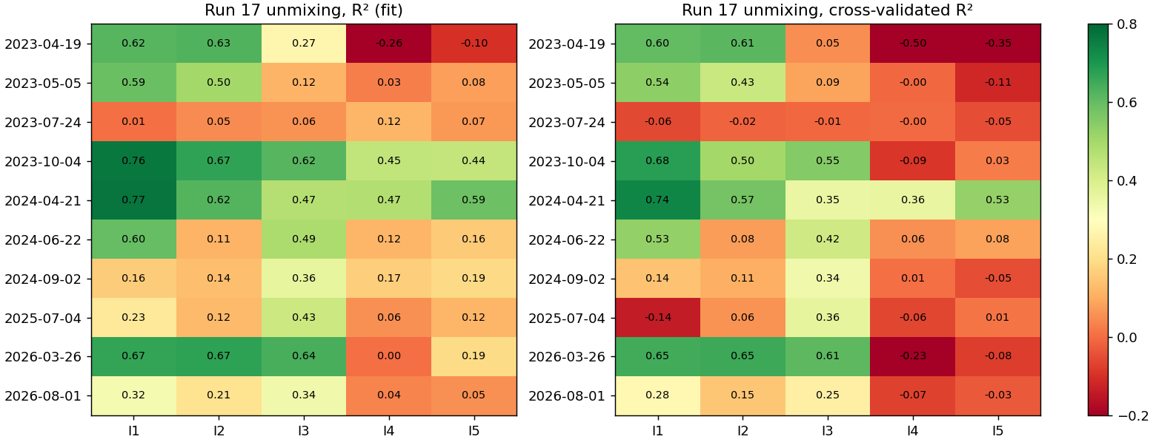
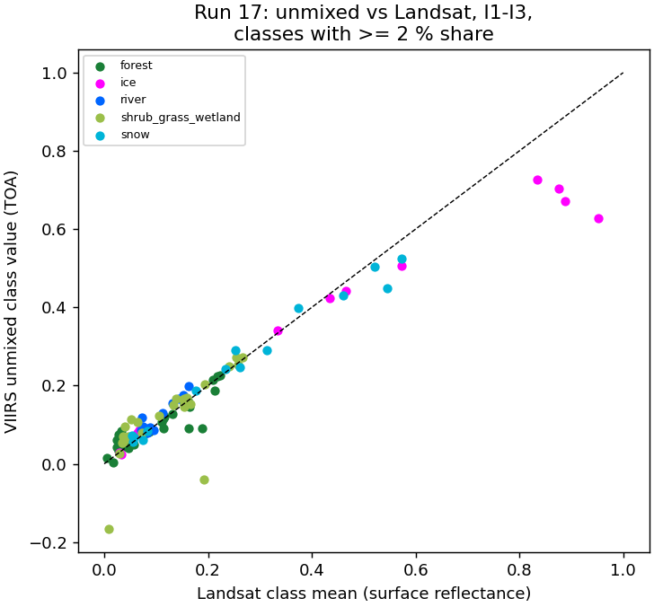
Unmixing works on snow days, fails in summer
VIIRS value = Σ class share x class value; least squares over the image.
Gaussian PSF σ = 134 m (375 m / 2.8), best shift searched.
2024-04-21 I1: ice 0.422 vs Landsat 0.434; snow 0.187 vs 0.177.
Summer R² < 0.1: forest, shrub and river look alike at 375 m.
River (0.4 %) comes out negative: too rare to unmix.

Slide 7
Run 17: fit metrics per band (R² / cross-validated R²)
date | I1 | I2 | I3 | I4 | I5
2023-04-19 | 0.62 / 0.60 | 0.63 / 0.61 | 0.27 / 0.05 | -0.26 / -0.50 | -0.10 / -0.35
2023-05-05 | 0.59 / 0.54 | 0.50 / 0.43 | 0.12 / 0.09 | 0.03 / -0.00 | 0.08 / -0.11
2023-07-24 | 0.01 / -0.06 | 0.05 / -0.02 | 0.06 / -0.01 | 0.12 / -0.00 | 0.07 / -0.05
2023-10-04 | 0.76 / 0.68 | 0.67 / 0.50 | 0.62 / 0.55 | 0.45 / -0.09 | 0.44 / 0.03
2024-04-21 | 0.77 / 0.74 | 0.62 / 0.57 | 0.47 / 0.35 | 0.47 / 0.36 | 0.59 / 0.53
2024-06-22 | 0.60 / 0.53 | 0.11 / 0.08 | 0.49 / 0.42 | 0.12 / 0.06 | 0.16 / 0.08
2024-09-02 | 0.16 / 0.14 | 0.14 / 0.11 | 0.36 / 0.34 | 0.17 / 0.01 | 0.19 / -0.05
2025-07-04 | 0.23 / -0.14 | 0.12 / 0.06 | 0.43 / 0.36 | 0.06 / -0.06 | 0.12 / 0.01
2026-03-26 | 0.67 / 0.65 | 0.67 / 0.65 | 0.64 / 0.61 | 0.00 / -0.23 | 0.19 / -0.08
2026-08-01 | 0.32 / 0.28 | 0.21 / 0.15 | 0.34 / 0.25 | 0.04 / -0.07 | 0.05 / -0.03
Regression, not classification: no confusion matrix.
cv R² = 5 folds of pixels; full RMSE and cv RMSE per band are in the report.
Thermal bands (I4, I5) do not unmix: surface temperature is not a fixed class value.

Slide 8
Run 18: whole image
% of open water, ice, snow and snow-free land per VIIRS pixel, then the states

Slide 9
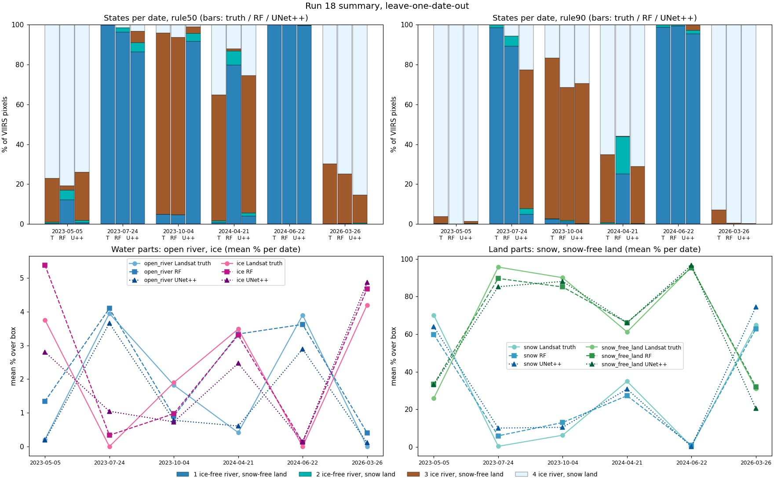
Good % mix, but the river state follows the day
model | water MAE / R² | ice | snow | no-snow land | acc50 | acc90
RF | 1.6 / 0.84 | 1.4 / 0.90 | 11.3 / 0.79 | 11.4 / 0.82 | 0.759 | 0.846
UNet++ | 1.1 / 0.76 | 1.3 / 0.77 | 11.8 / 0.71 | 12.1 / 0.73 | 0.704 | 0.744
Most pixels hold < 1 % river, so their river state is the date's ratio.
One wrong date flips the whole image: RF calls 2024-04-21 open (0.11).
UNet++ trails RF: 5 training images per fold.

Slide 10
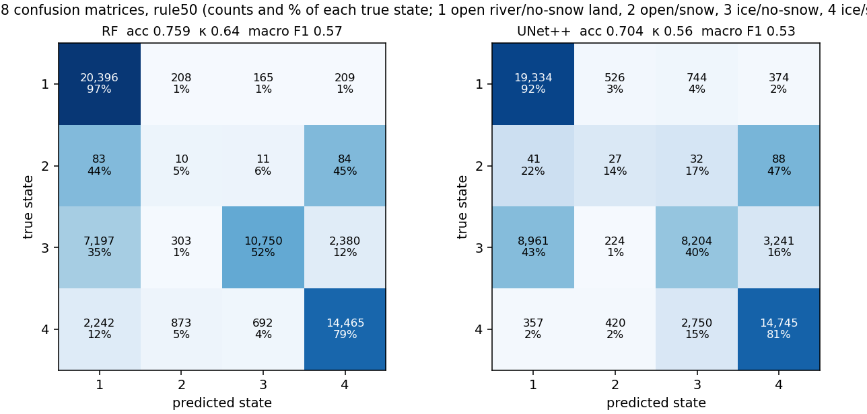
Run 18: confusion matrices, rule50
Rows true state, columns predicted; cell = pixels and % of the true state. 1 open river / no-snow land, 2 open / snow, 3 ice / no-snow, 4 ice / snow.

Slide 11
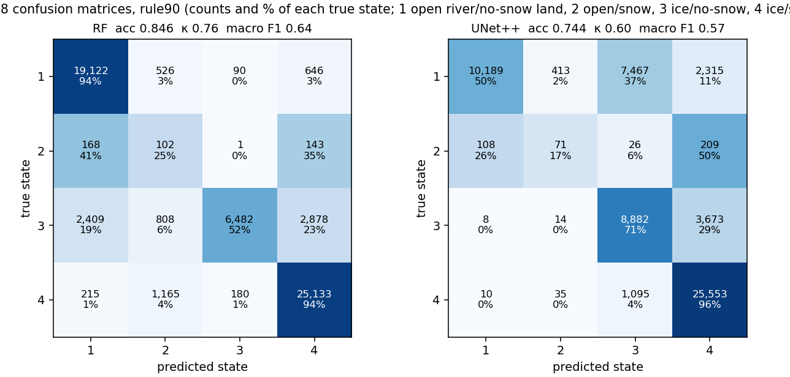
Run 18: confusion matrices, rule90
Rows true state, columns predicted; cell = pixels and % of the true state. 1 open river / no-snow land, 2 open / snow, 3 ice / no-snow, 4 ice / snow.

Slide 12
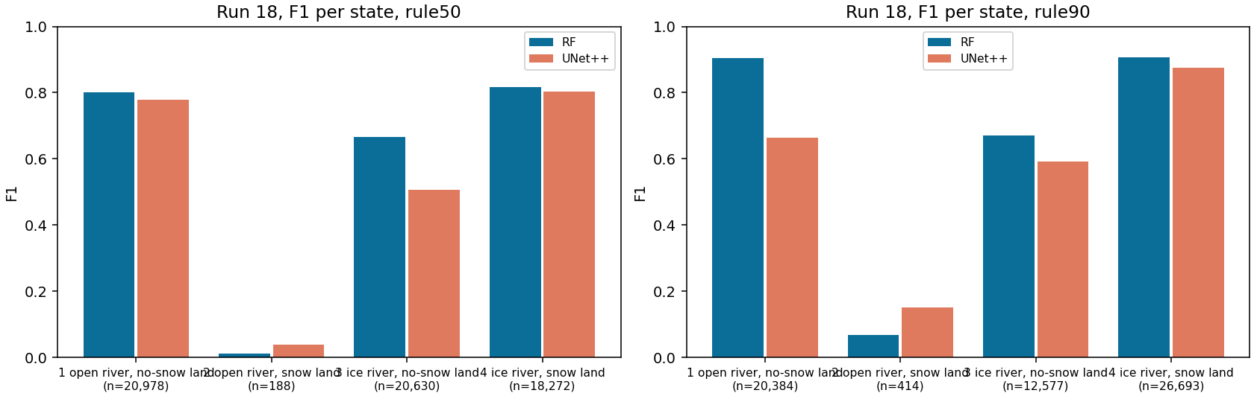
Run 18: all metrics and F1 per state
rule | model | acc | bal. acc | κ | macro P | macro R | macro F1 | wtd F1
rule50 | RF | 0.759 | 0.585 | 0.643 | 0.615 | 0.585 | 0.574 | 0.757
rule50 | UNet++ | 0.704 | 0.567 | 0.560 | 0.549 | 0.567 | 0.532 | 0.690
rule90 | RF | 0.846 | 0.660 | 0.760 | 0.686 | 0.660 | 0.637 | 0.850
rule90 | UNet++ | 0.744 | 0.584 | 0.604 | 0.609 | 0.584 | 0.570 | 0.739

Slide 13
Run 19: river + buffer
Water mask occurrence >= 0.05 (988 px) plus a 1-pixel (375 m) buffer (678 px).

Slide 14
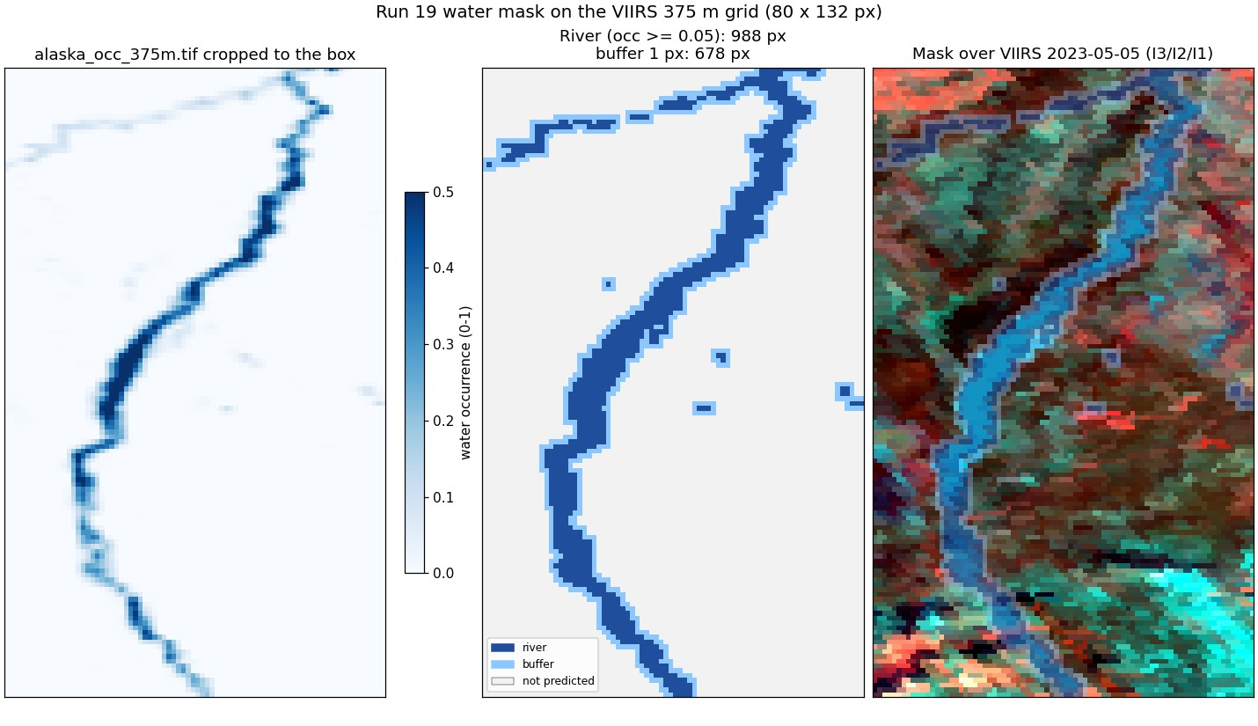
Run 19: the predicted area
Water mask occurrence >= 0.05 (988 px) plus a 1-pixel (375 m) buffer (678 px).
Pixels outside the mask are not predicted.
9,645 scored pixels over 6 days.

Slide 15
Run 19: four states at once, three models
model | rule50 acc | rule50 F1 | rule90 acc | rule90 F1
RF | 0.794 | 0.644 | 0.818 | 0.662
UNet++ | 0.714 | 0.535 | 0.742 | 0.477
2D CNN | 0.812 | 0.655 | 0.854 | 0.664
RF: depth 16, leaf 20, balanced classes (run 16 settings).
UNet++: resnet18, masked cross-entropy.
2D CNN: 4 conv 3 x 3 layers, 9 x 9 pixel view, 97k params.
State 2 (open river, snow land) is rare: low F1 everywhere.

Slide 16
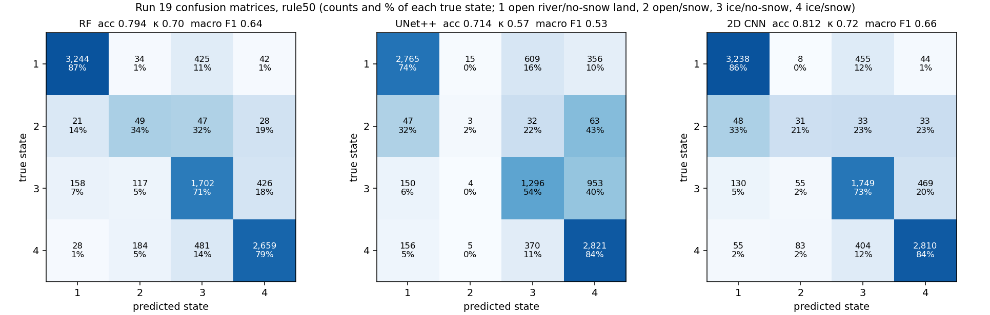
Run 19: confusion matrices, rule50
Rows true state, columns predicted; cell = pixels and % of the true state. 1 open river / no-snow land, 2 open / snow, 3 ice / no-snow, 4 ice / snow.

Slide 17
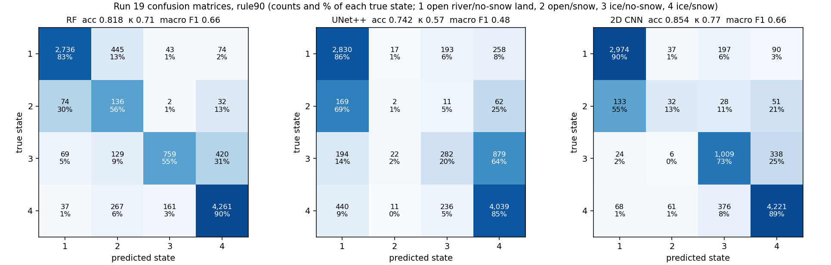
Run 19: confusion matrices, rule90
Rows true state, columns predicted; cell = pixels and % of the true state. 1 open river / no-snow land, 2 open / snow, 3 ice / no-snow, 4 ice / snow.

Slide 18
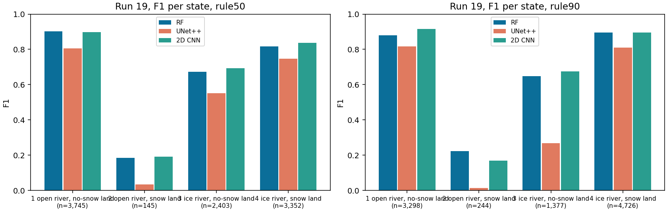
Run 19: all metrics and F1 per state
rule | model | acc | bal. acc | κ | macro P | macro R | macro F1 | wtd F1
rule50 | RF | 0.794 | 0.676 | 0.696 | 0.638 | 0.676 | 0.644 | 0.805
rule50 | UNet++ | 0.714 | 0.535 | 0.569 | 0.558 | 0.535 | 0.535 | 0.710
rule50 | 2D CNN | 0.812 | 0.661 | 0.719 | 0.652 | 0.661 | 0.655 | 0.815
rule90 | RF | 0.818 | 0.710 | 0.714 | 0.689 | 0.710 | 0.662 | 0.838
rule90 | UNet++ | 0.742 | 0.481 | 0.565 | 0.495 | 0.481 | 0.477 | 0.715
rule90 | 2D CNN | 0.854 | 0.665 | 0.766 | 0.672 | 0.665 | 0.664 | 0.853

Slide 19
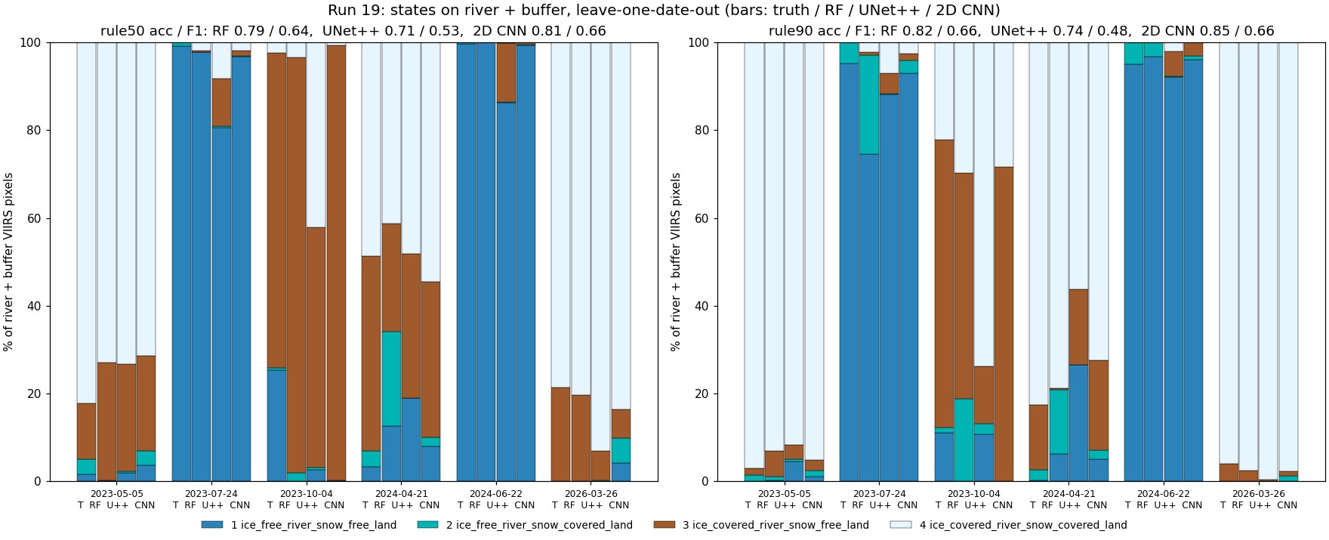
Run 19: states per day, truth and every model

Slide 20
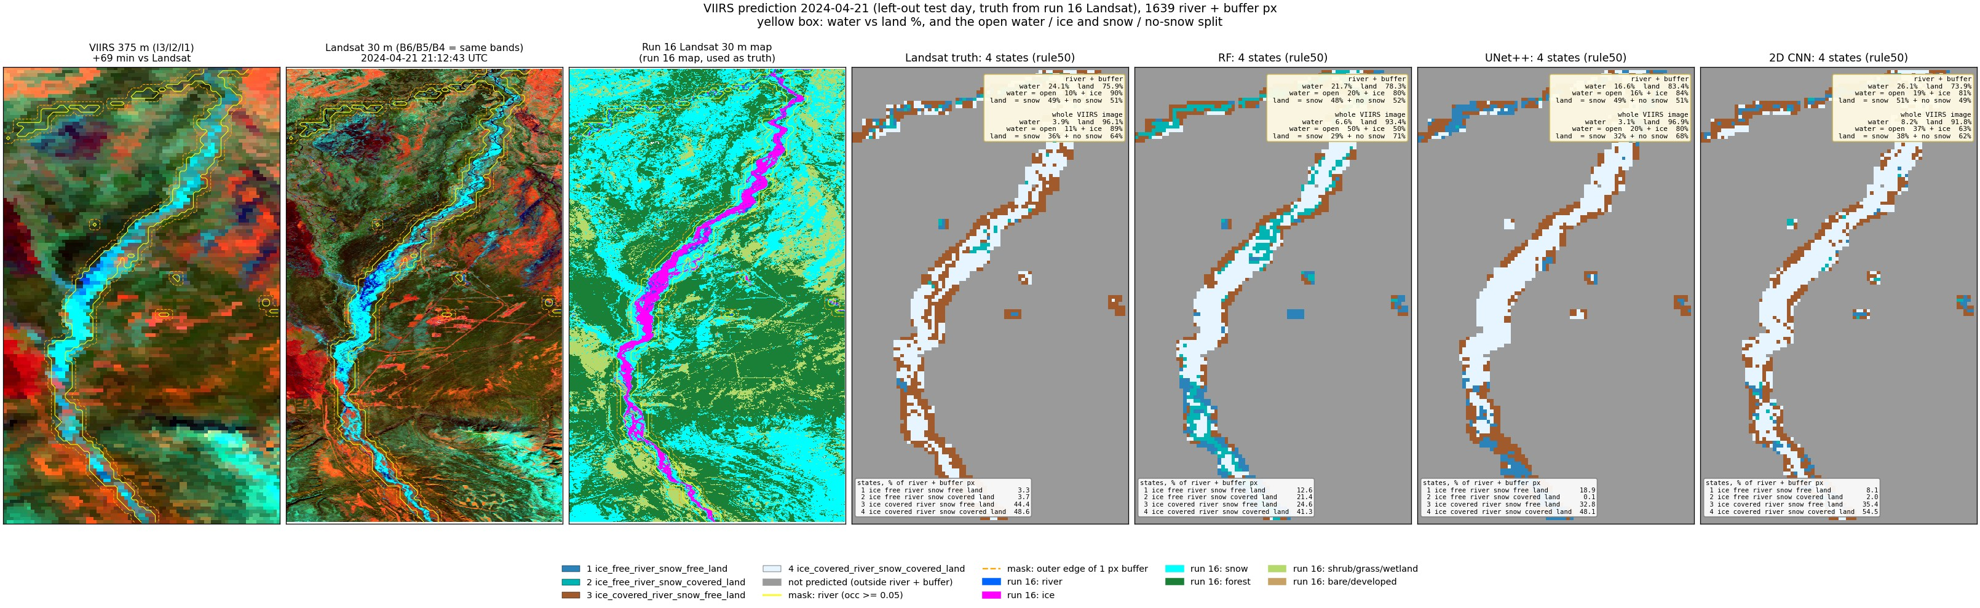
Run 19, 2024-04-21: predicted states (left-out test day)

Slide 21
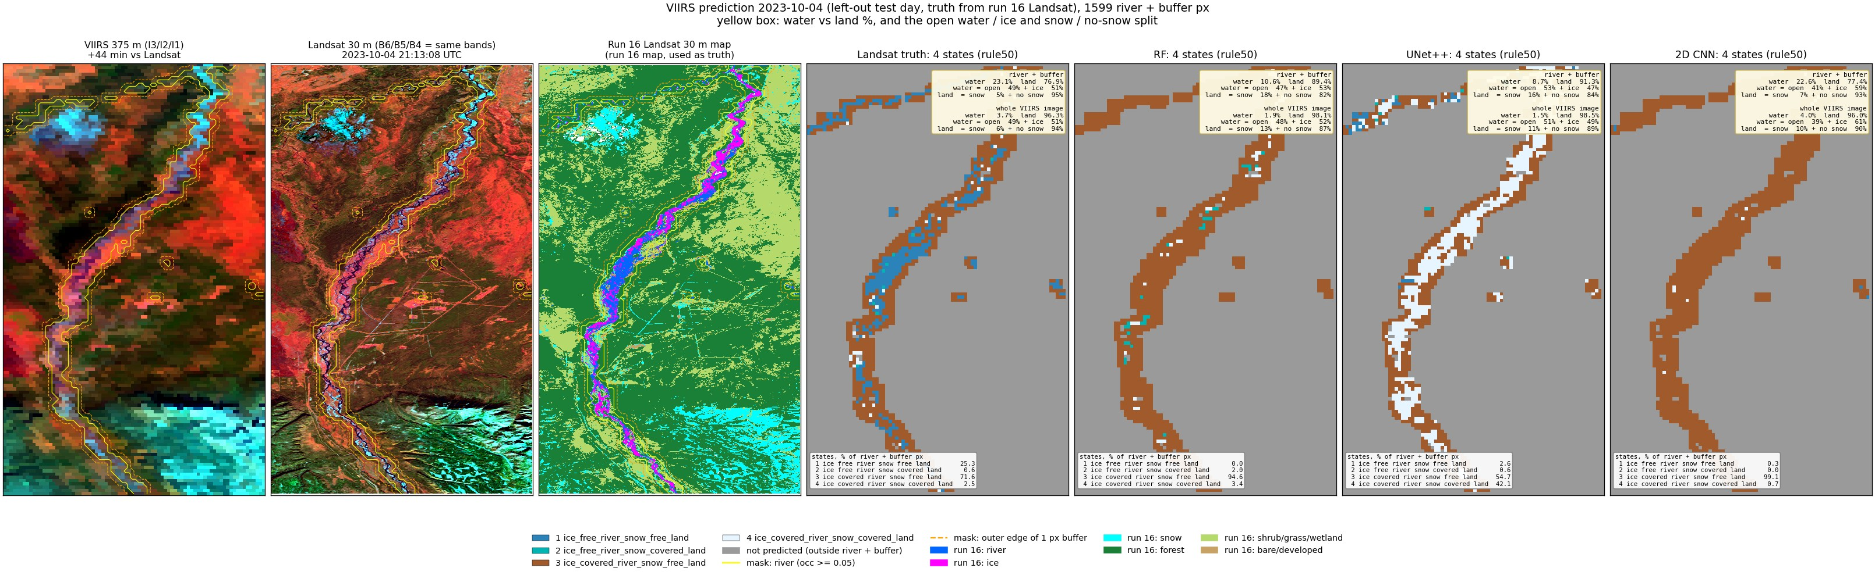
Run 19, 2023-10-04: predicted states (left-out test day)

Slide 22
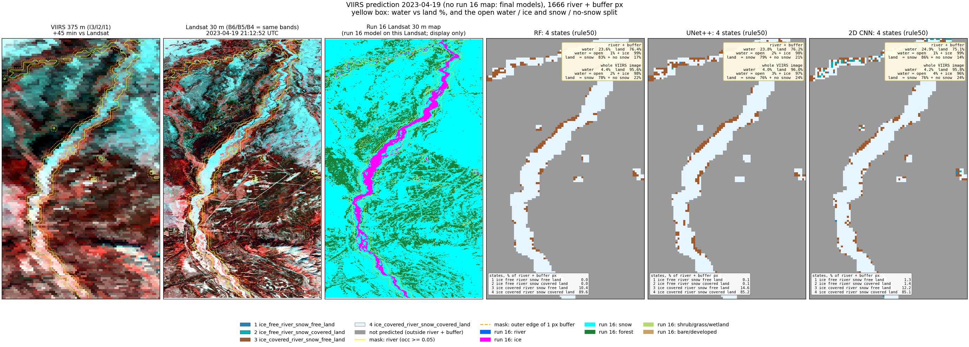
Run 19, 2023-04-19: predicted states (VIIRS only)

Slide 23
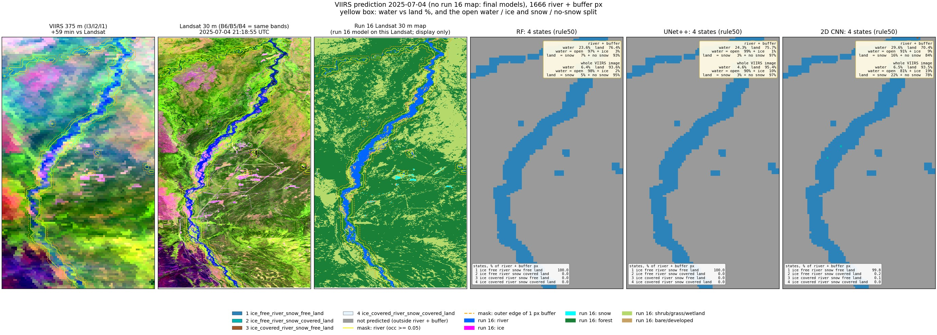
Run 19, 2025-07-04: predicted states (VIIRS only)

Slide 24
Run 19: water and land split (river + buffer)
date | Landsat truth | RF | UNet++ | 2D CNN
2023-05-05 | 24 % (5/95) | 77/23 | 24 % (12/88) | 64/36 | 17 % (3/97) | 66/34 | 23 % (4/96) | 87/13
2023-07-24 | 24 % (100/0) | 1/99 | 21 % (92/8) | 7/93 | 21 % (89/11) | 11/89 | 23 % (97/3) | 4/96
2023-10-04 | 23 % (49/51) | 5/95 | 11 % (47/53) | 18/82 | 9 % (53/47) | 16/84 | 23 % (41/59) | 7/93
2024-04-21 | 24 % (10/90) | 49/51 | 22 % (20/80) | 48/52 | 17 % (16/84) | 49/51 | 26 % (19/81) | 51/49
2024-06-22 | 24 % (100/0) | 1/99 | 21 % (97/3) | 2/98 | 18 % (97/3) | 1/99 | 24 % (100/0) | 0/100
2026-03-26 | 26 % (0/100) | 71/29 | 23 % (7/93) | 74/26 | 28 % (1/99) | 81/19 | 20 % (1/99) | 80/20
2023-04-19 | - | 24 % (1/99) | 83/17 | 24 % (2/98) | 79/21 | 25 % (1/99) | 86/14
2024-09-02 | - | 20 % (89/11) | 4/96 | 21 % (96/4) | 2/98 | 25 % (95/5) | 2/98
2025-07-04 | - | 24 % (97/3) | 7/93 | 24 % (99/1) | 3/97 | 30 % (91/9) | 16/84
2026-08-01 | - | 21 % (96/4) | 3/97 | 24 % (98/2) | 2/98 | 22 % (100/0) | 0/100
Cell: water % of the area (open / ice % of the water) | snow / no-snow % of the land. Labelled days: left-out predictions. VIIRS-only days: final models.

Slide 25
Run 20: river only
Water mask occurrence >= 0.05 only: 988 river pixels, no buffer.

Slide 26
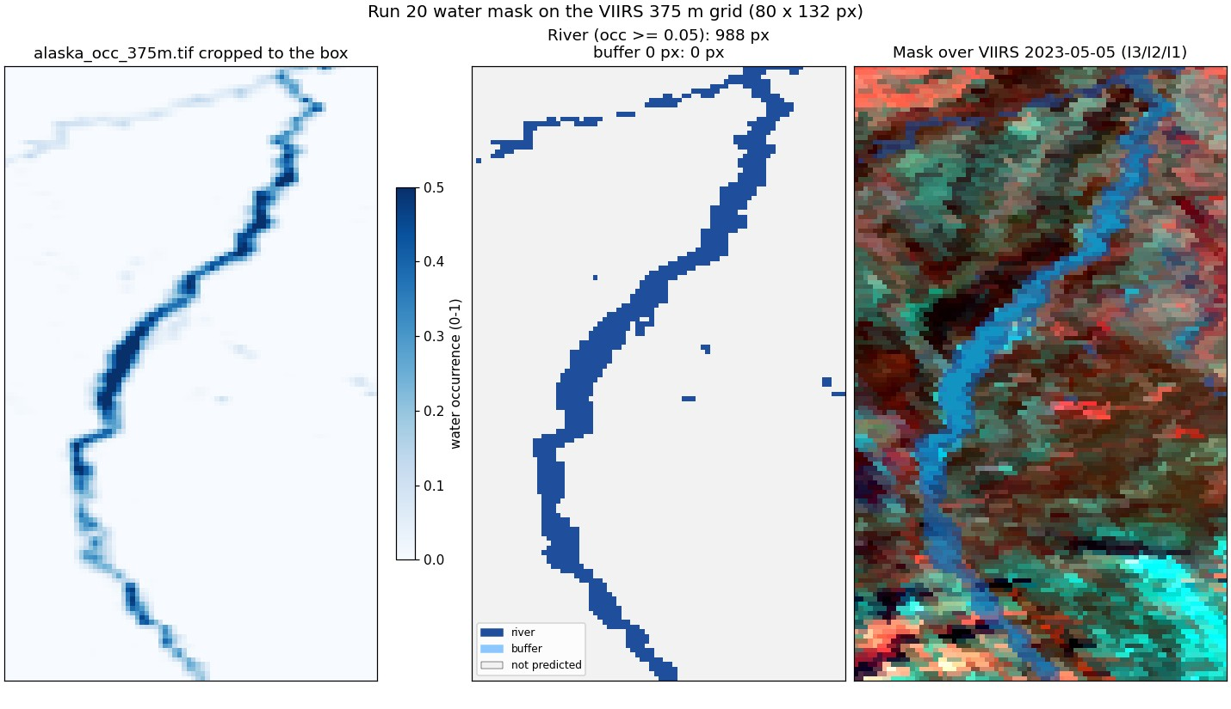
Run 20: the predicted area
Water mask occurrence >= 0.05 only: 988 river pixels, no buffer.
Pixels outside the mask are not predicted.
5,717 scored pixels over 6 days.

Slide 27
Run 20: four states at once, three models
model | rule50 acc | rule50 F1 | rule90 acc | rule90 F1
RF | 0.731 | 0.580 | 0.799 | 0.600
UNet++ | 0.698 | 0.481 | 0.755 | 0.431
2D CNN | 0.751 | 0.588 | 0.825 | 0.602
RF: depth 16, leaf 20, balanced classes (run 16 settings).
UNet++: resnet18, masked cross-entropy.
2D CNN: 4 conv 3 x 3 layers, 9 x 9 pixel view, 97k params.
State 2 (open river, snow land) is rare: low F1 everywhere.

Slide 28
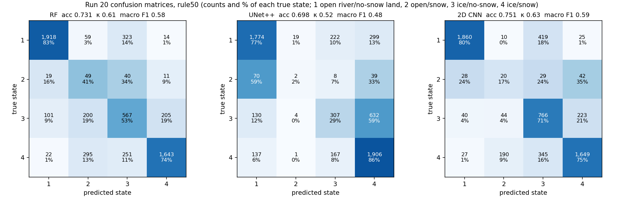
Run 20: confusion matrices, rule50
Rows true state, columns predicted; cell = pixels and % of the true state. 1 open river / no-snow land, 2 open / snow, 3 ice / no-snow, 4 ice / snow.

Slide 29
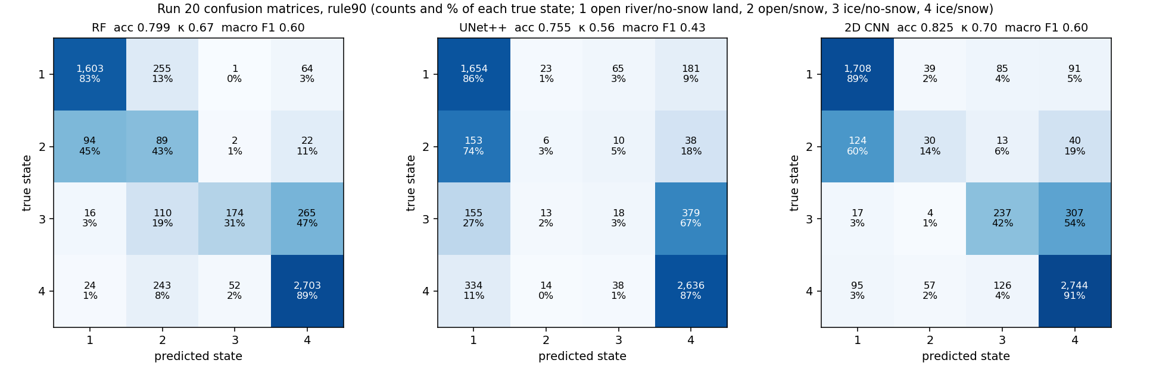
Run 20: confusion matrices, rule90
Rows true state, columns predicted; cell = pixels and % of the true state. 1 open river / no-snow land, 2 open / snow, 3 ice / no-snow, 4 ice / snow.

Slide 30
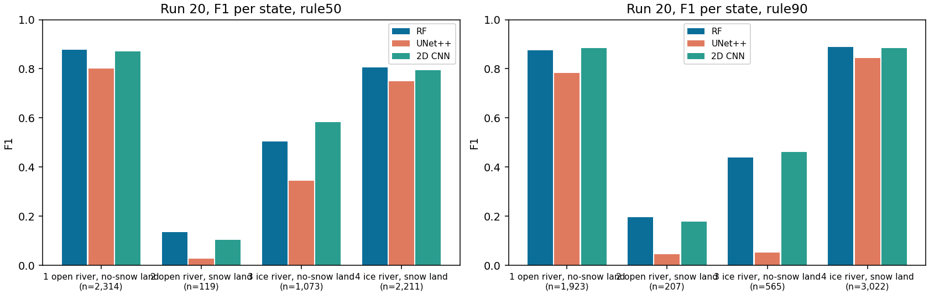
Run 20: all metrics and F1 per state
rule | model | acc | bal. acc | κ | macro P | macro R | macro F1 | wtd F1
rule50 | RF | 0.731 | 0.628 | 0.608 | 0.592 | 0.628 | 0.580 | 0.763
rule50 | UNet++ | 0.698 | 0.483 | 0.522 | 0.504 | 0.483 | 0.481 | 0.680
rule50 | 2D CNN | 0.751 | 0.608 | 0.633 | 0.592 | 0.608 | 0.588 | 0.771
rule90 | RF | 0.799 | 0.616 | 0.669 | 0.674 | 0.616 | 0.600 | 0.815
rule90 | UNet++ | 0.755 | 0.448 | 0.564 | 0.445 | 0.448 | 0.431 | 0.716
rule90 | 2D CNN | 0.825 | 0.590 | 0.700 | 0.621 | 0.590 | 0.602 | 0.817

Slide 31
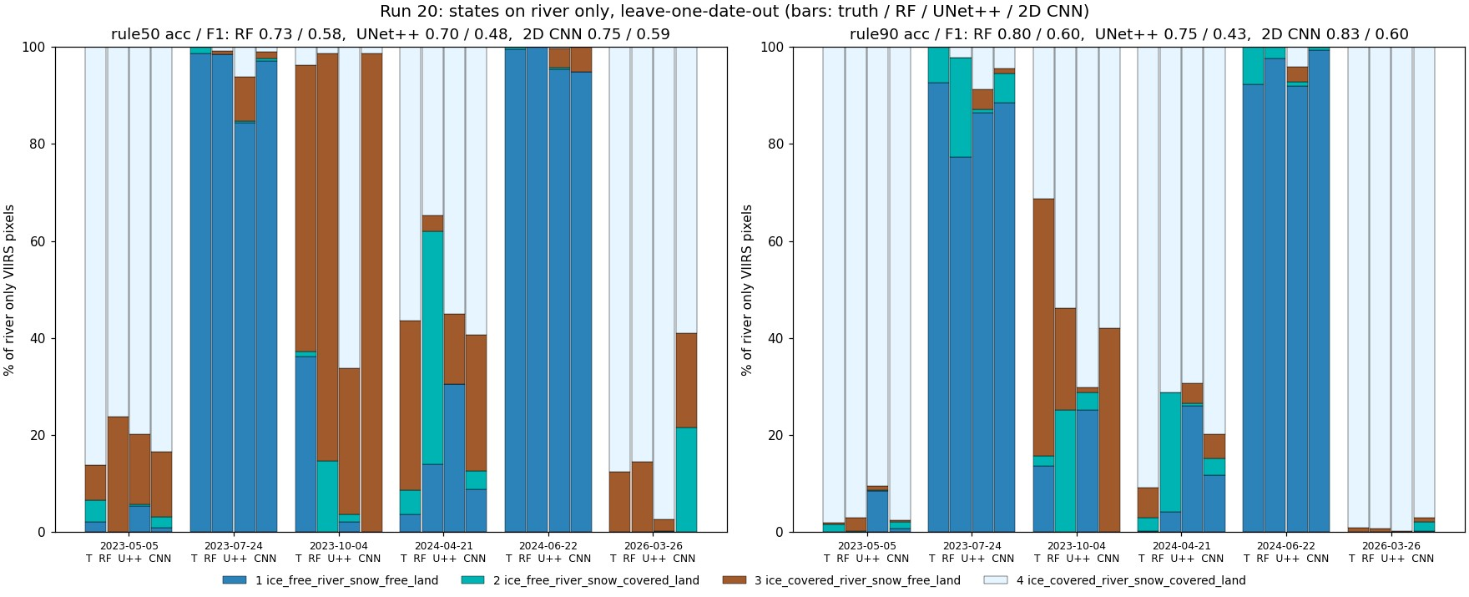
Run 20: states per day, truth and every model

Slide 32
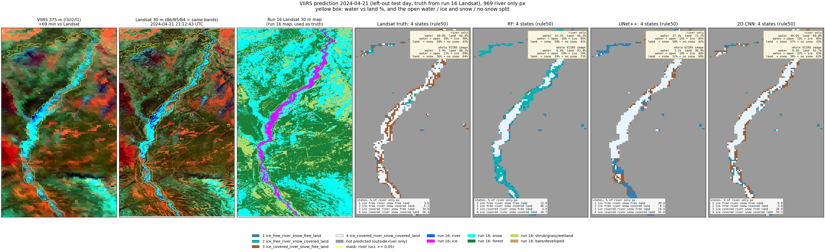
Run 20, 2024-04-21: predicted states (left-out test day)

Slide 33
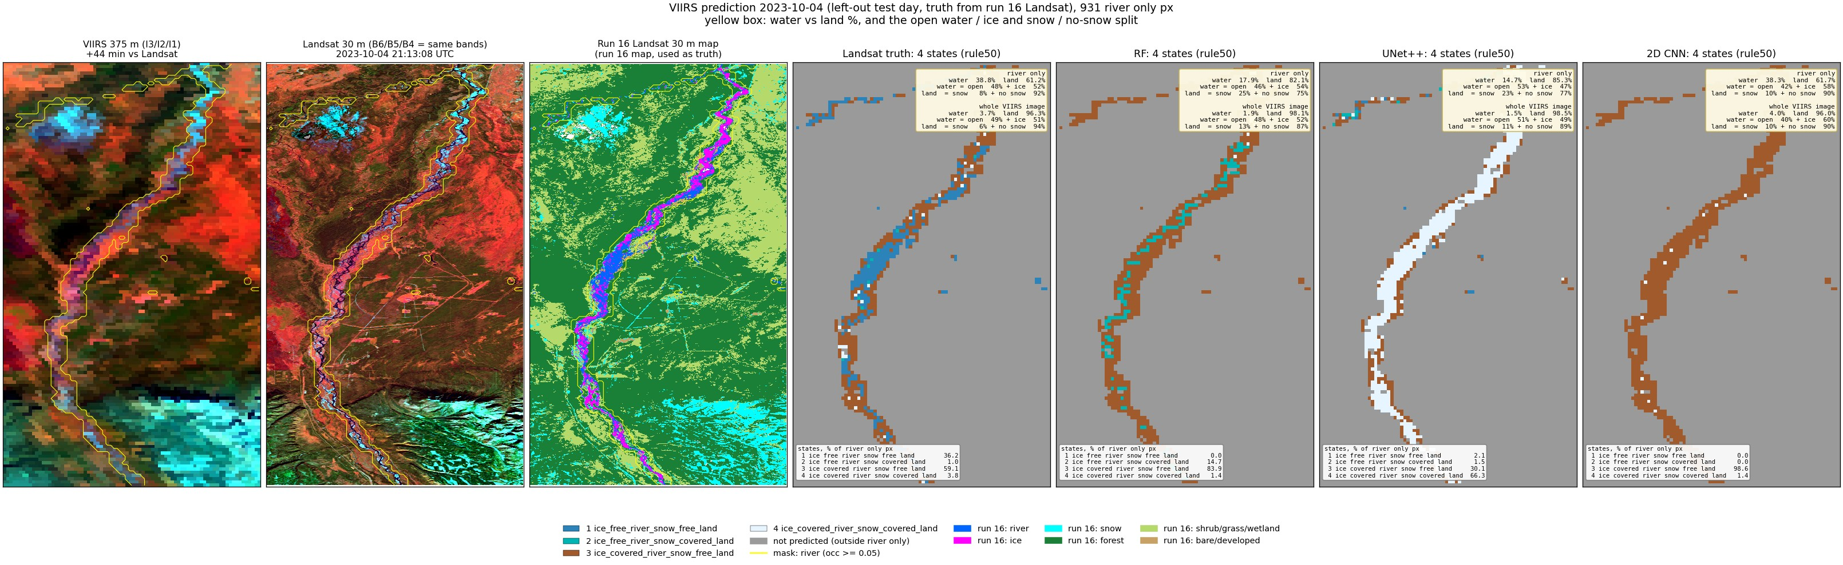
Run 20, 2023-10-04: predicted states (left-out test day)

Slide 34

Run 20, 2023-04-19: predicted states (VIIRS only)

Slide 35

Run 20, 2025-07-04: predicted states (VIIRS only)

Slide 36
Run 20: water and land split (river only)
date | Landsat truth | RF | UNet++ | 2D CNN
2023-05-05 | 40 % (5/95) | 81/19 | 37 % (11/89) | 66/34 | 29 % (3/97) | 74/26 | 38 % (4/96) | 90/10
2023-07-24 | 40 % (100/0) | 2/98 | 33 % (92/8) | 10/90 | 33 % (90/10) | 14/86 | 38 % (97/3) | 4/96
2023-10-04 | 39 % (48/52) | 8/92 | 18 % (46/54) | 25/75 | 15 % (53/47) | 23/77 | 38 % (42/58) | 10/90
2024-04-21 | 40 % (10/90) | 58/42 | 34 % (15/85) | 59/41 | 27 % (15/85) | 58/42 | 40 % (15/85) | 57/43
2024-06-22 | 40 % (100/0) | 2/98 | 35 % (96/4) | 2/98 | 31 % (97/3) | 2/98 | 39 % (100/0) | 0/100
2026-03-26 | 41 % (0/100) | 78/22 | 37 % (7/93) | 78/22 | 46 % (1/99) | 86/14 | 33 % (1/99) | 86/14
2023-04-19 | - | 39 % (1/99) | 88/12 | 39 % (1/99) | 86/14 | 41 % (1/99) | 90/10
2024-09-02 | - | 33 % (89/11) | 5/95 | 34 % (97/3) | 3/97 | 40 % (96/4) | 3/97
2025-07-04 | - | 37 % (96/4) | 9/91 | 41 % (99/1) | 4/96 | 44 % (94/6) | 12/88
2026-08-01 | - | 34 % (95/5) | 5/95 | 40 % (98/2) | 3/97 | 37 % (100/0) | 0/100
Cell: water % of the area (open / ice % of the water) | snow / no-snow % of the land. Labelled days: left-out predictions. VIIRS-only days: final models.

Slide 37
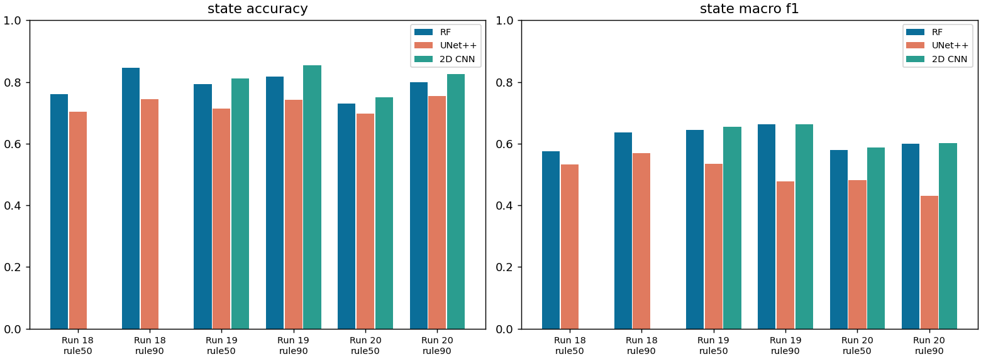
Runs 18-20 side by side
Run 18 scores the whole image, runs 19-20 only the river area: different questions.
Freeze-up (2023-10-04) and break-up (2024-04-21) are the hard days.
Summer days are near perfect in every run.
date | season | run 18 RF | run 19 RF | run 20 RF
2023-05-05 | spring break-up | 0.71 | 0.76 | 0.75
2023-07-24 | summer | 0.96 | 0.97 | 0.97
2023-10-04 | autumn freeze-up | 0.93 | 0.68 | 0.50
2024-04-21 | spring break-up | 0.11 | 0.55 | 0.33
2024-06-22 | summer | 1.00 | 1.00 | 0.99
2026-03-26 | late winter | 0.87 | 0.80 | 0.84

Slide 38
All metrics, all runs
run | rule | model | acc | bal. acc | κ | macro P | macro R | macro F1 | wtd F1
run 18 | rule50 | RF | 0.759 | 0.585 | 0.643 | 0.615 | 0.585 | 0.574 | 0.757
run 18 | rule50 | UNet++ | 0.704 | 0.567 | 0.560 | 0.549 | 0.567 | 0.532 | 0.690
run 18 | rule90 | RF | 0.846 | 0.660 | 0.760 | 0.686 | 0.660 | 0.637 | 0.850
run 18 | rule90 | UNet++ | 0.744 | 0.584 | 0.604 | 0.609 | 0.584 | 0.570 | 0.739
run 19 | rule50 | RF | 0.794 | 0.676 | 0.696 | 0.638 | 0.676 | 0.644 | 0.805
run 19 | rule50 | UNet++ | 0.714 | 0.535 | 0.569 | 0.558 | 0.535 | 0.535 | 0.710
run 19 | rule50 | 2D CNN | 0.812 | 0.661 | 0.719 | 0.652 | 0.661 | 0.655 | 0.815
run 19 | rule90 | RF | 0.818 | 0.710 | 0.714 | 0.689 | 0.710 | 0.662 | 0.838
run 19 | rule90 | UNet++ | 0.742 | 0.481 | 0.565 | 0.495 | 0.481 | 0.477 | 0.715
run 19 | rule90 | 2D CNN | 0.854 | 0.665 | 0.766 | 0.672 | 0.665 | 0.664 | 0.853
run 20 | rule50 | RF | 0.731 | 0.628 | 0.608 | 0.592 | 0.628 | 0.580 | 0.763
run 20 | rule50 | UNet++ | 0.698 | 0.483 | 0.522 | 0.504 | 0.483 | 0.481 | 0.680
run 20 | rule50 | 2D CNN | 0.751 | 0.608 | 0.633 | 0.592 | 0.608 | 0.588 | 0.771
run 20 | rule90 | RF | 0.799 | 0.616 | 0.669 | 0.674 | 0.616 | 0.600 | 0.815
run 20 | rule90 | UNet++ | 0.755 | 0.448 | 0.564 | 0.445 | 0.448 | 0.431 | 0.716
run 20 | rule90 | 2D CNN | 0.825 | 0.590 | 0.700 | 0.621 | 0.590 | 0.602 | 0.817

Slide 39
Things to know
Labels are model maps
Six days only
State 2 is rare
Run 16 errors (gravel as river, cloud as snow) become VIIRS labels.
Each model sees 5 days per fold; ice states come from 3 days.
A few hundred pixels: its F1 is not reliable.
No cloud mask
Mask from JRC (to 2021)
Cloudy VIIRS days give wrong states; check the % split (e.g. 2024-09-02).
Moved channels fall outside the water mask.

Slide 40
Daily river state from VIIRS
Best on unseen days, rule50: run 19 2D CNN 0.812, run 20 2D CNN 0.751. Next: more labelled days (ice and break-up), a cloud mask, and daily VIIRS downloads.

