Slide 1
Mapping river ice on the Nenana River
Random Forest on Landsat 30 m, trained only on hand-labelled ground truth
Notes:
Goal: label every Landsat 30 m pixel of the Nenana study box as river, ice, snow or land (and later three land types), using only our hand-drawn polygons as ground truth.

Slide 2
What we classify
Four classes from the hand labels
Six classes: land split by NLCD land cover
river
open water
river
as drawn
ice
frozen river
ice
as drawn
snow
as drawn
snow
snow on land or ice
forest
NLCD 41-43
land
everything else
shrub / grass / wetland
NLCD 51-95
bare / developed
NLCD 21-31
Hand labels are ground truth. The six-class land types come from NLCD Alaska 2016 inside the hand-drawn land polygons.
Notes:
Four classes come straight from the hand labels. For six classes, each land pixel takes its NLCD 2016 land-cover group (forest, shrub/grass/wetland, bare/developed); river, ice and snow stay as drawn.

Slide 3
Labelled data: 85,358 pixels on 4 dates
Date | Season | Labelled px
2023-07-24 | summer | 31,028
2023-10-04 | freeze-up | 8,020
2024-04-21 | breakup | 3,081
2024-06-22 | summer | 43,229
2024-03-12 | winter (daksh) | 532
Ice and snow are rare (2.7 % of labels), so they drive the macro F1.
Landsat grid 995 x 1635 px, EPSG:4326. Unlabelled dates 2024-04-20, 2024-04-29, 2026-03-26 and 2023-05-05 are only predicted.
Notes:
2023-07-24 holds most of the river pixels. 2024-03-12 is the only midwinter date; we use it either in training (with_daksh) or as an external test.

Slide 4
Pipeline
1
2
3
4
5
Labels
Inputs
Train
Score
Map
Hand polygons rasterised to the Landsat 30 m grid
Up to 93 per pixel: bands, band pairs, indices, texture, NLCD, terrain
Random Forest, 500 trees, class-balanced
5-fold spatial cross-validation + external winter test
Every date, unlabelled dates, JPEGs, QGIS layers
No water mask is used in the best models: river comes from the pixels themselves.
Notes:
Everything is reproducible from scripts in nenana_crops/daksh. The Random Forest runs in about a minute per cross-validation.

Slide 5
Inputs: every band set against every other
Bands
Band pairs
Indices
Blue, green, red, NIR, SWIR1, SWIR2 and surface temperature (B10)
All 15 pairs as (a - b)/(a + b) and a - b: NDVI, NDWI, MNDWI, NDSI and more
EVI, SAVI, MSAVI, BSI, AWEI x2, tasseled-cap brightness / greenness / wetness
Texture
Land cover
Terrain + context
Mean and spread in 3x3 and 7x7 windows of NDVI, NDSI, NDWI, NIR, blue
NLCD Alaska 2016 (30 m, from Landsat): 10 land-cover groups
Copernicus DEM: elevation, slope, height above valley floor; 15 / 31 px neighbourhood
Notes:
Different surfaces separate on different band pairs: snow is bright in visible and dark in SWIR (NDSI), water is dark in NIR and SWIR (NDWI, MNDWI), vegetation is bright in NIR (NDVI). A ratio is left out: it orders pixels like the normalised difference, so a tree gains nothing.

Slide 6
Honest scoring: spatial cross-validation
fold 1
64-row east-west bands (1.9 km)
Band i belongs to fold i mod 5 on every date. Train on 4 folds, score the 5th; drop training pixels within 12 rows of a test band.
Every labelled pixel is scored once, by a model that never saw it or its polygon's neighbours.
External test
Train on the 4 patch dates, test on the unseen winter date 2024-03-12 (532 px).
fold 2
fold 3
fold 4
fold 5
fold 3 = test
Notes:
A random pixel split would put neighbours from the same polygon in train and test and inflate the scores. Spatial bands avoid that. Macro F1 averages the classes equally, so rare ice and snow count as much as river.

Slide 7
Results
Four classes, then six classes, then the hardest test

Slide 8
Four classes: more inputs, better scores
0.961
accuracy, Random Forest with 68 inputs
0.755
macro F1 (river 0.97, ice 0.72, snow 0.36, land 0.97)
River only = trained and scored inside the river + 150 m corridor (fewer, harder pixels).
Notes:
11 inputs: bands, temperature, JRC water, NDWI, NDSI, NDVI. All bands: 68 inputs, no water mask. With the daksh date added: 0.957 / 0.745.

Slide 9
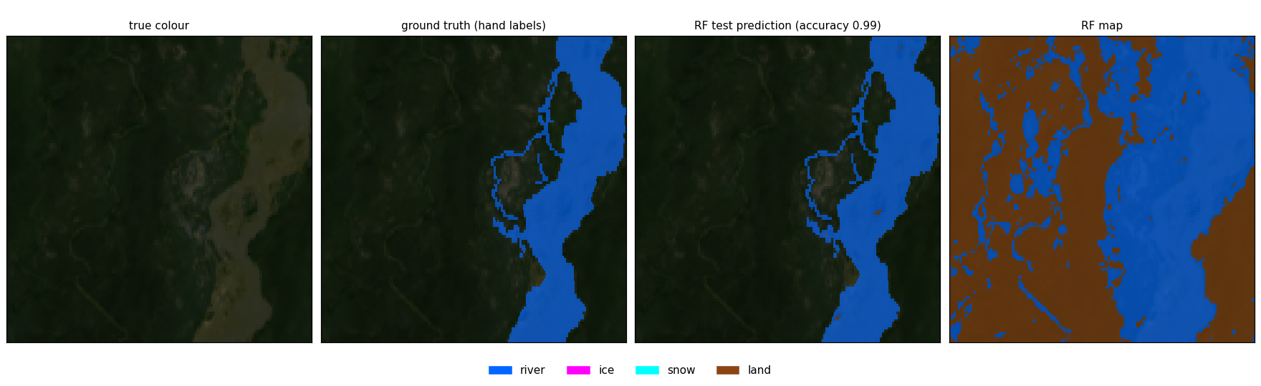
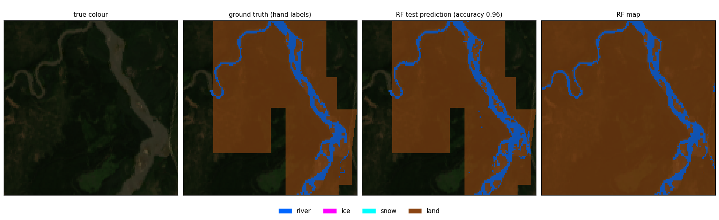
Four classes, summer: truth vs Random Forest
0.99
2023-07-24
0.96
2024-06-22
Notes:
Panels: true colour, hand labels, RF test prediction (cross-validated: each pixel predicted by a model that never saw it), RF map. Zoomed on the densest labels (3.6 x 3.6 km). Run 05.

Slide 10
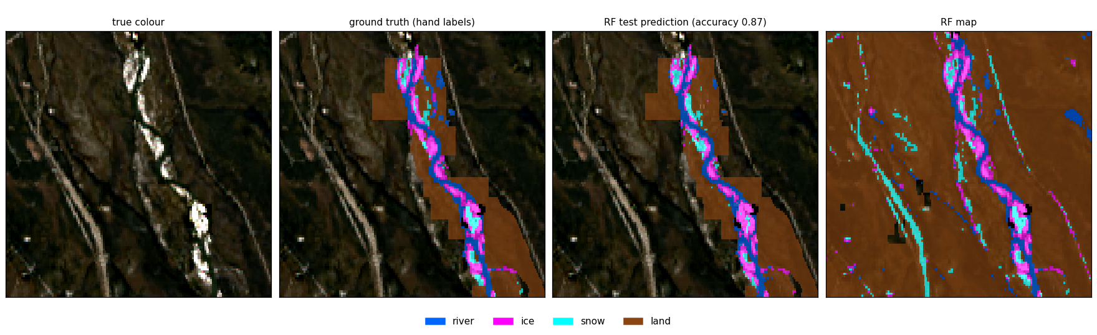
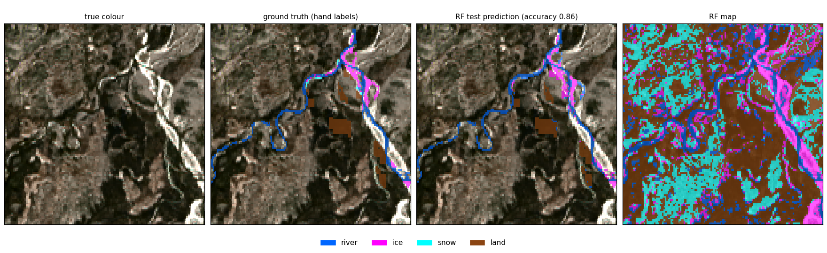
Four classes, ice seasons: truth vs Random Forest
0.87
2023-10-04 freeze-up
0.86
2024-04-21 breakup
Notes:
Panels: true colour, hand labels, RF test prediction (cross-validated: each pixel predicted by a model that never saw it), RF map. Zoomed on the densest labels (3.6 x 3.6 km). Run 05.

Slide 11
Six classes: what moved the score
0.826
best macro F1: all bands + NLCD + terrain + context
Forest settings moved F1 by under 0.01.
NLCD lifts the land types most, because the same map made their labels: read their scores as agreement with NLCD.
Notes:
Run 06: 68 inputs. 08: forest settings searched. 07/09: NLCD land cover as inputs. 10: + distance to NLCD water, Copernicus DEM terrain, 15/31 px context. Input-combination search (run 11) and bands + angles + land cover (run 12) still running.

Slide 12
Best six-class model: F1 per class
Strong
River 0.97 and the land types 0.91-0.98.
Weak
Snow 0.40: only 564 labels and confused with ice (325 snow pixels called ice).
Notes:
Accuracy 0.962, macro F1 0.826. Snow and ice limit macro F1; more snow and midwinter labels would help more than any model change.

Slide 13
Confusion matrix: best four-class Random Forest
Run 05, all bands (68 inputs), spatial CV, 4 patch dates. Accuracy 0.961, macro F1 0.755.
true \ predicted | river | ice | snow | land
river | 38,560 96% | 166 0% | 1 0% | 1,264 3%
ice | 250 14% | 1,316 76% | 125 7% | 41 2%
snow | 18 3% | 347 62% | 160 28% | 39 7%
land | 930 2% | 104 0% | 36 0% | 42,001 98%
class | prec. | recall | F1
river | 0.970 | 0.964 | 0.967
ice | 0.681 | 0.760 | 0.718
snow | 0.497 | 0.284 | 0.361
land | 0.969 | 0.975 | 0.972
Snow is mostly called ice (347 of 564). River and land swap about 2,200 pixels at the banks.
Notes:
Rows are the true class (hand label), columns the predicted class; each cell shows the pixel count and its share of that true class. Every pixel was predicted by a model that never saw it (spatial cross-validation).

Slide 14
Confusion matrix: best six-class Random Forest
Run 10, 93 inputs (all bands + NLCD + terrain + context), spatial CV, 4 patch dates. Accuracy 0.962, macro F1 0.826.
true \ predicted | river | ice | snow | forest | shrub/grass/wet. | bare/dev.
river | 38,749 97% | 226 1% | 3 0% | 314 1% | 440 1% | 259 1%
ice | 163 9% | 1,374 79% | 178 10% | 8 0% | 8 0% | 1 0%
snow | 17 3% | 325 58% | 212 38% | 2 0% | 5 1% | 3 1%
forest | 255 1% | 38 0% | 45 0% | 21,749 98% | 80 0% | 6 0%
shrub/grass/wet. | 188 1% | 44 0% | 32 0% | 252 2% | 15,110 97% | 0 0%
bare/dev. | 205 8% | 11 0% | 21 1% | 2 0% | 6 0% | 2,481 91%
class | prec. | recall | F1
river | 0.979 | 0.969 | 0.974
ice | 0.681 | 0.793 | 0.733
snow | 0.432 | 0.376 | 0.402
forest | 0.974 | 0.981 | 0.977
shrub/grass/wet. | 0.966 | 0.967 | 0.966
bare/dev. | 0.902 | 0.910 | 0.906
Ice and snow remain the confused pair (325 snow called ice). Land types are clean because NLCD is an input.
Notes:
Rows are the true class (hand label), columns the predicted class; each cell shows the pixel count and its share of that true class. Every pixel was predicted by a model that never saw it (spatial cross-validation).

Slide 15
Every run: accuracy / macro F1
Run | Classes | Model and inputs | Without daksh (CV) | With daksh (CV) | External test
01 | 4 | Random Forest, 11 inputs | 0.952 / 0.750 | 0.944 / 0.731 | 0.338 / 0.180
03 | 4 | Random Forest, river + 150 m only | 0.940 / 0.739 | 0.927 / 0.725 | 0.329 / 0.173
05 | 4 | Random Forest, all bands (68) | 0.961 / 0.755 | 0.957 / 0.745 | 0.299 / 0.191
06 | 6 | Random Forest, all bands (68) | 0.822 / 0.663 | 0.817 / 0.653 | 0.301 / 0.144
07 | 6 | Random Forest, + NLCD (78) | 0.962 / 0.819 | 0.958 / 0.813 | 0.305 / 0.147
08 | 6 | Random Forest, all bands, tuned | 0.823 / 0.667 | 0.815 / 0.659 | -
09 | 6 | Random Forest, + NLCD, tuned | 0.961 / 0.825 | 0.957 / 0.819 | -
10 | 6 | Random Forest, + NLCD + terrain + context (93) | 0.962 / 0.826 | 0.958 / 0.822 | 0.312 / 0.144
Highlighted: best four-class (05) and best six-class (10). External test = trained without 2024-03-12, scored on it.
Notes:
CV = 5-fold spatial cross-validation. With daksh adds the 2024-03-12 labels to training (9 inputs instead of 11 for runs 01-05 because that image has no SWIR2 or thermal band). Run 11 (input-combination search) and run 12 (bands + angles + land cover) are still training.

Slide 16
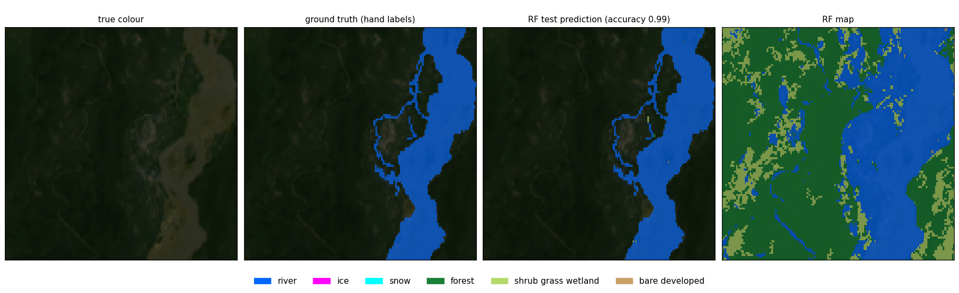
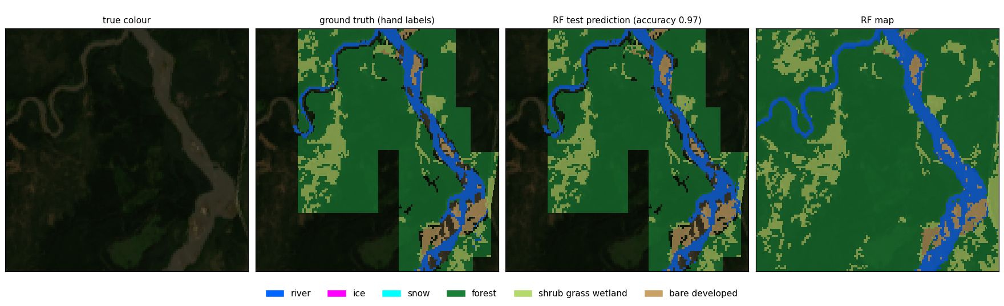
Six classes, summer: truth vs Random Forest
0.99
2023-07-24
0.97
2024-06-22
Notes:
Panels: true colour, hand labels, RF test prediction (cross-validated: each pixel predicted by a model that never saw it), RF map. Zoomed on the densest labels (3.6 x 3.6 km). Run 10.

Slide 17
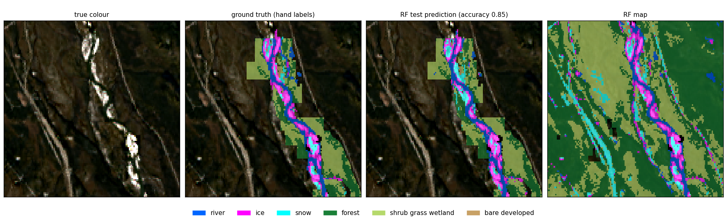
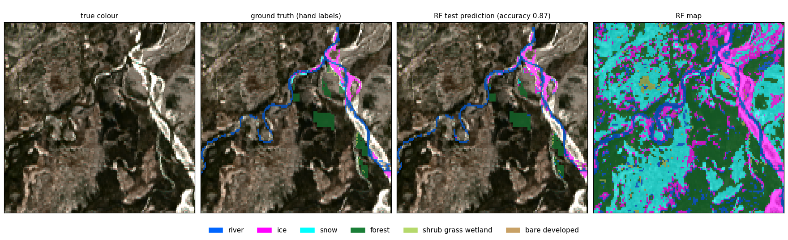
Six classes, ice seasons: truth vs Random Forest
0.85
2023-10-04 freeze-up
0.87
2024-04-21 breakup
Notes:
Panels: true colour, hand labels, RF test prediction (cross-validated: each pixel predicted by a model that never saw it), RF map. Zoomed on the densest labels (3.6 x 3.6 km). Run 10.

Slide 18
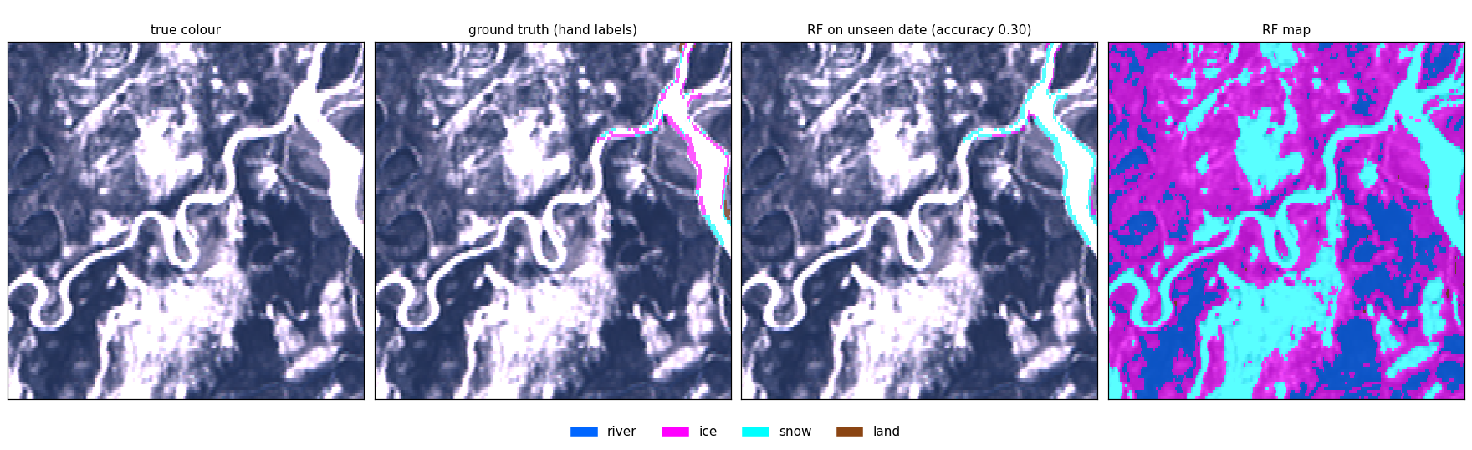
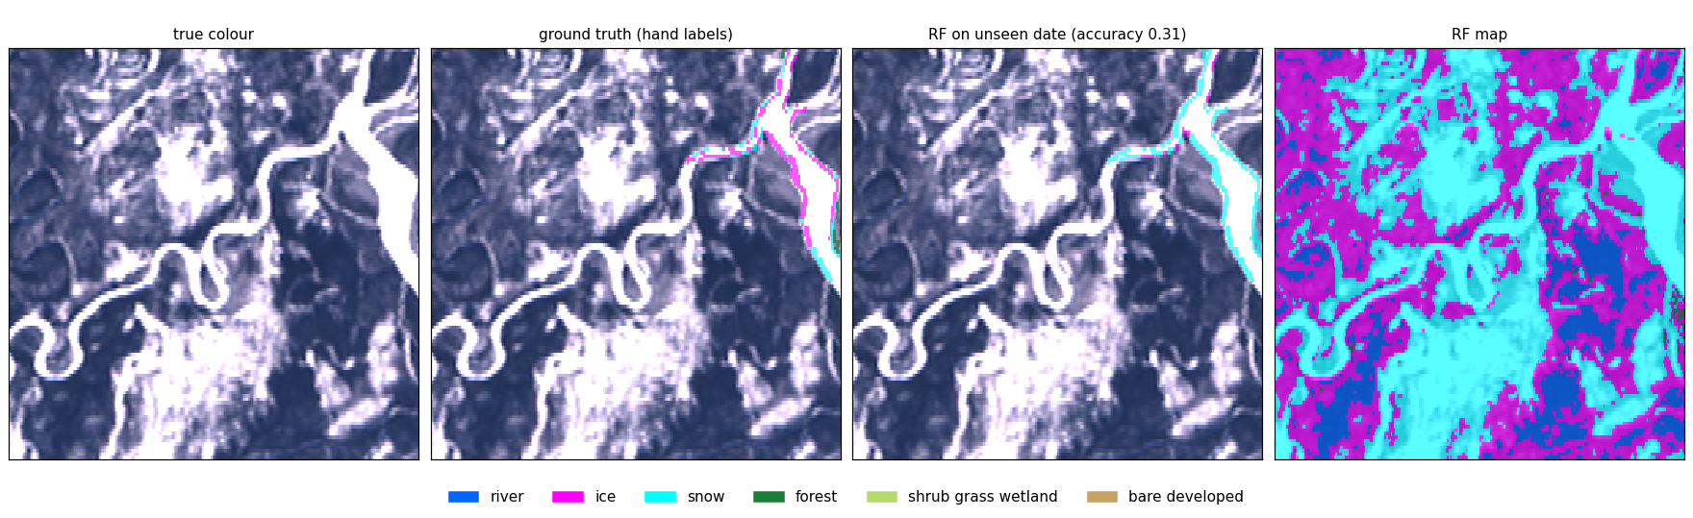
External test: unseen winter date 2024-03-12
0.30
four classes (run 05)
0.31
six classes (run 10)
Notes:
Trained on the 4 patch dates only, scored on 532 daksh pixels (342 ice, 150 snow, 40 land). Ice is called snow: none of the training dates is midwinter. More inputs did not fix it; a labelled midwinter date would.

Slide 19
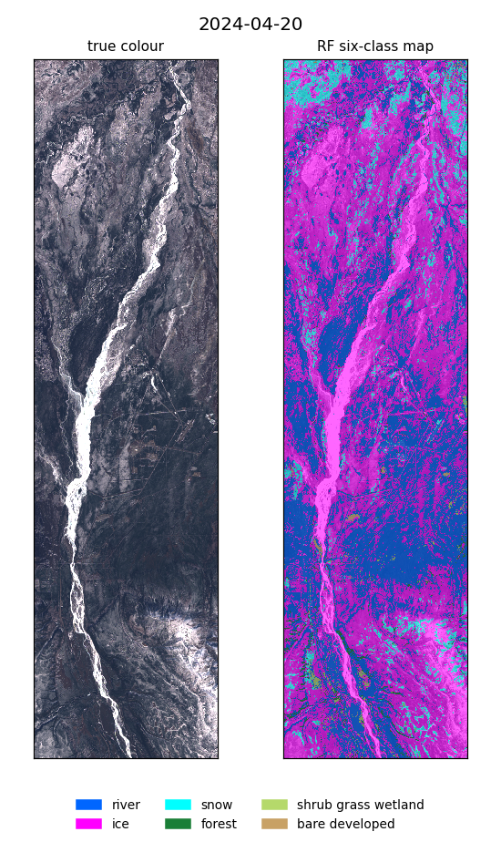
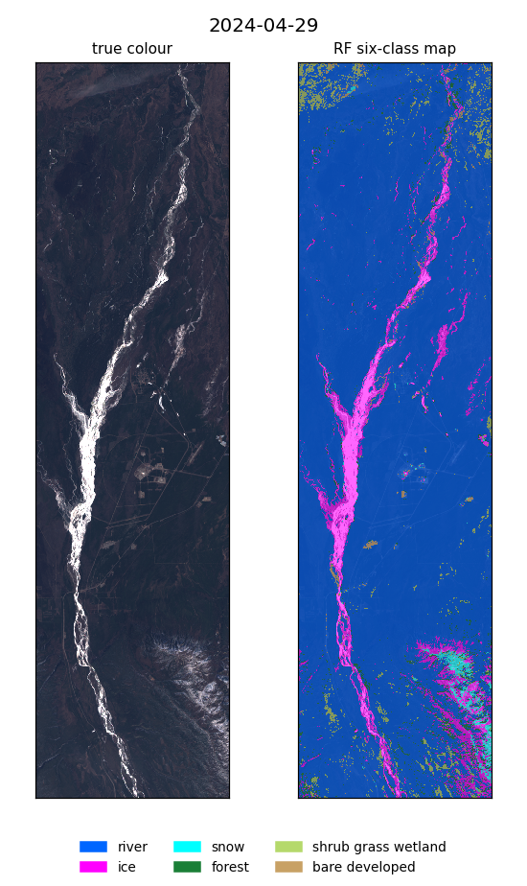
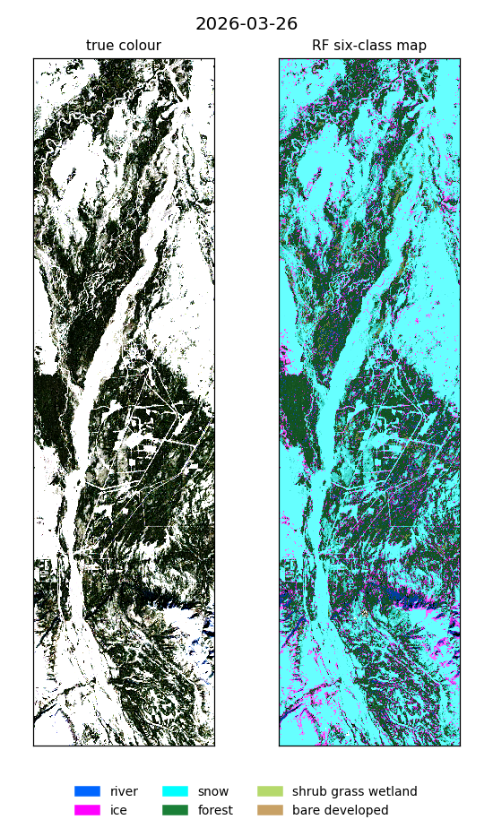
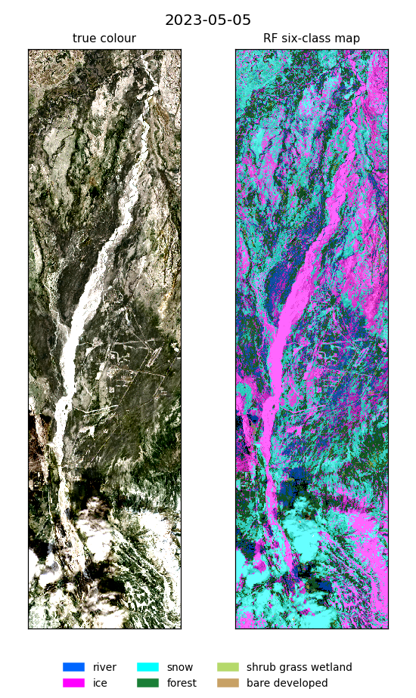
Predictions on dates with no labels
Best six-class Random Forest, whole box. No ground truth, so no score. Clouds and dark forest are the main false ice and river.
Notes:
2024-04-20 and 2024-04-29: daksh spring dates, with_daksh model. 2026-03-26 midwinter and 2023-05-05 breakup: model trained without daksh.

Slide 20
What we learned
Many inputs win
Inputs matter, settings don't
All band pairs, indices and land cover lift Random Forest the most.
68-93 inputs raised the scores; tuning the forest moved F1 by under 0.01.
Snow and ice are the limit
Season coverage matters most
Few labels: snow F1 about 0.40, ice about 0.73.
No midwinter training date, so the winter test fails for every model.
Notes:
NLCD as an input makes the land-type scores mostly agreement with NLCD itself; river, ice and snow remain a fair test.

Slide 21
Next steps
Label a midwinter date and more snow · label clouds · finish the input-combination search · add VIIRS
Notes:
All outputs: ~/Desktop/nenana_river_models (runs, reports, NDVI/NLCD layers, QGIS project, scripts).

