Slide 1
Mapping river ice on the Nenana River
Random Forest on Landsat 30 m · best: 0.962 accuracy, 0.826 macro F1 (6 classes)

Slide 2
Ground truth: 85,358 hand-labelled pixels on 4 dates
Dates
2023-07-24 summer · 2023-10-04 freeze-up · 2024-04-21 breakup · 2024-06-22 summer · 2024-03-12 winter (external test)
Classes
4 classes: river, ice, snow, land (as drawn).
6 classes: land split by NLCD Alaska 2016 into forest, shrub/grass/wetland, bare/developed.
Ice and snow are 2.7 % of labels: they limit macro F1.

Slide 3
Technique: many inputs per pixel, honest scoring
Bands
Band pairs
Indices
Blue to SWIR2 + surface temperature
All 15 as (a-b)/(a+b) and a-b: NDVI, NDWI, NDSI…
EVI, SAVI, MSAVI, BSI, AWEI, tasseled cap
Texture
Land cover
Terrain + context
3x3 / 7x7 mean and spread
NLCD Alaska 2016, 10 groups
DEM, height above valley floor, 15/31 px windows
Scoring 5-fold spatial cross-validation: 64-row east-west bands, 12-row buffer, same fold on every date, so no pixel is scored by a model that saw it or its neighbours.
External test Train on the 4 patch dates, test on the unseen winter date 2024-03-12.
Notes:
Model: Random Forest (500 trees, class-balanced, settings searched by spatial CV). No water mask in the best models.

Slide 4
Every run: accuracy / macro F1
Run | Classes | Model and inputs | Without daksh | With daksh | External test
01 | 4 | Random Forest, 11 inputs | 0.952 / 0.750 | 0.944 / 0.731 | 0.338 / 0.180
03 | 4 | Random Forest, river + 150 m only | 0.940 / 0.739 | 0.927 / 0.725 | 0.329 / 0.173
05 | 4 | Random Forest, all bands (68) | 0.961 / 0.755 | 0.957 / 0.745 | 0.299 / 0.191
06 | 6 | Random Forest, all bands (68) | 0.822 / 0.663 | 0.817 / 0.653 | 0.301 / 0.144
07 | 6 | Random Forest, + NLCD (78) | 0.962 / 0.819 | 0.958 / 0.813 | 0.305 / 0.147
08 | 6 | Random Forest, all bands, tuned | 0.823 / 0.667 | 0.815 / 0.659 | -
09 | 6 | Random Forest, + NLCD, tuned | 0.961 / 0.825 | 0.957 / 0.819 | -
10 | 6 | Random Forest, + NLCD + terrain + context (93) | 0.962 / 0.826 | 0.958 / 0.822 | 0.312 / 0.144
Highlighted: best four-class (05) and six-class (10). Spatial CV except the external test. NLCD also made the land-type labels, so 07-10 land scores show agreement with NLCD.

Slide 5
Best four-class Random Forest
Run 05, 68 inputs, spatial CV, 4 patch dates · accuracy 0.961 · macro F1 0.755
true \ predicted | river | ice | snow | land
river | 38,560 96% | 166 0% | 1 0% | 1,264 3%
ice | 250 14% | 1,316 76% | 125 7% | 41 2%
snow | 18 3% | 347 62% | 160 28% | 39 7%
land | 930 2% | 104 0% | 36 0% | 42,001 98%
class | prec. | recall | F1
river | 0.970 | 0.964 | 0.967
ice | 0.681 | 0.760 | 0.718
snow | 0.497 | 0.284 | 0.361
land | 0.969 | 0.975 | 0.972
Snow is mostly called ice (347 of 564). River and land swap about 2,200 pixels at the banks.
Notes:
Rows: true class (hand label). Columns: predicted class. Cell: pixel count and share of that true class. Spatial cross-validation: every pixel predicted by a model that never saw it.

Slide 6
Best six-class Random Forest
Run 10, 93 inputs, spatial CV, 4 patch dates · accuracy 0.962 · macro F1 0.826
true \ predicted | river | ice | snow | forest | shrub/grass/wet. | bare/dev.
river | 38,749 97% | 226 1% | 3 0% | 314 1% | 440 1% | 259 1%
ice | 163 9% | 1,374 79% | 178 10% | 8 0% | 8 0% | 1 0%
snow | 17 3% | 325 58% | 212 38% | 2 0% | 5 1% | 3 1%
forest | 255 1% | 38 0% | 45 0% | 21,749 98% | 80 0% | 6 0%
shrub/grass/wet. | 188 1% | 44 0% | 32 0% | 252 2% | 15,110 97% | 0 0%
bare/dev. | 205 8% | 11 0% | 21 1% | 2 0% | 6 0% | 2,481 91%
class | prec. | recall | F1
river | 0.979 | 0.969 | 0.974
ice | 0.681 | 0.793 | 0.733
snow | 0.432 | 0.376 | 0.402
forest | 0.974 | 0.981 | 0.977
shrub/grass/wet. | 0.966 | 0.967 | 0.966
bare/dev. | 0.902 | 0.910 | 0.906
Ice and snow stay the confused pair (325 snow called ice). River F1 0.97.
Notes:
Rows: true class (hand label). Columns: predicted class. Cell: pixel count and share of that true class. Spatial cross-validation: every pixel predicted by a model that never saw it.

Slide 7
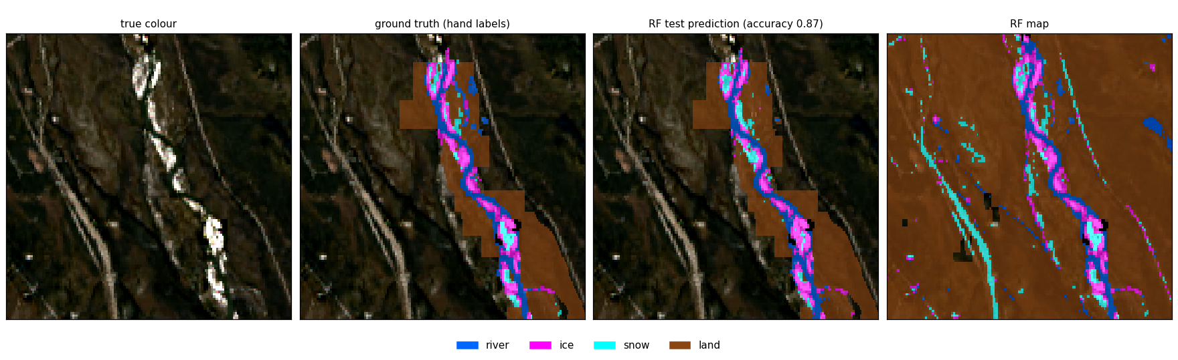
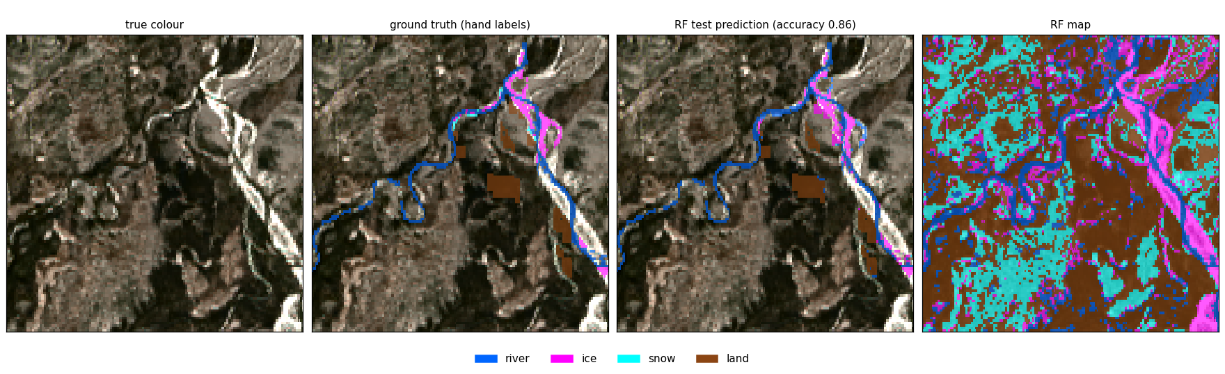
Four classes: ground truth vs Random Forest
0.87
2023-10-04 freeze-up
0.86
2024-04-21 breakup
Notes:
Panels: true colour, hand labels, RF test prediction (cross-validated: each pixel predicted by a model that never saw it), RF map. Zoomed on the densest labels (3.6 x 3.6 km). Run 05.

Slide 8
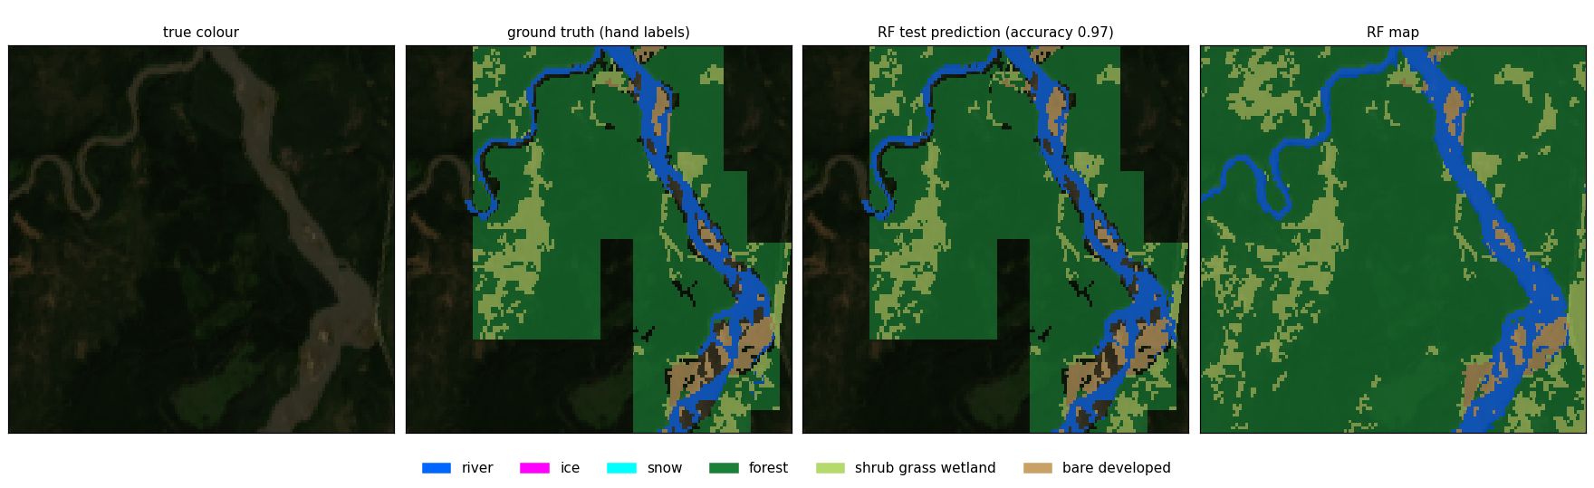
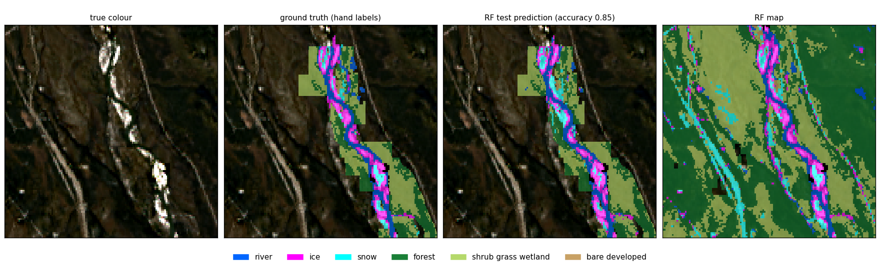
Six classes: ground truth vs Random Forest
0.97
2024-06-22 summer
0.85
2023-10-04 freeze-up
Notes:
Panels: true colour, hand labels, RF test prediction (cross-validated: each pixel predicted by a model that never saw it), RF map. Zoomed on the densest labels (3.6 x 3.6 km). Run 10.

Slide 9
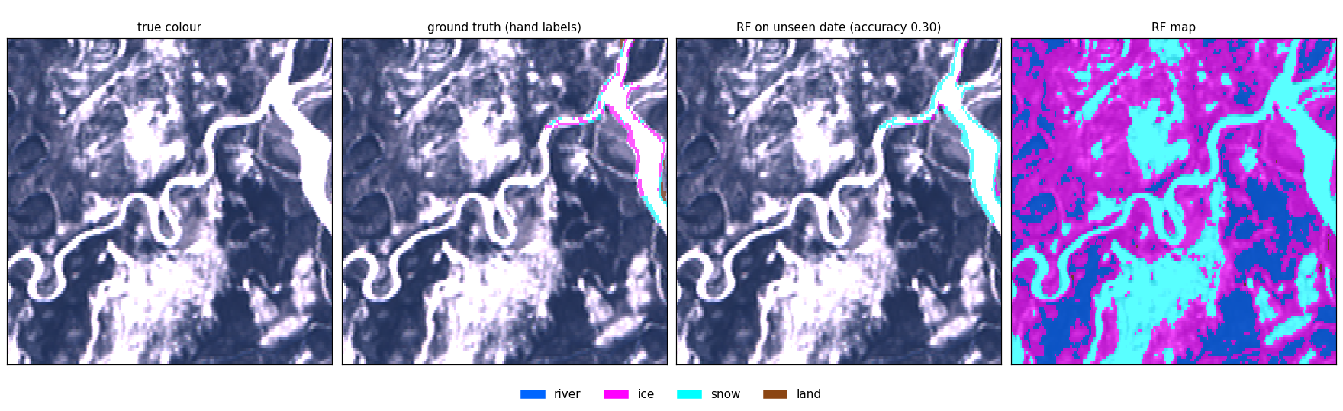
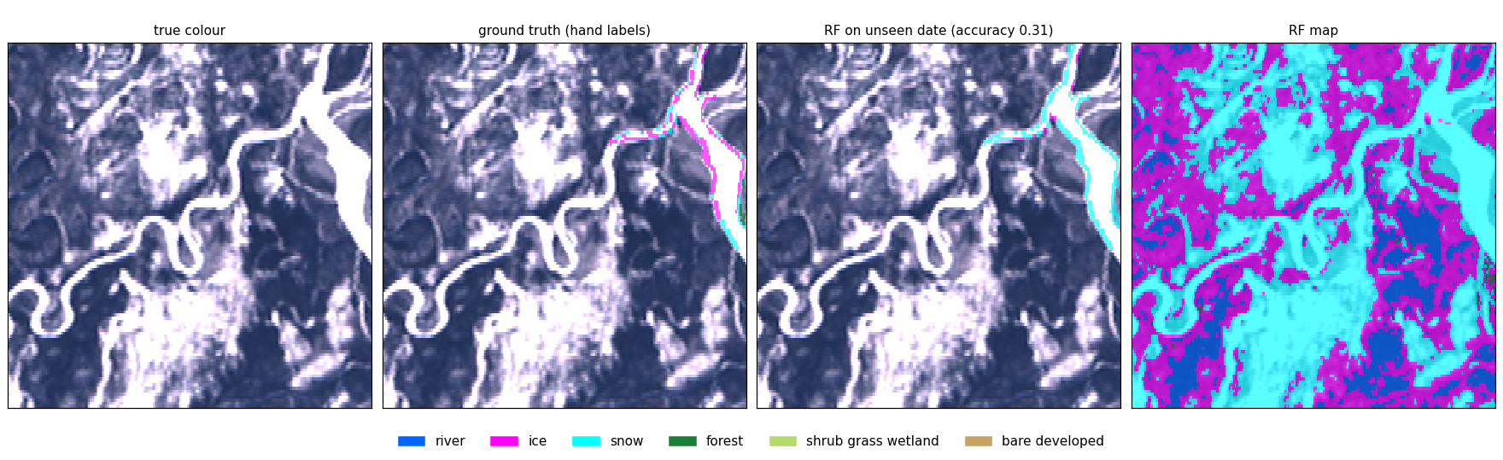
External test: unseen winter date 2024-03-12
0.30
four classes
0.31
six classes
Notes:
Models trained on the 4 patch dates only, scored on 532 daksh pixels (342 ice, 150 snow, 40 land). Ice is called snow: none of the training dates is midwinter.

Slide 10
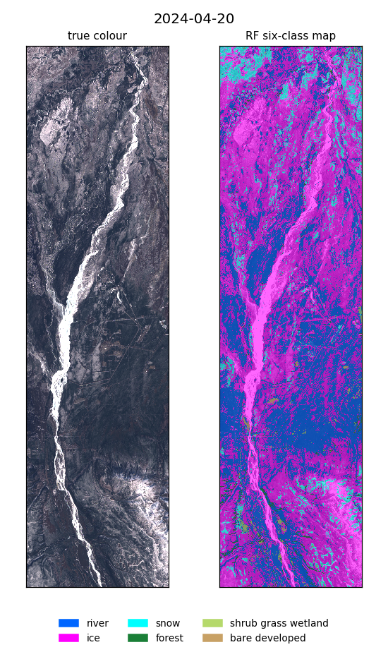
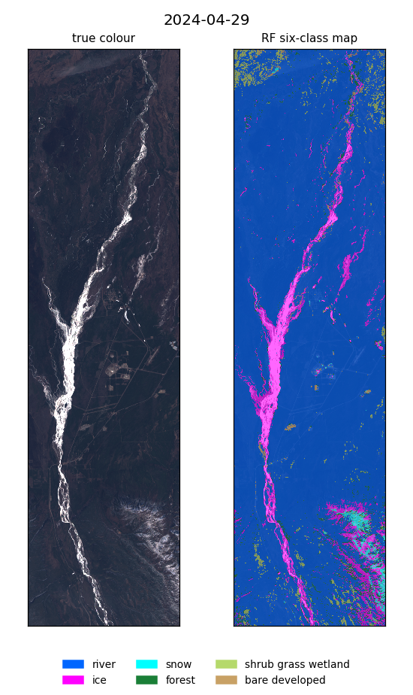
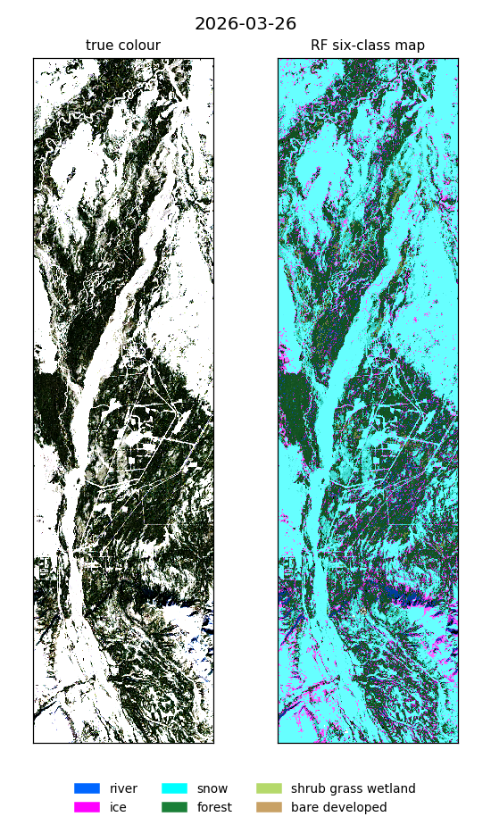
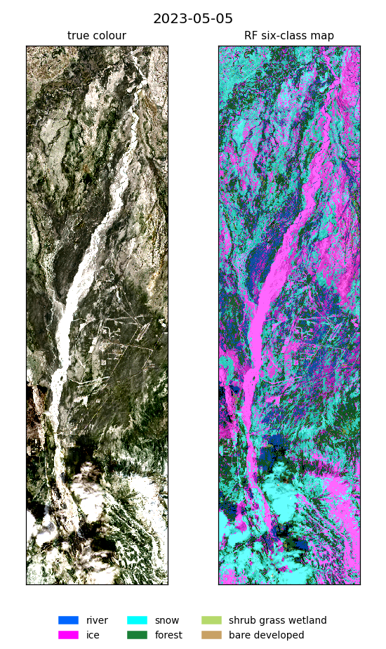
Predictions on dates with no labels
Best six-class Random Forest, whole box. No ground truth, so no score. Clouds and dark forest are the main false ice and river.
Notes:
2024-04-20 and 2024-04-29: daksh spring dates, with_daksh model. 2026-03-26 midwinter and 2023-05-05 breakup: model trained without daksh.

Slide 11
Findings and next steps
Many band pairs and indices lift Random Forest most; tuning settings adds < 0.01.
Snow (F1 0.40) and ice (0.73) limit the score; winter dates fail without winter training data.
Next: label a midwinter date, more snow and clouds; finish the input-combination search.

