Slide 1
Run 16: river ice with a water-zone rule
Landsat 30 m, six classes, Random Forest. JRC water occurrence decides where river and ice can be; NLCD 2016 decides the land types.

Slide 2
Run 16 is the cleanest and best-scoring model so far
0.984
0.902
0.7 %
accuracy with daksh dates, 5-fold spatial CV (run 10: 0.958)
accuracy on unseen winter date 2024-03-12 (run 10: 0.312)
training vs held-out accuracy gap: no overfitting
No river on land and no snow on the river: the water zone only allows river or ice, land only snow or a land type.
Scores are against the rule labels (snow on the river counted as ice). Against the original hand labels: 0.863 accuracy, macro F1 0.687.
The loss comes from labels the rule cannot reproduce: river where the channel has moved, gravel bars in the water zone.

Slide 3
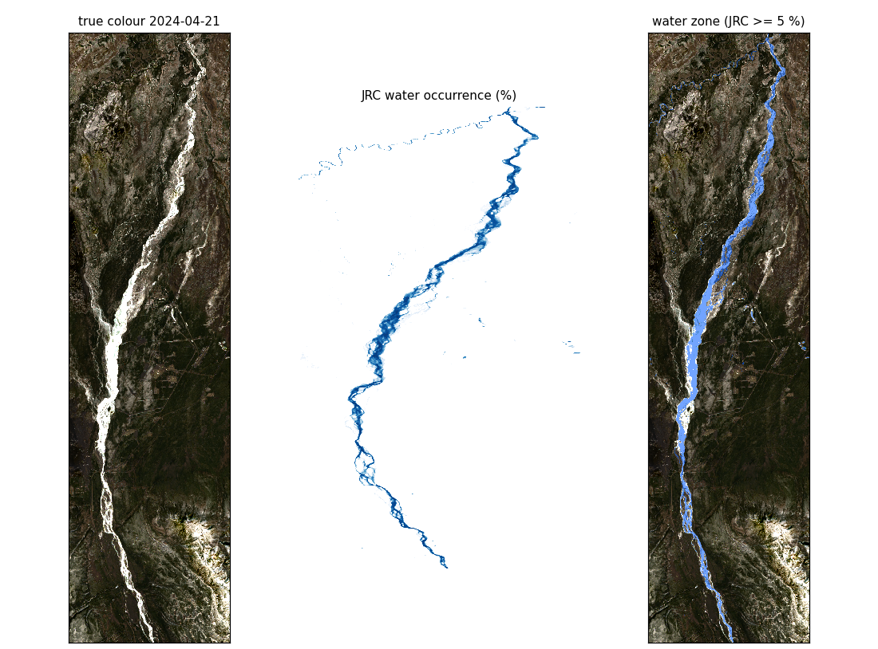
The JRC water zone decides what each pixel can be
Water zone: JRC >= 5 %
River or ice only. Snow on the frozen river counts as ice. 3.8 % of the study box.
Land: JRC < 5 %
Snow, forest, shrub/grass/wetland or bare/developed. Land types from NLCD 2016. No ice, no river.
One Random Forest per zone, each trained only on its own zone's pixels.

Slide 4
Hand labels were moved onto the rule
class | labelled | in water zone | became ice | left out
river | 39,991 | 32,251 | 0 | 7,740
ice | 2,074 | 1,687 | 0 | 387
snow | 714 | 387 | 387 | 0
forest | 22,208 | 70 | 0 | 70
shrub grass wetland | 15,627 | 82 | 0 | 82
bare developed | 2,726 | 1,616 | 0 | 1,616
Snow in the water zone became ice: it is snow lying on the frozen river.
River and ice left out lie where JRC says land, mostly where the channel moved after the JRC years (to 2021).
Bare left out are gravel bars inside the water zone.
with_daksh labels shown; 2024-04-20 and 2024-04-29 have no labels.

Slide 5
Inputs and model: small forests, spatial test folds
Bands
Inputs
Forests
7 without daksh: blue, green, red, NIR, SWIR1, SWIR2, thermal. 5 with daksh (no SWIR2, no thermal).
Pool of 83 / 66: band pairs, indices, textures, illumination, NLCD. Each forest keeps its top 25. JRC only picks the zone.
300 trees, depth 16, min 20 pixels per leaf, balanced class weights.
Testing
Top inputs (with daksh)
5-fold spatial CV: 1.9 km east-west bands, same fold on every date, 12-row buffer. External: train on 4 patch dates, test on 2024-03-12.
Water RF: blue_mean3, blue_std7, vis_brightness, red. Land RF: nlcd_barren, nlcd_woody_wetland, nlcd_deciduous_forest, blue.

Slide 6
Run 16 beats every earlier run on its rule labels
run (accuracy / macro F1) | exclude_daksh | with_daksh | external 2024-03-12
10 six classes, terrain (best before) | 0.962 / 0.826 | 0.958 / 0.822 | 0.312 / 0.144
15 six classes, forced river penalty | 0.947 / 0.808 | 0.942 / 0.797 | 0.307 / 0.142
16 water zone, rule labels | 0.982 / 0.892 | 0.984 / 0.923 | 0.902 / 0.471
16 water zone, original hand labels | 0.863 / 0.667 | 0.863 / 0.687 | 0.604 / 0.311
Rule labels leave out pixels the rule cannot hold, so they are not a like-for-like comparison with runs 10 and 15.
The original-label row is like-for-like: lower, because 19 % of river labels sit outside the JRC zone and most bare labels are gravel bars inside it.
External test: every ice and snow pixel right; the 36 forest/shrub pixels are called snow.

Slide 7
River, ice and land near perfect; snow weakest
Snow: recall 0.951 but precision 0.527. The land forest calls a few hundred bright forest and shrub pixels snow.
Ice vs river inside the water zone: F1 0.91 / 0.99.
Original-label losses: river outside the zone, gravel bars, snow on the river.

Slide 8
A 5 % JRC cutoff fits the hand labels best
Same training at JRC 1, 5, 10, 25 and 50 %.
Higher cutoffs narrow the zone to the main channel and push real river onto land.
River F1 on original labels: 0.87 at 5 %, 0.73 at 50 %.

Slide 9
Training and held-out accuracy match: no overfitting
Mean gap 0.7 % with daksh, 0.9 % without.
Limited forests (25 inputs, depth 16, leaf 20) cannot memorise pixels.
Held-out folds are 1.9 km bands never next to training pixels.

Slide 10
Maps
Ground truth vs prediction, then run 16 next to runs 10 and 15

Slide 11
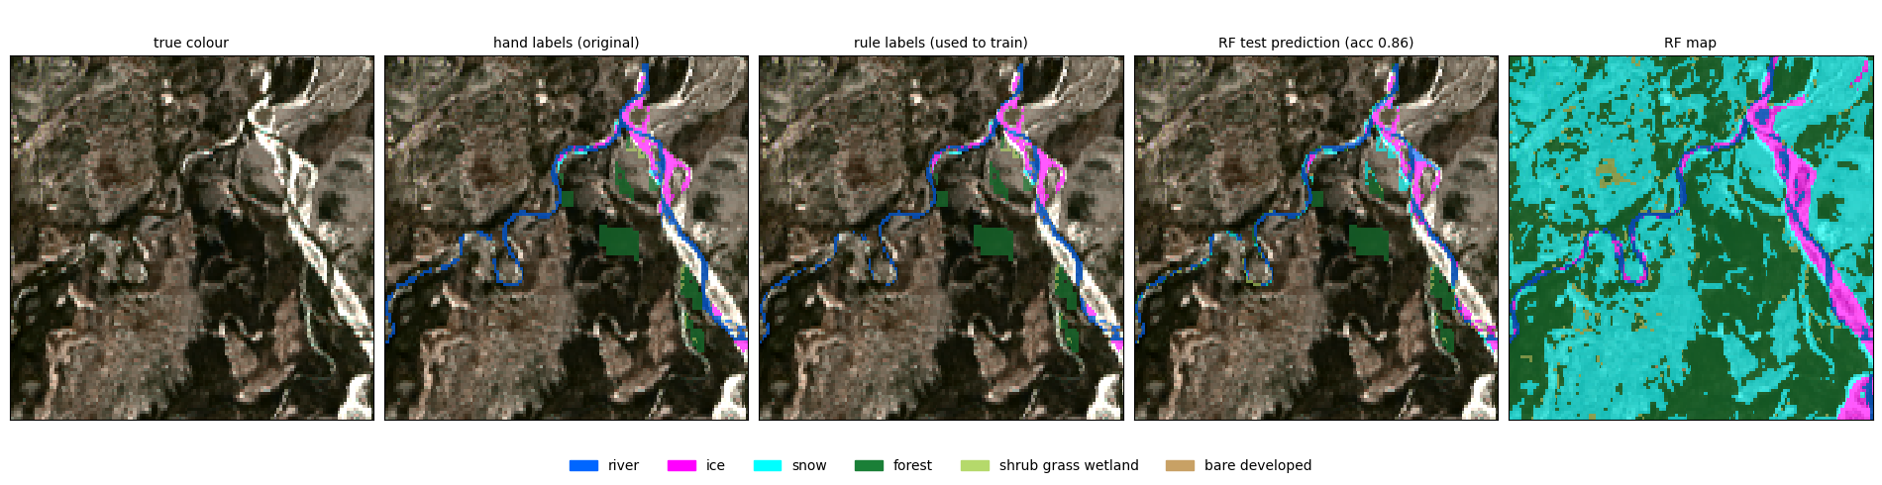
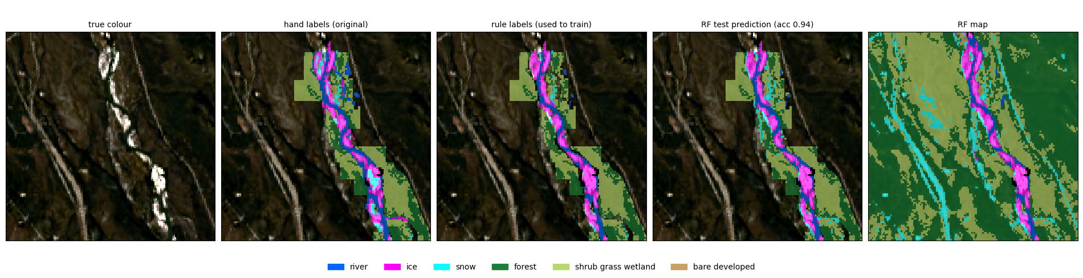
Spring and autumn: river vs ice in the water zone
true colour | hand labels | rule labels | test prediction | map
2024-04-21 spring break-up, test accuracy 0.86
2023-10-04 first ice, test accuracy 0.94

Slide 12
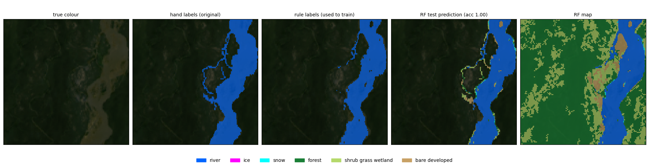
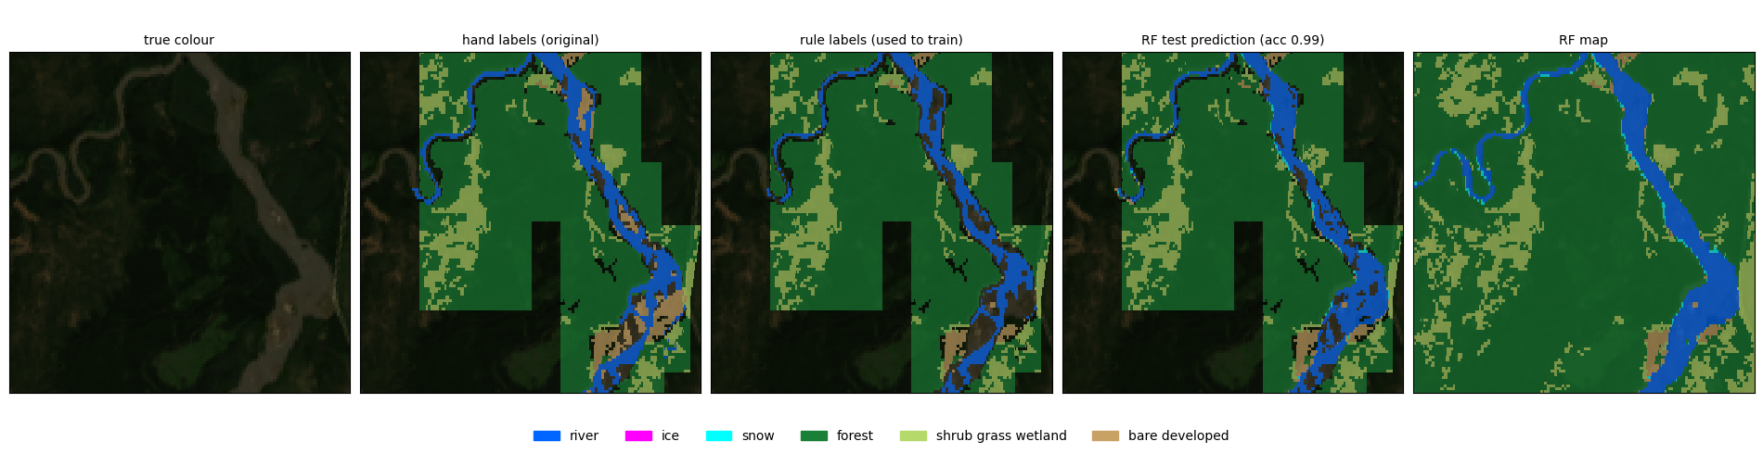
Summer: open river and NLCD land types
true colour | hand labels | rule labels | test prediction | map
2023-07-24 summer, test accuracy 1.00
2024-06-22 summer, test accuracy 0.99

Slide 13
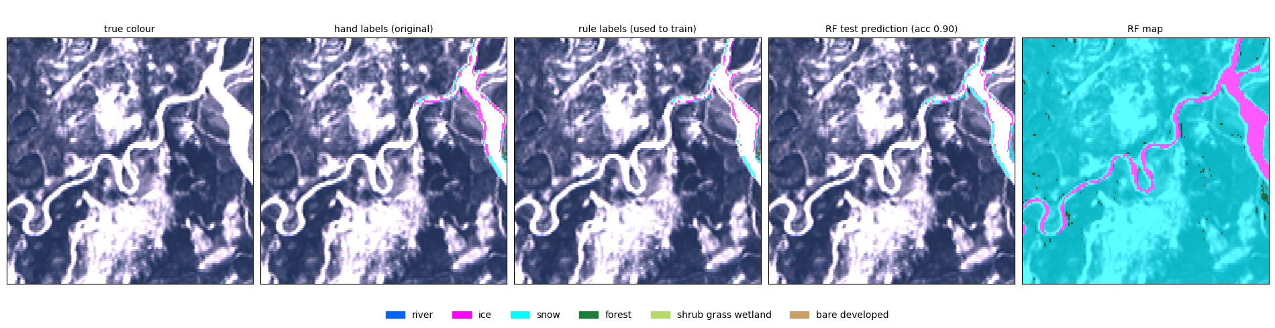
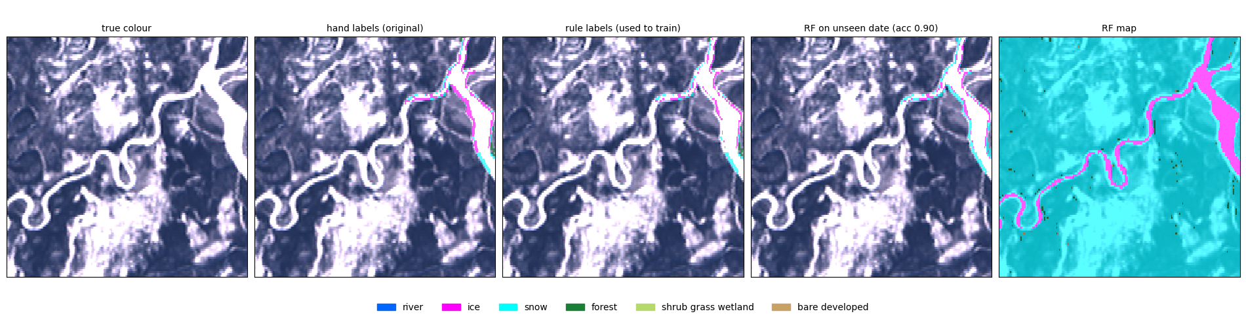
Winter: ice on the river, snow on land
true colour | hand labels | rule labels | test prediction | map
2024-03-12 with daksh in training, test accuracy 0.90
2024-03-12 unseen date (trained on patch dates only), accuracy 0.90

Slide 14
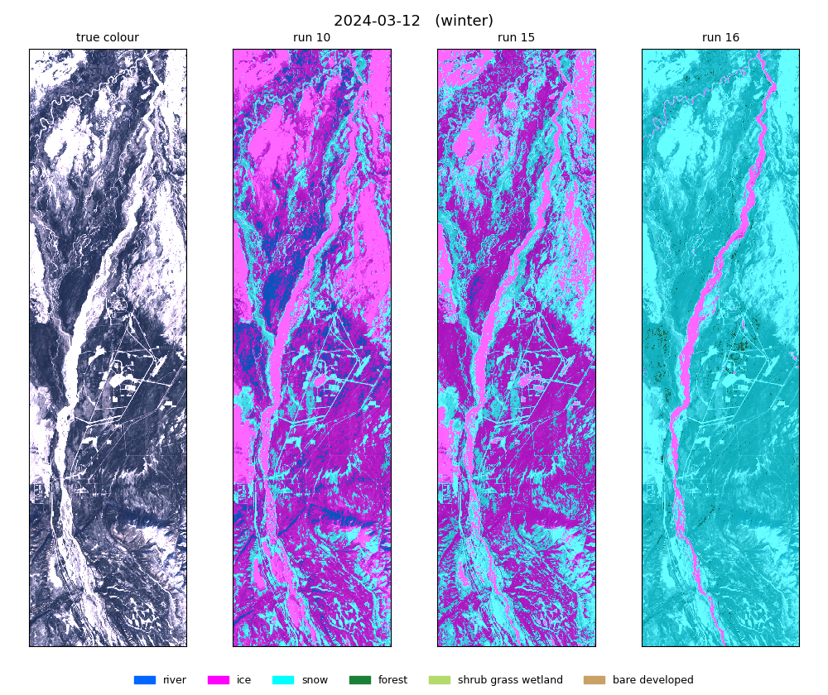
Winter: only run 16 keeps ice off the land
True colour, run 10, run 15, run 16.
Runs 10/15 paint large areas of land as ice (magenta).
Run 16: ice only inside the water zone, snow (cyan) on land.

Slide 15
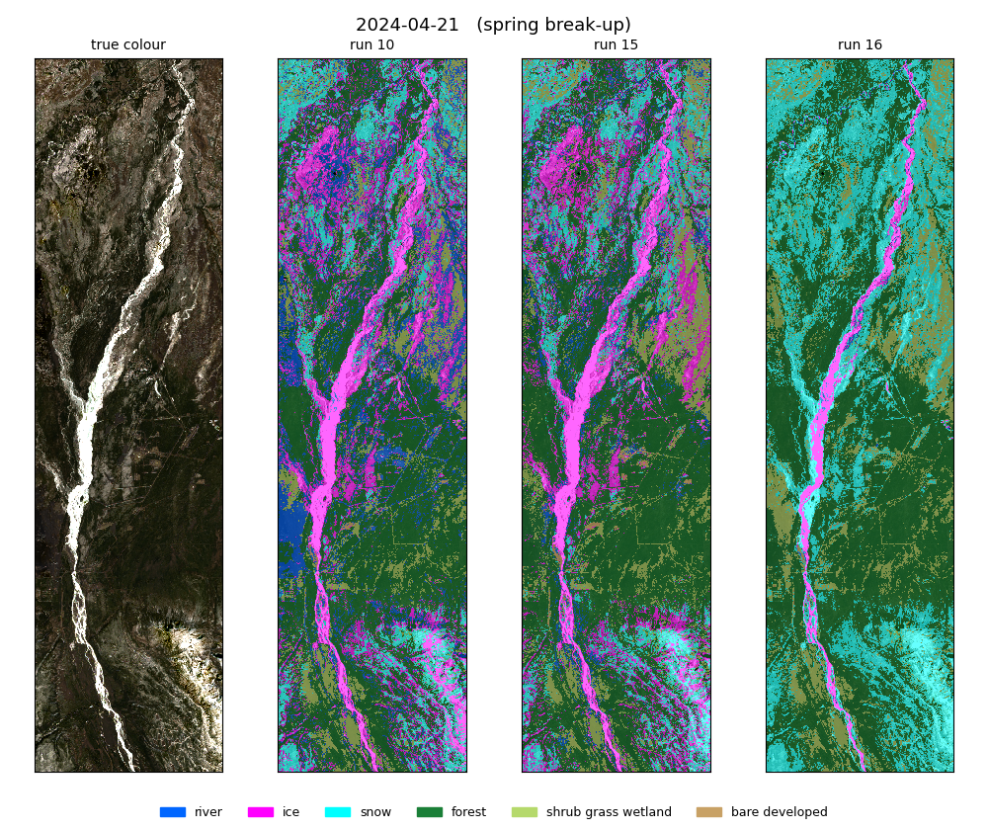
Break-up: run 16 keeps river and ice in the channel
Runs 10/15 show river and ice patches far from the river.
Run 16 keeps them in the JRC water zone.
Snow stays on high, open ground.

Slide 16
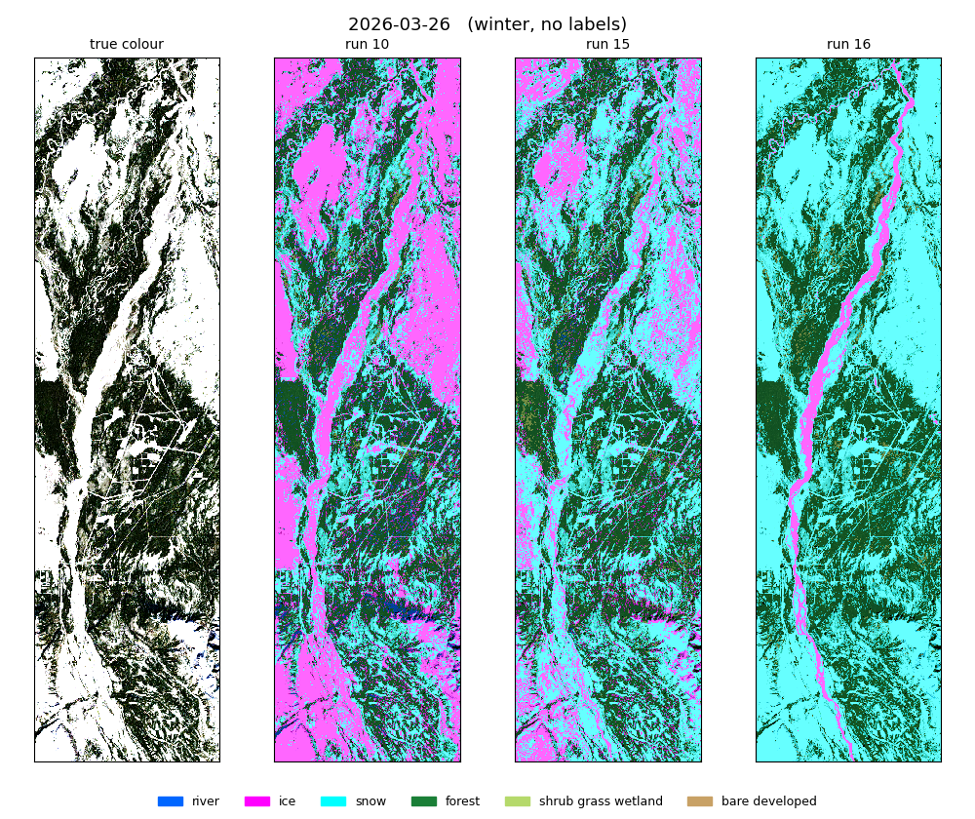
Unlabelled winter date: same picture
No labels: a check of how the models generalise.
Run 16 gives a single ice ribbon along the river and snow elsewhere.

Slide 17
Things to know
JRC ends in 2021
Gravel bars
Few ice/snow dates
Where the channel moved since, real river lies outside the zone and is mapped as land or snow.
Inside the water zone they can only be river or ice.
Ice and snow come from 3 dates, so their scores move with each polygon.
NLCD as input
Clouds
Forest/shrub/bare scores partly measure agreement with NLCD.
Never labelled: cloudy pixels become snow on land or ice in the water zone.

Slide 18
Run 16: clean maps, best scores
0.984 accuracy with daksh, 0.902 on the unseen date. Next: update the JRC zone where the channel moved, add a gravel-bar class in the water zone, label more ice and snow dates.

