Slide 1
Soapy Driver for the sBITX: A Software On-Ramp for the sBITX HF Transceiver
David Cherkus, N1AI
NARS Project Night
January 6th, 2026

Slide 2
overview of software defined radio
when people hear sdr they think of usb radio dongles (rtl-sdr, sdr-play, etc)
sdr refers to a processing technique used by many modern radios
  flexradio, icom (7300 and later), xiegu, ...
compare to cd/dvd/blu-ray technology:
  on the media, everything is just ones and zeros
  hardware reads bits, software decodes bits
  the processing software has different algorithms for different data
    music file vs movie file vs data backup etc
software defines the ways that the bits can be processed
  am, fm, sideband, rtty, ft8, sstv, atv, ...

Slide 3
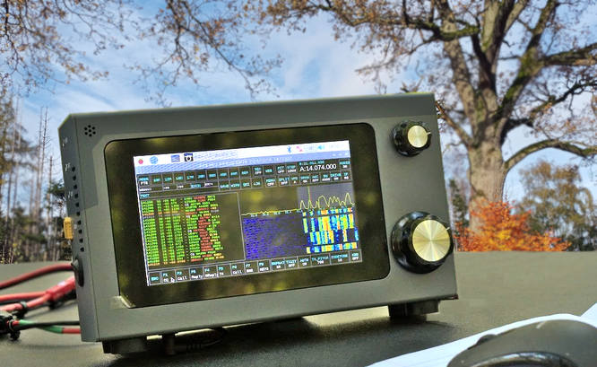
sbitx photo (mouse for scale, credit funkamature)

Slide 4
sbitx is linux-friendly HF transceiver made in india
web site: https://www.hfsignals.com/index.php/sbitx-v3
is a 20 watt class software-defined hf transceiver
has a raspberry pi 4 inside, along with radio hardware (filters, amps, etc)
has a pi 5 upgrade developed by the community
has a nice touchscreen ( the pi 7 inch touch display )
is a good shape and size for pota, runs from 12 volts
its designer did bitx40, ubitx, etc (zbitx is raw and should be avoided)
designer's goal is to make radios that are affordable for hams worldwide
currently costs $429 plus shipping and (potentially enhanced) tariffs

Slide 5
problem: sbitx is like a phone with no app store
sbitx comes with only one radio app
  that one app is written specifically for the sbitx hardware
  that one app doesn’t work for any other hardware
also, no other app works on the sbitx hardware
  community has been enhancing the one app, but there are no others
the internal format of sbitx's radio data is not the one that other apps expect
yet this is an open source linux platform and other sdr apps exist so we should be able to fix this, right?

Slide 6
how do we open sbitx up to more apps?
create a software device driver of a type that many sdr apps already know how to use
this driver does the necessary data conversions internally
  the apps don’t even know about the unusual data format
it also does other standard radio driver functionality
  set frequency, switch to transmit mode, etc

Slide 7
sbitx’s internal data format issue
a basic way to look at the problem:
  sbitx is mono (one signal channel)
  most apps expect “stereo” (two signal channels)
a more technical way:
  sbitx hardware uses the “real” data format
  almost all sdr apps expect the “IQ” data format
luckily there are a few different mathematical ways to convert real to IQ and IQ to real
  details out of scope for this talk...

Slide 8
the soapy sdr framework
the soapy sdr framework supports many sdrs on many OSes
  sdr applications use its applications programming interface
  systems programmers create device drivers for each type of radio
  almost all common sdrs are already supported (rtl-sdr, sdr-play, ...)
  many sdr apps already support it (see list on next page)
  the framework also provides useful command line utilities
soapy sdr is cross-platform (linux, windows, mac-os)
we created a soapy sdr device driver for the sBITX
  as mentioned, this driver does format conversions and radio control

Slide 9
many different sdr apps now work on sbitx
sbitx: original app, and a greatly enhanced 64-bit version
pihpsdr: g0orx's original and dl1ycf's much updated version
deskhpsdr: fork of dl1ycf aimed at desktop instead of touch screen
linhpsdr: w4whl's fork of g0orx's original code, supports >1 RX stream
quisk: simpler app whose source code is easy to learn (C, Python)
CubicSDR: a more complex app with "dsp expert-frendly" code
SparkSDR: has a leading-edge UI, supports ft8 internally
gqrx: well-rounded, general-purpose sdr rx app
gnuradio: key enabler for experimentation

Slide 10
status, availability, plans
driver now works well enough to support our target apps
driver is still experimental and is undergoing many updates
files are private on github, will be public soon
goal: driver and apps to be included in a future sbitx 64-bit image
sbitx 64-bit team url: https://github.com/drexjj/sbitx/wiki

Slide 11
on to the demo!
original sbitx app
soapy sdr "find" command
soapy sdr "info" command
SparkSDR
others?
gnuradio (optional, to show the signal processing steps)

