Slide 1





Slide 2
Paracache Simulator Links
https://www3.ntu.edu.sg/home/smitha/ParaCache/Paracache/dmc.html
Paracache Tutorial Youtube Links for Student Reference
https://youtu.be/PLfLjqzepss
https://youtu.be/QFpSC5HompU

Slide 3
Cache Mapping Problems
Consider a direct mapped cache of size 16 bytes with block size 4 bytes. The size of main memory is 256 bytes. Find Number of bits in tag, index and offset. The processor generates requests as follows
1,4,8,5,14,11,13,38,9,B,4,2B,5,6,9,11.Find hit rate and miss rate.
HEX | DEC | TAG | INDEX | OFFSET
1 | 1 | 0000 | 00 | 01
4 | 4 | 0000 | 01 | 00
8 | 8 | 0000 | 10 | 00
5 | 5 | 0000 | 01 | 01
14 | 20 | 0001 | 01 | 00
11 | 17 | 0001 | 00 | 01
13 | 19 | 0001 | 00 | 11
38 | 56 | 0011 | 10 | 00
HEX | DEC | TAG | INDEX | OFFSET
9 | 9 | 0000 | 10 | 01
B | 11 | 0000 | 10 | 11
4 | 4 | 0000 | 01 | 00
2B | 43 | 0010 | 10 | 11
5 | 5 | 0000 | 01 | 01
6 | 6 | 0000 | 01 | 10
9 | 9 | 0000 | 10 | 01
11 | 17 | 0001 | 00 | 01

Slide 4
Cache Mapping Problems
2.Consider a direct mapped cache of size 16 KB with block size 256 bytes. The size of main memory is 128 KB. Find Number of bits in tag. Find hit rate and miss rate.
3. Consider a 2-way set associative cache of size 16 KB with block size 256 bytes. The size of main memory is 128 KB. Find Number of bits in tag. Randomly generate 10 addresses and find hit rate and miss rate.
4. Consider a main memory having 64 byte capacity and cache memory of 8 bytes initially empty .The following addresses are generated by the CPU. All values in hexadecimal. Clearly label data that is replaced in cache lines. Show the cache memory table and filled data in the cache lines of block size 1 byte. LRU Policy is used. The cache is mapped as
a)Direct Mapped b)Two way set Associative
c)Four Way Set associative d)Fully Associative

Slide 5
Cache Mapping Problems
5. A computer system uses 16-bit memory addresses. It has a 2K-byte cache organized in a direct-mapped manner with 64 bytes per cache block. Assume that the size of each memory word is 1 byte.
a) Calculate the number of bits in each of the Tag, Block, and Word fields of the memory address.
(b) When a program is executed, the processor reads data sequentially from the following word addresses: 128, 144, 2176, 2180, 128, 2176
All the above addresses are shown in decimal values. Assume that the cache is initially empty. For each of the above addresses, indicate whether the cache access will result in a hit or a miss.

Slide 6



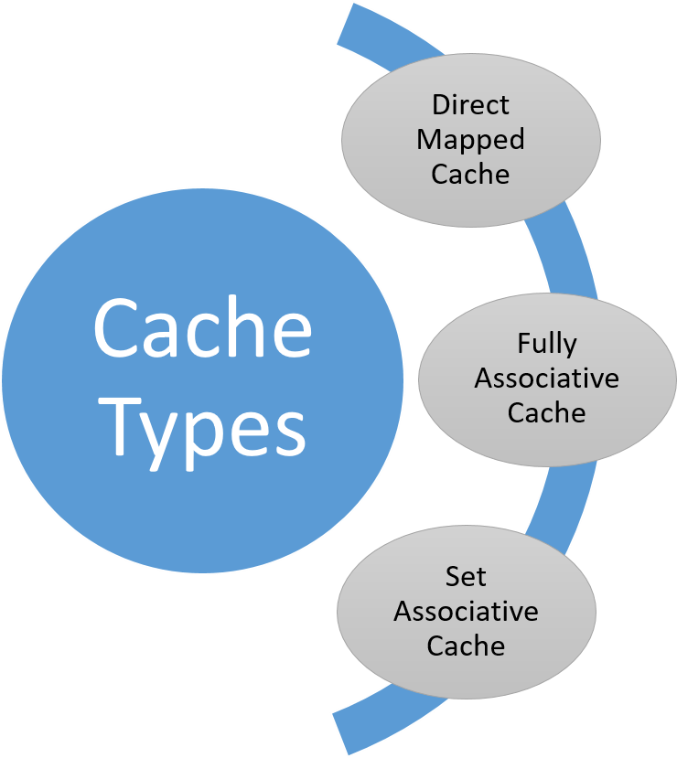
CACHE
To speed up accesses by storing recently used data closer to CPU instead of main memory
Accessed by content → Content Addressable Memory
HIT / MISS
Cache Hit - When requested data is found in cache
Cache Miss – When requested data is not found in the cache
REPLACEMENT POLICY
How do we choose victim cache line?
FIFO (First In First Out)
LRU (Least Recently Used)
Random

Slide 7

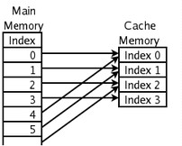



Length of address in Main Memory
DEFINITIONS
TAG – distinguished one cache memory block with another
INDEX – identifies the cache block
OFFSET – points to desired data in cache block
INSTRUCTION BREAKDOWN
Each of the address of load instruction is broken into three parts: tag, index and offset.
Main memory size = M , cache size = C and offset
bits = Z results in the following (right figure).
Length of load instruction | : log₂(M) | bits
OFFSET | : z | bits
INDEX | : log₂(C) – z | bits
TAG | : log₂(M) – log₂(C) | bits
CACHE BLOCKS | : log₂(C) | blocks

Slide 8
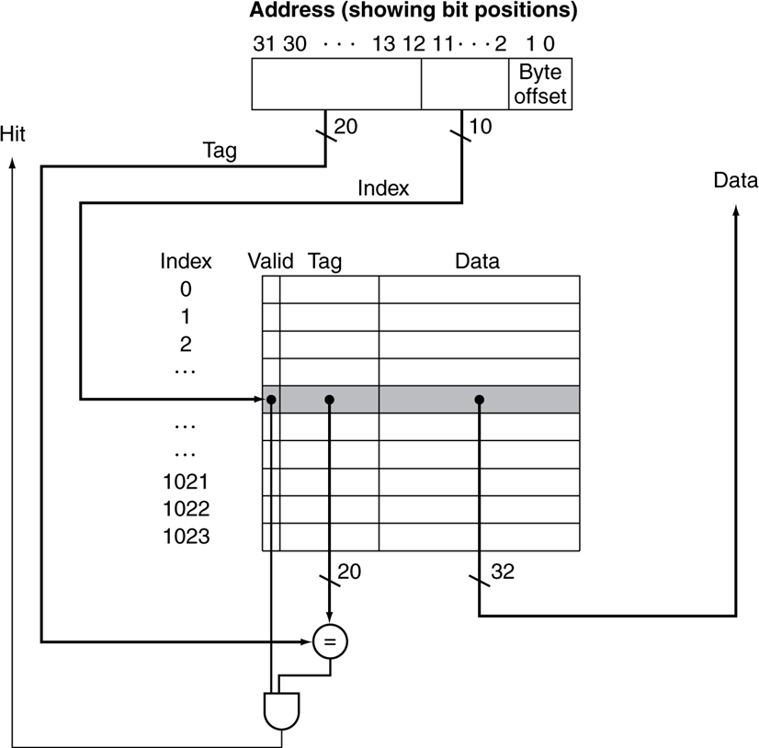
HOW IT WORKS
The requested address is broken down into tag, index, and
offset.
Cache table with corresponding index will be examined.
If valid bit of the index is equals to 0, cache miss is obtained
Else tag bit of the requested address will be compared
with tag bit in cache table
If tag is matched, cache hit is obtained
Else cache miss is obtained
When cache hit is obtained, data from cache table will be
returned. Else, data will be retrieved from main memory.
PRO / CONS Direct mapping is simple and inexpensive to implement, but if a program accesses 2 blocks that map to the same line repeatedly, the cache begins to thrash back and forth reloadingthe line over and over again leads to high miss rate.

Slide 9
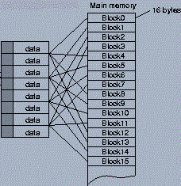


Length of address in Main Memory
DEFINITIONS
TAG – distinguished one cache memory block with another
OFFSET – points to desired data in cache block
INSTRUCTION BREAKDOWN
Each of the address of load instruction is broken into three parts: tag and offset.
Main memory size = M , cache size = C and offset bits = Z results in the following (right figure).
Length of load instruction OFFSET
TAG
CACHE BLOCKS
: log₂(M) bits
: z bits
: log₂(M) – log₂(C) bits
: log₂(C) blocks

Slide 10
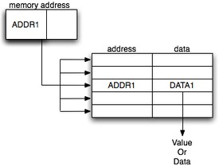
HOW IT WORKS
The requested address is broken down into tag and offset.
Requested tag will be searched through cache with valid bit
If there is tag matched with one of the index in the cache table, cache hit is obtained
Else, cache miss is obtained
When cache hit is obtained, data from cache table will be returned. Else, data will be retrieved from main memory.
PRO / CONS
Fully Associative is the most efficient utilisation of cache blocks, yet it is expensive to transverse through the cache to find each requested tag. Since there is no specified slot for each instruction, an algorithm of replacement policy must be designed along with implementation of fully associative cache.

Slide 11

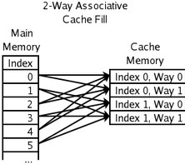


Length of address in Main Memory
N-way set associative cache combines the idea of direct mapped cache and fully associative cache. It has direct mapped principle to an index, yet fully associative concept within the index. An index contains N blocks of way.
INSTRUCTION BREAKDOWN
Each of the address of load instruction is broken into three parts: tag, index and offset.
N-way set associative, Main memory size = M ,
cache size = C and offset bits = Z results in the following (right figure).
Length of load instruction OFFSET
INDEX TAG
CACHE BLOCKS
: log₂(M)
: z
: log₂(C) – z – log₂(N)
bits bits bits
: log₂(M) – log₂(C)+ log₂(N) bits
: log₂(C) blocks

Slide 12
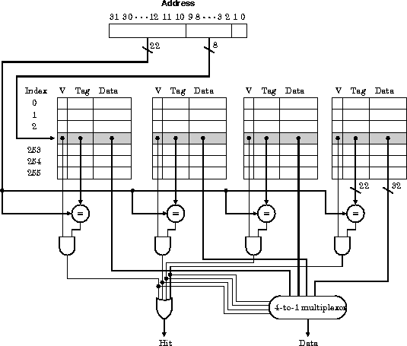
HOW IT WORKS
The requested address is broken down into tag, index and
offset.
Cache table with corresponding index will be examined. N- ways of cache blocks will be transversed.
If one of the way has the requested index, a cache hit
will be obtained
Else cache miss is obtained
When cache hit is obtained, data from cache table will be returned. Else, data will be retrieved from main memory.
PRO / CONS
Combining direct mapped and fully associative principle is seen as the most balanced way to obtain high hit rate meanwhile maintaining the resources cost. However, N-Way associative could be hard for initial implementation as various concepts is involved.

Slide 13
Different cache types has varied resource utilization.
This section will explain NAND gates used in each type of cache.
Decision made by each cache type when an instruction is loaded:
Direct Mapped
Fully Associative
N-way set associative
: 1 * valid_bit + valid_bit_1* tag_comparison.
: cache_size * valid_bit + valid_bit_1 * tag_comparison
: N* valid_bit + valid_bit_1 *tag_comparison
Valid_bit_1 is a variable to calculate the number of (validbit==1) in respective situation, meanwhile valid_bit and tag_comparison are the NAND needed for each action.

Slide 14
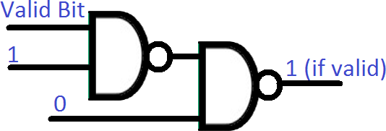
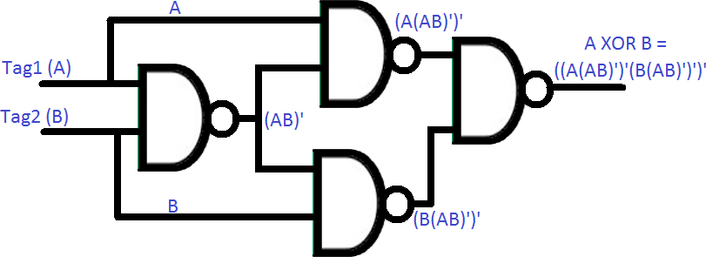
Tag_Comparison_per_bit
(4 NAND GATES)
Valid_Bit
(2 NAND GATES)

Slide 15
Tag_comparison = cache_bit * tag_comparison_per_bit.
Hence, the costs of each cache can be summarised as:
Direct Mapped
Fully Associative
N-way set associative
: 1 * 2 + valid_bit_1* 4 * cache_bit .
: cache_size * 2 + valid_bit_1 * 4 * cache_bit
: N* 2 + valid_bit_1 *4 * cache_bit

Slide 16
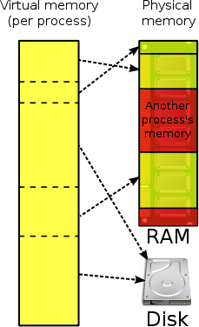
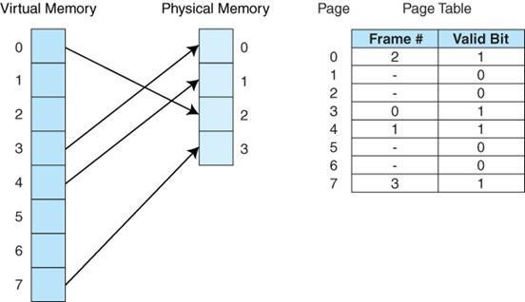
VIRTUAL MEMORY
Extends the memory capacity of the main memory by using a portion of the disk drive.
Allows the system to run programs that are bigger than the size
of main memory
Paging is implemented in this system.
PAGE TABLE
Data structure that maintain information concerning the location of each page, whether on disk or in memory.

Slide 17



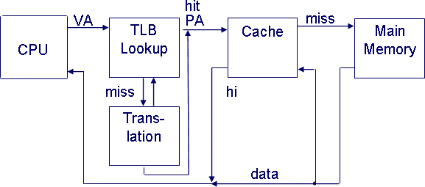
Length of Virtual Address
DEFINITIONS
Page Frames – virtual memory partitions of main memory.
OFFSET – points to desired data in page
frame
Physical address – actual memory address
of physical memory
Virtual address – addresses where physical address mapped into
TLB (Translation Lookaside Buffer)
A memory cache that stores recent translations of virtual memory to physical addresses for faster retrieval

Slide 18
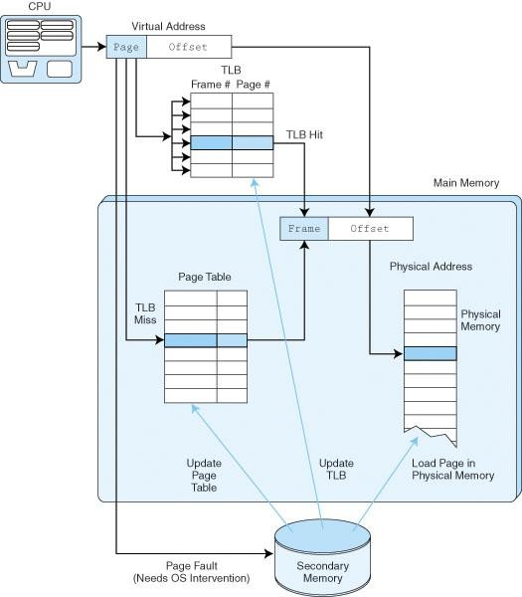
HOW IT WORKS
The requested address is broken down into page and offset.
Requested page is searched in TLB with fully associative principle.
If there is a frame number that matched the page, TLB HIT is obtained, and data will be loaded from TLB.
Else, page will be searched through page table with
direct mapping principle.
If matched page id is found in page table, Page Table Hit is obtained and data will be loaded from
Page Table. TLB will be updated accordingly.
Else, Miss is obtained, and data will be loaded from secondary memory.

Slide 19


