Slide 1
SUBJECT
WRITING
UNIV.MAJOR.NAME

Slide 2
목차
1
2
3
4
STEP1
STEP2
STEP3
STEP4

Slide 3
부제목
Text

Slide 4
부제목
Text

Slide 5
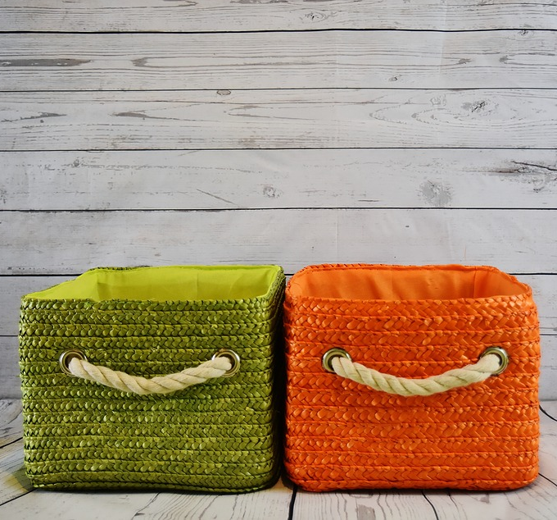
부제목
STEP1
This picture was taken at a place that appears to be a studio. There is two basket on the floor. One is green, and the other is orange.
STEP2
This picture was taken at a place that appears to be a studio. There is two basket on the floor. One is green, and the other is orange.

