Slide 1

A brief introduction to AI
How machines evolved from sounding like steam engines to coherent speech

Slide 2
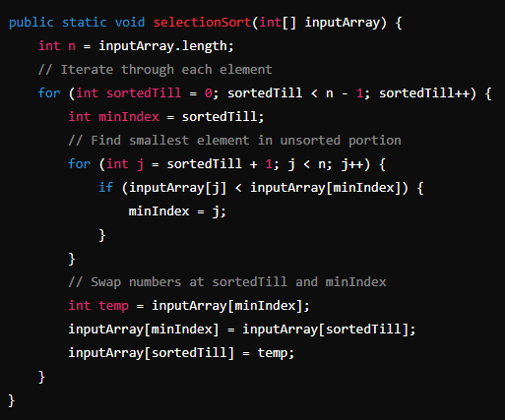
Algorithms
An algorithm is a series of simple instructions
that achieve a goal when executed in order
This is how selection sort follows some instructions and sorts an array of numbers
Initialize an integer ‘sortedTill’ to 0.
Find the index of the smallest number in ‘inputArray’
between indices ‘sortedTill’ and ‘inputArray.length’
and assign it to a variable ‘minIndex’.
3. Swap the numbers at ‘minIndex’ and ‘sortedTill’.
Increment ‘sortedTill’ by 1.
Repeat steps 2 to 4 until ‘sortedTill’ is equal to
‘inputArray.length’.

Slide 3
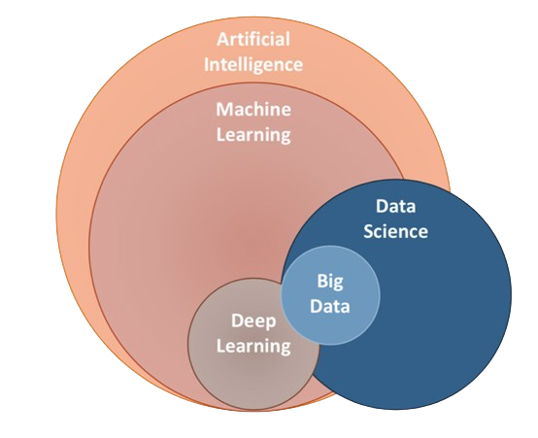
Artificial Intelligence
Any machine that can make decisions, either through
programmed logic or by learning.
Machine Learning
A subset of AIs with the ability to learn patterns from
data.
Deep Learning
A subset of machine learning algorithms that neural
networks with many layers, the most successful
ML algorithms so far belong to this category and have
Outperformed other algorithms by a large margin.

Slide 4
AI but not ML
Both AI and ML
Rule based systems
Search algorithms
Dijkstra’s algorithm
A-star
BFS/DFS
Genetic algorithms
Linear and Logistic regression
K nearest neighbors
Neural networks
Face recognition models
OCR model
Language models

