Slide 1
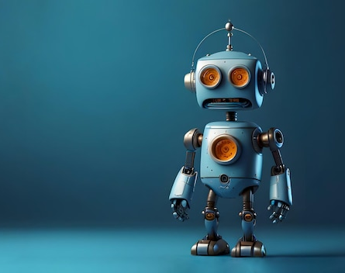
A brief introduction to AI
How machines evolved from sounding like steam engines to coherent speech

