Slide 1
Beginning R
Bradley Barney
(with influence from others)

Slide 2
Goals:
Be able to start R session and install/load packages
Become aware of and use various resources for R help
Learn some basic mathematical operations and statistical functionality, including functions for various distribution types
Use custom plotting capabilities
Fit linear regression models

Slide 3
Conventions
In the remainder of this guide, anything in italics is a placeholder and not literal text
For example:
plot(xvector, yvector)
means that xvector and yvector are placeholders. If x is the name of one existing vector and y is the name of another existing vector, then the command actually used would be
plot(x,y)

Slide 4
Some important notes to remember
R is case sensitive, so make sure you are careful with capitalization.
In directory paths/folder names, make sure you use either \\ or / (instead of \)
For example “E:/mydata.txt” or “E:\\mydata.txt”, but NOT “E:\mydata.txt”
To make comments, use the pound sign (#)
Rest of line will be ignored

Slide 5
Starting R
R can be downloaded at
http://cran.r-project.org
R is available for Windows, Macs, and Unix
Run Rgui.exe (can be done by double clicking on R icon or launched from startup menu)
You can change the working directory with the command setwd(directoryPathInQuotes)
This allows you to avoid providing the filepath later, as the default is to look for the file in the working directory
Example: setwd(“E:/Rwork/”)

Slide 6
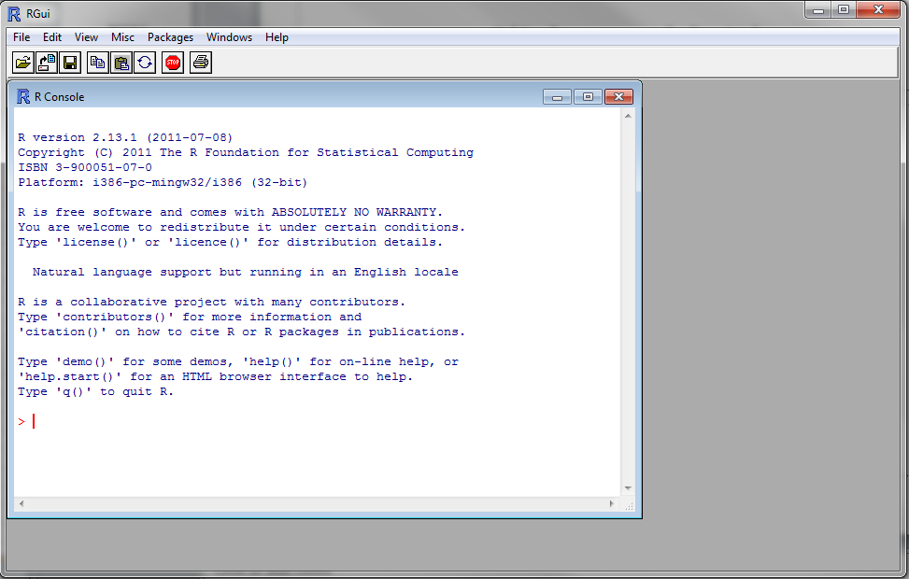
What does R’s GUI look like?
Command prompt
I recommend using a script and typing everything there. Go to “File”-> “New Script”

Slide 7
Starting R: continued
Open a new or existing R script. I strongly recommend putting all your commands in the script and running from there (rather than typing at the command line) so you can readily reproduce your work.
Save your R script immediately. Then periodically save as you work.
Run R commands by copying and pasting from R script into command window, or by using Ctrl-R

Slide 8
Starting R: continued
At startup, load any (non-base) packages you will need in the session with the library command
library(packageName)
Example: library(nlme)
If a package has not been installed, you will need to install it first.
Can be done using option in Packages tab, or by typing install.packages(“packageName”)
Installing a package only has to be done once, but every time an R session is begun the package must be reloaded to be accessible.

Slide 9
Alternative GUI: R Commander (John Fox et al.) 127.0.0.1:22320/library/Rcmdr/html/Rcmdr-package.html
GUI with considerable point-and-click functionality.
Displays corresponding R code in script
To install, type
install.packages()
R is case sensitive, so make sure all letters lower case in above command
Select a mirror, then select the “Rcmdr” package.

Slide 10
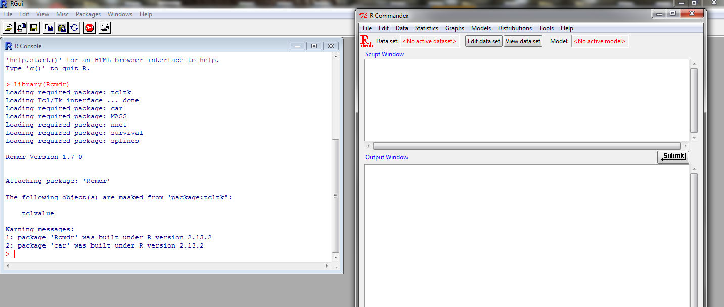
Loading R Commander
In R command prompt, type “library(Rcmdr)”
Must be done EVERY time you begin R

Slide 11
Calculations
One of my professors referred to R as a “statistician’s calculator.”
Can perform numerous mathematical operations
exp(1.2); sqrt(16); log(3.7) #natural log
gamma(4.5); beta(1.2,2.3); choose(4,2)

Slide 12
Statistical computation
Distributions (e.g., Cauchy, normal, binomial)
Convention to have either p, q, d, or r followed immediately by some version of distribution name
dcauchy, pcauchy, qcauchy, rcauchy
ddistribution: evaluate density (pdf or pmf)
rdistribution: generate (pseudo)random numbers from distribution
pdistribution: evaluate cumulative density
qdistribution: evaluate quantile function (inverse cdf)

Slide 13
Variable/Object Assignment
Make assignments with target on left-hand side, then <- (Less than sign followed immediately by minus sign) and then what you are assigning to the left hand side
Examples
x <- 3
y <- “USA”
Many names are already assigned, so make sure names you use are free unless you intend to replace them
Easiest way to check: type what you thought about using
Example: Want to assign ls to have value 3, but type ls first, and see that it is already a function.

Slide 14
Variable Names
Can start with any letter (or period, but I would avoid this)
Can contain letters, numbers, periods, and underscores
Unlike some object-oriented languages, the period does not have any particular meaning in, say, print.x or x.print.
Good practice to keep variable names informative but not too lengthy

Slide 15
Reading in a csv (Comma-separated values) file
Desired data set name
Assignment operator (<-)
read.csv(“file (including full path)”, header=TRUE)
Examples
cars <- read.csv(“C:/Users/bbarney2/Desktop/mtcars.csv”,header=TRUE)
ChickWt <- read.csv(“E:/STAT8225/chickwt.csv”,header=TRUE)
Note the file path uses “/” instead of the Windows “\”, even though I am running this with Windows!!

Slide 16
Reading in Dataset
If reading in tab-delimited txt file, use
data1 <- read.table(lotsOfStuff)
If reading in csv file, use read.csv()
data2 <- read.csv(lotsOfStuff)
If reading in xlsx file, use read.xlsx(“fileIncludingFilePath.xlsx”,worksheetNumber) from the xlsx package
Reading in SAS data set: can be done using read.ssd(lotsOfStuff) from the foreign package
I recommend using csv files to read into R; it is easier to go between different software packages with a generic format.

Slide 17
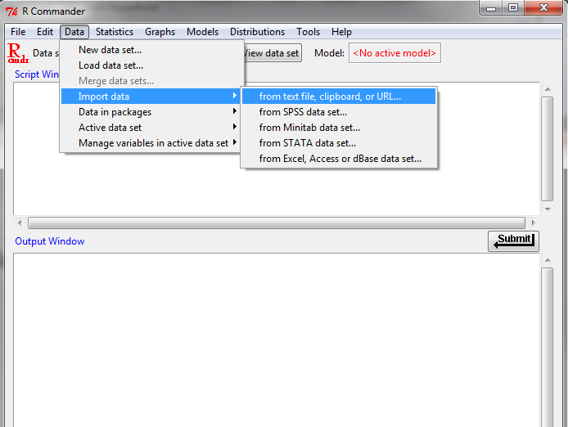
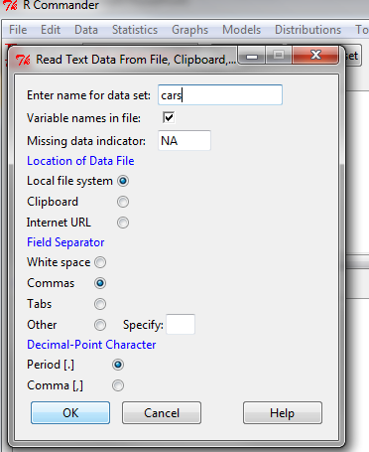
Reading CSV with R Commander
Step 1: Data -> Import data -> from text file, clipboard, or URL
Step 2: Choose the name you want for the data set, change Field Separator to “Commas”, and click OK

Slide 18
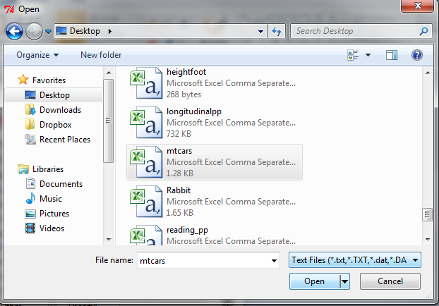
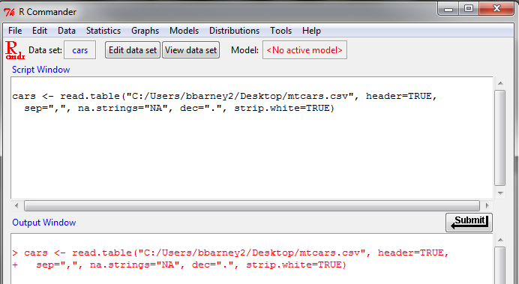
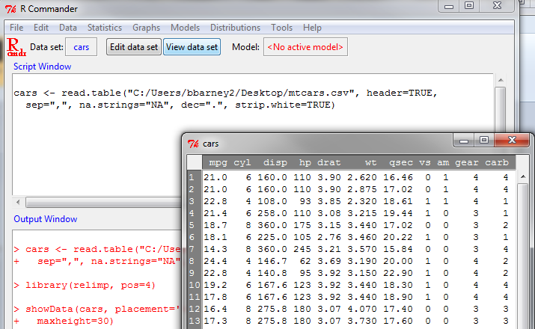
Reading CSV w/ R Commander (cont)
Step 3: Browse to the csv file and click Open
Step 4: Check the output Window and Messages (below output window) to make sure it worked.
Step 5 (optional): Click the “View data set” button in the R commander GUI to see the data

Slide 19
mtcars data set
Note: data set “cars” is just a copy of the data set “mtcars” which is pre-loaded with R and thus accessible directly (as mtcars)
More info? Type “?mtcars” in R
Brings up help file http://127.0.0.1:18491/library/datasets/html/mtcars.html
Preceding a function or object name with a question mark brings up the help file (if it exists)
Examples: ?mean; ?sd; ?read.csv; ?read.table

Slide 20
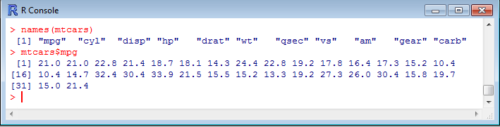
Variables in data set?
names() function allows you to see what subcomponents are in an object
names(mtcars) returns the variable names in the data set
Can access a specific variable by using data set name, followed by dollar sign, followed by variable name
Input: Red
Output: Blue

Slide 21
What about creating a variable inside of an existing data set?
Make sure to use (a) the data set name, followed by (b) a dollar sign, followed by (c) the name for the new variable on the left-hand side
mtcars$mpg2 <- mtcars$mpg^2
# The line above creates a variable in mtcars
# containing the square of mpg & calls it mpg2

Slide 22
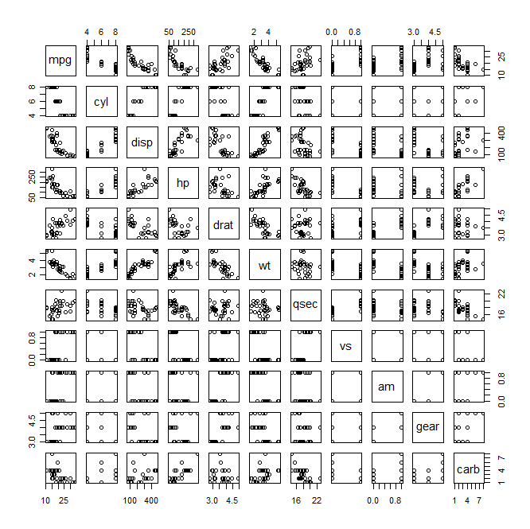
Scatterplots
plot function is object oriented:
plot(mtcars) produces panel of plots with every pair of variables

Slide 23
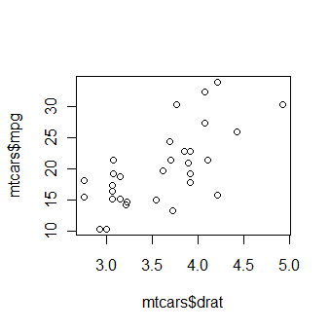
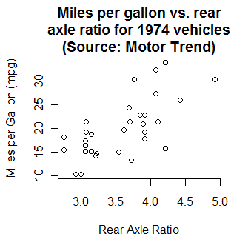
Scatterplots (cont)
plot(mtcars$drat,mtcars$mpg)
--produces scatterplot of Rear axle ratio (drat) on x-axis, miles per gallon (mpg) on y-axis
plot(mtcars$drat, mtcars$mpg, xlab=‘Rear Axle Ratio’, ylab=‘Miles per Gallon (mpg)’, main=‘Miles per gallon vs. rear\n axle ratio for 1974 vehicles \n(Source: Motor Trend)’)
-- same data plotted, but formatted

Slide 24
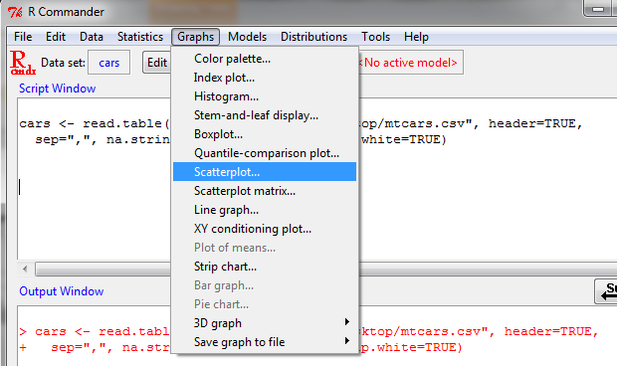
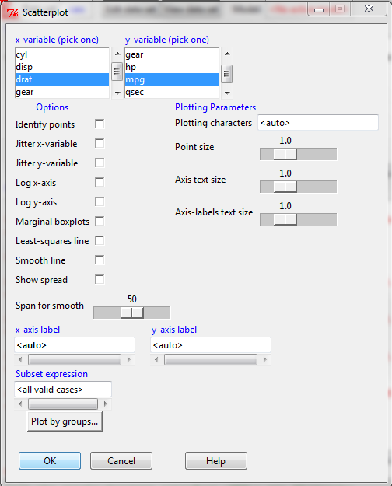
Scatterplot with R Commander
Step 1: With data already loaded, go to Graphs -> Scatterplot…
Step 2: Select the x- and y- variables; unselect all boxes. Can add x- and y-axis labels to be more informative. OK.

Slide 25
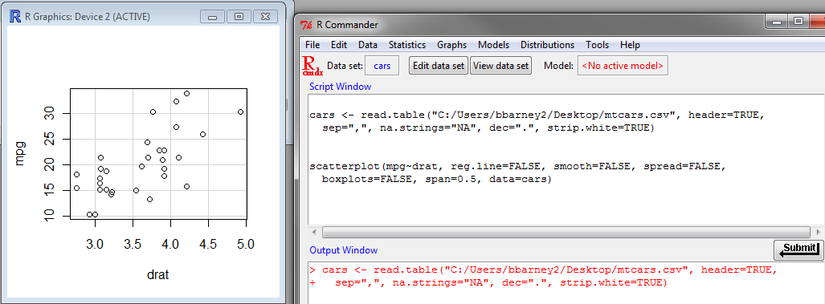
Scatterplot with R Commander (cont)
Generated Plot
Automatically generated code to generate plot

Slide 26
Linear Regression
lm() function can be used to fit linear regression
Inputs
formula: response variable ~ explanatory variable
data set name (optional): data= (data set name)
Examples
fit1 <- lm(mtcars$mpg, mtcars$drat)
fit2 <- lm(mpg~drat, data=mtcars) # this version
# lets you avoid writing mtcars$ before each variable
By default, formula includes intercept. So model in fit1 is
mpg=β₀ + β₁ drat + ε

Slide 27
Linear Regression Output
Use summary() function on a lm() model fit to get some typical regression output
Use anova() function to get the ANOVA table
fit1 <- lm(mtcars$mpg~mtcars$drat)
summary(fit1)
anova(fit1)

Slide 28
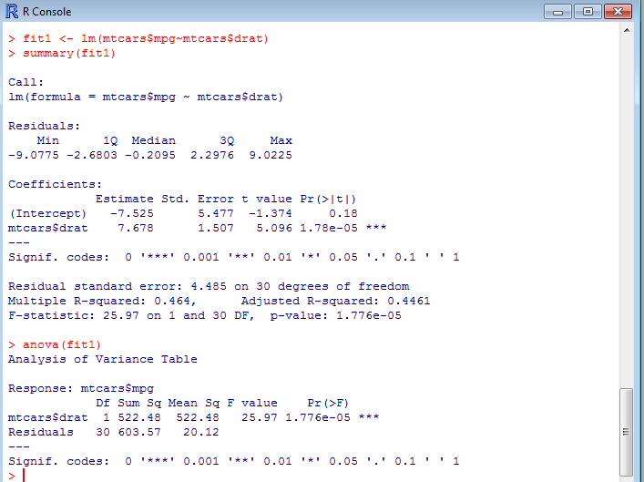

Estimates of β₀ and β₁
Standard errors of $\hat{β_{0}} and \hat{β_{1}}$
Test statistic and 2-sided p-value for null hypothesis that parameter=0 vs. alternative that parameter ≠0
s (Estimate of σ) and df
Test Statistic and p-value for testing significance of regression
Gives test of significance of regression IF MODEL IS SLR (only ONE predictor)

Slide 29
More Linear Regression
Predicted values for observed data
predict(fit1)
1 2 3 4 5 6 7 8
22.42049 22.42049 22.03658 16.12434 16.66181 13.66730 17.12251 20.80806
Residuals
resid(fit1)
1 2 3 4 5 6
-1.42048871 -1.42048871 0.76342292 5.27566203 2.03818575 4.43269646
95% Confidence intervals for β₀ and β₁
confint(fit1)
2.5 % 97.5 %
(Intercept) -18.70946 3.660219
mtcars$drat 4.60113 10.755335
90% Confidence intervals: confint(fit1,level=0.90)

Slide 30
Model fitting
Models require a formula (similar to Model statement in SASTM)
Formula: response ~ predictor1 + predictor2 + …+predictork
Interactions included using colon to separate variables varA:varB (SAS uses * instead)
Can include polynomial terms using I(operation)
E.g., I(age^2) is age²
Example 1:
lm(income ~ yearsEducation+ yearsExperience+gender + gender:yearsEducation+ gender:yearsExperience, data=incData)
Example 2:
lm(income ~ yearsEducation+ I(yearsEducation^2) + gender, data=incData)
linear regression of income on gender, years of education, and years-of-education-squared

