Slide 1

Nonparametrics: An Introduction
Notes prepared by Bradley Barney for STAT 7900 Special Topics: Nonparametrics.
Notes are based somewhat on the preface and Chapter 0 of the required course textbook.
Higgins, James J. (2004). Introduction to Modern
Nonparametric Statistics. Thomson/Brooks Cole:
Pacific Grove, CA.
Do not redistribute these notes in any form whatsoever. Any mistakes should be assumed to be my own.

Slide 2
The Role of Assumptions in Statistical Inference
The use of statistical inference always depends on some assumptions
This naturally gives rise to a variety of questions, such as:
Can the assumptions be checked?
Which assumptions are the most important?
How much is inference affected by violations of the assumptions?
What if the assumptions are not met?
Should we avoid making assumptions?
Notes:
Sometimes assumptions can be checked; sometimes they cannot

Slide 3
Can the assumptions be checked?
That depends on what the assumption is.
Some are relatively easy to assess:
Normality of error terms in a simple linear regression model
Linear relationship between the explanatory variable and response variable
Some are harder to assess:
Multivariate normality of a response vector
Independence of observations
Some cannot be checked:
Example: the missing data mechanism when data are not missing at random (see, for example, Fitzmaurice, Laird, and Ware 2011).

Slide 4
Which assumptions are the most important?
Arguably, the ones that most affect the inference
The Central Limit Theorem may be invoked in many situations where an assumption of normally distributed data is not met
If available data do not reflect the characteristics of the population of interest, this is especially problematic.

Slide 5
How much is inference affected by violations of the assumptions?
It depends on the nature and severity of the violation

Slide 6
Should we avoid making assumptions?
You can’t avoid them all.
If the assumptions are reasonable, there are advantages to employing them.
If the assumptions are not reasonable, then …

Slide 7
What if the assumptions are not met?
You’ll learn a variety of techniques in this course.
However, these are not a cure-all.
Remember the acronym GIGO.
You must be willing to make some assumptions, but some assumptions are stronger than others

Slide 8
Nonparametric Statistics vs. Parametric Statistics (See Higgins 2004, Section 0.5)
“Nonparametric methods require minimal assumptions about the form of the distribution of the population…By contrast, parametric methods require that the form of the population distribution be completely specified except for a finite number of parameters.”
If normality assumption is violated, then what should we do?
Might try transforming the data
Might try assuming a different family of distributions
Might use nonparametric techniques that don’t assume any particular distribution
(Or it MIGHT be reasonable to not worry about the nonnormality)

Slide 9
Why have nonparametric methods?
Because they might still provide valid inference even when a specific parametric method does not.
They are “safer”

Slide 10
Should we ALWAYS use nonparametric methods?
My opinion is a resounding NO!
They have their place, but their generality often results in less efficient estimates
Efficiency of an estimator depends upon the variability of the estimator.
Parametric techniques often have less variability in the estimator IF THE ASSUMPTIONS ARE MET.
My advice: unless it is especially important to be caution, use parametric methods when you can; when you can’t then use nonparametric methods
It is not a bad idea to compare results from nonparametric and parametric methods.

Slide 11
Course Overview
To a large extent, we’ll follow the course textbook pattern:
Consider a parametric test that may be used for a particular situation
Introduce and practice one or more nonparametric alternatives
Monte Carlo
Permutation Tests
Bootstrapping
Rank Transformations
Added emphasis on robust regression techniques

Slide 12
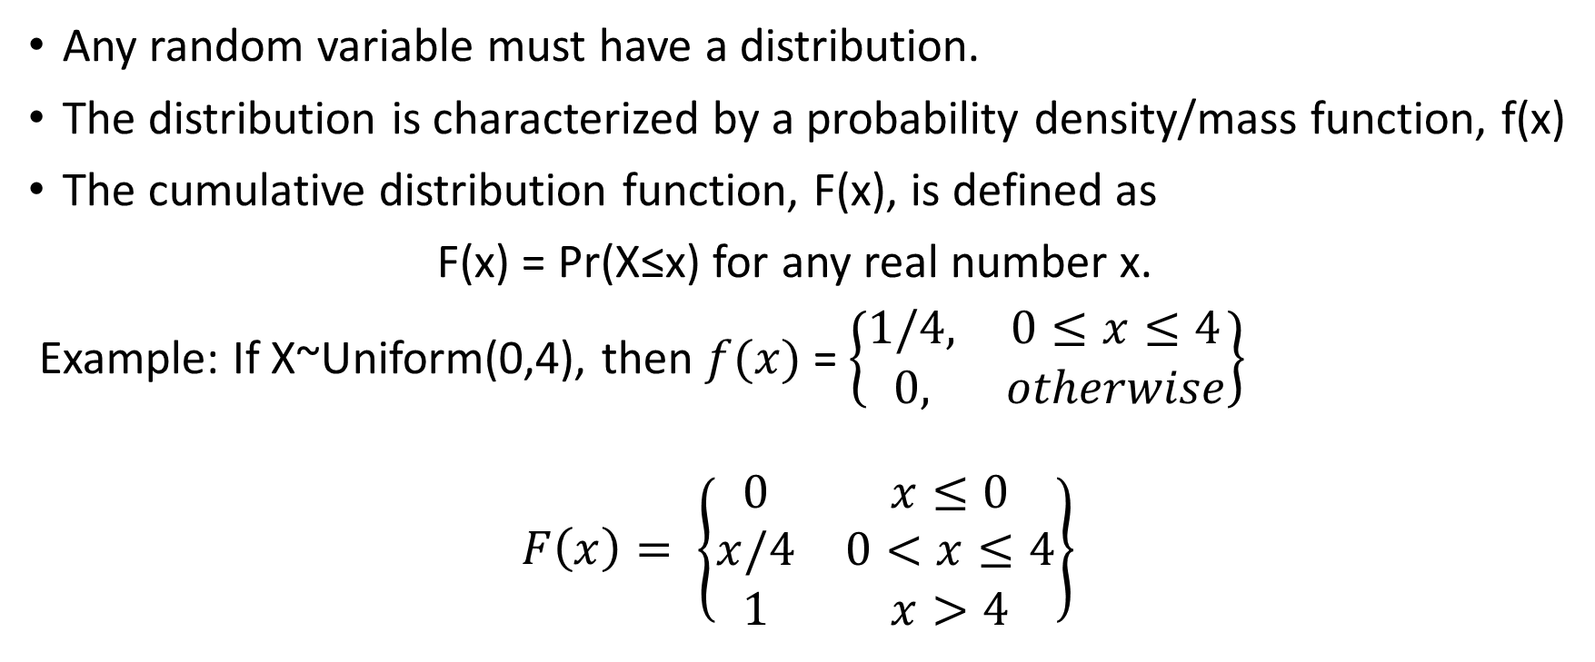
Chapter 0: Review material
Any random variable must have a distribution.
The distribution is characterized by a probability density/mass function, f(x)
The cumulative distribution function, F(x), is defined as
F(x) = Pr(X≤x) for any real number x.
Example: If X~Uniform(0,4), then $f(x)$= $\left\{\begin{matrix}1/4, & 0≤x≤4 \\ 0, & otherwise\end{matrix}\right\}$
$$F\left(x\right)= \left\{\begin{matrix}0 & x≤0 \\ x/4 & 0<x≤4 \\ 1 & x>4\end{matrix}\right\}$$

Slide 13
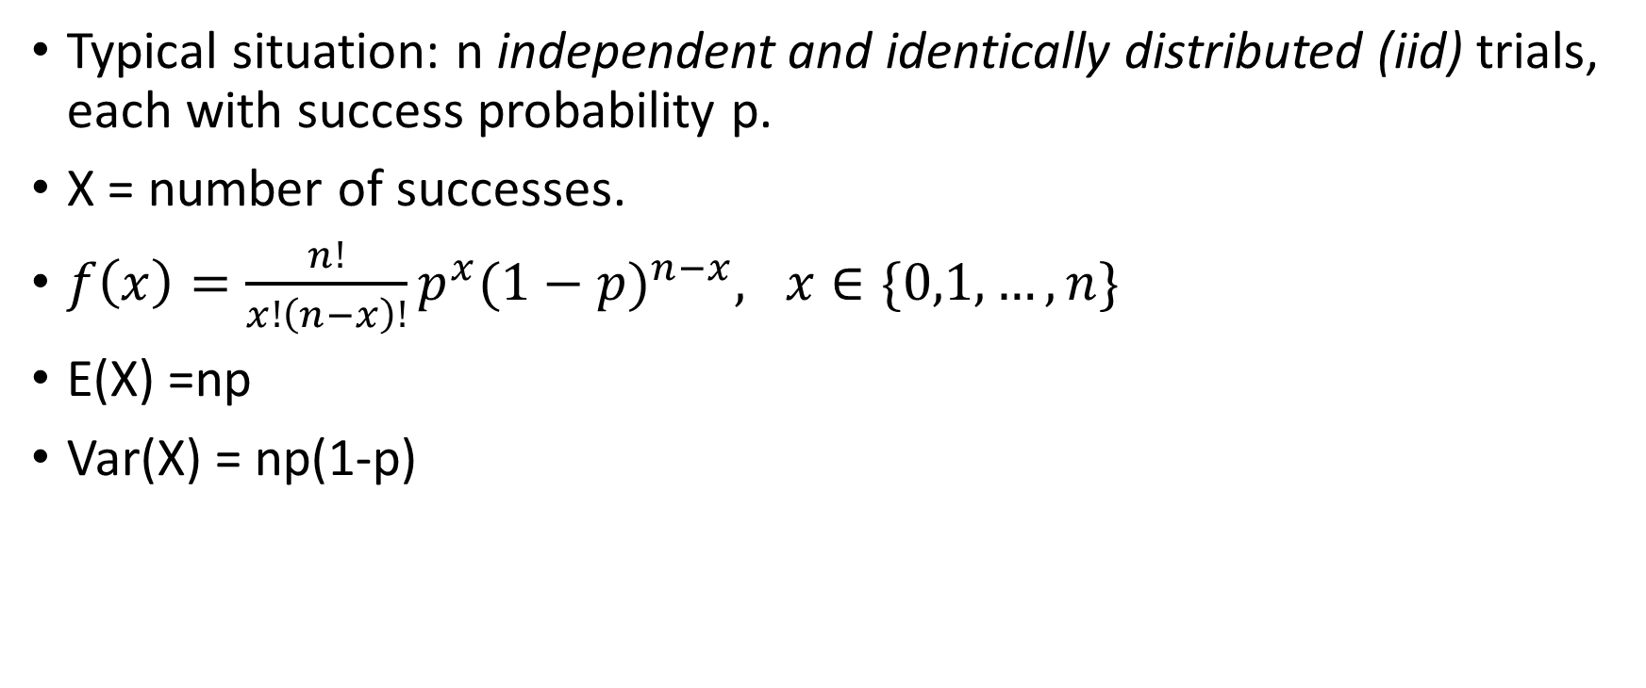
Binomial Distribution
Typical situation: n independent and identically distributed (iid) trials, each with success probability p.
X = number of successes.
$f\left(x\right)=\frac{n!}{x!\left(n−x\right)!}p^{x}{(1−p)}^{n−x}, x∈\{0,1, …,n\}$
E(X) =np
Var(X) = np(1-p)

Slide 14
Confidence Intervals
Often based on a pivotal quantity: that is, a function of the data and parameters that has a fully known distribution (when the assumptions are met; Casella and Berger 2002, pp. 427-428).
Example: Sample average with normally distributed data, unknown mean, known variance
Example 2: Sample average with normally distributed data, unknown mean, unknown variance

Slide 15
Hypothesis Testing
Based on the course prerequisite, the fundamental concepts of hypothesis testing should be ingrained in your memory.
Concise Review:
Data are summarized as a TEST STATISTIC
The p-value is the probability that the test statistic should have been at least as extreme as it actually was if the null hypothesis is true
Note that extremity is only considered in the direction(s) implied by the alternative hypothesis.
The p-value is compared to a significance level to make a decision re the hypotheses.
Especially small p-values are considered sufficient justification to claim the null hypothesis is false and the alternative hypothesis is true; otherwise, we fail to reject the null hypothesis.

Slide 16
Monte Carlo Techniques
Monte Carlo methods involve using stochasticity to approximate unknown sampling distributions
They may be used to great effect in analyses (both parametric and nonparametric)
Example: Approximating the distribution of the maximum from a sample of size 15 from the t distribution with 7 df.

Slide 17
Example R Code
### Create a vector in which to store the maximum from a sample of 15 observations
#### for 1000 different samples.
Maxvals <- rep(NA, 1000)
## use a for loop to sample 15 values 1000 times, each time saving the maximum
for (i in 1:1000){
Maxvals[i] <- max(rt(15,7))
}
## Use a kernel density estimator to estimate the sampling distribution of the max.
plot(density(Maxvals))

Slide 18
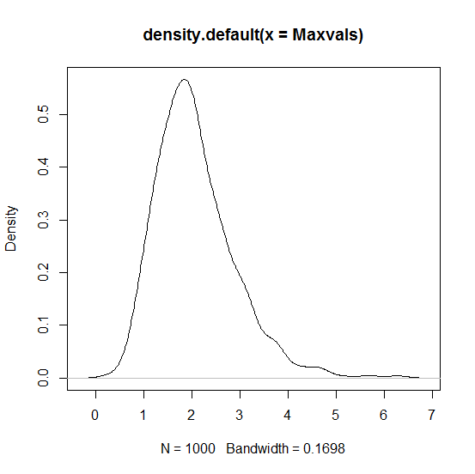
Estimated sampling distribution of the maximum of 15 values when sampled independently from the T distribution with 7 df.

Slide 19
How much R should you already know?
No prior knowledge is assumed.
We will go through any new R code in detail in class.
We will often use R as a calculator, for Monte Carlo approximations, and to write our own functions
We will also make use of existing R functions, primarily for bootstrapping
R is a tool to help us, and NOT the focus of this course.

