Slide 1

Nonparametrics: Chapter 1: One-sample Methods
Notes prepared by Bradley Barney for STAT 7900 Special Topics: Nonparametrics.
Notes are based somewhat on Chapter 1 of the required course textbook.
Higgins, James J. (2004). Introduction to Modern
Nonparametric Statistics. Thomson/Brooks Cole:
Pacific Grove, CA.
Do not redistribute these notes in any form whatsoever. Any mistakes should be assumed to be my own.

Slide 2
Inference on the Population Median
For a random variable X with a continuous distribution, the population median is generally unique
It will have the property that Pr(X<median)=Pr(X>median)=0.5
What is Pr(X=median)?
How could we test whether or not the median exceeds a particular null value?

Slide 3
Inference on the Population Median (cont.)
Consider B=# of sample values that exceed the null value for the median.
Before the data are collected, B is a random variable. After the data are collected, we have one specific value; we call this realized value b (note the lower case) to distinguish it from the random variable B.
If H₀ true, B~binomial(n, p=0.5).
P-value = Pr(B≥b), where b is the actual number of sample values that exceed the null value in the observed data.

Slide 4
Inference on the Population Median (cont.)
How could we test if the median is LOWER than some null value?
Example: For car tires that have a reported median life of 50,000 miles, I believe the median is lower than reported.
Data from a (fictional) sample:
With this data, how would we conduct the test?
41238 | 37391 | 68214 | 89797 | 71000+ | 52431+ | 11281
19682 | 39137 | 28210 | 72431+ | 49186 | 62388 | 23897
74301+ | 44231 | 44531 | 48306 | 51032 | 40070 | 48264

Slide 5
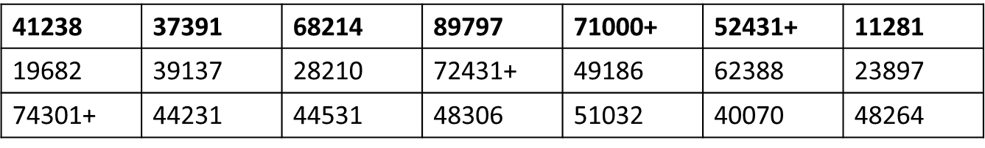
Summarize the data with a test statistic
How many values are above the null median?
How many should we have expected to be above the null median?
What is the probability of having this few or even fewer values above the null median if the null hypothesis is true?

Slide 6
Binomial Probabilities
In R, may use dbinom(k,n,p) to get the probability of exactly k successes in n trials, each having an individual success probability of p.
Of more use, the function pbinom(k,n,p) gives Pr(X≤k).
To get Pr(X≥k), what would you do?
If np and n(1-p) are each sufficiently large, then X has approximately normal distribution (and of course, the mean and standard deviation are still np and sqrt(n*p*(1-p)), respectively).
Approximate probability: Pr(X≤k)≈pnorm(k,n*p,sqrt(n*p*(1-p)))
Approximate probability: Pr(X≥k) ≈ 1-pnorm(k, n*p, sqrt(n*p*(1-p)))

Slide 7
Confidence Interval for the population median:
May use order statistics (ordered data values) as interval endpoints
Definition: Let x_{(k)} be the k^{th} smallest value of the x_{i}’s.
That is, x₍₁₎ ≤ x₍₂₎ ≤ … ≤ x_{(n)}
These order statistics are nondecreasing.
Principle: Identify values of a, b so that
Pr(X_{(a)} < population median < X_{(b)}) = 1-α (i.e., desired confidence level)
In general, you won’t be able to get exactly the confidence level you want

Slide 8
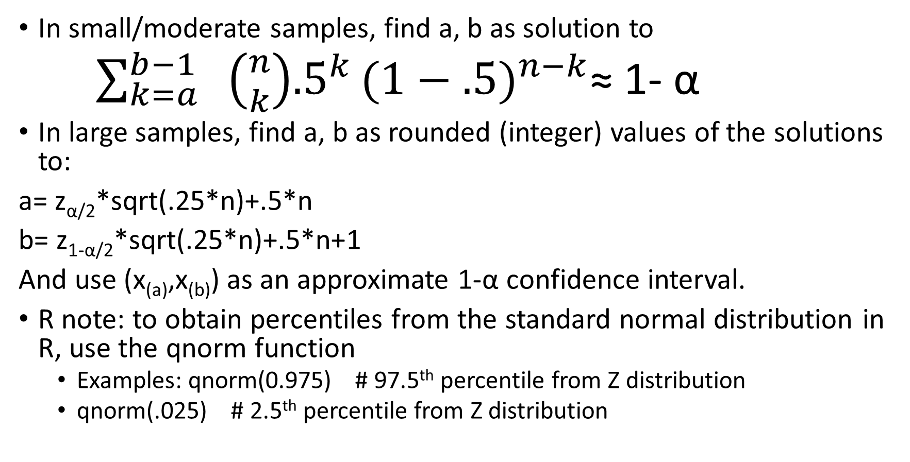
Selection of a, b
In small/moderate samples, find a, b as solution to
$\sum_{k=a}^{b−1}{ \left({n \atop k}\right){.5}^{k}{(1−.5)}^{n−k}}$≈ 1- α
In large samples, find a, b as rounded (integer) values of the solutions to:
a= z_{α/2}*sqrt(.25*n)+.5*n
b= z_{1-α/2}*sqrt(.25*n)+.5*n+1
And use (x_{(a)},x_{(b)}) as an approximate 1-α confidence interval.
R note: to obtain percentiles from the standard normal distribution in R, use the qnorm function
Examples: qnorm(0.975) # 97.5th percentile from Z distribution
qnorm(.025) # 2.5th percentile from Z distribution

Slide 9
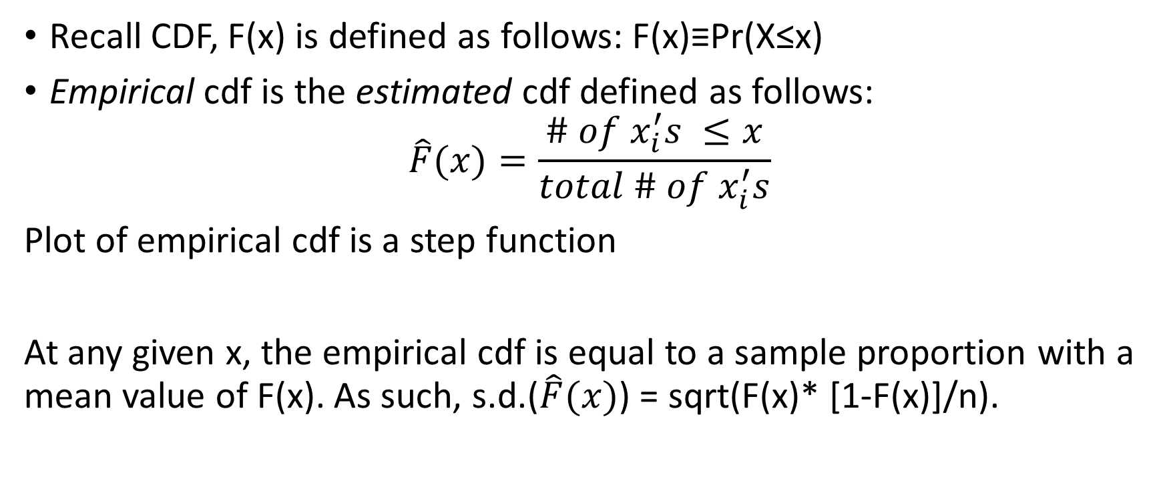
Empirical CDF
Recall CDF, F(x) is defined as follows: F(x)≡Pr(X≤x)
Empirical cdf is the estimated cdf defined as follows:
$$\hat{F}(x)=\frac{\# of x_{i}^{′}s ≤x}{total \# of x_{i}^{′}s}$$
Plot of empirical cdf is a step function
At any given x, the empirical cdf is equal to a sample proportion with a mean value of F(x). As such, s.d.($\hat{F}(x)$) = sqrt(F(x)* [1-F(x)]/n).

Slide 10

Empirical CDF (cont)
A confidence interval for F(x) is then given by
$\hat{F}\left(x\right)±z_{(1−\frac{α}{2})}\sqrt{\frac{\hat{F}\left(x\right)[1−\hat{F}\left(x\right)]}{n}}$ (Higgins 2004, p. 16)
When would this confidence interval be expected to be reliable?

Slide 11
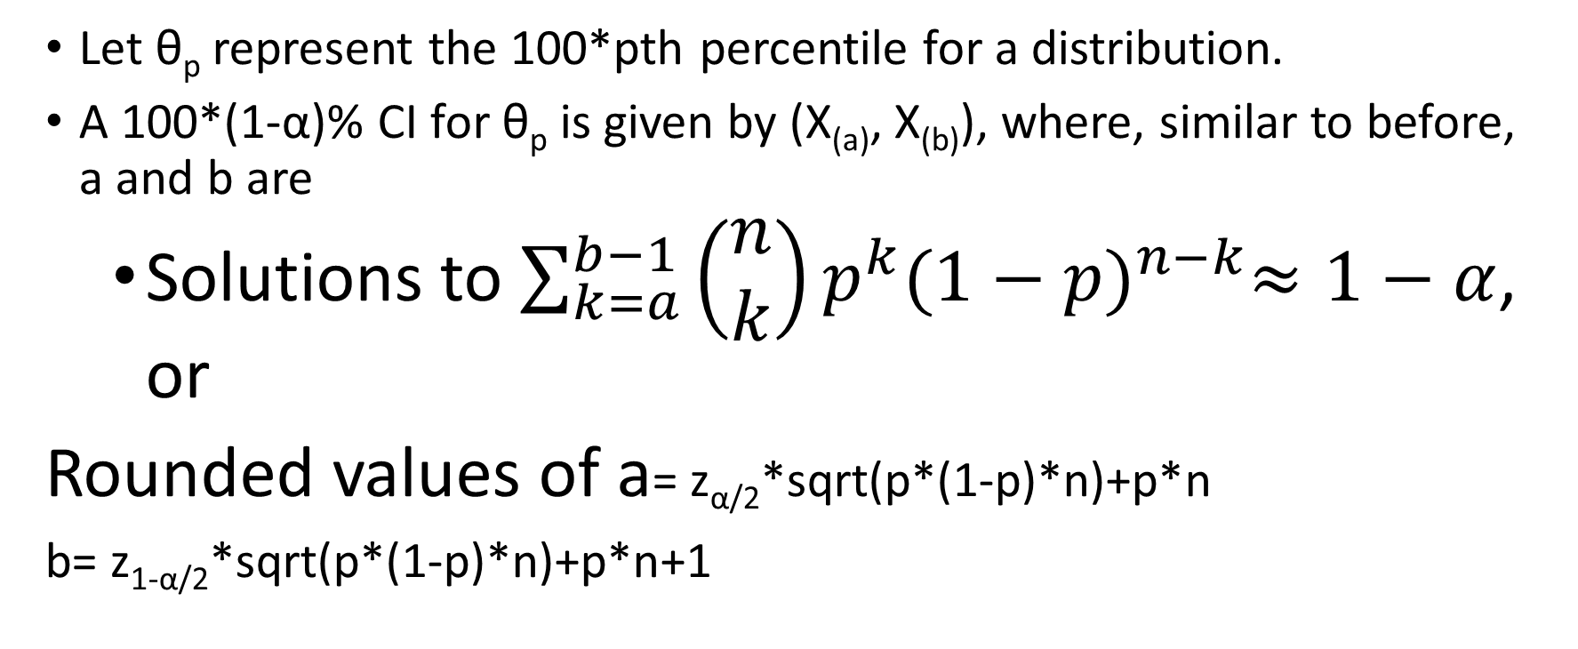
Inference for Arbitrary Percentiles (Sect. 1.2.2)
Let θ_{p} represent the 100*pth percentile for a distribution.
A 100*(1-α)% CI for θ_{p} is given by (X_{(a)}, X_{(b)}), where, similar to before, a and b are
Solutions to $\sum_{k=a}^{b−1}{\left(\begin{matrix}n \\ k\end{matrix}\right)}p^{k}{(1−p)}^{n−k}≈1−α$, or
Rounded values of a= z_{α/2}*sqrt(p*(1-p)*n)+p*n
b= z_{1-α/2}*sqrt(p*(1-p)*n)+p*n+1

Slide 12
Comparison of Parametric, Nonparametric Tests
Two important considerations:
Is the nominal (i.e., stated) significance level at least close to the actual significance level?
What is the power of the test? (Power is the probability of rejecting the null hypothesis given the truth)

Slide 13
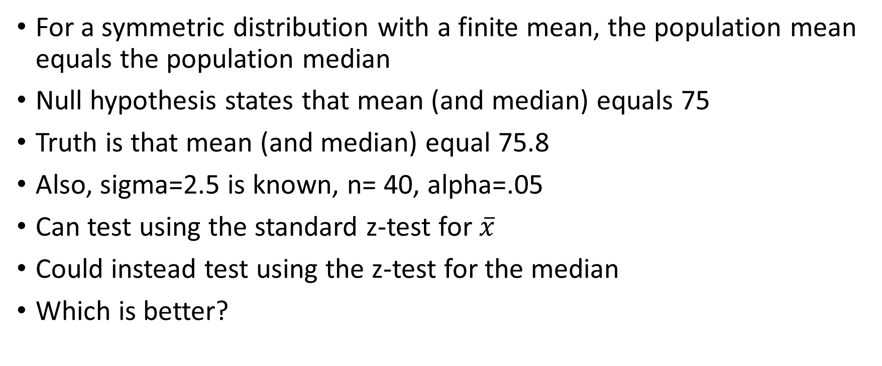
Example 1.3.1 (Higgins 2004, pp. 19-20)
For a symmetric distribution with a finite mean, the population mean equals the population median
Null hypothesis states that mean (and median) equals 75
Truth is that mean (and median) equal 75.8
Also, sigma=2.5 is known, n= 40, alpha=.05
Can test using the standard z-test for $\overline{x}$
Could instead test using the z-test for the median
Which is better?

Slide 14
Example 1.3.1 (cont)
Test based on median and test based on mean both have significance levels close to the nominal value in most large-sample situations
If the data are from a normal distribution, power of the mean-based test is .65
If the data are from a normal distribution, power of the median-based test is .48
Winner: Test for the mean

Slide 15
Example 1.3.1 (cont)
Test based on median and test based on mean both have significance levels close to the nominal value in most large-sample situations
If the data are from a Laplace distribution, power of the mean-based test is .65
If the data are from a Laplace distribution, power of the median-based test is .76
Winner: Test for the median

Slide 16
Lesson Learned?
When the assumptions are met (e.g., normally distributed data), parametric tests tend to be more powerful
When they are not met, the nonparametric tests might be more powerful.

Slide 17
In-class exercise:
To Be Announced…

