Slide 1

Nonparametrics:
Chapter 2: Two-sample Methods
Notes prepared by Bradley Barney for STAT 7900 Special Topics: Nonparametrics.
Notes are based somewhat on Chapter 2 of the required course textbook.
Higgins, James J. (2004). Introduction to Modern
Nonparametric Statistics. Thomson/Brooks Cole:
Pacific Grove, CA.
Do not redistribute these notes in any form whatsoever. Any mistakes should be assumed to be my own.

Slide 2
Lecture 1 Concepts
Binomial Test for the median
Confidence interval for the median, other percentiles
Empirical CDF, and CI for the CDF
Comparison of parametric, nonparametric tests

Slide 3
Implementing the Binomial Test in R
I wrote a function named test.median (saved in Chapter1.R) to facilitate conducting this test.
We’ll go through some examples of its use during class

Slide 4
Comparing Two Samples
Idea: In comparing two samples, the null hypothesis is that the distribution of the data is the same in each population. The alternative is that one distribution is stochastically dominated by the other.
  This is a one-sided alternative if the dominated distribution is prespecified; it is a two-sided alternative otherwise
  “A dominating B means that F_{A}(x) ≤ F_{B}(x) for all x, with strict inequality at some x.”
  http://en.wikipedia.org/wiki/Stochastic_dominance, accessed 01 June 2015

Slide 5
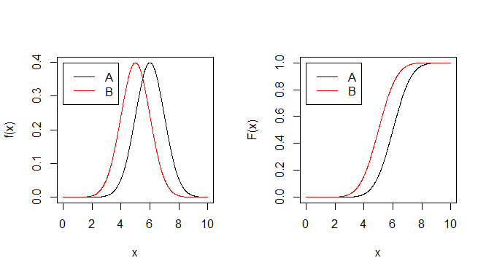
Example of A stochastically dominating B
In this case, strict inequality everywhere: F_{A}(x) < F_{B}(x)
Also in this case, the distributions are the same save for a location shift.

Slide 6
Using permutation to approximate sampling distributions
Many parametric tests rely on a known form for the sampling distribution—the distribution of the test statistic
The sampling distribution is affected by the underlying distribution of the data points, which may or may not behave as expected
What can we do if we are concerned about the validity of the assumed sampling distribution?

Slide 7
Permutation Tests
One approach—avoid assuming the known distribution
Instead, use permutations of the data to approximate the sampling distribution
  Permutations are simply relabels of the observations
We do require for this test that the alternative hypothesis is consistent with stochastic dominance.

Slide 8
Permutation Test for the Mean (see Table 2.1.1)
Treatment A:
  4 observations: 37, 49, 55, 57
Treatment B:
  3 observations: 23, 31, 46
H₀: Treatment A and Treatment B have same distribution for the response.
H_{A}: F_{A}(x) ≤ F_{B}(x) for all x, but strict inequality for at least one x. (Treatment A is more effective than treatment B).
How to test?

Slide 9
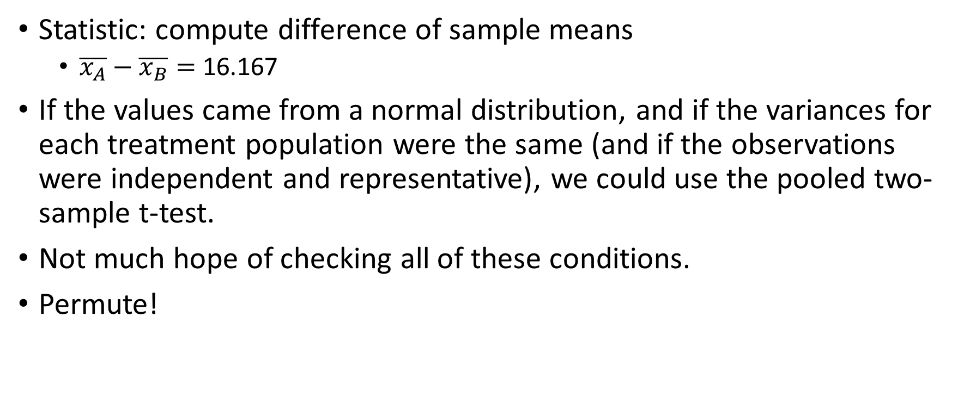
Rationale for Permutation Test
Statistic: compute difference of sample means
  $\overline{x_{A}}−\overline{x_{B}}=$ 16.167
If the values came from a normal distribution, and if the variances for each treatment population were the same (and if the observations were independent and representative), we could use the pooled two-sample t-test.
Not much hope of checking all of these conditions.
Permute!

Slide 10
Relabels
Suppose H₀ is true and consider the seven scores.
With H₀ true, any unique set of four would have been equally likely to be the measurements from treatment A.
Some examples:
Treatment A | Treatment B | Difference in Means (A-B)
31, 46, 55, 57 | 23, 37, 49 | 10.917
46, 49, 55, 57 | 23, 31, 37 | 21.417
23, 31, 37, 46 | 49, 55, 57 | -19.417
23, 37, 46, 55 | 31, 49, 57 | -5.417
31, 37, 49, 55 | 23, 46, 57 | 1.000

Slide 11
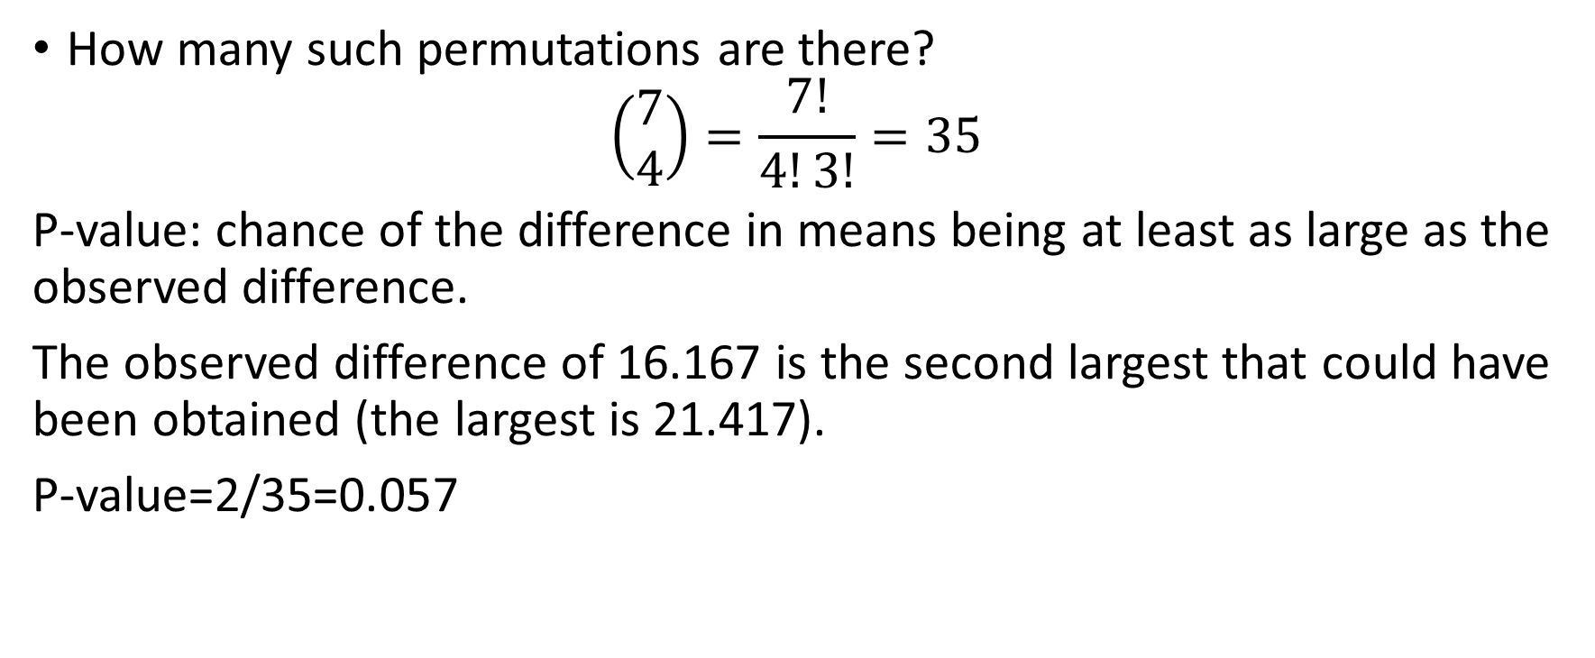
P-value for permutation test
How many such permutations are there?
$$\left(\begin{matrix}7 \\ 4\end{matrix}\right)=\frac{7!}{4!3!}=35$$
P-value: chance of the difference in means being at least as large as the observed difference.
The observed difference of 16.167 is the second largest that could have been obtained (the largest is 21.417).
P-value=2/35=0.057

Slide 12
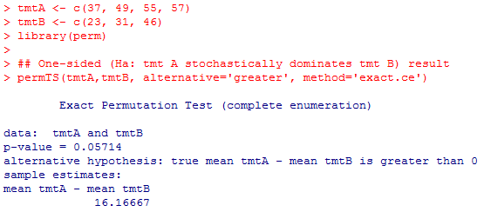
R code for two-sample permutation test
(Ensure the perm package is already installed first)

Slide 13
Two-sided Test
To get the p-value from a two-sided permutation test, use the proportion of the permutations for which the absolute value of the statistic is at least as large as the observed statistic’s absolute value.

Slide 14
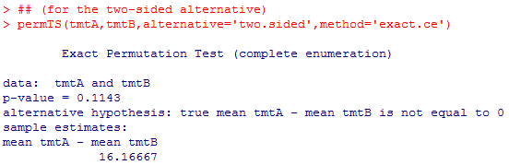
R Code for two-sided two-sample permutation test

Slide 15
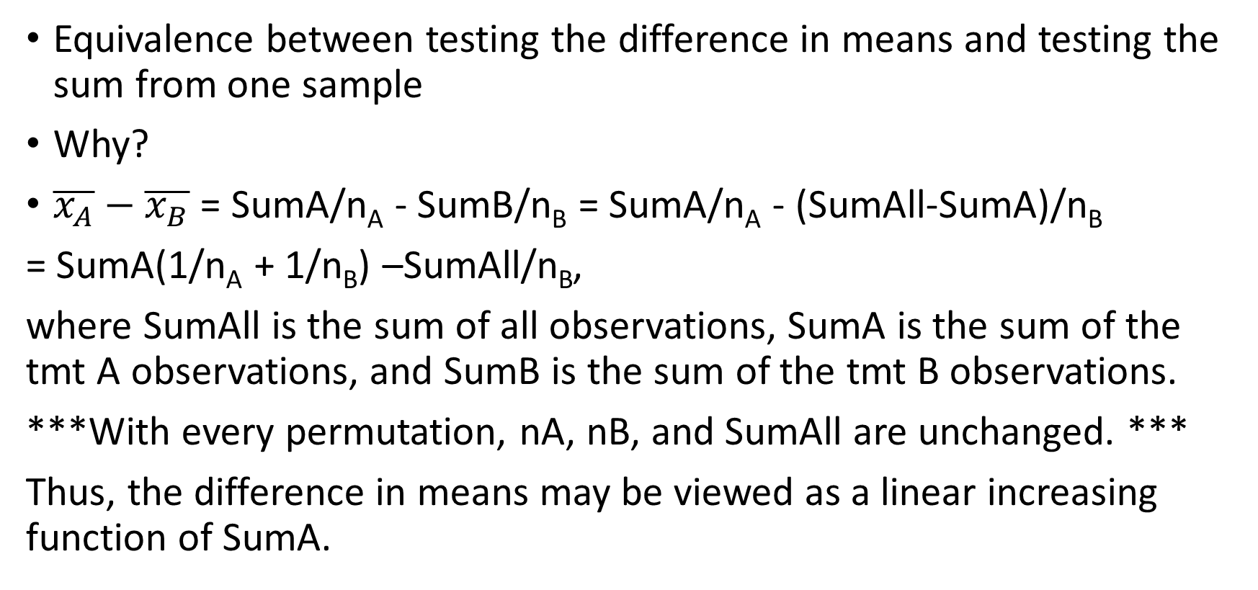
An equivalence (see Higgins 2004, pp. 27-28)
Equivalence between testing the difference in means and testing the sum from one sample
Why?
$\overline{x_{A}}−\overline{x_{B}}$ = SumA/n_{A} - SumB/n_{B} = SumA/n_{A} - (SumAll-SumA)/n_{B}
= SumA(1/n_{A} + 1/n_{B}) –SumAll/n_{B},
where SumAll is the sum of all observations, SumA is the sum of the tmt A observations, and SumB is the sum of the tmt B observations.
***With every permutation, nA, nB, and SumAll are unchanged. ***
Thus, the difference in means may be viewed as a linear increasing function of SumA.

Slide 16
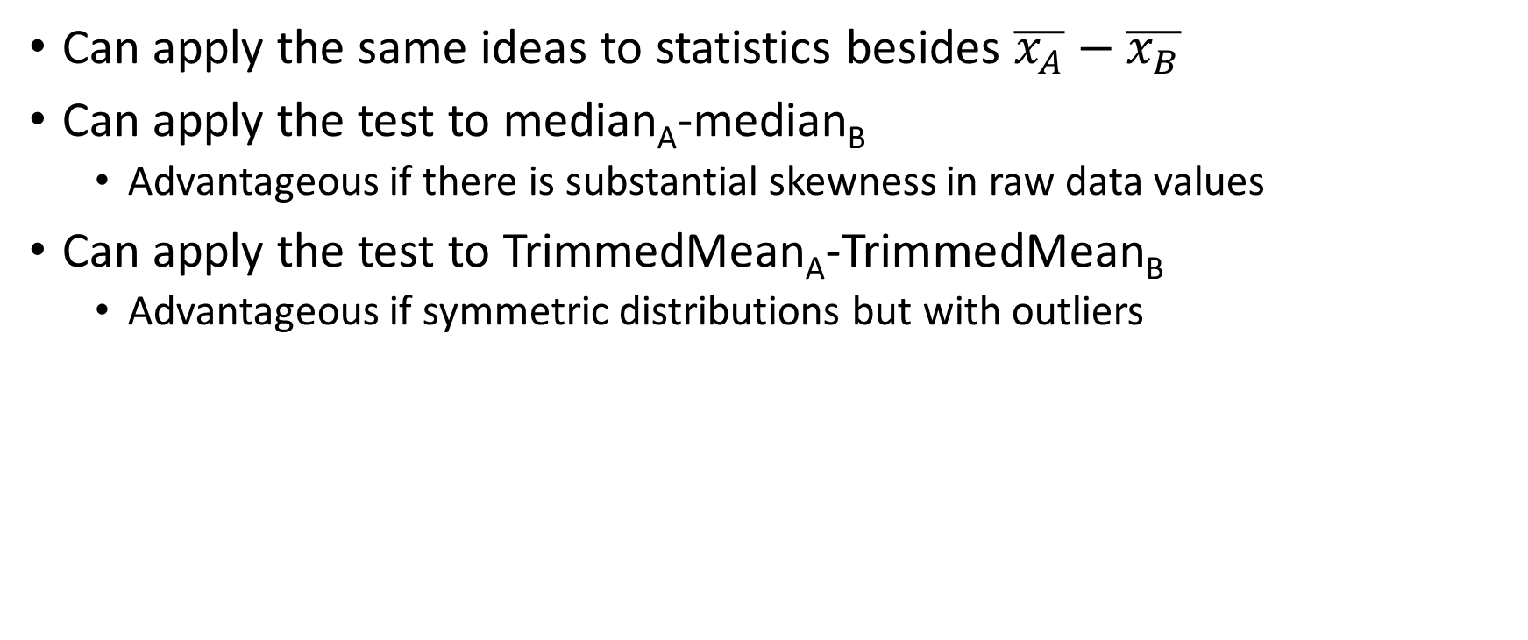
Permutation Tests for Median, Trimmed Mean
Can apply the same ideas to statistics besides $\overline{x_{A}}−\overline{x_{B}}$
Can apply the test to median_{A}-median_{B}
  Advantageous if there is substantial skewness in raw data values
Can apply the test to TrimmedMean_{A}-TrimmedMean_{B}
  Advantageous if symmetric distributions but with outliers

Slide 17
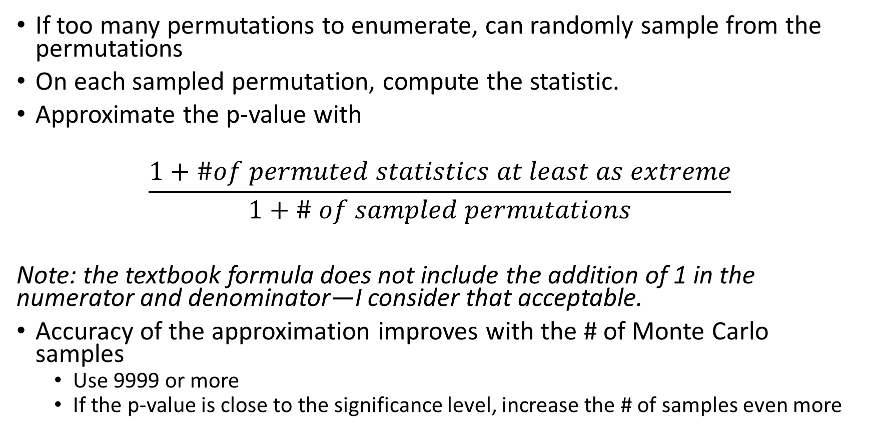
Computation
If too many permutations to enumerate, can randomly sample from the permutations
On each sampled permutation, compute the statistic.
Approximate the p-value with
$$\frac{1+\#of permuted statistics at least as extreme}{1+\# of sampled permutations}$$
Note: the textbook formula does not include the addition of 1 in the numerator and denominator—I consider that acceptable.
Accuracy of the approximation improves with the # of Monte Carlo samples
  Use 9999 or more
  If the p-value is close to the significance level, increase the # of samples even more

Slide 18
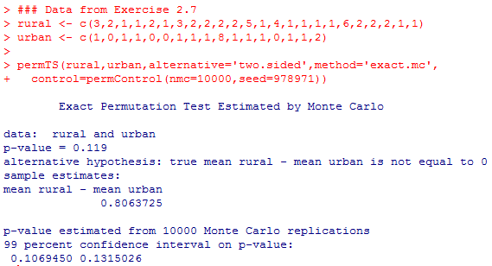
R Code for Monte Carlo P-values
(Data are number of siblings for rural, urban hometowns in college students)
In the perm function, use the option method=‘exact.mc’)
Will also add control=permControl(nmc=,seed=) option to specify the number of permutations to sample (nmc) and the seed for the pseudorandom number generation

Slide 19
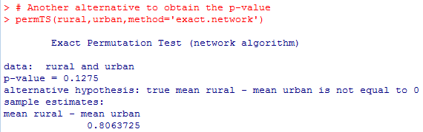
Alternate computation of exact p-value

Slide 20
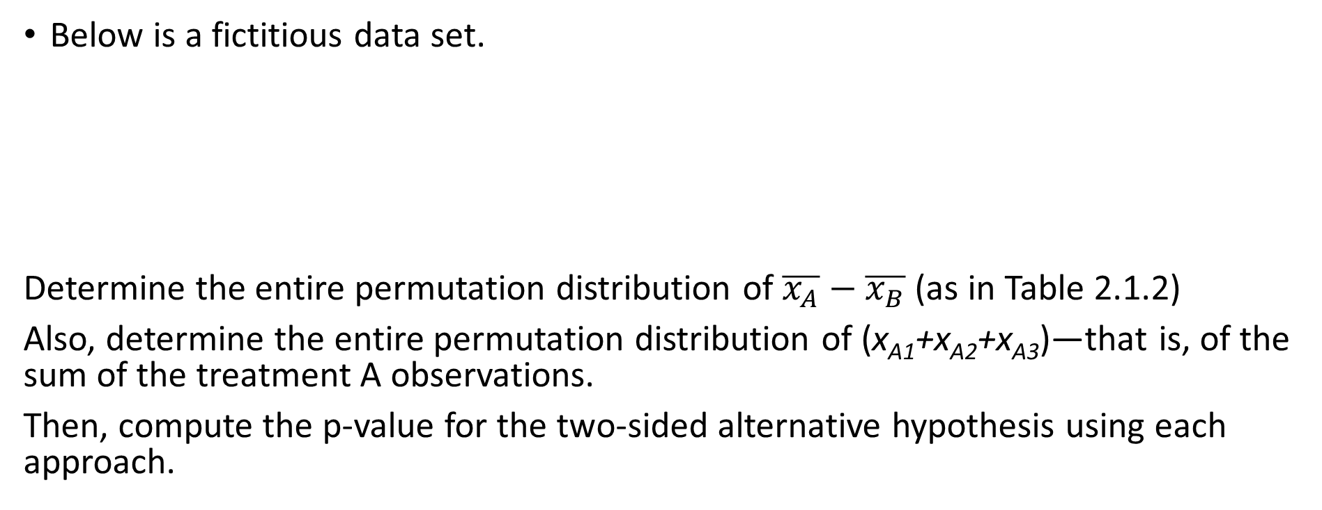
In-Class Practice (from Exercise 2.2)
Below is a fictitious data set.
Determine the entire permutation distribution of $\overline{x_{A}}−\overline{x_{B}}$ (as in Table 2.1.2)
Also, determine the entire permutation distribution of (x_{A1}+x_{A2}+x_{A3})—that is, of the sum of the treatment A observations.
Then, compute the p-value for the two-sided alternative hypothesis using each approach.
Treatment A | 10 | 15 | 50
Treatment B | 12 | 17 | 19

Slide 21
Wilcoxon Rank Sum Test
Use the rank transformation on every value
  Remember: combine all the data (from both samples) and then determine the overall rank of each value
The ranks for sample A are added up to create the Wilcoxon rank sum test statistic, W
Then, from all possible permutations of the sample assignments, add up the ranks for sample A
Compute the p-value as the proportion of all possible permutations yielding a rank sum at least as extreme as the original rank sum W

Slide 22

Ranks
In R, the rank function gives the rank from smallest (1) to largest (n):

Slide 23

Calculation of the Wilcoxon Rank Sum Statistic

Slide 24
Another alternative if too many permutations
You can use a sample of permutations if it is infeasible to enumerate every possible permutation
As another alternative, if both sample sizes are moderate to large, then the permutation distribution of the Wilcoxon Rank Sum statistic is approximately normal with mean E(W)=[n_{A}(n_{A}+n_{B}+1)/2] and variance Var(W) = [n_{A}*n_{B}*(n_{A}+n_{B}+1)/12].
Thus, approximate p-values may be obtained, as, for example (with a one-sided alternative):
Pr(W≥30) ≈Pr(Z ≥ (30- [n_{A}(n_{A}+n_{B}+1)/2] )/sqrt[n_{A}*n_{B}*(n_{A}+n_{B}+1)/12])

Slide 25
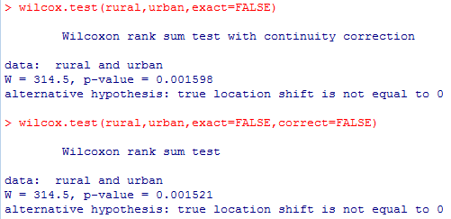
Conducting the Wilcoxon Rank Sum Test in R
Why is this test statistic (314.5) different from the test statistic of 614.5 from two slides earlier? Hint: type ?wilcox.test in R and read up on the function.

Slide 26
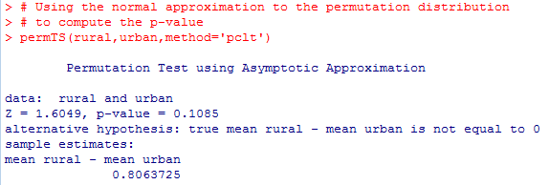
Rural, Urban Example Revisited

Slide 27
Ties?
If there are ties, then average the ranks for the tied values.
Example: values are 4.7, 5.2, 5.2, 6.3, 7.1, 7.1, 7.1
The ranks are 1, 2.5, 2.5, 4, 6, 6, 6

Slide 28
Mann-Whitney Test (Section 2.6)
The test statistic is
U=# of (x_{i},y_{j}) pairings where x_{i} < y_{j}, i=1,…,n_{A} and j=1,…,n_{B}
Where x_{i} is a value from sample A and y_{j} is a value from sample B
Section 2.6.2 proves the equivalence of the Mann-Whitney test to the Wilcoxon Rank Sum test.

Slide 29
Confidence Interval for the Shift Parameter
If F_{A}(x)=F_{B}(x-Δ), then Δ is a shift parameter.
A confidence interval for Δ is computed as follows:
Compute every pairwise difference D of a value from sample A minus a value from sample B. (Note: there are n_{A}*n_{B} such differences)
  The median of all of these D’s is the Hodges-Lehmann estimate.
Sort them, and define pwd(k) as the kth smallest difference
Determine the integers k₁ and k₂ that satisfy
Pr(k₁ ≤ U ≤ k₂-1)≈1-α
The confidence interval is (pwd(k₁),pwd(k₂))

Slide 30
R Code to Conduct the Tests
I recommend usage of the permTS function in the perm package.
It has several options for method=
  If the sample sizes are both small, use method=‘exact.ce’ to get the exact p-value
  If the sample sizes are neither both small nor both large, use either method=‘exact.mc’ (for sampling from the permutations) or method=‘exact.network’
  If the sample sizes are both large, you may use method=‘pclt’ (for using the approximate distribution based on the asymptotic normality of the permutation distribution)

Slide 31
In-Class Practice (Examples 2.3.1, 2.5.2)
Table 2.3.1 has the length of time (in minutes) to get two liters of runoff in an experiment testing two different tilling techniques.
Tmt 1 times: 59.1, 60.3, 58.1, 61.3, 65.1, 55.0, 63.4, 67.8
Tmt 2 times: 60.1, 62.1, 59.3, 55.0, 54.6, 64.4, 58.7, 62.5
Use the permutation test on the difference in means for a two-sided alternative
Use the Wilcoxon rank sum test for a two-sided alternative

Slide 32
Homework 1 (Due Friday, June 10th by 10:00 PM):
Chapter 1 Exercises: 3, 5, and 6
Chapter 2 Exercises: 4, 5, 6, including the additions below:
For question 4 a, also show by hand how the permutation test statistic was calculated
For question 4 b, also show by hand how the Wilcoxon rank-sum statistic was calculated.
(After tonight’s class, you should be able to complete all 6 questions)

