Slide 1

Nonparametrics: Chapter 2: Two-sample Methods
Notes prepared by Bradley Barney for STAT 7900 Special Topics: Nonparametrics.
Notes are based somewhat on Chapter 2 of the required course textbook.
Higgins, James J. (2004). Introduction to Modern
Nonparametric Statistics. Thomson/Brooks Cole:
Pacific Grove, CA.
Do not redistribute these notes in any form whatsoever. Any mistakes should be assumed to be my own.

Slide 2
Lecture 2 Concepts
Stochastic Dominance
Permutations
Permutation Tests for Difference in Means
Wilcoxon Rank Sum Test/Mann-Whitney Test
Exact p-values
Complete Enumeration
Network Computation
Monte Carlo Estimation
Approximate p-values based on Asymptotic Normality

Slide 3
Implementation of Selected Tests in SAS
Use Proc NPar1Way
Basic syntax (http://support.sas.com/documentation/cdl/en/statug/67523/HTML/default/viewer.htm#statug_npar1way_toc.htm )
Proc npar1way data=data_set_name (options, such as Wilcoxon or ab);
class group_variable;
exact (options for exact computation);
var response_variable;
Run;

Slide 4
Wilcoxon Rank Sum Test in SAS
Data set: birthwt from MASS package in R. https://stat.ethz.ch/R-manual/R-devel/library/MASS/html/birthwt.html
I have created a .csv version of this dataset, named birthwt.csv, in D2L
Focus on two variables:
smoke=0 if mother smoked, smoke=1 if not
bwt= birth weight in grams of newborns delivered in 1986 at BayState Medical Center in Springfield, MA
Goal: Determine if smoking by mother impacts the baby’s birth weight
Method: WRS test of birth weights for smoking mothers vs. nonsmoking mothers

Slide 5
SAS Code
/* Wilcoxon Rank Sum Test */
proc npar1way data=birthwt wilcoxon;
class smoke;
var bwt;
run;

Slide 6
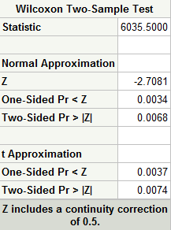
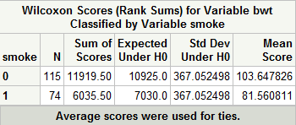

Slide 7
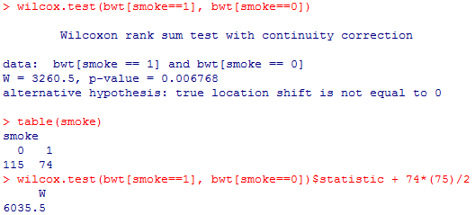
Comparison with R

Slide 8
Exact Computation Approach (think Complete enumeration)
/* Wilcoxon Rank Sum Test: Don't run this one! */
proc npar1way data=birthwt wilcoxon;
class smoke;
exact ; *Far too computationally intensive given the sample sizes!;
var bwt;
run;

Slide 9
Other uses of exact statement:
/* Wilcoxon Rank Sum Test: Monte Carlo p-value */
proc npar1way data=birthwt wilcoxon;
class smoke;
exact /seed=189791 n=10000 ;
var bwt;
run;

Slide 10
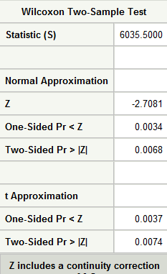
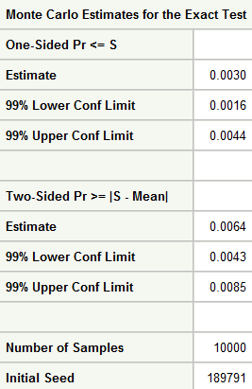

Slide 11
Scores
Recall one motivation for Wilcoxon rank sum test: using ranks instead of raw values limits potential impact of outliers.
Another alternative to ranks: scores based off of a particular distribution

Slide 12
Scores (cont.)
Normal Scores: Expected values of order statistics from a standard normal distribution
Relatively difficult to compute
Closely related: Van der Waerden scores
Assign the kth smallest value the score V_{(k)} = Φ⁻¹(k/(N+1)).
N is the total sample size (e.g., n_{A}+n_{B}) and Φ⁻¹ is the inverse cdf for the standard normal distribution
In R, use the function qnorm() to compute Φ⁻¹

Slide 13
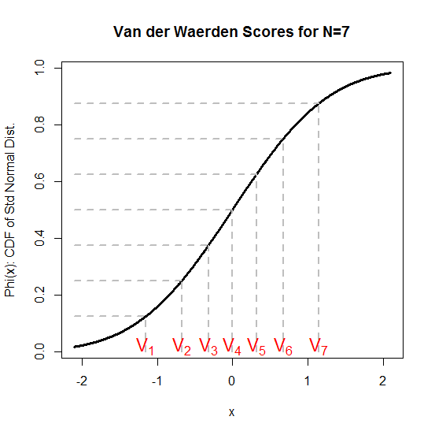

Van der Waerden Scores
In R, could use the following (but would then still need to assign each value to the correct score):

Slide 14
Scores (cont)
Exponential scores: use expected values for exponential(1)’s order statistics
E₍₁₎= 1/N
E₍₂₎= 1/N + 1/(N-1)
E₍₃₎= 1/N + 1/(N-1) + 1/(N-2)
etc.
Savage scores= E_{(k)} -1 (Exponential scores minus 1)
Exponential scores add up to N, while Savage scores add up to 0.

Slide 15
Scores (cont)
What if ties are present?
Average the scores for the tied values (as before)
Then, conduct the permutation test as before
permTS can be used if you supply the scores rather than the raw data values for the function’s arguments

Slide 16
Tests Using Various Scores
/* Van der Waerden scores */
proc npar1way data=birthwt vw;
class smoke;
exact /seed=189791 n=10000 ;
var bwt;
run;

Slide 17
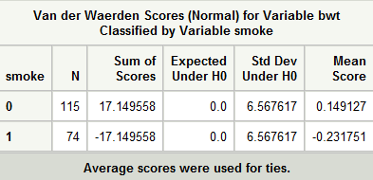
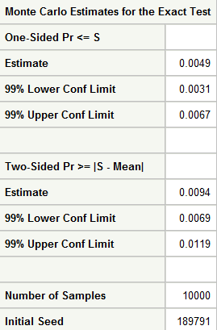
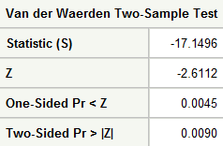

Slide 18
Savage Scores
/* Savage Scores */
proc npar1way data=birthwt savage;
class smoke;
exact /seed=189791 n=10000 ;
var bwt;
run;

Slide 19
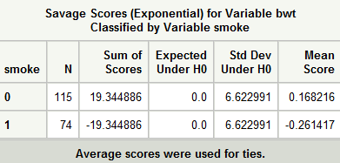
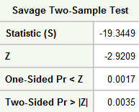

Slide 20
Testing Equality of Scale
If Xi (Yj) is an observation from Population A (B), then assume
X_{i}=μ + σ_{A}ε_{Ai}
Y_{j}=μ + σ_{B}ε_{Bj}
where all ε’s come from a common distribution (whether from Population A or from Population B).
Distribution of Xi is same as distribution of Yj if and only if σ_{A}=σ_{B}
How could we test whether or not the scale (spread) differs?

Slide 21
Siegel-Tukey Test
Guiding principle: a population with more spread will tend to have values farther from the center.
In some sense, we could rank how far a value is from the “middle”
Siegel-Tukey Procedure:
1) Sort the combined data
2) Assigns ranks by numbering in the following sequence: lowest overall=1, highest overall=2, 2nd highest overall=3, 2nd lowest overall=4, 3rd lowest overall=5, etc.
That is, you alternate counting in from the lowest end and the highest end.
3) Use the Wilcoxon rank sum test where the ranks are as given by (2).

Slide 22
Example of Siegel-Tukey Test
/* Siegel-Tukey Test */
proc npar1way data=birthwt st;
class smoke;
exact /seed=189791 n=10000 ;
var bwt;
run;

Slide 23
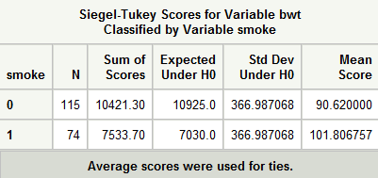
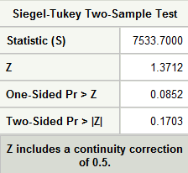
What is being tested? What is the conclusion?

Slide 24
Ansari-Bradley Test
Like the Siegel-Tukey test, but computes two sets of rankings:
The same ranking as in the ST test, and
The ranking obtained when alternating from high to low (not low to high)
The two sets are averaged.
The Wilcoxon Test is performed
I recommend using SAS Proc npar1way to conduct the Ansari-Bradley or Siegel-Tukey tests.

Slide 25
Ansari-Bradley Test in SAS
/* Ansari-Bradley Test */
proc npar1way data=birthwt ab;
class smoke;
exact /seed=189791 n=10000 ;
var bwt;
run;

Slide 26
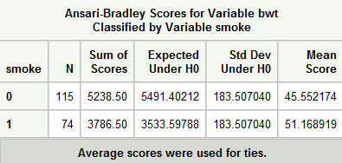
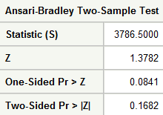
Compare with the Siegel-Tukey Test. →
Why is there a (small) difference?

Slide 27
Ratio of Mean Deviances (RMD) Test of Scale
Both the ST and the AB test assume a common median
What if this is not the case?
Higgins (2004) presents a test that is reasonable whether or not the medians of each population are the same.
Two versions of the test: one if medians are known, the other if not
My opinion? Use the latter
See the next slide

Slide 28
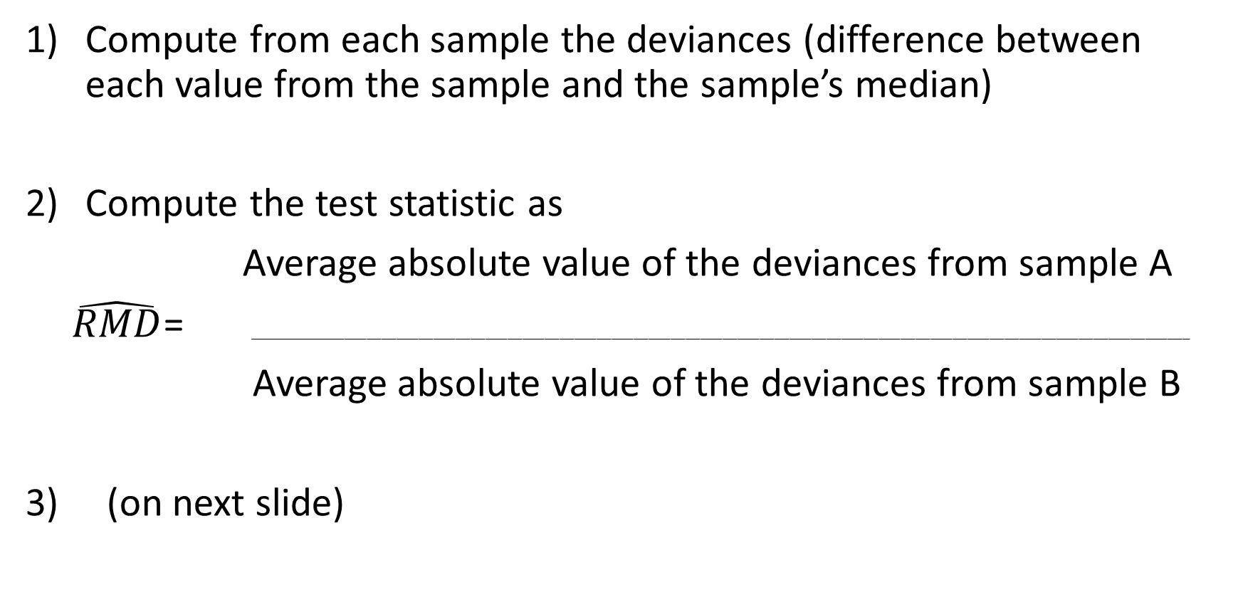
RMD Test if population medians unknown
Compute from each sample the deviances (difference between each value from the sample and the sample’s median)
Compute the test statistic as
Average absolute value of the deviances from sample A
$\hat{RMD}$= _______________________________________________________________________________________________________________________________
Average absolute value of the deviances from sample B
3) (on next slide)

Slide 29
RMD Test (cont)
3) Permute the deviances, recompute the test statistic, and use the distribution of these permutation-based test statistics to get the p-value
* One-sided p-value (if H_{a} is that Population A has more spread):
Pr(permuted RMD ≥ observed RMD)
* Two-sided: for each RMD value, use RMD*= max(RMD, 1/RMD) then
Pr(permuted RMD* ≥ observed RMD*)

Slide 30

R Function to Compute RMD Test
It appears that this test might not be standard, so you might not find it implemented in SAS or R.
I wrote a function (RMD.test) to implement it in R
Compare the answer below to Example 2.8.2

Slide 31

RMD Test applied to Birth Weight Data

Slide 32
Kolmogorov-Smirnov Test
Omnibus Test: H₀: F_{A}(x)=F_{B}(X); H_{A}: F_{A}(x) ≠ F_{B}(x) (though it is possible to have a one-sided test)
Test is based on the maximum discrepancy between the empirical cdfs from each sample.
The larger the difference, the smaller the p-value
Use the ks.test function in R

Slide 33
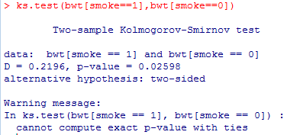

Slide 34
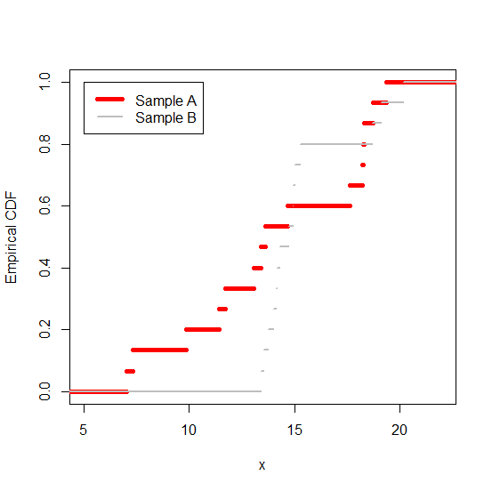
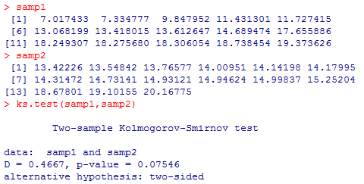
Kolmogorov-Smirnov Test Example Note that at x=13.420, one empirical cdf is 7/15 and the other is 0/15; absolute value of the deviation is 7/15=.4667

Slide 35
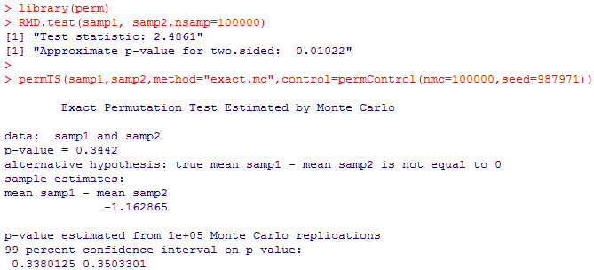
Which Test Should Be Used? Previous slide showed KS test; Consider two others possibilities

Slide 36
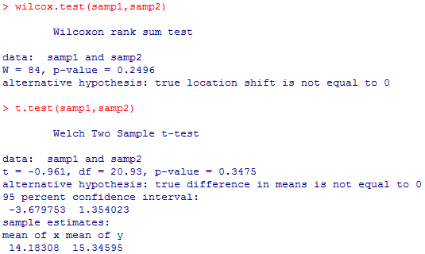
And two other possibilities …

Slide 37
Why are there such different p-values?
Consider what each test focuses on.
RMD: differences in scale for deviations (e.g., variances)
t.test, Wilcoxon rank sum, permutation test: differences in location (e.g., means)
KS: Any kind of difference in distributions (shape, location, scale,…)
The sample data were simulated from two distributions with the same mean, but very different scales and also slightly different shapes (Normal vs. t_{df=4})

Slide 38
Review
What tests have we discussed so far?
For each one, what are the null and alternative hypotheses?
When should the test be especially useful?

Slide 39
In-Class Assignment
Part a) Again use the birthwt dataset, but now focus on comparing birth weights for babies born to mothers with a history of hypertension (ht=1) versus birth weights for babies born to mothers without a history of hypertension (ht=0)
Part b), Now compare the birth weights based on whether ui=1 (presence of uterine irritability) versus ui=0 (absence of uterine irritability).

Slide 40
Power of a test: The probability of obtaining a test statistic that is statistically significant.
What does this depend on?
*The truth: the farther the truth is from what the null hypothesis claims (in the direction of the alternative hypothesis), the higher the power should be.
* Sample size: bigger samples should make it easier to find evidence that H0 is wrong (if it is wrong)
* Variability in the population(s): the more variability there are in individual data values, the greater the standard error of the test statistic
* The significance level alpha used: the higher it is, the easier it is to get a statistically significant result
* Properties of the test itself: how well can it detect problems with H0?

Slide 41
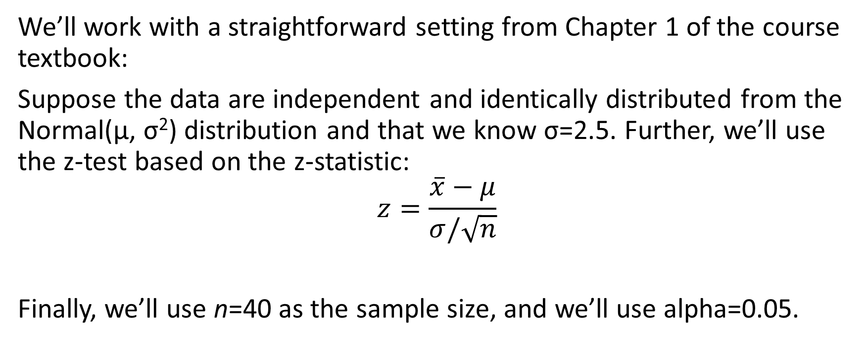
Consider testing H₀: µ=75 vs. H_{a}: µ>75
We’ll work with a straightforward setting from Chapter 1 of the course textbook:
Suppose the data are independent and identically distributed from the Normal(µ, σ²) distribution and that we know σ=2.5. Further, we’ll use the z-test based on the z-statistic:
$$z=\frac{\overline{x}−μ}{σ/\sqrt{n}}$$
Finally, we’ll use n=40 as the sample size, and we’ll use alpha=0.05.

Slide 42
Reminder: Homework 1 Due Friday, June 10th):
Chapter 1 Exercises: 3, 5, and 6
Chapter 2 Exercises: 4, 5, 6, including the additions below:
For question 4 a, also show by hand how the permutation test statistic was calculated
For question 4 b, also show by hand how the Wilcoxon rank-sum statistic was calculated.

