Slide 1

Nonparametrics: Chapter 3: K-sample Methods
Notes prepared by Bradley Barney for STAT 7900 Special Topics: Nonparametrics.
Notes are based somewhat on Chapter 3 of the required course textbook.
Higgins, James J. (2004). Introduction to Modern
Nonparametric Statistics. Thomson/Brooks Cole:
Pacific Grove, CA.
Do not redistribute these notes in any form whatsoever. Any mistakes should be assumed to be my own.

Slide 2
Lecture 3 Concepts
Alternate Scoring Methods
Tests of Scale Differences
Omnibus Test
Example SAS, R Code
Power

Slide 3
Chapter 3 Outline
K-Sample Permutation Tests (Section 3.1)
Kruskal-Wallis Test (Section 3.2)
Multiple Comparison (Section 3.3)
Ordered Alternatives (Section 3.4)

Slide 4
K-Sample Permutation Tests
Hypotheses:
H₀: Each population has the same distribution; F₁(x)=F₂(x)=…=F_{k}(x)
Ha: At least one population stochastically dominates at least one other population; F_{i}(x)≤F_{j}(x) or F_{i}(x) ≥F_{j}(x), with a strict inequality at least somewhere, for at least one (i,j) pair
Is the alternative hypothesis consistent with a location shift in one population?
Is the alternative hypothesis consistent with a scale shift in one population?

Slide 5
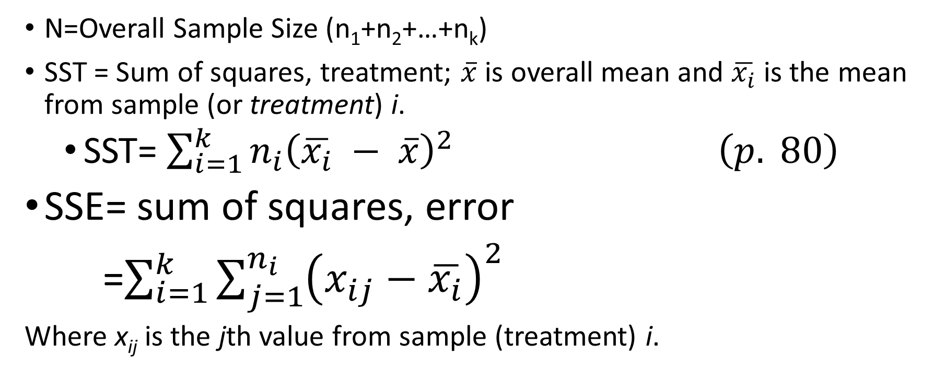
Notation
N=Overall Sample Size (n₁+n₂+…+n_{k})
SST = Sum of squares, treatment; $\overline{x}$ is overall mean and $\overline{x_{i}}$ is the mean from sample (or treatment) i.
SST= $\sum_{i=1}^{k}{n_{i}{\left(\overline{x_{i}} − \overline{x}\right)}^{2}} \left(p. 80\right)$
SSE= sum of squares, error
=$\sum_{i=1}^{k}{\sum_{j=1}^{n_{i}}{{\left(x_{ij}−\overline{x_{i}}\right)}^{2}}}$
Where x_{ij} is the jth value from sample (treatment) i.

Slide 6
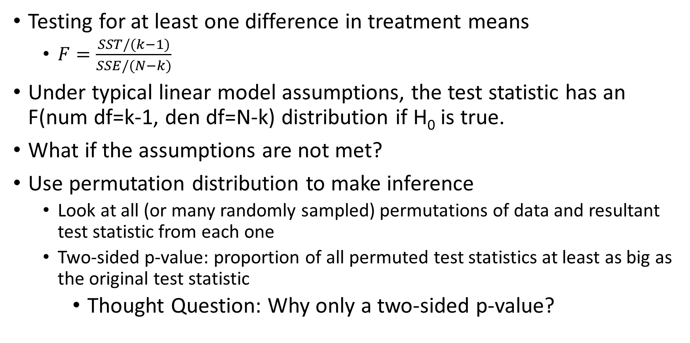
ANOVA F statistic
Testing for at least one difference in treatment means
$F=\frac{SST/(k−1)}{SSE/(N−k)}$
Under typical linear model assumptions, the test statistic has an F(num df=k-1, den df=N-k) distribution if H₀ is true.
What if the assumptions are not met?
Use permutation distribution to make inference
Look at all (or many randomly sampled) permutations of data and resultant test statistic from each one
Two-sided p-value: proportion of all permuted test statistics at least as big as the original test statistic
Thought Question: Why only a two-sided p-value?

Slide 7
When to use Permutation Distribution of F statistic
What if assumptions for standard ANOVA are met?
What if they are not met?
What if there are outliers?

Slide 8
Permutation Distribution of F Statistic
Implementation in Chapter3.R file
Easy way: permKS function (from perm package)
Pedagogical way: using sample function to illustrate permutation methodology

Slide 9
Iris data
Famous data set used in statistics
Collected by Edgar Anderson
Available as dataset iris in base R
Has several variables: we’ll focus on comparing the petal width (Petal.Width) by Species (setosa, versicolor, and virginica)

Slide 10
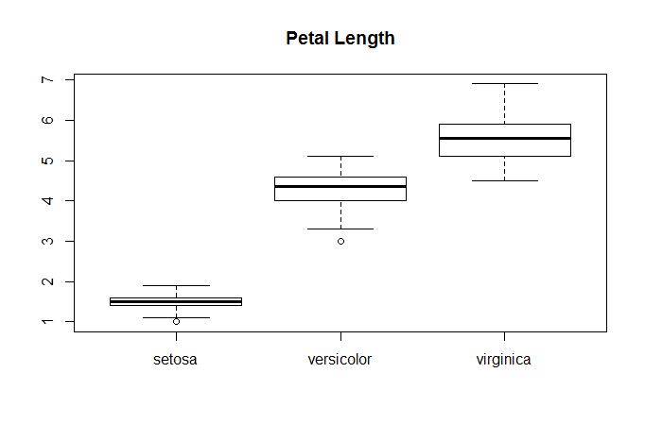
ANOVA assumptions met?
Recommended test?

Slide 11

Standard ANOVA results

Slide 12
Permutation Test
Four steps (see Higgins 2004, p. 81)
(1) Compute the F-statistic
For each of a large number of replications,
(2) Permute the data
(3) Compute the F-statistic for the permuted data (F-star)
(4) Compute the (two-sided) p-value as the proportion of the replications where the F-star was at least as big as the value from step 1.

Slide 13
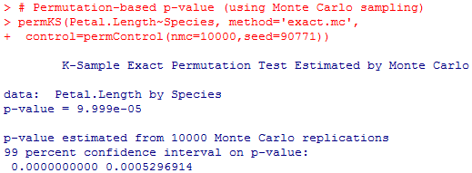
P-value for permutation test on Iris data ≈ 0
In my version of the permutation test, 0 of 10000 random sampled permutations had F statistic that was at least as extreme as the observed F statistic. An approximate P-value is (0+1)/(10000+1), or 9.999e-.05 < .0001; the textbook would have computed as 0/10000=0.
Using permKS with Monte Carlo approximation, p-value is

Slide 14
F-statistic permutation test
Has approximate F distribution if all sample sizes large enough
Could also be rescaled to have approximate chi-square distribution if all sample sizes large enough

Slide 15
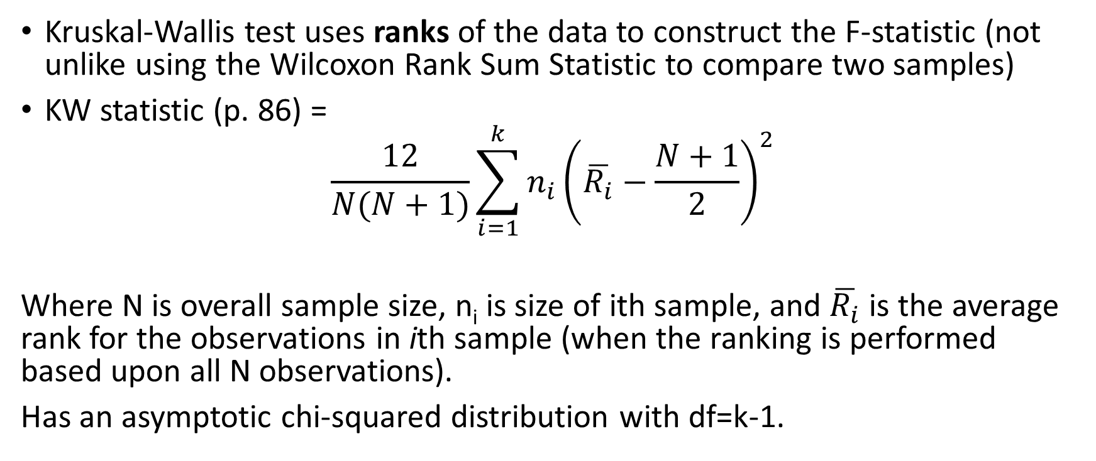
An alternative (if no ties)
Kruskal-Wallis test uses ranks of the data to construct the F-statistic (not unlike using the Wilcoxon Rank Sum Statistic to compare two samples)
KW statistic (p. 86) =
$$\frac{12}{N(N+1)}\sum_{i=1}^{k}{n_{i}{\left(\overline{R_{i}}−\frac{N+1}{2}\right)}^{2}}$$
Where N is overall sample size, n_{i} is size of ith sample, and $\overline{R_{i}}$ is the average rank for the observations in ith sample (when the ranking is performed based upon all N observations).
Has an asymptotic chi-squared distribution with df=k-1.

Slide 16
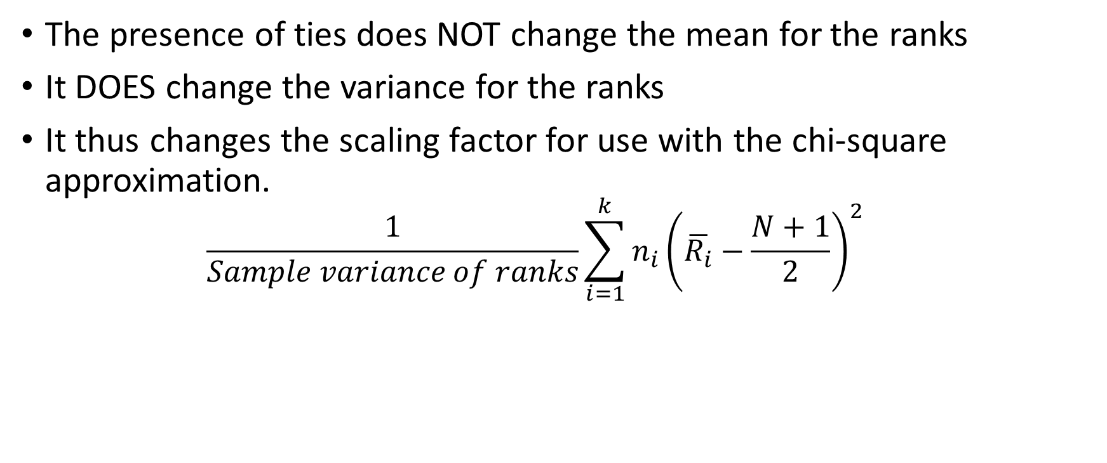
KW test with ties
The presence of ties does NOT change the mean for the ranks
It DOES change the variance for the ranks
It thus changes the scaling factor for use with the chi-square approximation.
$$\frac{1}{Sample variance of ranks}\sum_{i=1}^{k}{n_{i}{\left(\overline{R_{i}}−\frac{N+1}{2}\right)}^{2}}$$

Slide 17
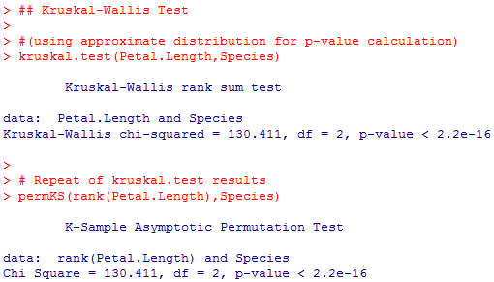
Implementation of KW Test in R (using chi-squared approximation)

Slide 18
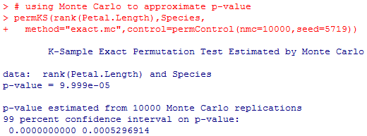
KW test using Monte Carlo-estimated p-value

Slide 19
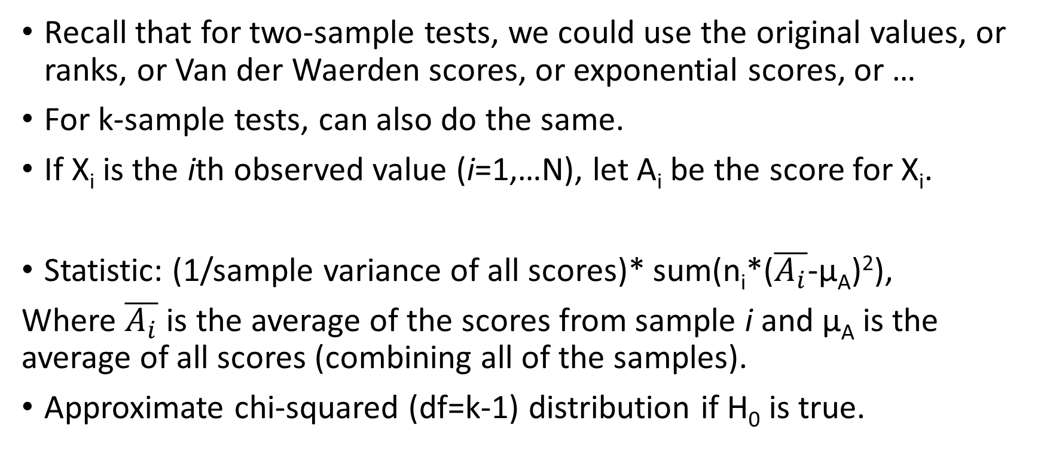
Scores (p. 91)
Recall that for two-sample tests, we could use the original values, or ranks, or Van der Waerden scores, or exponential scores, or …
For k-sample tests, can also do the same.
If X_{i} is the ith observed value (i=1,…N), let A_{i} be the score for X_{i}.
Statistic: (1/sample variance of all scores)* sum(n_{i}*($\overline{A_{i}}$-µ_{A})²),
Where $\overline{A_{i}}$ is the average of the scores from sample i and µ_{A} is the average of all scores (combining all of the samples).
Approximate chi-squared (df=k-1) distribution if H₀ is true.

Slide 20
In-Class Practice
(Based on Exercises 2,3 in Chapter 3):
The data set vehicle.csv contains “the left femur loads on driver-side crash dummies for automobiles in various weight classes” (p. 105).
Considering the data, what are the null and alternative hypotheses to be tested?
Apply ANOVA F-test, permutation F-test, and Kruskal-Wallis test to the data.
Compare the conclusions from each way of conducting the test.
Which of the three tests do you prefer in this instance, and why?

Slide 21
Problem with Multiple Comparisons
In a two-sample test, only one comparison needs to be made: sample 1 vs. sample 2 (to infer about population 1 vs. population 2)
With a k-sample test, might “drill down” to ascertain which populations differ
Pairwise comparisons of sample i and sample j are more abundant:
k*(k-1)/2 distinct pairings
The more tests performed, the greater the potential for false positives (spurious claims that the pair of populations differ)

Slide 22
Three adjustments
Bonferroni Correction: Perform each pairwise test at significance level =α/[k(k-1)/2] to have experimentwise-error rate (rate of at least one false positive) no more than α.
Fisher’s Protected Least Significant Difference (LSD): First perform global test (e.g., k-sample permutation test of F statistic) using sig. level of α. If rejected, perform each pairwise test (again at sig. level= α). If not rejected, don’t conduct any pairwise tests.

Slide 23
Three adjustments (cont)
Tukey’s Honest Significant Difference (HSD), as generalized by Tukey-Kramer (and assuming normality of each population):
Each pairwise test is considered indicative of a statistically significant difference if absolute value of difference in sample means is at least
q(α,k df=N-k)*sqrt((MSE/2) * (1/n_{i}+1/n_{j}))
Note that the q(α,k,N-k) value for some possibilities is contained in Table A8.
In SAS, compute this q(α,k,df) value as
Probmc(“RANGE”,., 1-α,df, k); (see Higgins 2004, p. 345)

Slide 24
Three adjustments as applied to permutation tests
Bonferroni: to conduct each pairwise test at α/[k(k-1)/2], use the two-sample permutation test
LSD: first do k-sample permutation test at α. Then if and only if rejected, do each pairwise test by: (1) sampling n_{i} and n_{j} values from the overall (all samples together) vector and computing T_{ij} (a test statistic for comparing two means) from each such permutation; (2) Determine 100*(1-α) percentile of |T_{ij}| from the permutations; (3) Declare population i to differ from population j if
abs(T_{ij} for observed data)
is at least as large as this percentile.

Slide 25
Three adjustments as applied to permutation tests (cont)
HSD (if equal sample sizes): (1) Perform permutations for the overall data set to be split into the k samples, and for each permutation determine Q*= maximum of abs(T_{ij}) for all resulting two-sample test statistics; (2) Identify the 100*(1-α) percentile of Q’s permutation distribution—i and j said to differ if |T_{ij}| is at least as large as this percentile
If unequal sample sizes, use
T_{ij}= (Xbar_{i}-Xbar_{j})/sqrt(MSE*(1/n_{i}+1/n_{j}))

Slide 26
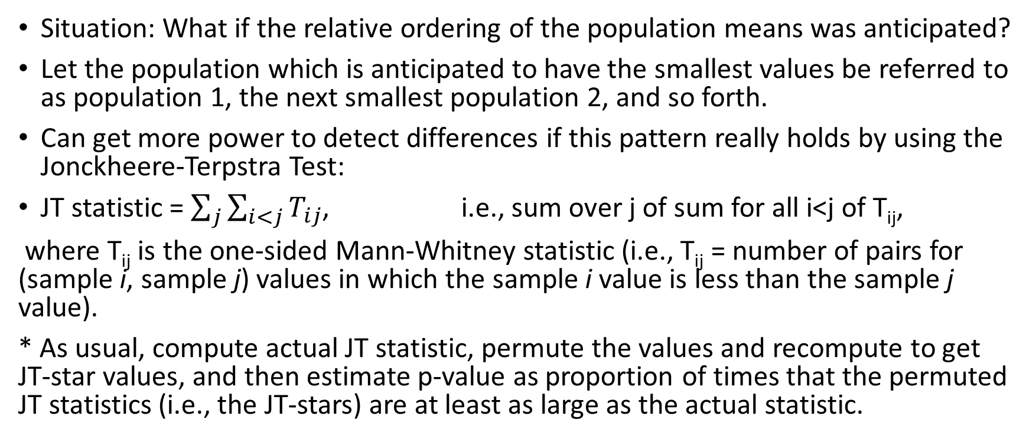
Ordered Alternatives
Situation: What if the relative ordering of the population means was anticipated?
Let the population which is anticipated to have the smallest values be referred to as population 1, the next smallest population 2, and so forth.
Can get more power to detect differences if this pattern really holds by using the Jonckheere-Terpstra Test:
JT statistic = $\sum_{j}{\sum_{i<j}{T_{ij}}}$, i.e., sum over j of sum for all i<j of T_{ij},
where T_{ij} is the one-sided Mann-Whitney statistic (i.e., T_{ij} = number of pairs for (sample i, sample j) values in which the sample i value is less than the sample j value).
* As usual, compute actual JT statistic, permute the values and recompute to get JT-star values, and then estimate p-value as proportion of times that the permuted JT statistics (i.e., the JT-stars) are at least as large as the actual statistic.

Slide 27
In-class Assignment, part 2
Using the same data as for the in-class assignment part 1, do the following:
Use the permutation Bonferroni procedure to look for pairwise differences that are statistically significant at alpha=.05
Use the permutation LSD procedure, again with alpha=.05
Use the permutation HSD procedure, again with alpha=.05
Conduct the Jonckheere-Terpstra test, again with alpha=.05, where it is assumed that increased weight should lead to increased values of the response variable (left femur loads)

