Slide 1

Nonparametrics: Chapter 4: Paired Comparisons and Blocked Designs
Notes prepared by Bradley Barney for STAT 7900 Special Topics: Nonparametrics.
Notes are based somewhat on Chapter 4 of the required course textbook.
Higgins, James J. (2004). Introduction to Modern
Nonparametric Statistics. Thomson/Brooks Cole:
Pacific Grove, CA.
Do not redistribute these notes in any form whatsoever. Any mistakes should be assumed to be my own.

Slide 2
Lecture 4 Concepts
K-Sample Permutation Tests (Section 3.1)
Kruskal-Wallis Test (Section 3.2)
Multiple Comparison (Section 3.3)
Ordered Alternatives (Section 3.4)

Slide 3
Exciting News
The following website (for a course taught by Chris Williams using the same course text as we adopted) is a valuable resource:
www.webpages.uidaho.edu/~chrisw/stat514/lect514y10.htm
It contains many R and SAS implementations of textbook examples.
We’ll make some use of these code examples during class.

Slide 4
Chapter 4 Outline
Paired Comparisons via Permutation (Section 4.1)
Wilcoxon Signed Rank Test (Section 4.2)
Sign Test (Section 4.3)
Randomized Complete Block Test via Permutations (Section 4.4)
RCB Test via Friedman’s Test (and special cases; Section 4.5)
Page’s Test (Section 4.6.1)

Slide 5
Multi-sample methods already discussed
Compared two (Chapter 2) or more (Chapter 3) populations where responses were considered to be independent between populations
What if they are not?
For example, a study on the effects of exercise might compare subject’s resting heart rates before and after embarking on a detailed fitness regimen for 90 days.

Slide 6
(Fictional) data on Resting Heart Rate (RHR)
Subject | RHR before fitness program | RHR after 90 days on program
Chris | 65 | 62
Claire | 73 | 67
Carlos | 58 | 62
Christian | 83 | 75
Carmelo | 58 | 58
Catarina | 62 | 61
Cara | 78 | 63

Slide 7
How to Analyze?
Parametric Technique:
Paired t-test
Statistic (given in class):
Two-sided P-value: Pr(T > |observed statistic|)
Under certain assumptions, p-value may be obtained using t distribution with df=n-1
Assumptions: differences have a normal distribution; differences are independent from one person to the next; differences are identically distributed

Slide 8
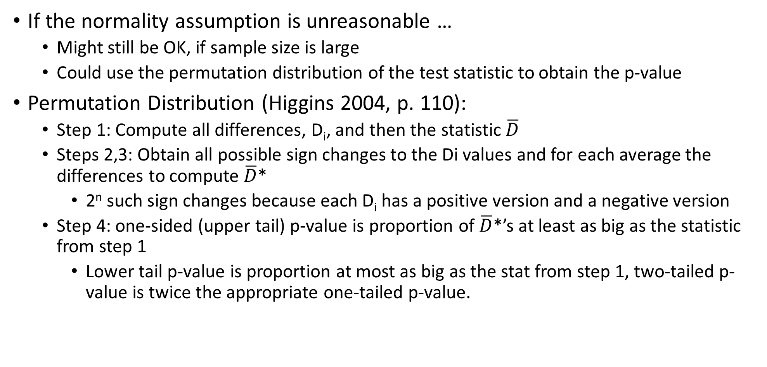
Permutation Test
If the normality assumption is unreasonable …
Might still be OK, if sample size is large
Could use the permutation distribution of the test statistic to obtain the p-value
Permutation Distribution (Higgins 2004, p. 110):
Step 1: Compute all differences, D_{i}, and then the statistic $\overline{D}$
Steps 2,3: Obtain all possible sign changes to the Di values and for each average the differences to compute $\overline{D}$*
2^{n} such sign changes because each D_{i} has a positive version and a negative version
Step 4: one-sided (upper tail) p-value is proportion of $\overline{D}$*’s at least as big as the statistic from step 1
Lower tail p-value is proportion at most as big as the stat from step 1, two-tailed p-value is twice the appropriate one-tailed p-value.

Slide 9
Hypotheses (p. 112)
Null hypothesis: distribution of differences is symmetric around 0
F(x)= 1-F(-x), because Pr(X≤x) = Pr(X≥-x) if X has a symmetric distribution around 0
Alternative hypothesis: Differences tend to be above/below/different from 0 (for upper/lower/two-sided alternatives)
Upper: F(x) ≤ 1-F(-x)
Lower: F(x) ≥ 1-F(-x)
Two-sided: {either F(x) ≤ 1-F(-x) or F(x) ≥ 1-F(-x) }
In each case there must be at least one x having a strict inequality

Slide 10
(Fictional) data on Resting Heart Rate (RHR)
Subject | RHR before | RHR after | Difference
Chris | 65 | 62
Claire | 73 | 67
Carlos | 58 | 62
Christian | 83 | 75
Carmelo | 58 | 58
Catarina | 62 | 61
Cara | 78 | 63

Slide 11
Together, we will
Input the differences into R
Compute the mean difference
Obtain the permutation distribution of the average difference, where permutations result from either changing or not changing the sign of each individual difference (We’ll use Monte Carlo for ease of coding, but it is feasible to use complete enumeration.)
Compute each one-sided p-value and the two-sided p-value

Slide 12
Could equivalently base test on the sum of the differences for those differences that: when the sign is permuted have a positive value
Likewise, could base on the sum of the differences that when the sign is permuted are negative.
What if a value is 0?
The sign will not matter, so the value can be completely ignored for the permutation test.

Slide 13
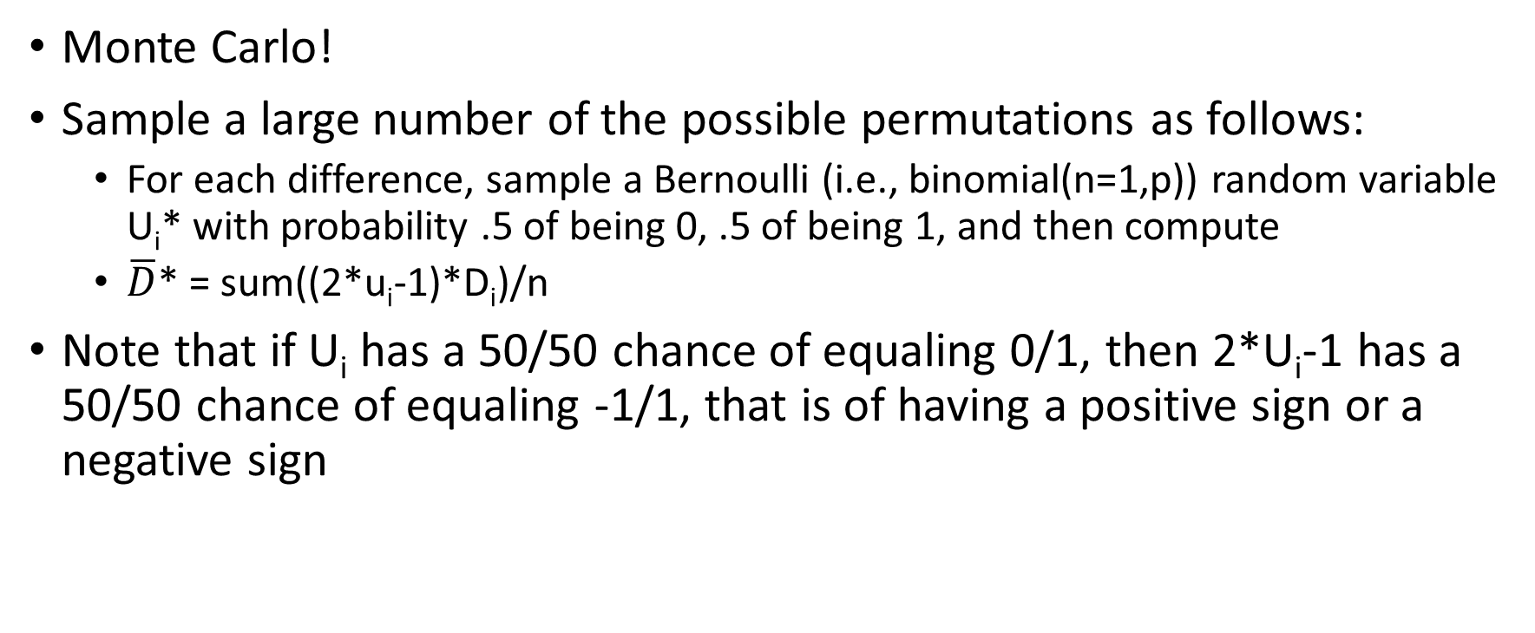
What if there are too many permutations of the signs?
Monte Carlo!
Sample a large number of the possible permutations as follows:
For each difference, sample a Bernoulli (i.e., binomial(n=1,p)) random variable U_{i}* with probability .5 of being 0, .5 of being 1, and then compute
$\overline{D}$* = sum((2*u_{i}-1)*D_{i})/n
Note that if U_{i} has a 50/50 chance of equaling 0/1, then 2*U_{i}-1 has a 50/50 chance of equaling -1/1, that is of having a positive sign or a negative sign

Slide 14
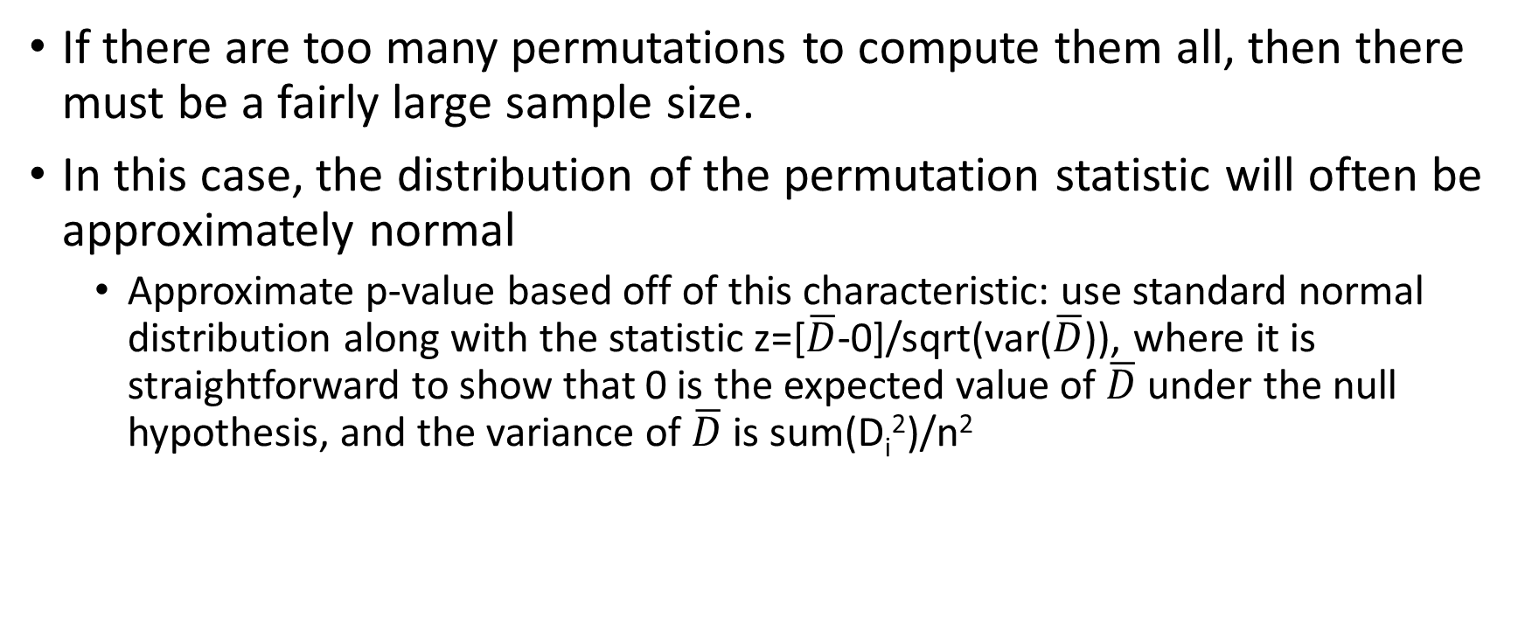
Another alternative
If there are too many permutations to compute them all, then there must be a fairly large sample size.
In this case, the distribution of the permutation statistic will often be approximately normal
Approximate p-value based off of this characteristic: use standard normal distribution along with the statistic z=[$\overline{D}$-0]/sqrt(var($\overline{D}$)), where it is straightforward to show that 0 is the expected value of $\overline{D}$ under the null hypothesis, and the variance of $\overline{D}$ is sum(D_{i}²)/n²

Slide 15
In-class exercise:
Plot the differences for the heart rate data in such a manner that will allow you to assess the appropriateness of using the paired t-test or the permutation t-test
Test the one-sided alternative hypothesis that the differences (post-pre) tend to be negative using the paired t-test.
Hint: type ?t.test into R and read about this function
Compare with the test of the one-sided alternative using the permutation test

Slide 16
Can perform a one-sample test on median by using a permutation test of the differences, where the differences are defined as x_{i}-null value of median

Slide 17
Wilcoxon Signed-Rank Test
Possible for outliers to be problematic in the paired t-test (with or without using permutation distribution to get the p-value)
Can mitigate this possibility by using ranks instead of the original values
Ranking is made as follows:
Take the absolute value of each difference
Assign the ranks
Use the sign of the original difference on the rank
Statistic is the sum of the signed ranks

Slide 18
Subject | RHR before | RHR after | Diff. | Rank | Signed Rank
Chris | 65 | 62
Claire | 73 | 67
Carlos | 58 | 62
Christian | 83 | 75
Carmelo | 58 | 58
Catarina | 62 | 61
Cara | 78 | 63
Wilcoxon Signed Rank statistic (including 0’s):

Slide 19
Subject | RHR before | RHR after | Diff. | Rank | Signed Rank
Chris | 65 | 62
Claire | 73 | 67
Carlos | 58 | 62
Christian | 83 | 75
Carmelo | 58 | 58
Catarina | 62 | 61
Cara | 78 | 63
Wilcoxon Signed Rank statistic (excluding 0’s):

Slide 20
Wilcoxon Signed Rank Test P-value
Can use complete enumeration (if small number of differences), Monte Carlo, or normal approximation (if large number of differences).
Details for normal approximation in the textbook.

Slide 21
wilcox.test in R can conduct Wilcoxon signed rank test by using paired=TRUE
In SAS, compute the differences and then use proc univariate on the differences (see page 1 of publichealth.lsuhsc.edu/Faculty_pages/BIOS6222/Lectures/lecture03_sas.pdf )

Slide 22
Sign Test
Not unlike the test for the median.
Each difference is categorized as either positive or negative.
Without differences of 0, the number of positive values under the null hypothesis has a binomial(n, p=.5) distribution
Use this distribution to compute p-values.
What if there are differences of 0? Ignore these difference (reduces the sample size)

Slide 23
Subject | RHR before | RHR after | Diff. | Sign of Difference
Chris | 65 | 62
Claire | 73 | 67
Carlos | 58 | 62
Christian | 83 | 75
Carmelo | 58 | 58
Catarina | 62 | 61
Cara | 78 | 63
Sign test statistic: p-value for upper tail test:

Slide 24
Comparison
When would the paired t-test be best?
When should the permutation test on the average difference be considered?
The Wilcoxon Signed Rank Test?
The Sign Test?

Slide 25
In-class Exercise
(Based off of Exercises 2, 5, and 6 in Higgins 2004, p. 142)
The data set stats_importance.csv contains the before and after ratings of how much each student agreed that “statistics is important to my major area of study” on a 1-5 scale (1=strongly disagree; 5=strongly agree).
Test if the ratings tended to increase from before until after the course was completed using the paired t-test, permutation test, Wilcoxon signed rank test, and sign test.
Comment on which of the tests you feel is most appropriate for these data.

Slide 26
What if there are more than two sets of dependent measurements?
Farming Example:
Different fields in the farm could have considerable variability in level of nutrients, pests, exposure, etc.
If you want to compare multiple fertilizers for their effect on crop yield, it won’t do to give some fields fertilizer A, other fields fertilizer B, and the remainder fertilizer C
It is advantageous to apply each fertilizer to one third of each field.
“averages out” the field effect
In analysis, include the field as a block effect

Slide 27
Experimental Design Approach to Analysis
Fit the model y_{ij}=μ+ treatment_{i} + block_{j} + ε_{ij}
With y_{ij} denoting the yield in the portion of block (plot) j that was given treatment i, μ the “overall average”, treatment_{i} the main effect of receiving fertilizer i, block_{j} the effect of plot j, and ε_{ij} representing the experimental error (or “pure error”).
i goes from 1,2,…,k and j goes from 1,2,…,b.
Assumed that block effects, pure error all mutually independent with mean 0. Var(ε_{ij})=σ². And if the error terms are assumed to be normally distributed, the F statistic defined on next page has an F distribution with numerator df=k-1 and denominator df=(k-1)*(b-1) if the null hypothesis of no treatment effect is true.

Slide 28
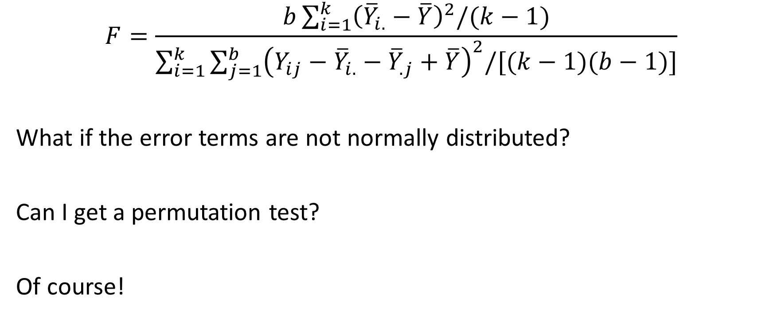
F statistic for Randomized Complete Block Design (RCBD)
$$F=\frac{b\sum_{i=1}^{k}{{\left({\overline{Y}}_{i.}−\overline{Y}\right)}^{2}/(k−1)}}{\sum_{i=1}^{k}{\sum_{j=1}^{b}{{\left(Y_{ij}−{\overline{Y}}_{i.}−{\overline{Y}}_{.j}+\overline{Y}\right)}^{2}/[(k−1)(b−1)]}}}$$
What if the error terms are not normally distributed?
Can I get a permutation test?
Of course!

Slide 29
Permutation Test for RCBD
Step 1: Determine the F statistic for the observed data
Steps 2,3: permute INSIDE of the blocks (but NOT BETWEEN blocks) and for each permutation compute the F* value.
Step 4: 2-sided p-value is proportion of F* values that are at least as large as the observed F statistic from Step 1

Slide 30
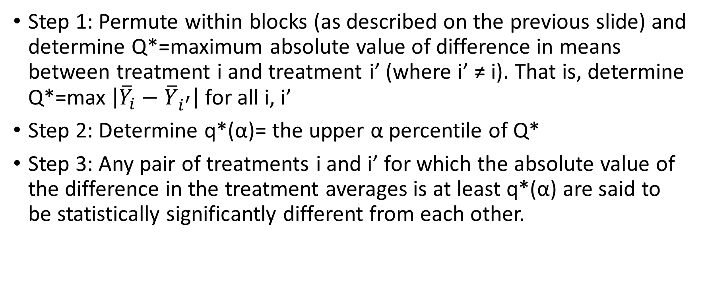
Can Look at Pairwise Comparisons using the HSD procedure, as described on pp. 130-131.
Step 1: Permute within blocks (as described on the previous slide) and determine Q*=maximum absolute value of difference in means between treatment i and treatment i’ (where i’ ≠ i). That is, determine Q*=max $\left|{\overline{Y}}_{i}−{\overline{Y}}_{i^{′}}\right|$ for all i, i’
Step 2: Determine q*(α)= the upper α percentile of Q*
Step 3: Any pair of treatments i and i’ for which the absolute value of the difference in the treatment averages is at least q*(α) are said to be statistically significantly different from each other.

Slide 31
But is there a rank analogue to this?
Of course!
Friedman’s Test modifies the RCBD permutation test procedure by using ranks in place of the original values for the construction of the F statistic.
Very important: The ranking is done within each block (not overall).
It also uses a slightly different constant to normalize the statistic, so that it will have an approximate chi-squared distribution with df=k-1 if H₀ is true and the number of observations is sufficiently large.
Friedman’s statistic (with or without ties) may be written as given on page 134

Slide 32
Friedman’s Test in R
Use friedman.test function with the following inputs:
y= vector of all of the response values
groups= vector of all of the group memberships
blocks= vector of all of the block memberships
friedman.test(y=, groups=, blocks=)

Slide 33
Cochran’s Q, Kendall’s W
If responses are success (1) or failure (0) and then Friedman’s test (with ties) is applied, this is also termed Cochran’s Q test
If responses from multiple judges give ranks to participants, then testing if the participants have different average abilities (compared to the null hypothesis that they are all of the same ability) is equivalent to Kendall’s W test of concordance.

Slide 34
Ordered Alternatives
The Jonckheere-Terpstra test allows us to test an alternative hypothesis of a prespecified ordering of the k treatment’s CDF’s for k independent samples
Similarly, Page’s test let’s us do this for RCBD data
y_{ij}=μ+ treatment_{i} + block_{j} + ε_{ij}
H_{a} is either treatment₁ ≤ treatment₂ ≤ … ≤ treatment_{k}, or
Treatment₁ ≥ treatment₂ ≥ … ≥ treatment_{k}, with at least one strict inequality.

Slide 35
Page’s Test (cont)
Page’s statistic: sum of (i*R_{i}) for i=1,2,…,k,
where each R_{i} is the sum of the ranks for the treatment i observations (where again, the ranks are within each block, not the overall ranks).
Can get p-value using permutation distribution, or approximate p-value using large sample normality (see Higgins 2004, p. 139)
If treatment means get progressively larger, then Page statistic should be larger than expected under H₀;
If treatment means get smaller, Page statistic should be small.

Slide 36
In-class Practice (Chapter 4, Exercise 12)
“Three varieties of soybeans were tested for yields in a randomized complete block design. The varieties are known to have varying levels of susceptibility to iron deficiency. The data are average chlorosis scores based on a scale of 1 to 9, with 1 being the best plant condition and 9 the worst. Use an appropriate procedure to test for differences among the varieties.”
The data are given below
Variety | Block 1 | Block 2 | Block 3 | Block 4
Susceptible | 4.5 | 6.3 | 5.7 | 5.3
Moderately Resistant | 3.5 | 4.3 | 3.3 | 5.0
Resistant | 1.0 | 1.3 | 1.0 | 1.7

