Slide 1

Nonparametrics: Chapter 5: Tests for Trends and Associations
Notes prepared by Bradley Barney for STAT 7900 Special Topics: Nonparametrics.
Notes are based on Chapter 5 of the required course
textbook.
Higgins, James J. (2004). Introduction to Modern
Nonparametric Statistics. Thomson/Brooks Cole:
Pacific Grove, CA.
and on code provided by Chris Williams at www.webpages.uidaho.edu/~chrisw/stat514/lect514y10.htm
Do not redistribute these notes in any form whatsoever. Any mistakes should be assumed to be my own.

Slide 2
Chapter 5 Outline
Trends/Associations between Numeric Variables (Sections 5.1-5.3)
Relationships between Two Categorical Variables (Sections 5.4-5.8)
Nominal Variables
One or Both Ordinal
Multiple Strata (we’ll skip for this week)
Paired Data

Slide 3
Regression (STAT 8210 lives on!)
For now (chapter 5), we’ll consider simple case of one explanatory variable, one response variable
Simple linear regression model: y=β₀ + β₁x + ε
Emphasis is on the slope parameter
Often assume the errors are independent and identically distributed (iid), and also that they are normally distributed.
Also, we assume that the model is correctly specified--that is, E(Y|x)=β₀+β₁x.
So what could go wrong? More on this in a moment …

Slide 4
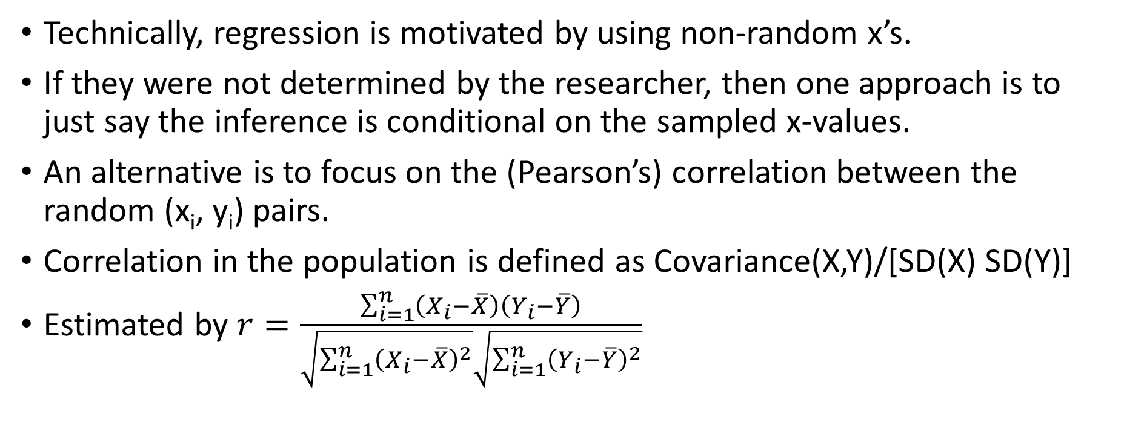
(Pearson’s) Correlation
Technically, regression is motivated by using non-random x’s.
If they were not determined by the researcher, then one approach is to just say the inference is conditional on the sampled x-values.
An alternative is to focus on the (Pearson’s) correlation between the random (x_{i}, y_{i}) pairs.
Correlation in the population is defined as Covariance(X,Y)/[SD(X) SD(Y)]
Estimated by $r=\frac{\sum_{i=1}^{n}{\left(X_{i}−\overline{X}\right)\left(Y_{i}−\overline{Y}\right)}}{\sqrt{\sum_{i=1}^{n}{{\left(X_{i}−\overline{X}\right)}^{2}}}\sqrt{\sum_{i=1}^{n}{{\left(Y_{i}−\overline{Y}\right)}^{2}}}}$

Slide 5
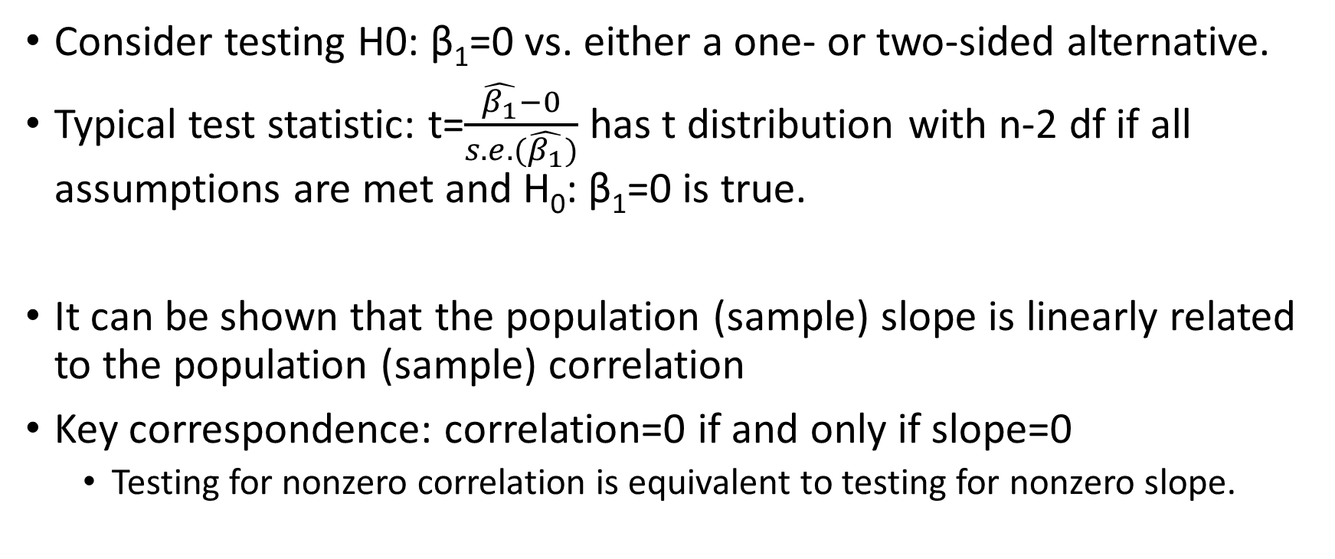
Inference on the Slope of the Regression Line
Consider testing H0: β₁=0 vs. either a one- or two-sided alternative.
Typical test statistic: t=$\frac{\hat{β_{1}}−0}{s.e.(\hat{β_{1}})}$ has t distribution with n-2 df if all assumptions are met and H₀: β₁=0 is true.
It can be shown that the population (sample) slope is linearly related to the population (sample) correlation
Key correspondence: correlation=0 if and only if slope=0
Testing for nonzero correlation is equivalent to testing for nonzero slope.

Slide 6
Alternate Inference on Slope
Can use the permutation distribution of the slope to make decisions
Permutations are made by “reshuffling” which y value goes with each x value.
Why does this make sense?
Under the null hypothesis, x and y are independent
Each y was equally likely to come from any given x if H₀ true.
Same permutation procedure conducted for inference on the correlation

Slide 7
Easy implementation in SAS
Example code at www.webpages.uidaho.edu/~chrisw/stat514/ch5permr1.sas
Key step: Use the Frequency Procedure (Proc Freq) with the tables statement for the crosstabulation of the x and y variables, and the following additional statement:
Exact pcorr;
(If that would create too many permutations, can use Monte Carlo)

Slide 8
Let’s practice …
Exercise 4 of Chapter 5 has the following height data from mother/daughter pairs (mother’s height first)
(70,67); (69,64); (65,62); (64,64); (66,69); (65,70);
(64,65); (66,66); (60,63); (70,74); (66,60).
Plot the data
Compute Pearson’s correlation and the slope of the regression line
Test Pearson’s correlation (or slope)

Slide 9
What if there is a general positive (or negative) association, but not a linear association?
Two alternative measures: Spearman’s correlation and Kendall’s tau.
Spearman’s Correlation: Use the rank of each X (among all X’s), the rank of each y (among all Y’s) as the data and then compute the regular (Pearson’s) correlation
Toy example: Suppose original data pairs are (1,1), (2,5), (8,5.2), (55,5.24), (100, 5.23)
Then the rank data pairs are (1,1), (2,2), (3,3), (4,5), (5,4)
To get permutation based p-value, use proc freq along with the extra statement: “exact scorr;” (see ch5spearman1.sas from previous website)

Slide 10
Another alternative: Kendall’s Tau
A pair of (x,y) observations (e.g., (x_{i},y_{i}) and (x_{j},y_{j})) is said to be
Concordant if the smaller x value is with the smaller y value
Discordant if the smaller x value is with the larger y value
Kendall’s tau is a measure of association based on the probability of a pair being concordant:
2*Pr(a pair is concordant)-1
(The multiplication by 2 and subtraction of 1 limits the range to (-1,1), with 0 representing no association)
Estimation of Kendall’s tau is (if no ties present):
2*(sample proportion of concordant pairs)-1

Slide 11
What if ties are present?
If x_{i}=x_{j} and/or y_{i}=y_{j}, then the pair can’t be considered concordant or discordant; it is in a sense neutral.
Higgins (2004), Section 5.3.3 uses the convention that in computing the sample proportion of concordant pairs, a pair of observations with the x’s and/or y’s tied is considered ½ concordant, ½ discordant.
Referred to as Kendall’s Tau-a
This does not appear to be the most common adjustment (SAS seems to prefer Tau-b, described at https://en.Wikipedia.org/wiki/Kendall_rank_correlation_coefficient)

Slide 12
Example calculation of Kendall’s Tau-A
Consider the following data:
(3, 4.7); (-12, 18); (6,18); (3,6); (6,25)
Number of distinct pairings: (5 choose 2)= 5*4/2 = 10
(pair 1 with pair 2, 1 with 3, 1 with 4, 1 with 5, 2 with 3, 2 with 4, 2 with 5, 3 with 4, 3 with 5, 4 with 5)
Pairs that are completely concordant:
Pairs that are completely discordant:
Pairs that are tied:
Kendall’s tau-A:

Slide 13
Computing Kendall’s Tau-b in SAS (based on code in ch5tau1.sas, ch5taudvd.sas)
Use “measures” option on proc freq tables statement
Could also use proc corr with the kendall option on the proc corr statement.
Example:
Data tauexample;
input x y @@;
Datalines;
3 4.7 -12 18 6 18 3 6 6 25
;
Proc corr data=tauexample kendall pearson spearman;
var x y;
Run;

Slide 14
R Code (based on RAssocMeasures1.txt)
Use the function cor.test (and its help file, accessed via ?cor.test)
Provide the vector of x values first, then the vector of y values
Has the alternative= option like many other R functions for hypothesis testing
Use the method= option with either “pearson”, “spearman”, or “kendall”
Use exact=TRUE for small enough sample sizes to get the exact p-value
Example:
cor.test(c(3,-12,6,3,6),c(4.7,18,18,6,25),method="kendall",exact=TRUE)
(but note the exact p-value won’t always be possible, such as if ties are present)

Slide 15
In-class Practice (cont)
Exercise 4 of Chapter 5 has the following height data from mother/daughter pairs (mother’s height first)
(70,67); (69,64); (65,62); (64,64); (66,69); (65,70);
(64,65); (66,66); (60,63); (70,74); (66,60).
Compute Spearman’s correlation, Kendall’s Tau-B
Test for statistical significance of Spearman’s correlation, Kendall’s Tau B
Discuss if Pearson’s, Spearman’s, and Kendall’s association measures are each suitable for these data.

Slide 16
More In-class Practice (cont)
For the data in chapter5xydata.csv, compare the following:
Strength of Pearson’s correlation
Strength of Spearman’s correlation
Strength of Kendall’s tau-b
Then try to fit a good regression model by transforming x and/or y, and reassess the strength of the correlation.

Slide 17
Relationships between Categorical Variables
Consider investigating two categorical variables for a possible relationship
Data often summarized in a (two-way) contingency table, such as the following fictional example:
 | Voted in 2014 | Did Not Vote in 2014 | Total
Democrat | 9 | 7 | 16
Independent | 1 | 3 | 4
Republican | 8 | 8 | 16
Total | 18 | 18 | 18

Slide 18
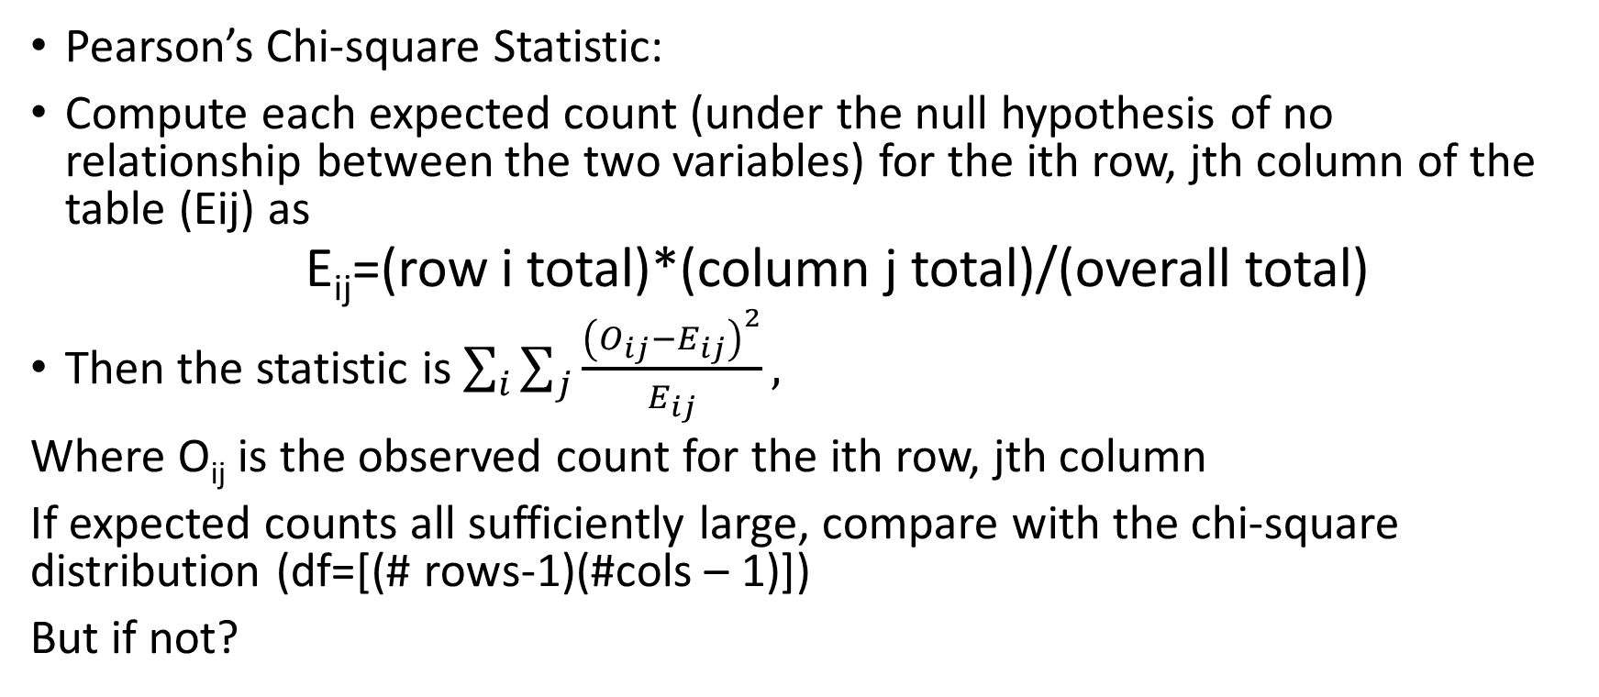
General Association:
Pearson’s Chi-square Statistic:
Compute each expected count (under the null hypothesis of no relationship between the two variables) for the ith row, jth column of the table (Eij) as
E_{ij}=(row i total)*(column j total)/(overall total)
Then the statistic is $\sum_{i}{\sum_{j}{\frac{{\left(O_{ij}−E_{ij}\right)}^{2}}{E_{ij}}}},$
Where O_{ij} is the observed count for the ith row, jth column
If expected counts all sufficiently large, compare with the chi-square distribution (df=[(# rows-1)(#cols – 1)])
But if not?

Slide 19
Why not permute?
Permutation proceeds by “reshuffling” so that all row and column totals remain constant.
The statistic is recomputed for each permutation, and the permutation distribution is used to compute the p-value for the original test statistic.
Special case of this is Fisher’s Exact Test for a 2 by 2 table.
Implemented in R with the fisher.test function

Slide 20
Example: Possible permutations of a 2 by 2 table
Suppose we observe the following data. What are the possible permutations?
 | Accident in last year | No accident in last year | Total
Within 2 years of license | 2 | 5 | 7
2+ years since license | 3 | 44 | 47
Total | 5 | 49 | 54

Slide 21
The Possible Permutations with distinct contingency tables
 | Accident | No accident | Total
New license |  |  | 7
Not new |  |  | 47
Total | 5 | 49 | 54
 | Accident | No accident | Total
New license |  |  | 7
Not new |  |  | 47
Total | 5 | 49 | 54
 | Accident | No accident | Total
New license |  |  | 7
Not new |  |  | 47
Total | 5 | 49 | 54
 | Accident | No accident | Total
New license |  |  | 7
Not new |  |  | 47
Total | 5 | 49 | 54
 | Accident | No accident | Total
New license |  |  | 7
Not new |  |  | 47
Total | 5 | 49 | 54
 | Accident | No accident | Total
New license |  |  | 7
Not new |  |  | 47
Total | 5 | 49 | 54

Slide 22
Are each of these permutations equally likely? No!
Sufficient statistic for a 2 by 2 table is the count in the top left cell.
Call this N₁₁
Pr(N₁₁=x) is given by hypergeometric distribution
 | Accident | No accident | Total
New license
Not new
Total

Slide 23
Probability of a selected permutation if H₀ is true:
 | Accident | No accident | Total
New license |  |  | 7
Not new |  |  | 47
Total | 5 | 49 | 54

Slide 24
Implementation of Chi-square test in R, SAS (see also code files from Williams)
For R, use the chisq.test function with the simulate.p.value=TRUE and B=10000 (or a sufficiently large number of replications)
Initial input to the function can be the table itself OR both the x and y vectors.
For SAS, use proc freq with an exact statement and chisq as a tables statement option.
As before, can use n= option on the exact statement if there are too many permutations to realistically use them all.
As with R, initial input to proc freq can be both the x and y variables, or if you also add a weight statement you can input the table itself.

Slide 25
Multiple Comparisons?
Suppose we wish to compare the distribution of the response variable for pairs of rows (and there are more than 2 rows).
Higgins (2004) Section 5.4.3 outlines an approach similar in spirit to Tukey’s Honest Significant Difference procedure.

Slide 26
What if one (or both) of the variables is ordinal?
If only one variable is ordinal, can use Kruskal-Wallis Test to compare the levels of the nominal variable (with the ordinal variable being considered the “response” variable).
For the ordinal variable, assign numerical values that properly respect the ordinality.
If both variables are ordinal, use the Jonckheere-Terpstra test
The “treatments” (or explanatory variable) need to be in the correct order, and the “response” variable needs to have numbers assigned that are consistent with the ordinality
We’ll discuss the examples in Williams’ ch5orderedtable1.sas

Slide 27
In-class Example: Chapter 5, Exercise 8
“Test for association between the English and mathematics grades of the 56 college applicants.”
1) First, do so without treating either variable as ordinal.
2) Now, with only math score as ordinal.
3) Finally, with both scores as ordinal.
Math Grade
 | A | B | C
A | 6 | 8 | 8
B | 4 | 12 | 12
C | 1 | 3 | 2
English Grade

Slide 28
McNemar’s Test
What if we have paired categorical data?
Examples: Opinion on an issue before and after debate; political party in youth and as adult; opinion on campaign finance reform before and after a political action committee scandal.
The pairing of the data changes the focus to the before/after comparisons.
We’ll consider only pairs of dichotomous data (two possible responses).
Was there a change in the proportion of “successes”?
If and only if the overall number of switches from failure to success differs from the overall number of switches from success to failure

Slide 29
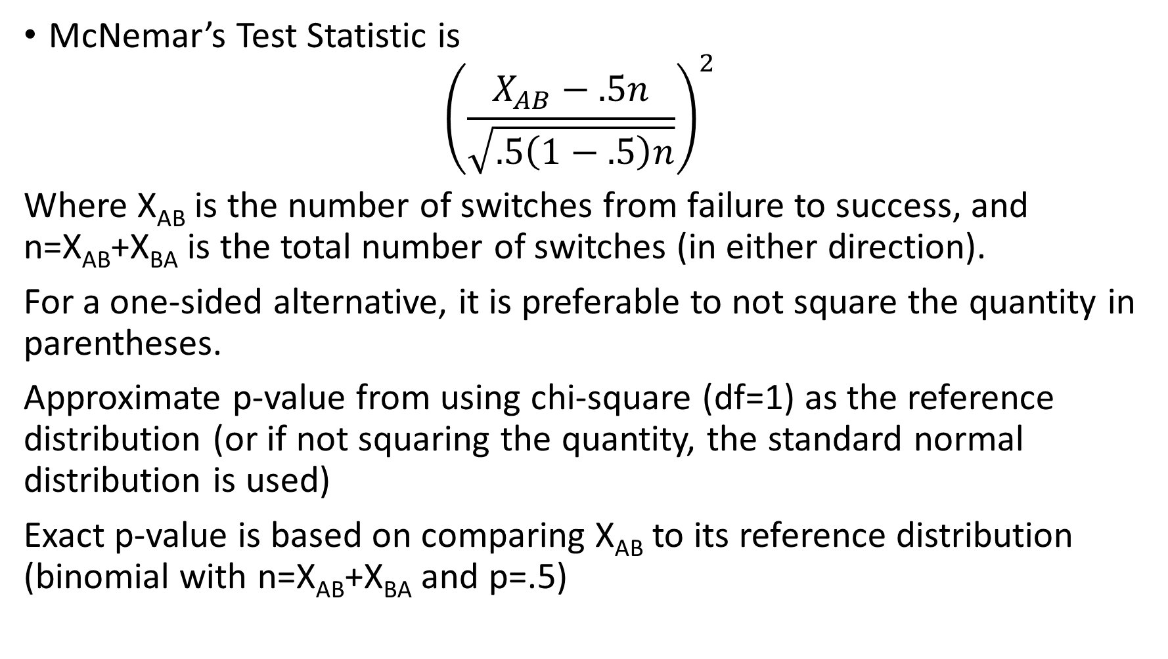
McNemar’s Test Statistic is
$${\left(\frac{X_{AB}−.5n}{\sqrt{.5\left(1−.5\right)n}}\right)}^{2}$$
Where X_{AB} is the number of switches from failure to success, and n=X_{AB}+X_{BA} is the total number of switches (in either direction).
For a one-sided alternative, it is preferable to not square the quantity in parentheses.
Approximate p-value from using chi-square (df=1) as the reference distribution (or if not squaring the quantity, the standard normal distribution is used)
Exact p-value is based on comparing X_{AB} to its reference distribution (binomial with n=X_{AB}+X_{BA} and p=.5)

Slide 30
In-class example
Textbook Exercise 4.2 reconsidered. Categorized version of student agreement with importance of statistics for major. (‘neutral’ included with the ‘not important’ level).
“Did the course help students see the light?” (use alpha=.05)
 | Important (after course) | Not important (after course) | Total
Important (before course) | 8 | 0
Not Important (before course) | 6 | 5
Total

Slide 31
Technical Comments on the hypotheses tested by the chi-squared tests of this chapter

