Slide 1

Nonparametrics: Chapter 8: Nonparametric Bootstrap Methods
Notes prepared by Bradley Barney for STAT 7900 Special Topics: Nonparametrics.
Notes are based on Chapter 8 of the required course
textbook.
Higgins, James J. (2004). Introduction to Modern
Nonparametric Statistics. Thomson/Brooks Cole:
Pacific Grove, CA.
and on code provided by Chris Williams at www.webpages.uidaho.edu/~chrisw/stat514/lect514y10.htm
Do not redistribute these notes in any form whatsoever. Any mistakes should be assumed to be my own.

Slide 2
Topics from Last Week
Trends/Associations between Numeric Variables (Sections 5.1-5.3)
Relationships between Two Categorical Variables (Sections 5.4-5.6, 5.8)
Nominal Variables
One or Both Ordinal
Paired Data

Slide 3
Recurring Themes
Assumptions might not be met.
This can cause difficulties with standard parametric procedures
Sometimes nonparametric methods can be implemented to great effect
Among these are using the PERMUTATION DISTRIBUTION and using RANKS of the original data values (or other scoring methods)

Slide 4
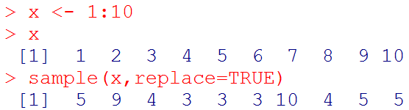
Bootstrapping Methods
Another alternative is to use bootstrapping (as in “pulling yourself up by your bootstraps”)
Like permuting, it is an example of a resampling method
Unlike permuting, bootstrapping samples WITH replacement.
In R, such a sample may be obtained using the sample function along with the replace=TRUE option.

Slide 5
Motivation for Bootstrapping
If we fully know the sampling distribution of a statistic, then we can use this knowledge to conduct statistical inference.
Even if it is not analytically determined, we can still conduct valid inference if we are able to sample from a statistic’s true sampling distribution. (Monte Carlo approach)
What if we cannot directly sample from the entire sampling distribution?
To the extent that the observed data adequately mirror the distribution of a random variable, we can resample the data (with replacement) and each time compute the sample statistic to mimic the sampling distribution
This is essentially what we do with bootstrapping methods.

Slide 6
Bootstrapping Assumption
A fundamental assumption for valid bootstrapping inference is that the available data is a good representation of the population (not just in terms of location, but for shape, spread, skewness, etc.)
This is critical because bootstrapping can be considered a random sample from an infinite population where each possible value is represented in the same proportion as in the data.

Slide 7
Mean Squared Error
Estimates are not the same as the true value of the parameter, so how can we measure the goodness of an estimator?
One criterion: the mean squared error (MSE)
MSE=Expected value of [(estimator-parameter)^2]
Can be decomposed into two components:
Squared Bias of estimator (i.e., [E(estimator)-parameter]²)
Variance of Estimator (i.e., E(estimator-E(estimator))²)
If an estimator is unbiased, then its MSE is simply the variance of the estimator

Slide 8
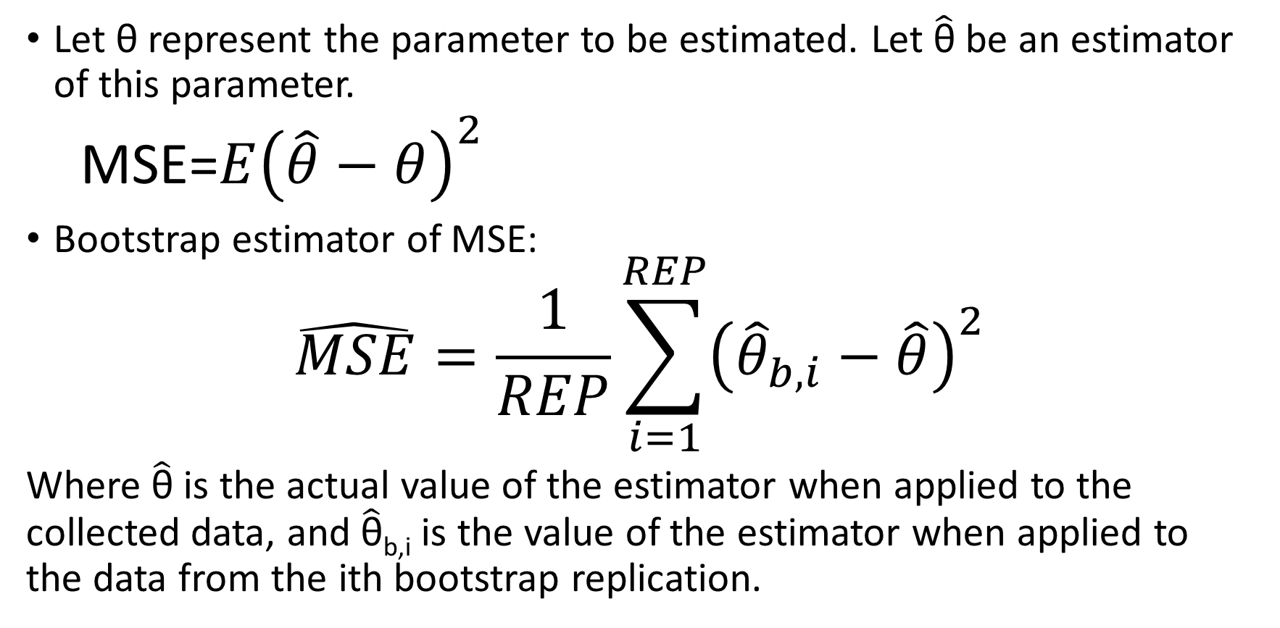
How can we estimate MSE?
Let θ represent the parameter to be estimated. Let $\hat{\text{θ}}$ be an estimator of this parameter.
MSE=$E{\left(\hat{θ}−θ\right)}^{2}$
Bootstrap estimator of MSE:
$$\hat{MSE}=\frac{1}{REP}\sum_{i=1}^{REP}{{\left({\hat{θ}}_{b,i}−\hat{θ}\right)}^{2}}$$
Where $\hat{\text{θ}}$ is the actual value of the estimator when applied to the collected data, and $\hat{\text{θ}}$_{b,i} is the value of the estimator when applied to the data from the ith bootstrap replication.

Slide 9
Number of Replications for Bootstrap Resample
Ideally could use all possible replications
If a sample of n observations is to be resampled with replacement, how many possible (ordered) resamples are possible?
Almost never feasible, so instead?
Monte Carlo!

Slide 10
In-Class Practice
For the following data (from Table 8.1.1), use bootstrap methodology to compute the MSE of the sample mean:
data811 <- c(7,11,15,16,20,22,24,25,29,33,34,37,41,42,49,57,66,71,84,90)
Then, use bootstrap methodology to compute the MSE of the sample variance.
Next, use bootstrap methodology to compute the MSE of the sample minimum.
Finally, consider if the use of bootstrapping methods is concerning for any of the three aforementioned statistics.

Slide 11
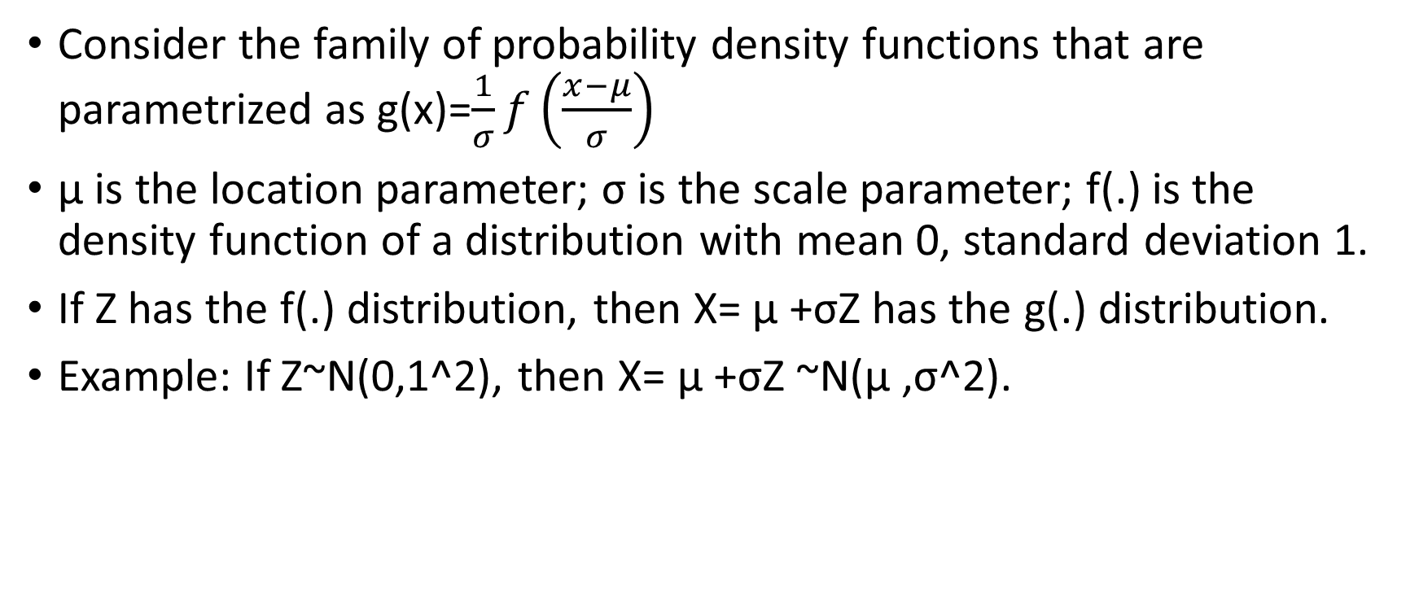
Confidence Intervals via Bootstrapping
Consider the family of probability density functions that are parametrized as g(x)=$\frac{1}{σ}f\left(\frac{x−μ}{σ}\right)$
μ is the location parameter; σ is the scale parameter; f(.) is the density function of a distribution with mean 0, standard deviation 1.
If Z has the f(.) distribution, then X= μ +σZ has the g(.) distribution.
Example: If Z~N(0,1^2), then X= μ +σZ ~N(μ ,σ^2).

Slide 12
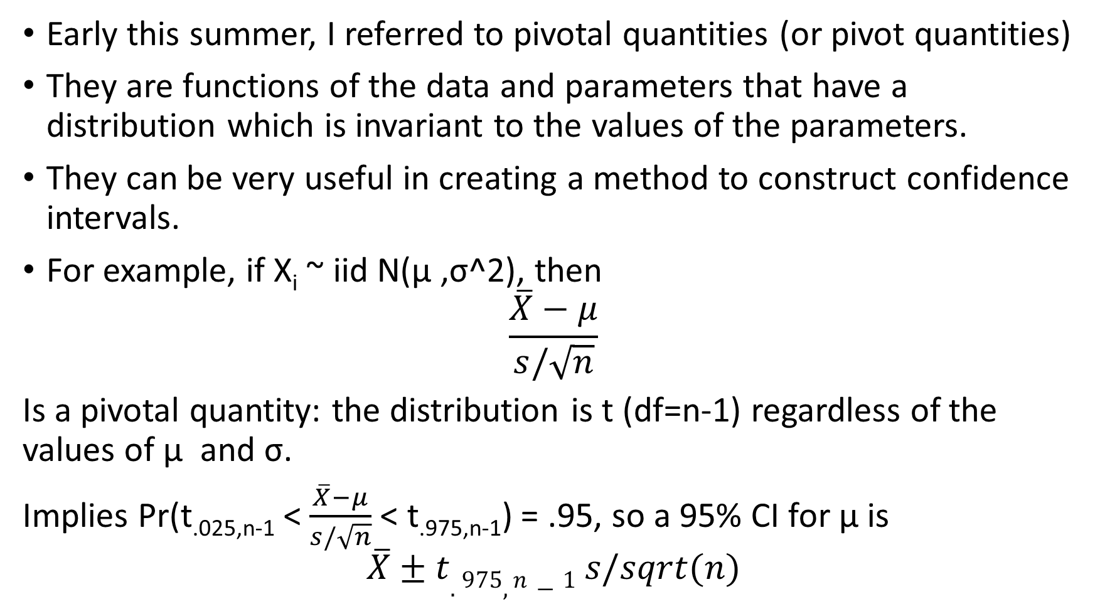
Pivotal Quantities
Early this summer, I referred to pivotal quantities (or pivot quantities)
They are functions of the data and parameters that have a distribution which is invariant to the values of the parameters.
They can be very useful in creating a method to construct confidence intervals.
For example, if X_{i} ~ iid N(μ ,σ^2), then
$$\frac{\overline{X}−μ}{s/\sqrt{n}}$$
Is a pivotal quantity: the distribution is t (df=n-1) regardless of the values of μ and σ.
Implies Pr(t_{.025,n-1} < $\frac{\overline{X}−μ}{s/\sqrt{n}}$ < t_{.975,n-1}) = .95, so a 95% CI for μ is
$$\overline{X}±t.975,n−1 s/sqrt(n)$$

Slide 13
How does bootstrapping feature?
If the data are not normally distributed, then (particularly for small samples with skewness/outliers) the pivotal quantity might not have a t distribution (not even approximately).
Can use bootstrapping to approximate the pivotal quantity’s distribution.

Slide 14
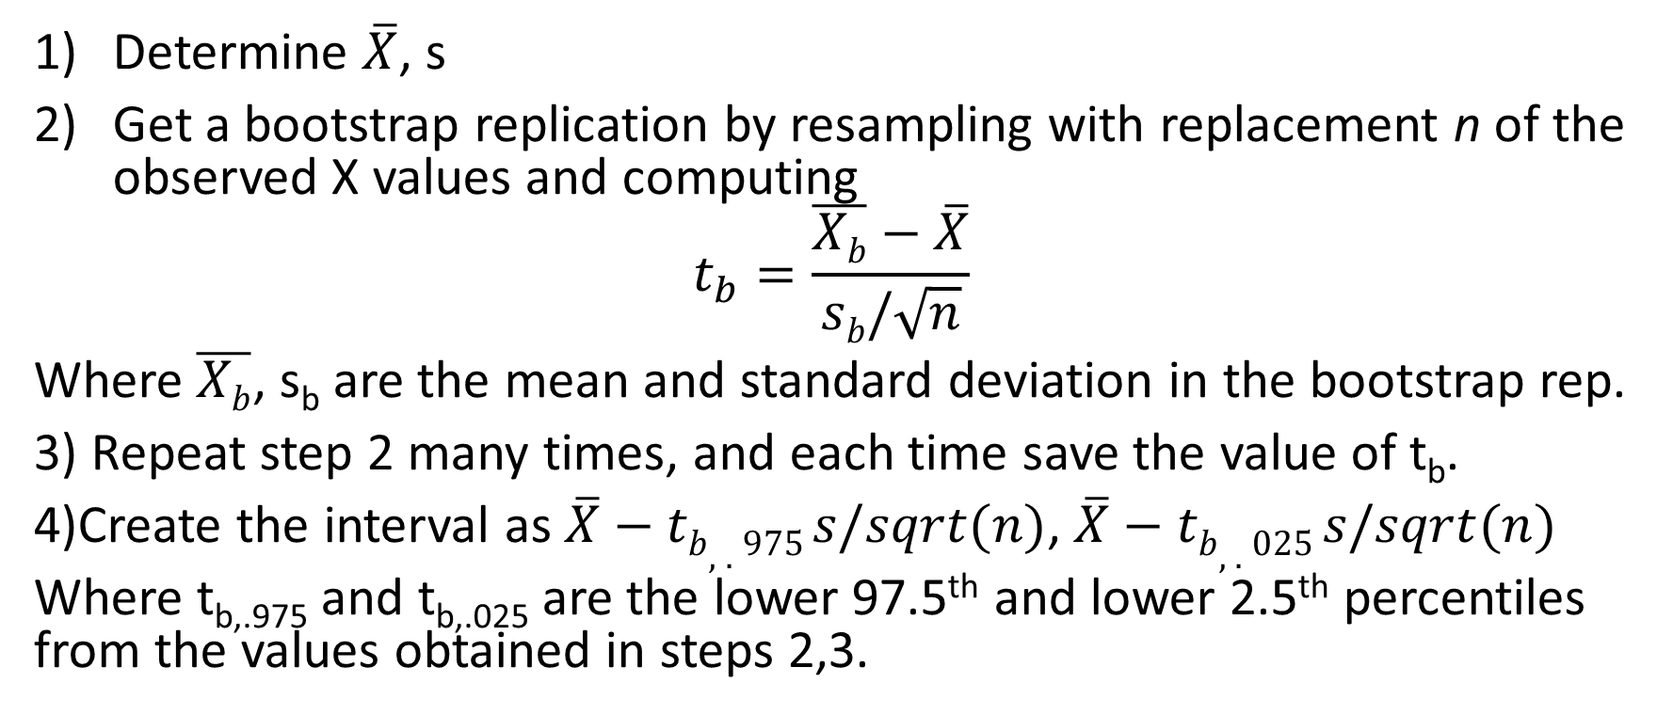
T-Pivot Bootstrap CI for the Population Average (Higgins 2004, p. 256)
Determine $\overline{X}$, s
Get a bootstrap replication by resampling with replacement n of the observed X values and computing
$$t_{b}=\frac{\overline{Xb}−\overline{X}}{sb/\sqrt{n}}$$
Where $\overline{Xb}$, s_{b} are the mean and standard deviation in the bootstrap rep.
3) Repeat step 2 many times, and each time save the value of t_{b}.
4)Create the interval as $\overline{X}−tb,.975 s/sqrt(n)$, $\overline{X}−tb,.025 s/sqrt(n)$
Where t_{b,.975} and t_{b,.025} are the lower 97.5th and lower 2.5th percentiles from the values obtained in steps 2,3.

Slide 15
Example of t-pivot bootstrap
Data from Table 8.3.1 (20 simulated values from Exponential with mean=10)
Xs <- c(.77, 1.17, 2.79, 3.13, 3.31, 3.70, 4.13, 5.28, 5.84, 7.38, 7.75, 8.25, 9.00, 10.12, 11.51, 15.82, 18.28, 21.73, 32.74, 38.28)
Code is in Chapter8.R
95% CI for μ using the t-pivot method: (6.67. 18.46)

Slide 16
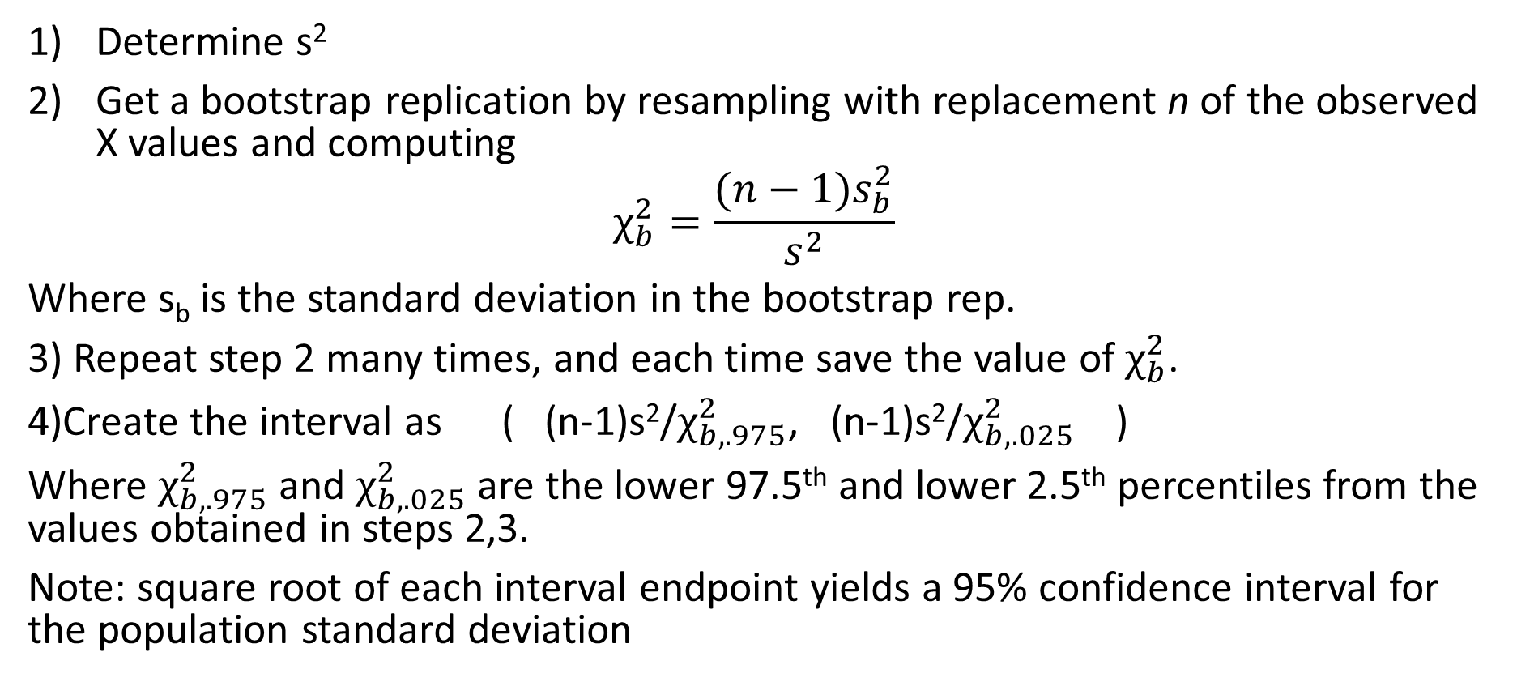
χ²-Pivot Bootstrap CI for the Population Variance (Higgins 2004, p. 257)
Determine s²
Get a bootstrap replication by resampling with replacement n of the observed X values and computing
$$χ_{b}^{2}=\frac{(n−1)s_{b}^{2}}{s^{2}}$$
Where s_{b} is the standard deviation in the bootstrap rep.
3) Repeat step 2 many times, and each time save the value of $χ_{b}^{2}$.
4)Create the interval as ( (n-1)s²/$χ_{b,.975}^{2}$, (n-1)s²/$χ_{b,.025}^{2}$ )
Where $χ_{b,.975}^{2}$ and $χ_{b,.025}^{2}$ are the lower 97.5th and lower 2.5th percentiles from the values obtained in steps 2,3.
Note: square root of each interval endpoint yields a 95% confidence interval for the population standard deviation

Slide 17
In-class Practice
Using the χ²-pivot bootstrap technique, construct a 95% confidence interval for the population variance of the data from Table 8.3.1

Slide 18
General Approaches (whether or not for a location or scale parameter)
Percentile Method
Residual Method
Bias Corrected (BC)
Bias Corrected and Accelerated (BCA)

Slide 19
Percentile Method
Probably the simplest, but usually does not work as well
Two steps:
1) Draw B (where B is a large number) bootstrap samples of the data, and compute the estimate for each sample separately
2) Use sample quantiles of the estimates to create the confidence interval (e.g., the 2.5th and 97.5th percentile of the estimates from step 1 for a 95% confidence interval)

Slide 20
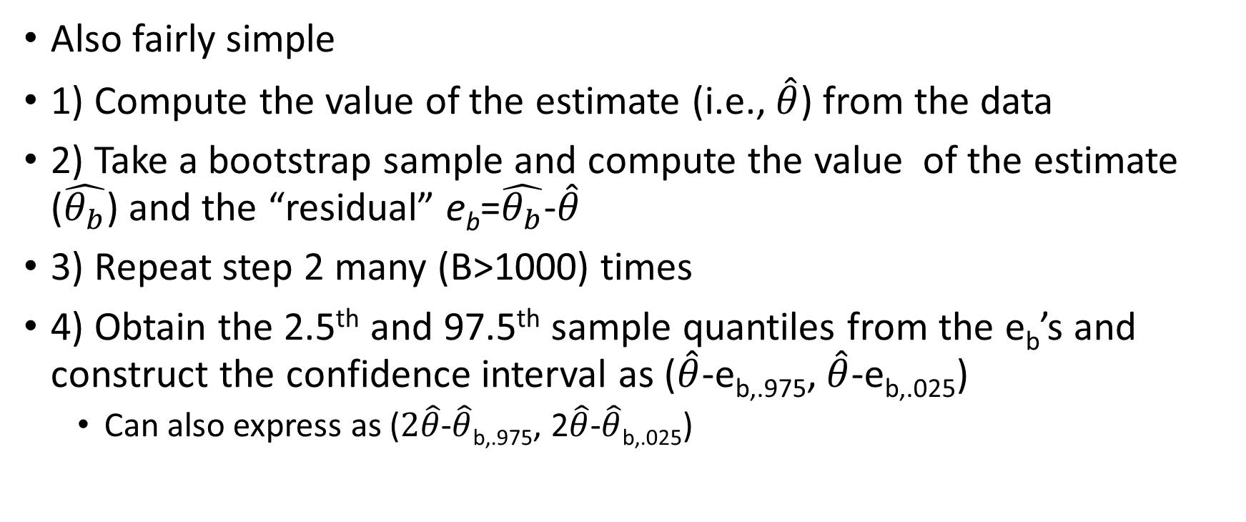
Residual Method
Also fairly simple
1) Compute the value of the estimate (i.e., $\hat{θ}$) from the data
2) Take a bootstrap sample and compute the value of the estimate ($\hat{θ_{b}}$) and the “residual” e_{b}=$\hat{θ_{b}}$-$\hat{θ}$
3) Repeat step 2 many (B>1000) times
4) Obtain the 2.5th and 97.5th sample quantiles from the e_{b}’s and construct the confidence interval as ($\hat{θ}$-e_{b,.975}, $\hat{θ}$-e_{b,.025})
Can also express as ($2\hat{θ}$-$\hat{θ}$_{b,.975}, 2$\hat{θ}$-$\hat{θ}$_{b,.025})

Slide 21
Illustration of Percentile, Residual Methods
Data from Table 8.3.1 (20 simulated values from Exponential with mean=10)
Xs <- c(.77, 1.17, 2.79, 3.13, 3.31, 3.70, 4.13, 5.28, 5.84, 7.38, 7.75,
8.25, 9.00, 10.12, 11.51, 15.82, 18.28, 21.73, 32.74, 38.28)
See the code in Chapter8.R
95% CI for mean using percentile method: (6.55, 15.22)
95% CI for mean using residual method: (5.82, 14.51)

Slide 22
Bias Corrected Interval
What if the estimator is biased? Things get tricky.
Let’s use the more general correction for bias and confidence interval coverage that does not match the nominal level
The coverage of a confidence interval is the actual probability that the method will produce a confidence interval that contains the parameter.
This more general correction is termed the Bias Corrected and Accelerated (BCA) interval

Slide 23
BCA Interval
Motivation
Assuming an increasing one-to-one function of the estimate has a normal distribution, then the interval could be computed on this transformed scale and then backtransformed to get a CI in the original scale.
With the normality on the transformed scale, could use the standard normal distribution to get the interval endpoints.
The beauty of the approach: we don’t need to know which function would produce the normality—there just has to be such a function.

Slide 24
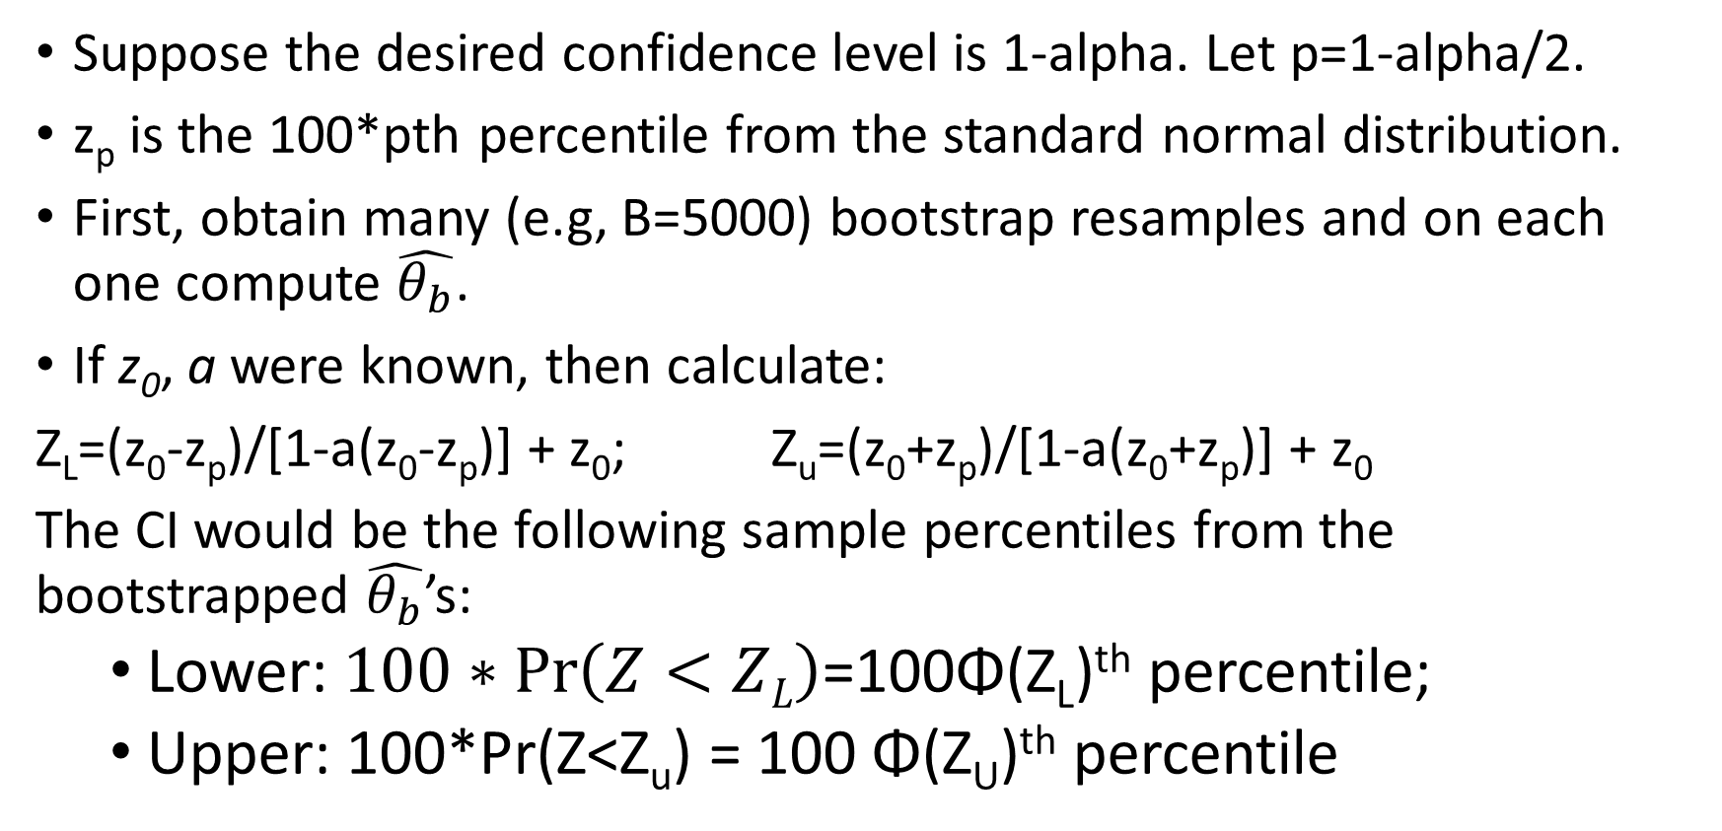
BCA Interval Computation
Suppose the desired confidence level is 1-alpha. Let p=1-alpha/2.
z_{p} is the 100*pth percentile from the standard normal distribution.
First, obtain many (e.g, B=5000) bootstrap resamples and on each one compute $\hat{θ_{b}}$.
If z₀, a were known, then calculate:
Z_{L}=(z₀-z_{p})/[1-a(z₀-z_{p})] + z₀; Z_{u}=(z₀+z_{p})/[1-a(z₀+z_{p})] + z₀
The CI would be the following sample percentiles from the bootstrapped $\hat{θ_{b}}$’s:
Lower: $100∗\operatorname{Pr}\left(Z<ZL\right)$=100Φ(Z_{L})^{th} percentile;
Upper: 100*Pr(Z<Z_{u}) = 100 Φ(Z_{U})^{th} percentile

Slide 25
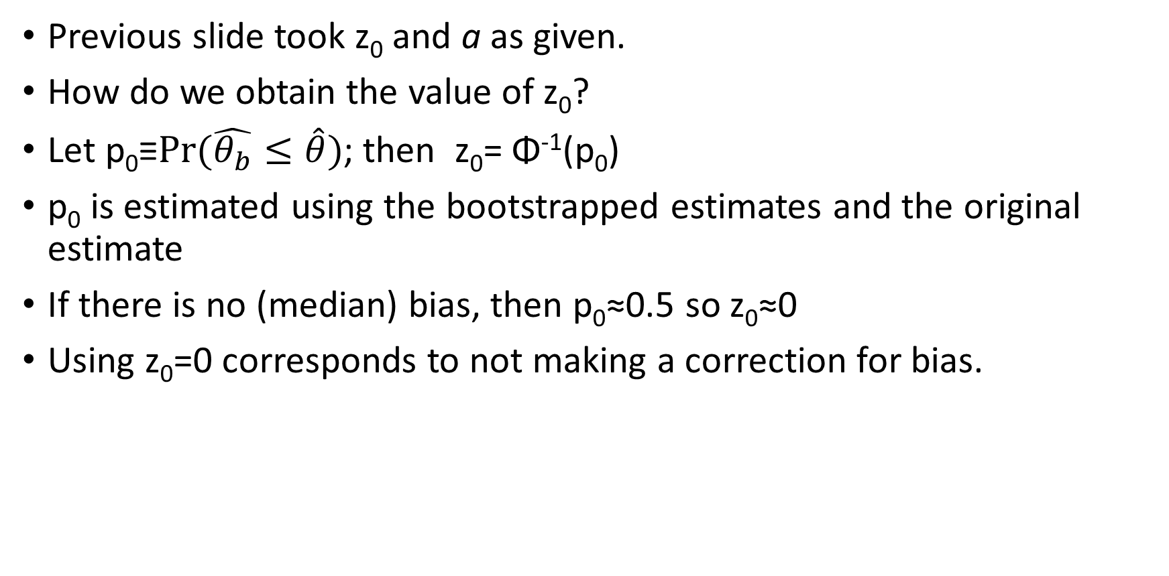
BCA Interval Computation (cont)
Previous slide took z₀ and a as given.
How do we obtain the value of z₀?
Let p₀≡$Pr(\hat{θ_{b}}≤\hat{θ})$; then z₀= Φ⁻¹(p₀)
p₀ is estimated using the bootstrapped estimates and the original estimate
If there is no (median) bias, then p₀≈0.5 so z₀≈0
Using z₀=0 corresponds to not making a correction for bias.

Slide 26
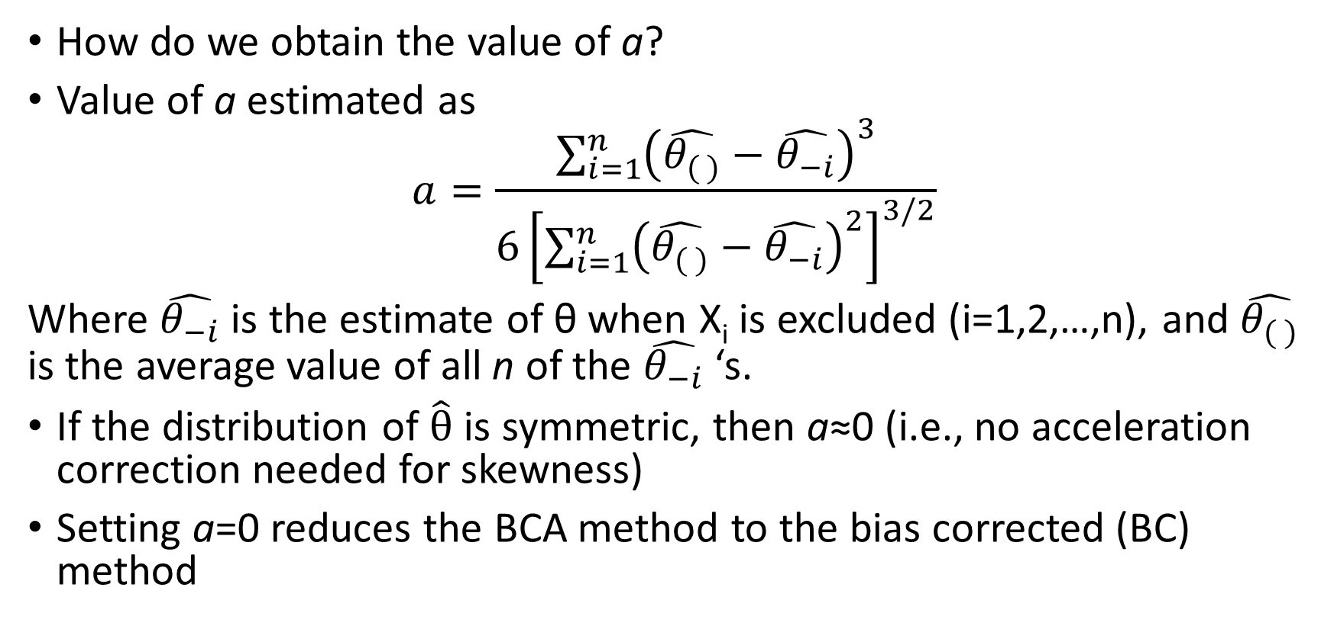
BCA Interval Computation (cont)
How do we obtain the value of a?
Value of a estimated as
$$a=\frac{\sum_{i=1}^{n}{{\left(\hat{θ_{( )}}−\hat{θ_{−i}}\right)}^{3}}}{6{\left[\sum_{i=1}^{n}{{\left(\hat{θ_{( )}}−\hat{θ_{−i}}\right)}^{2}}\right]}^{3/2}}$$
Where $\hat{θ_{−i}}$ is the estimate of θ when X_{i} is excluded (i=1,2,…,n), and $\hat{θ_{( )}}$ is the average value of all n of the $\hat{θ_{−i}}$‘s.
If the distribution of $\hat{θ}$ is symmetric, then a≈0 (i.e., no acceleration correction needed for skewness)
Setting a=0 reduces the BCA method to the bias corrected (BC) method

Slide 27
Question:
If you were to use a=0 and z₀=0, then the BCA method would be equivalent to which other bootstrap method?

Slide 28
Example (cont)
Again refer to the example code in Chapter8.R
BC method (when a is set to 0): (6.71, 15.49)
BCA method (when a is estimated): (7.07, 16.21)

Slide 29
In-class Practice
BlackmoreCont12.csv contains the weekly hours of exercise by healthy 12-year-old girls.
It was created from a subset of Blackmore in the car package of R.
Compute 98% confidence intervals for the population mean using:
The t-pivot method
The percentile method
The residual method
The BC method
The BCA method
The standard parametric inference based on the population distribution being normally distributed.
Determine which of the above methods were suitable to use and which were not. Also, compare their widths, centers, and skewness)

Slide 30
Bootstrap Confidence Interval for rho—the population correlation between two variables
When would this be an appropriate technique?
(X,Y) pairs randomly selected from the target population
Note that X is random, not just Y!
X and Y are linearly related (to the extent that they are related)
Procedure (Higgins 2004, p. 267):
1) Draw B bootstrap samples, where each bootstrap sample is n (Xi,Yi) pairs selected at random (with replacement) from the n (X,Y) data points
2) Compute Pearson’s correlation on each of the B samples
3) Use the BCA (preferred) or percentile method to construct a confidence interval.

Slide 31
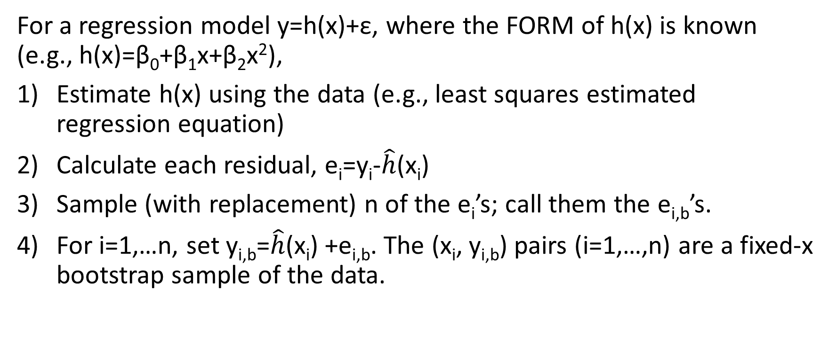
How to bootstrap sample (X,Y) values if X’s are nonstochastic (e.g., fixed by researcher; Higgins 2004, p.268)
For a regression model y=h(x)+ε, where the FORM of h(x) is known (e.g., h(x)=β₀+β₁x+β₂x²),
Estimate h(x) using the data (e.g., least squares estimated regression equation)
Calculate each residual, e_{i}=y_{i}-$\hat{h}$(x_{i})
Sample (with replacement) n of the e_{i}’s; call them the e_{i,b}’s.
For i=1,…n, set y_{i,b}=$\hat{h}$(x_{i}) +e_{i,b}. The (x_{i}, y_{i,b}) pairs (i=1,…,n) are a fixed-x bootstrap sample of the data.

Slide 32
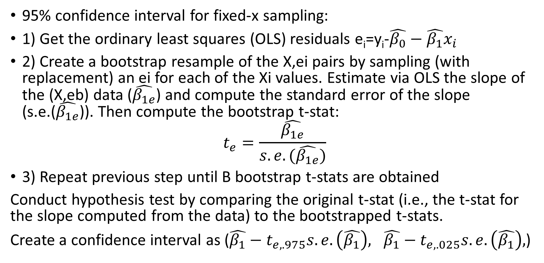
Example: Inference on Slope in Simple Linear Regression (Higgins 2004, Section 8.4.3)
95% confidence interval for fixed-x sampling:
1) Get the ordinary least squares (OLS) residuals e_{i}=y_{i}-$\hat{β_{0}}−\hat{β_{1}}x_{i}$
2) Create a bootstrap resample of the X,ei pairs by sampling (with replacement) an ei for each of the Xi values. Estimate via OLS the slope of the (X,eb) data ($\hat{β_{1e}}$) and compute the standard error of the slope (s.e.($\hat{β_{1e}}$)). Then compute the bootstrap t-stat:
$$t_{e}=\frac{\hat{β_{1e}}}{s.e.(\hat{β_{1e}})}$$
3) Repeat previous step until B bootstrap t-stats are obtained
Conduct hypothesis test by comparing the original t-stat (i.e., the t-stat for the slope computed from the data) to the bootstrapped t-stats.
Create a confidence interval as ($\hat{β_{1}}−t_{e,.975}s.e.\left(\hat{β_{1}}\right), \hat{β_{1}}−t_{e,.025}s.e.\left(\hat{β_{1}}\right),$)

Slide 33
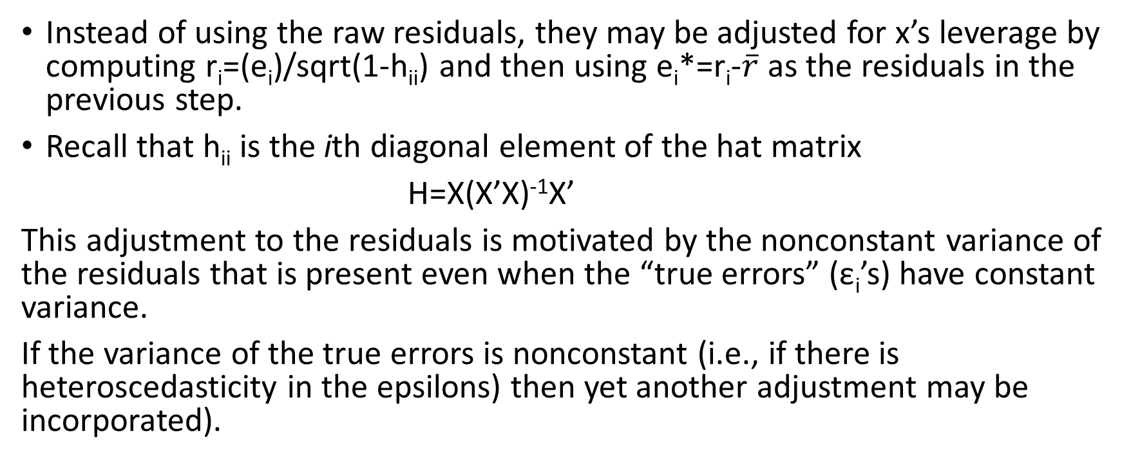
Adaptation for nonconstant residual variance
Instead of using the raw residuals, they may be adjusted for x’s leverage by computing r_{i}=(e_{i})/sqrt(1-h_{ii}) and then using e_{i}*=r_{i}-$\overline{r}$ as the residuals in the previous step.
Recall that h_{ii} is the ith diagonal element of the hat matrix
H=X(X’X)⁻¹X’
This adjustment to the residuals is motivated by the nonconstant variance of the residuals that is present even when the “true errors” (ε_{i}’s) have constant variance.
If the variance of the true errors is nonconstant (i.e., if there is heteroscedasticity in the epsilons) then yet another adjustment may be incorporated).

Slide 34
In-class Practice
The data for this in-class practice are from the data set Angell in the R package car. We’ll use a linear regression framework with the explanatory variable being the natural logarithm of the mobility measure and the response variable being the natural logarithm of the moral measure.
Compute a 95% confidence interval for the slope using:
The standard regression parametric technique (hint: first use the lm function and then the confint function)
The percentile method (for B bootstrap samples, compute the estimated slope and then take the 2.5th and 97.5th percentiles)
The approach from two slides earlier
The adjustment from the previous slide.

Slide 35
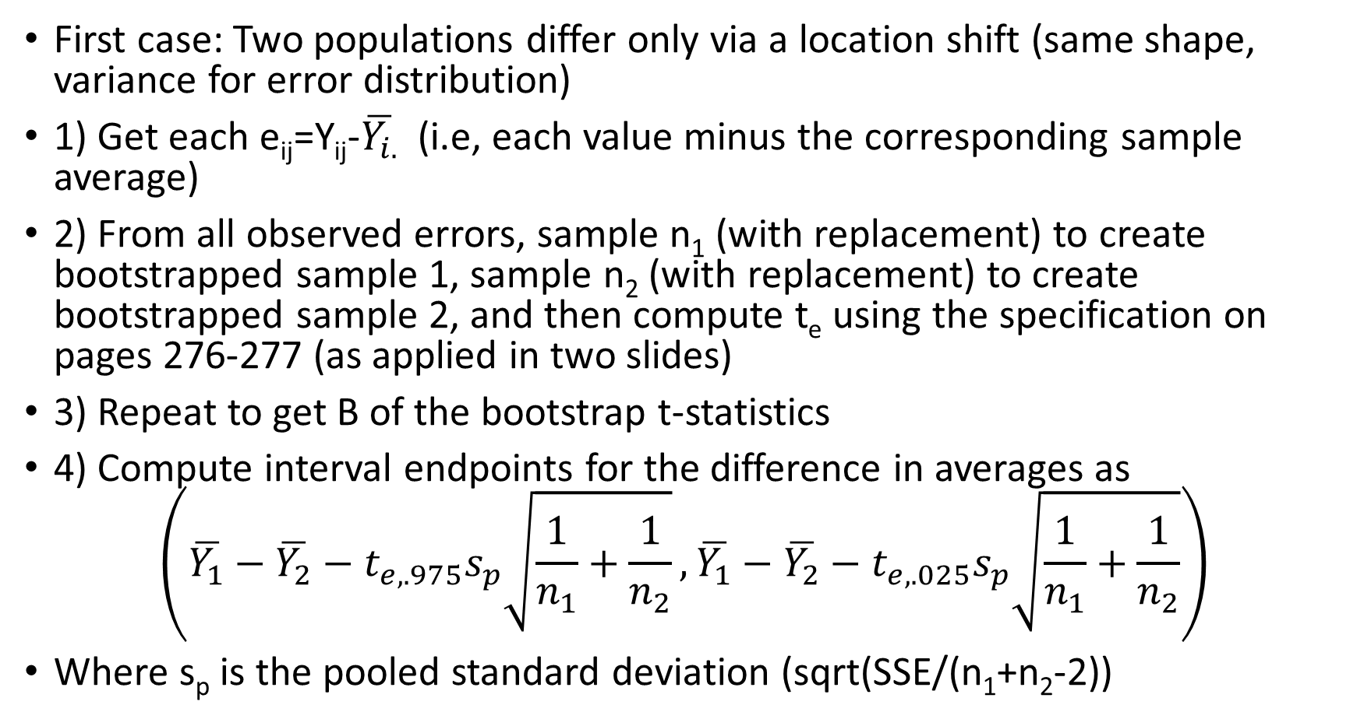
Two-sample Inference (Section 8.5)
First case: Two populations differ only via a location shift (same shape, variance for error distribution)
1) Get each e_{ij}=Y_{ij}-$\overline{Y_{i.}}$ (i.e, each value minus the corresponding sample average)
2) From all observed errors, sample n₁ (with replacement) to create bootstrapped sample 1, sample n₂ (with replacement) to create bootstrapped sample 2, and then compute t_{e} using the specification on pages 276-277 (as applied in two slides)
3) Repeat to get B of the bootstrap t-statistics
4) Compute interval endpoints for the difference in averages as
$$\left(\overline{Y_{1}}−\overline{Y_{2}}−t_{e,.975}s_{p}\sqrt{\frac{1}{n_{1}}+\frac{1}{n_{2}}},\overline{Y_{1}}−\overline{Y_{2}}−t_{e,.025}s_{p}\sqrt{\frac{1}{n_{1}}+\frac{1}{n_{2}}}\right)$$
Where s_{p} is the pooled standard deviation (sqrt(SSE/(n₁+n₂-2))

Slide 36
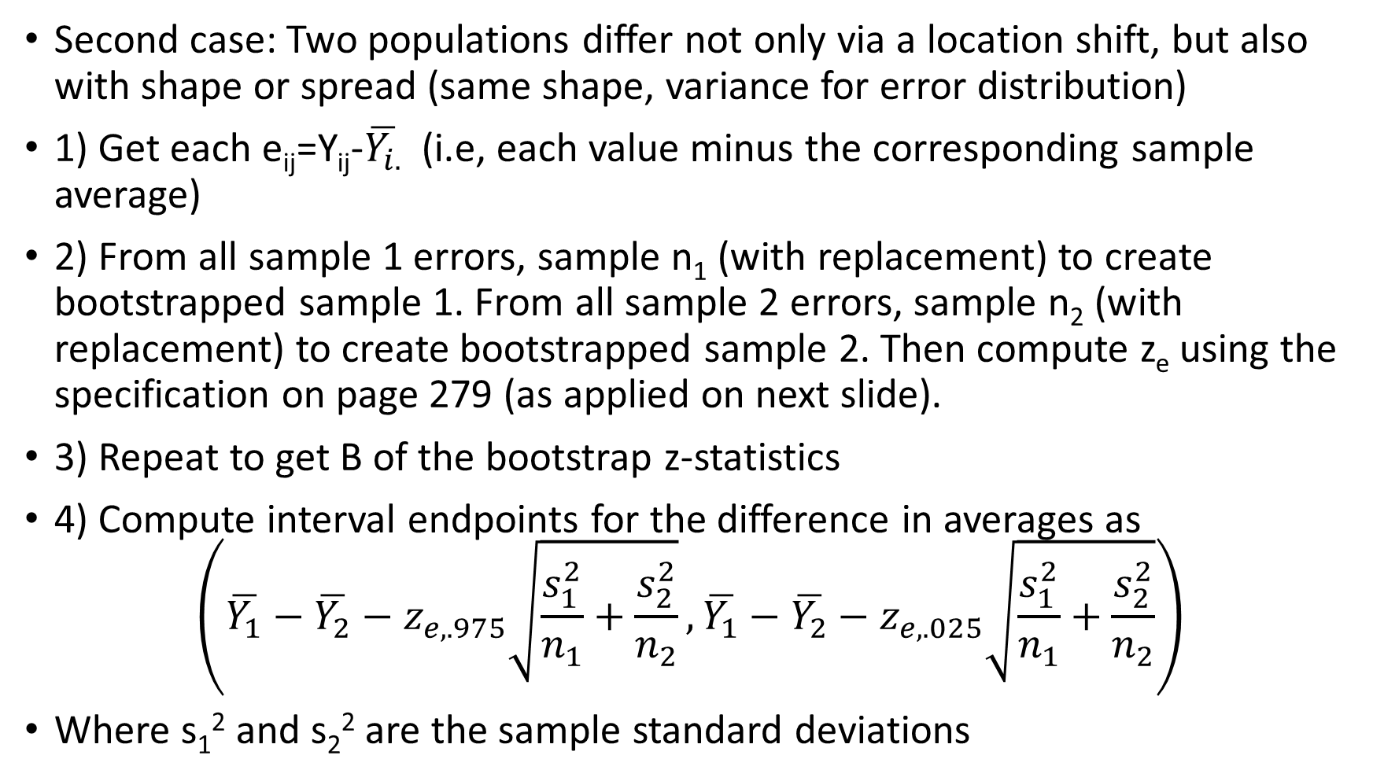
Two-sample Inference (cont)
Second case: Two populations differ not only via a location shift, but also with shape or spread (same shape, variance for error distribution)
1) Get each e_{ij}=Y_{ij}-$\overline{Y_{i.}}$ (i.e, each value minus the corresponding sample average)
2) From all sample 1 errors, sample n₁ (with replacement) to create bootstrapped sample 1. From all sample 2 errors, sample n₂ (with replacement) to create bootstrapped sample 2. Then compute z_{e} using the specification on page 279 (as applied on next slide).
3) Repeat to get B of the bootstrap z-statistics
4) Compute interval endpoints for the difference in averages as
$$\left(\overline{Y_{1}}−\overline{Y_{2}}−z_{e,.975}\sqrt{\frac{s_{1}^{2}}{n_{1}}+\frac{s_{2}^{2}}{n_{2}}},\overline{Y_{1}}−\overline{Y_{2}}−z_{e,.025}\sqrt{\frac{s_{1}^{2}}{n_{1}}+\frac{s_{2}^{2}}{n_{2}}}\right)$$
Where s₁² and s₂² are the sample standard deviations

Slide 37
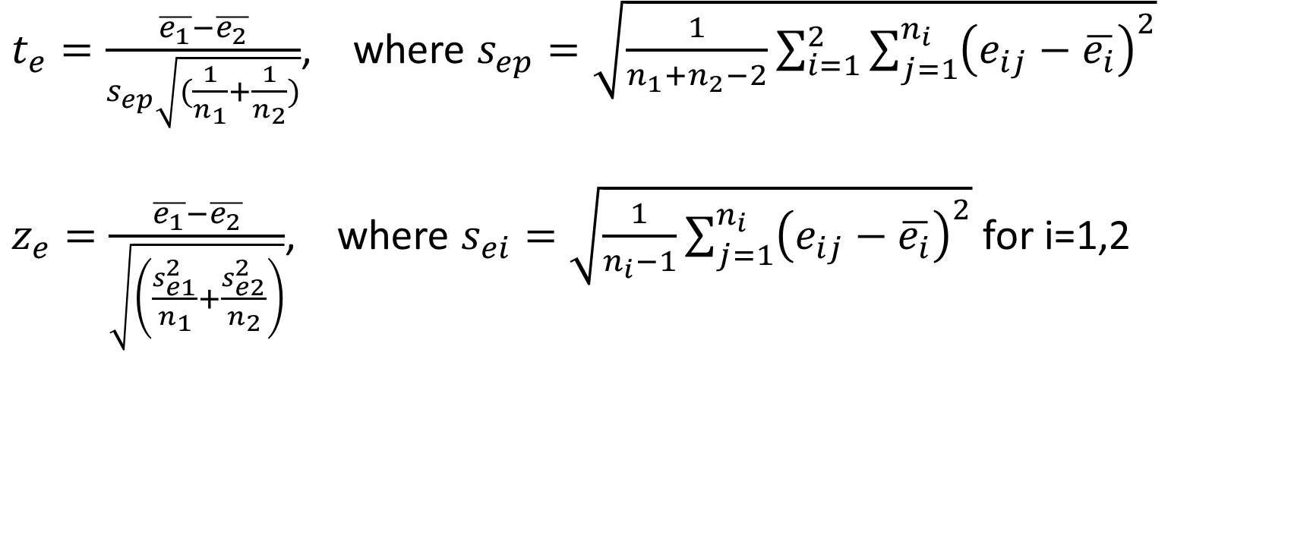
t_{e} and z_{e} specifications (pp. 276-277, 279)
$t_{e}=\frac{\overline{e_{1}}−\overline{e_{2}}}{s_{ep}\sqrt{(\frac{1}{n_{1}}+\frac{1}{n_{2}})}}$, where $s_{ep}=\sqrt{\frac{1}{n_{1}+n_{2}−2}\sum_{i=1}^{2}{\sum_{j=1}^{n_{i}}{{\left(e_{ij}−\overline{e_{i}}\right)}^{2}}}}$
$z_{e}=\frac{\overline{e_{1}}−\overline{e_{2}}}{\sqrt{\left(\frac{s_{e1}^{2}}{n_{1}}+\frac{s_{e2}^{2}}{n_{2}}\right)}}$, where $s_{ei}=\sqrt{\frac{1}{n_{i}−1}\sum_{j=1}^{n_{i}}{{\left(e_{ij}−\overline{e_{i}}\right)}^{2}}}$ for i=1,2

Slide 38
In-class example
Comparing values of moral (measure of morality) in the South (region==‘S’), East (region==‘E’) using the Angell data, compute a 95% confidence interval for the difference in means
Assuming the same error distribution
Not assuming the same error distribution
Do each of these using both bootstrap confidence intervals and standard parametric confidence intervals.

Slide 39
Another Way to Bootstrap
I highly recommend the boot package in R.
You’ll use the boot function and the boot.ci function
boot function is to obtain the bootstrap replications
boot.ci is to obtain a confidence interval for up to five distinct methods
It takes some getting used to, but it will be helpful to master
We will practice using these functions in Lecture 8

Slide 40
Also next class:
Bootstrap sampling of more than two populations
Multiple regression bootstrapping, including tests of the general linear hypothesis
Comparison of Permutation Testing with Bootstrapping
Multifactor experiments (pending class decision)

