Slide 1
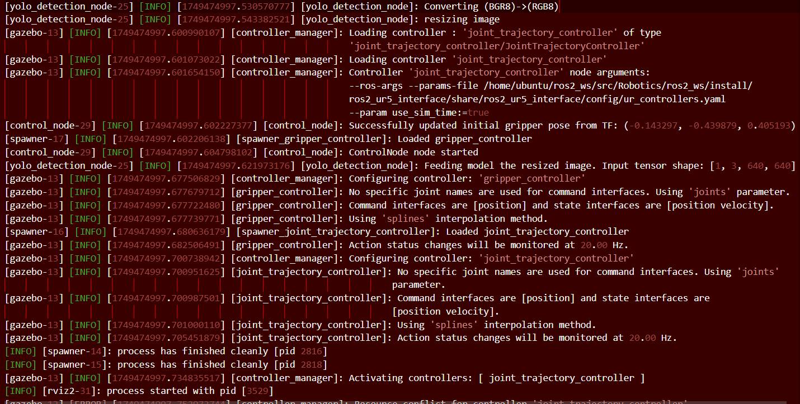
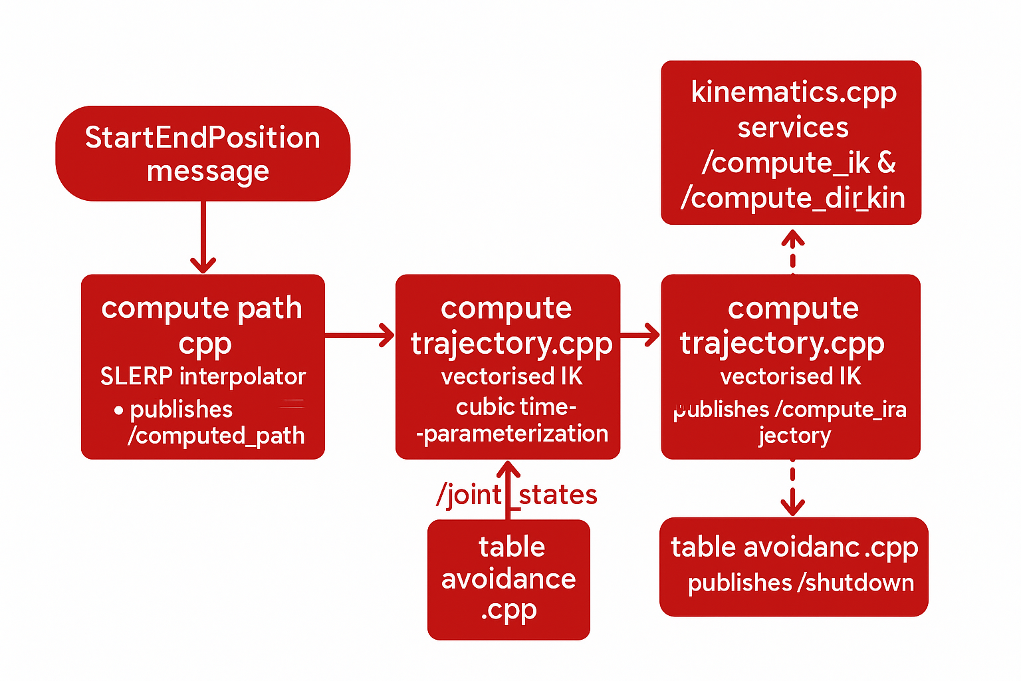
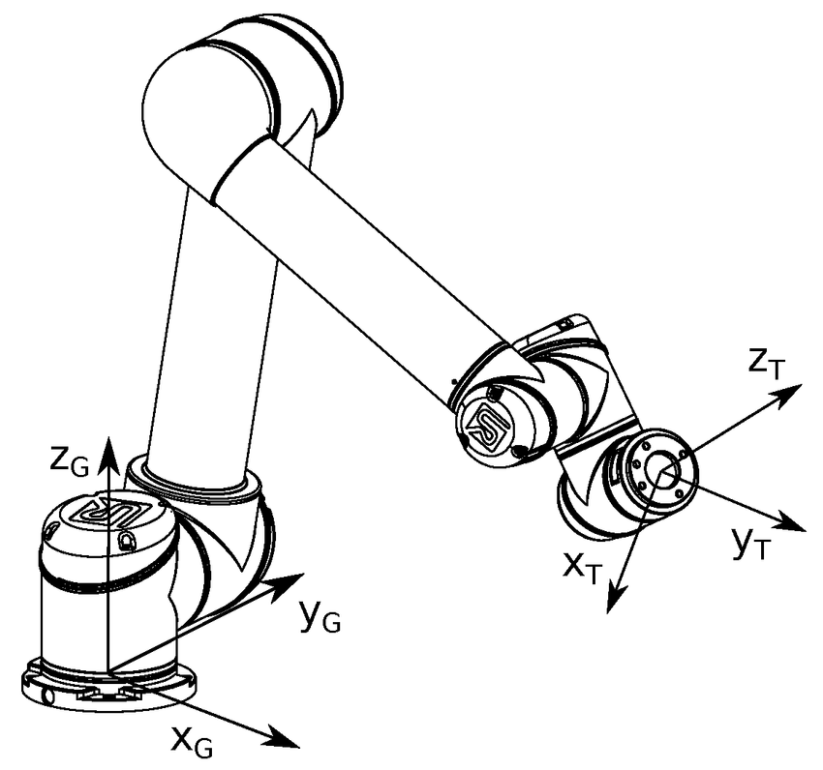
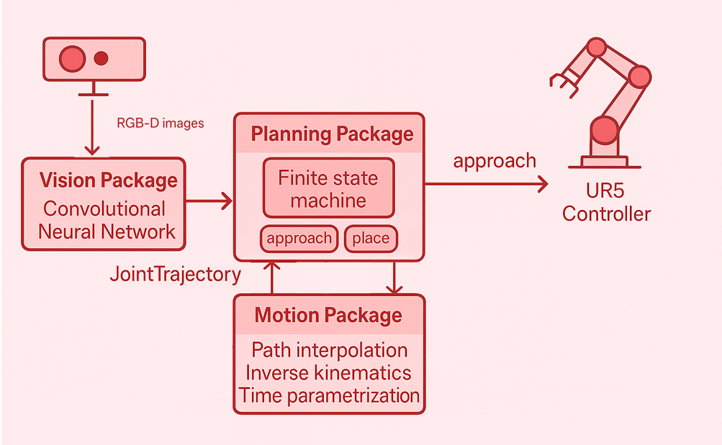
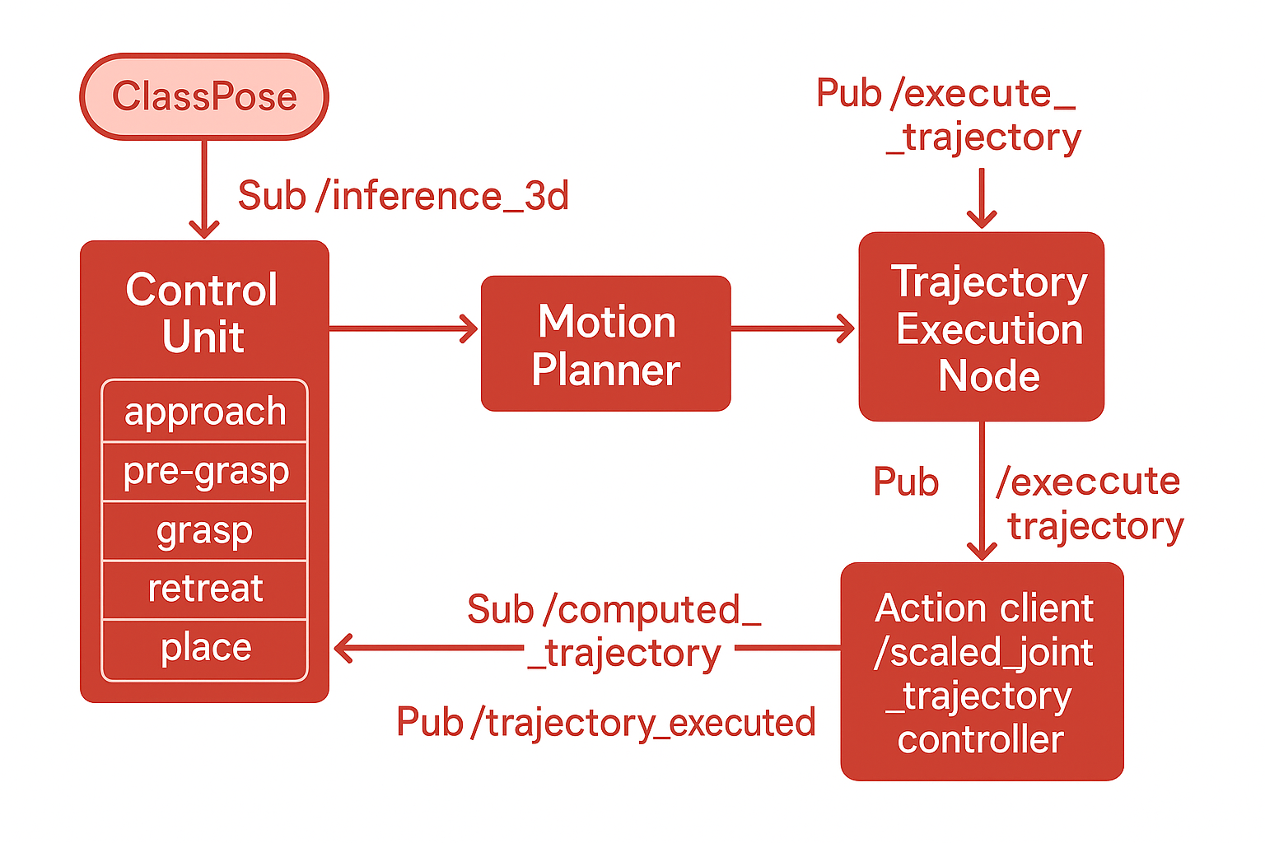
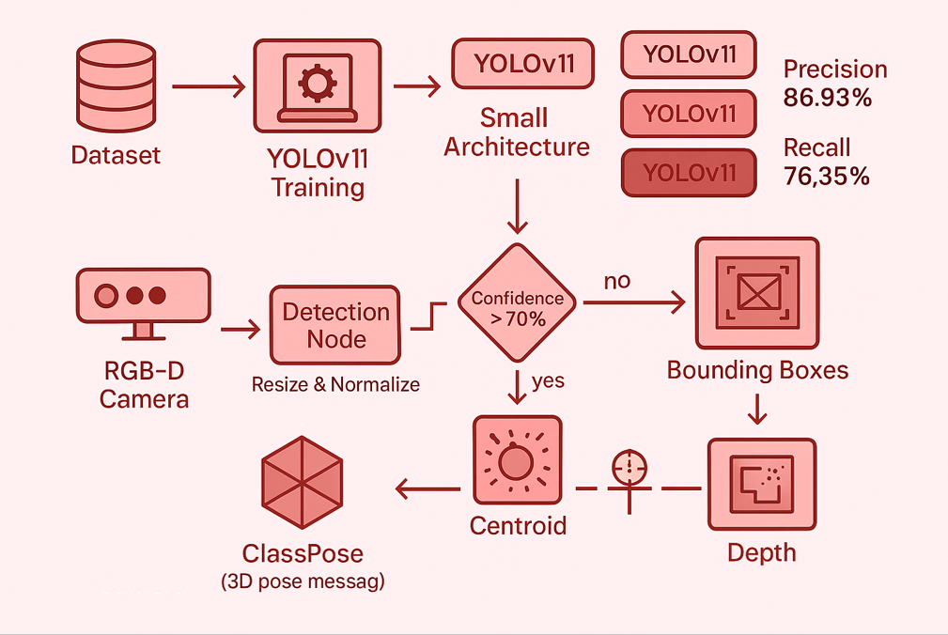
Vision-Guided
Pick-and-Place
Final Results
Motion Package
A Class-Based Object Sorting with an Anthropomorphic Robotic Arm
Task Overview:
Objects begin upright and unordered on the stand; pick each one up and place it into the silhouette that marks its assigned class position.
The Workflow
Work Division:
Responsabilities were split evenly: we collaborating on every stage of the project and meeting regularly
Planning Package
Vision Package
Sara Francavilla – Nivriti Raisingh

Slide 2
Vision-Guided
Pick-and-Place
The Workflow:
RGB-D camera → 3-D object poses
FSM picks tactic, sends start/goal poses
Motion stack builds trajectory
UR5 executes, repeats
Sara Francavilla – Nivriti Raisingh

Slide 3
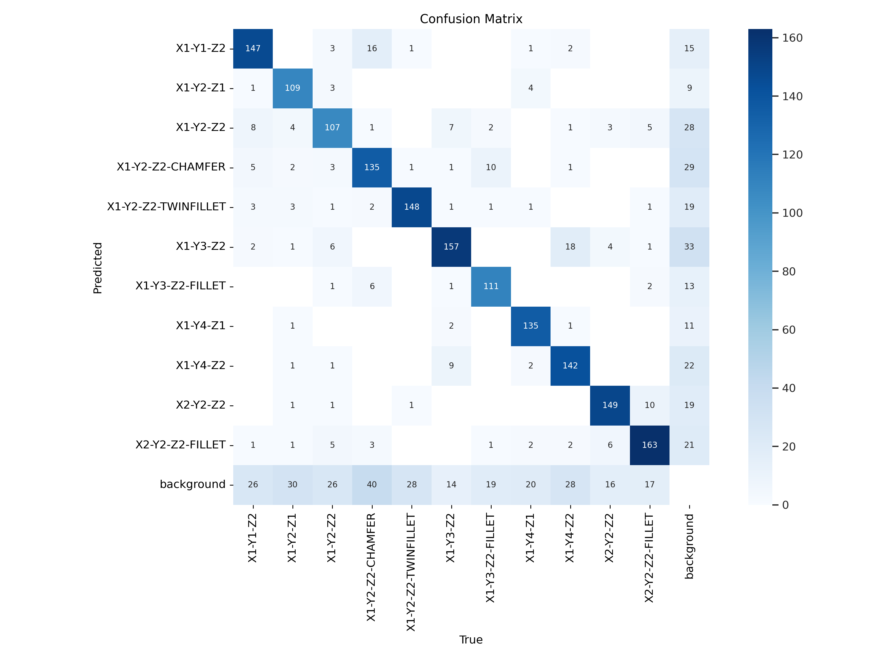
Vision-Guided
Pick-and-Place
Vision Package
Fine-tuned YOLOv11-small on course dataset → 87 % precision, 76 % recall; chosen for best speed/accuracy.
Sara Francavilla – Nivriti Raisingh

Slide 4
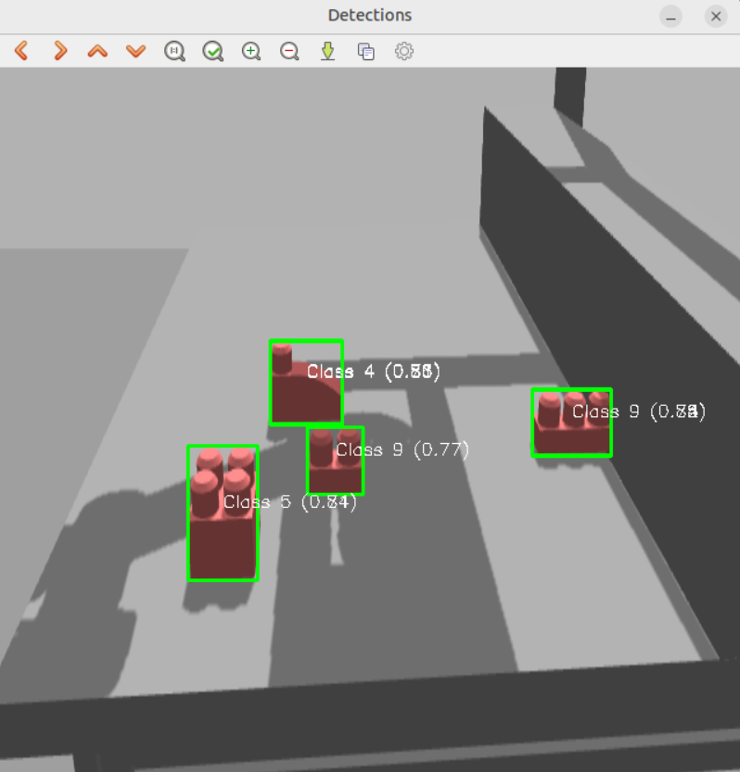
Vision-Guided
Pick-and-Place
Vision Package
FSM picks tactic, sends start/goal poses
detection.cpp: resize + normalize RGB, run CNN, keep boxes > 70 % confidence (class + 2-D center).
Sara Francavilla – Nivriti Raisingh

Slide 5
Vision-Guided
Pick-and-Place
Vision Package
position.cpp: project box into depth cloud, compute 3-D centroid, transform to robot base frame.
Outputs a ClassPose (centroid + class) → vision stage complete.
Sara Francavilla – Nivriti Raisingh

Slide 6
Vision-Guided
Pick-and-Place
Planning Package
Control Node FSM reacts to each ClassPose, cycling through approach → pre-grasp → grasp → retreat → place
FSM picks tactic, sends start/goal poses
It publishes start/goal poses on /path_extrema, triggers motion, and waits for /trajectory_executed feedback before advancing.
Trajectory Execution converts ViaPoints to a MoveIt JointTrajectory, drives the UR5, and flags completion for the next FSM step.
Sara Francavilla – Nivriti Raisingh

Slide 7
Vision-Guided
Pick-and-Place
Motion Package:
Path Builder: SLERP turns each start/goal pair into 101 Cartesian waypoints, publishing a PoseArray.
Trajectory Generator: vectorised IK + cubic timing pick the smoothest UR5 joint path, yielding a JointTrajectory
Kinematics Services: on-demand FK/IK and singularity checks keep solutions valid.
Safety Watchdog: 100 Hz height check shuts down motion if the tool descends below the table..
Sara Francavilla – Nivriti Raisingh

Slide 8
Vision-Guided
Pick-and-Place
Final Results:
Open issues: rare goal rejections from RViz simulated-time skew; fix by hardening clock sync and adopting minimum-jerk profiles for smoother paths.
Sara Francavilla – Nivriti Raisingh

