Slide 1
Habit Tracker App
CLI Habit Tracking Application (Python)
Nikita Wokurka
IU DLBDSOOFPP01 — Portfolio Part 2 (Development/Reflection)

Slide 2
Overview
CLI habit tracking backend (OOP + functional analytics)
• Goal: track daily/weekly habits, record check-offs, and compute streak analytics with authentication
• Scope: CLI-only (no GUI), single-user workflow, modular architecture for future UI/storage swaps
• Python: 3.7+ (implemented with modern Python features)
• Persistence: SQLite by default; JSON as optional alternative backend

Slide 3
Architecture
Separation of concerns: CLI → Services/Logic → Storage + Analytics
CLI (Boundary)
questionary menus
input validation
prints results
Logic (Control)
HabitManager
AuthManager
write-through saves
Storage (Persistence)
Storage interface
SqliteStorage
Analytics (Functional)
pure functions
streaks & filters
no I/O side-effects
• Key rule: UI contains no business logic; analytics functions accept data and return computed results.

Slide 4
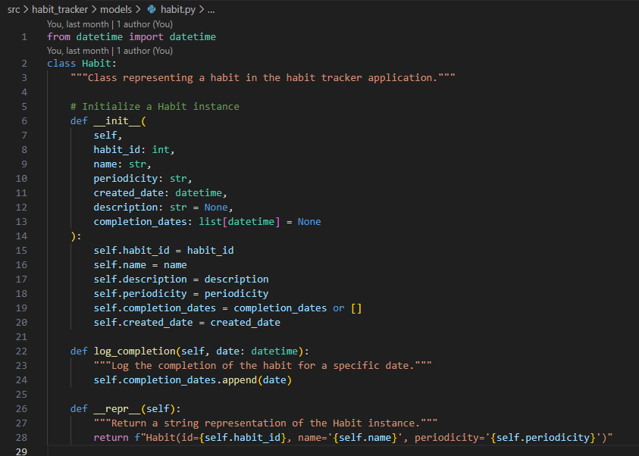
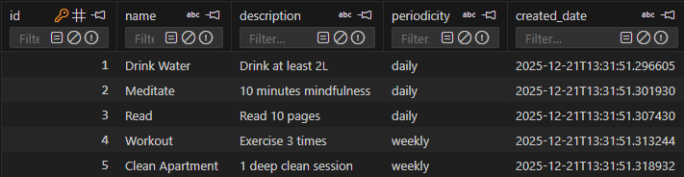
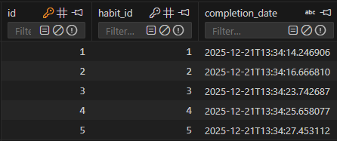

Data Model
Habit entity + completion events (suitable for JSON or SQLite)
Habit entity
SqlLite
Each completion is stored as a timestamped event

Slide 5
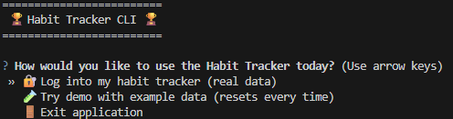
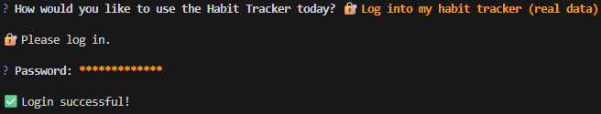

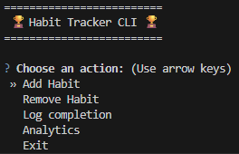
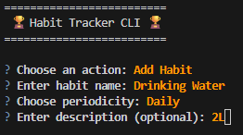
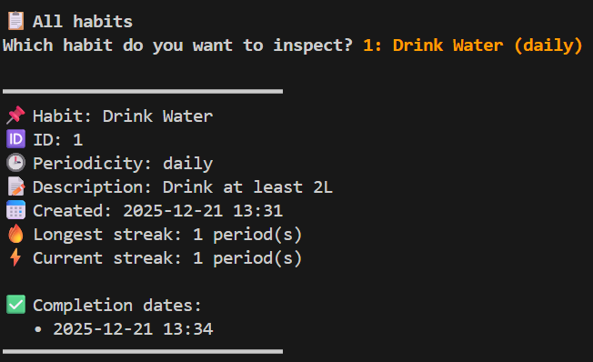
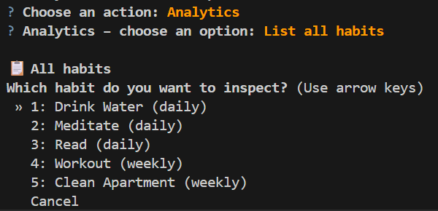
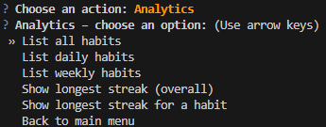
User Flow
Create → Check-off → Persist → Analytics
Welcome Screen
Login
Check-off
Main menu
Habit creation
Habit inspection
Habit list
Analytics menu

Slide 6
Key Features
Core requirements implemented
• Supports daily and weekly habits (periodicity is part of the habit definition).
• Check-off logging uses timestamps; history enables streak.
• Streak computation respects periodicity rules (daily vs weekly).
• Predefined fixtures: 5 habits + 4 weeks sample check-offs for quick demo & testing.
• Write-through persistence: user actions are saved immediately.
• Authentication with SHA256 Hash and salt

Slide 7
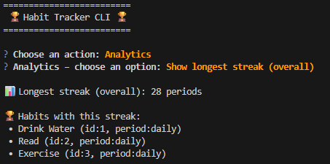
Analytics
Questions answered (pure functions) + sample CLI output
• List all habits
• List habits by periodicity (daily / weekly)
• Longest streak overall (across all habits)
• Longest streak for a selected habit

Slide 8
Tech Choices
Why these tools?
• SQLite: lightweight, zero-config DB; supports structured queries and reliable persistence.
• JSON (optional): simple file portability for quick experiments.
• questionary: user-friendly interactive CLI menus (less error-prone than raw input()).
• pytest: fast unit tests for streak rules and analytics correctness.
• stdlib: sqlite3/json/datetime + hashlib for secure password hashing (if auth enabled).

Slide 9
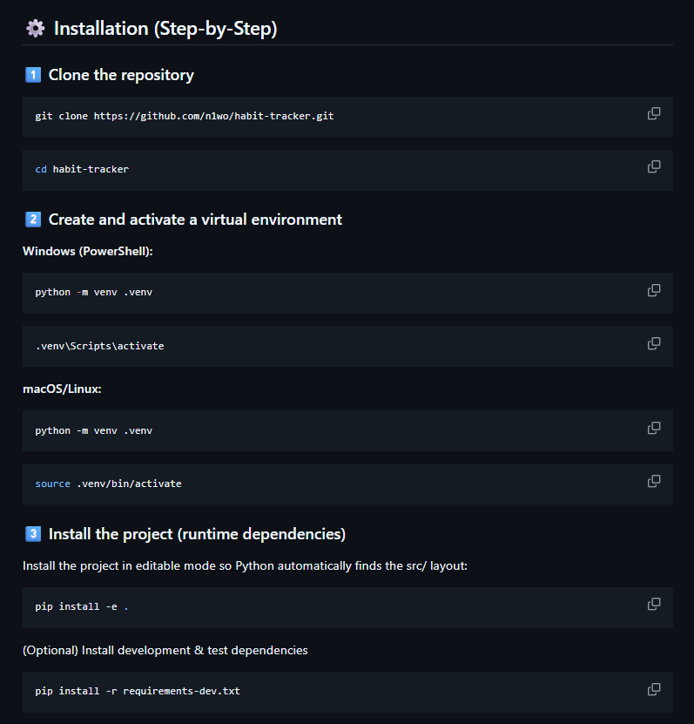
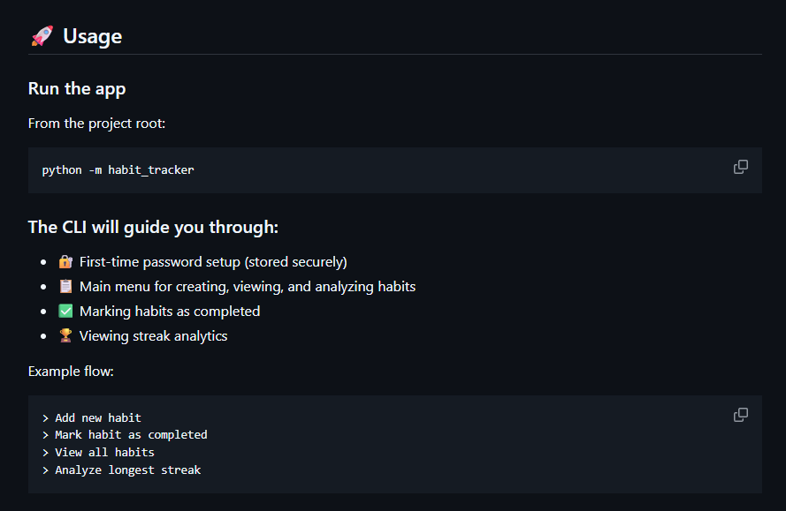
How to Run
Clean install + common commands (copy/paste)

Slide 10
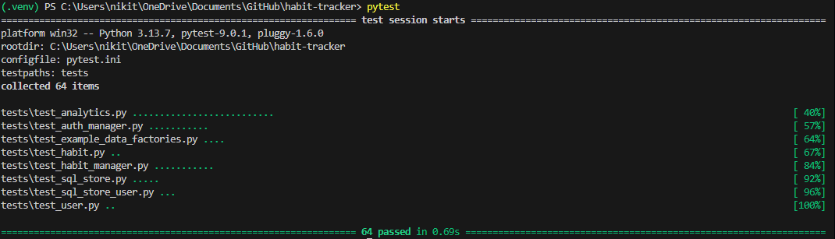
Tests & Quality
Confidence in streak rules + pure analytics
• Unit tests cover: habit creation, check-off behavior, streak calculations, analytics filters.
• Edge cases handled: duplicate check-offs in same period; empty completion history; mixed daily/weekly.
• Storage is abstracted → tests can use InMemoryStorage to isolate logic.
• Docstrings + README ensure reproducible setup and usage.

Slide 11
Reflection
What worked, trade-offs, limits, next steps
• Worked well: clean separation (UI/logic/storage/analytics) → easier testing and maintenance.
• Trade-offs: CLI-first UX keeps scope tight; SQLite adds structure vs JSON simplicity.
• Known limits: single user; basic reporting; no reminders/notifications; minimal visualization.
• Next steps: richer analytics (missed periods, trends), export CSV, multi-user profiles, optional web UI.

