Slide 1


COBOL:
An Overview

Slide 2


Contents
Historical Background of COBOL
COBOL Program Structure
Variable Declaration
Explanation of Solution Code (Stack Implementation)

Slide 3
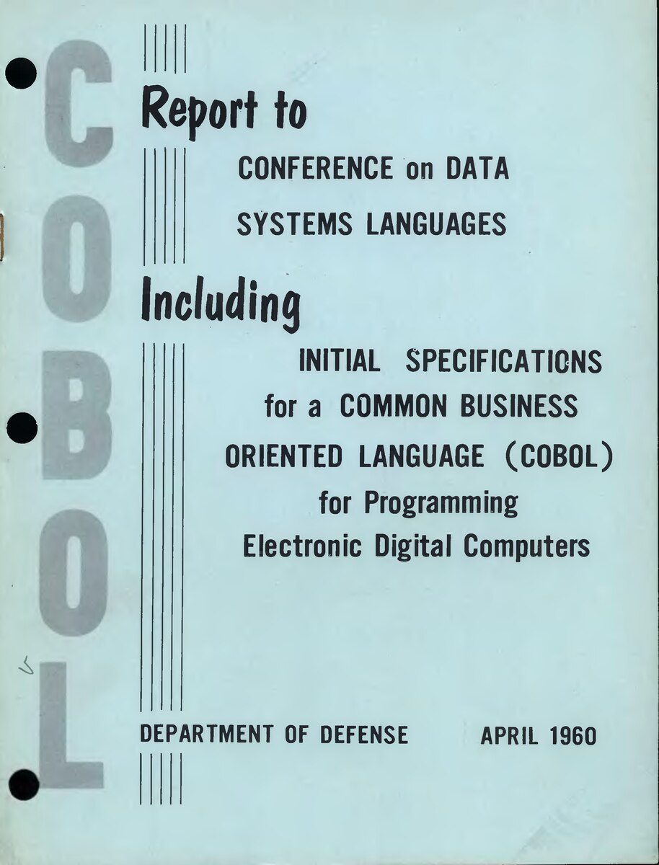
Historical Background

Slide 4
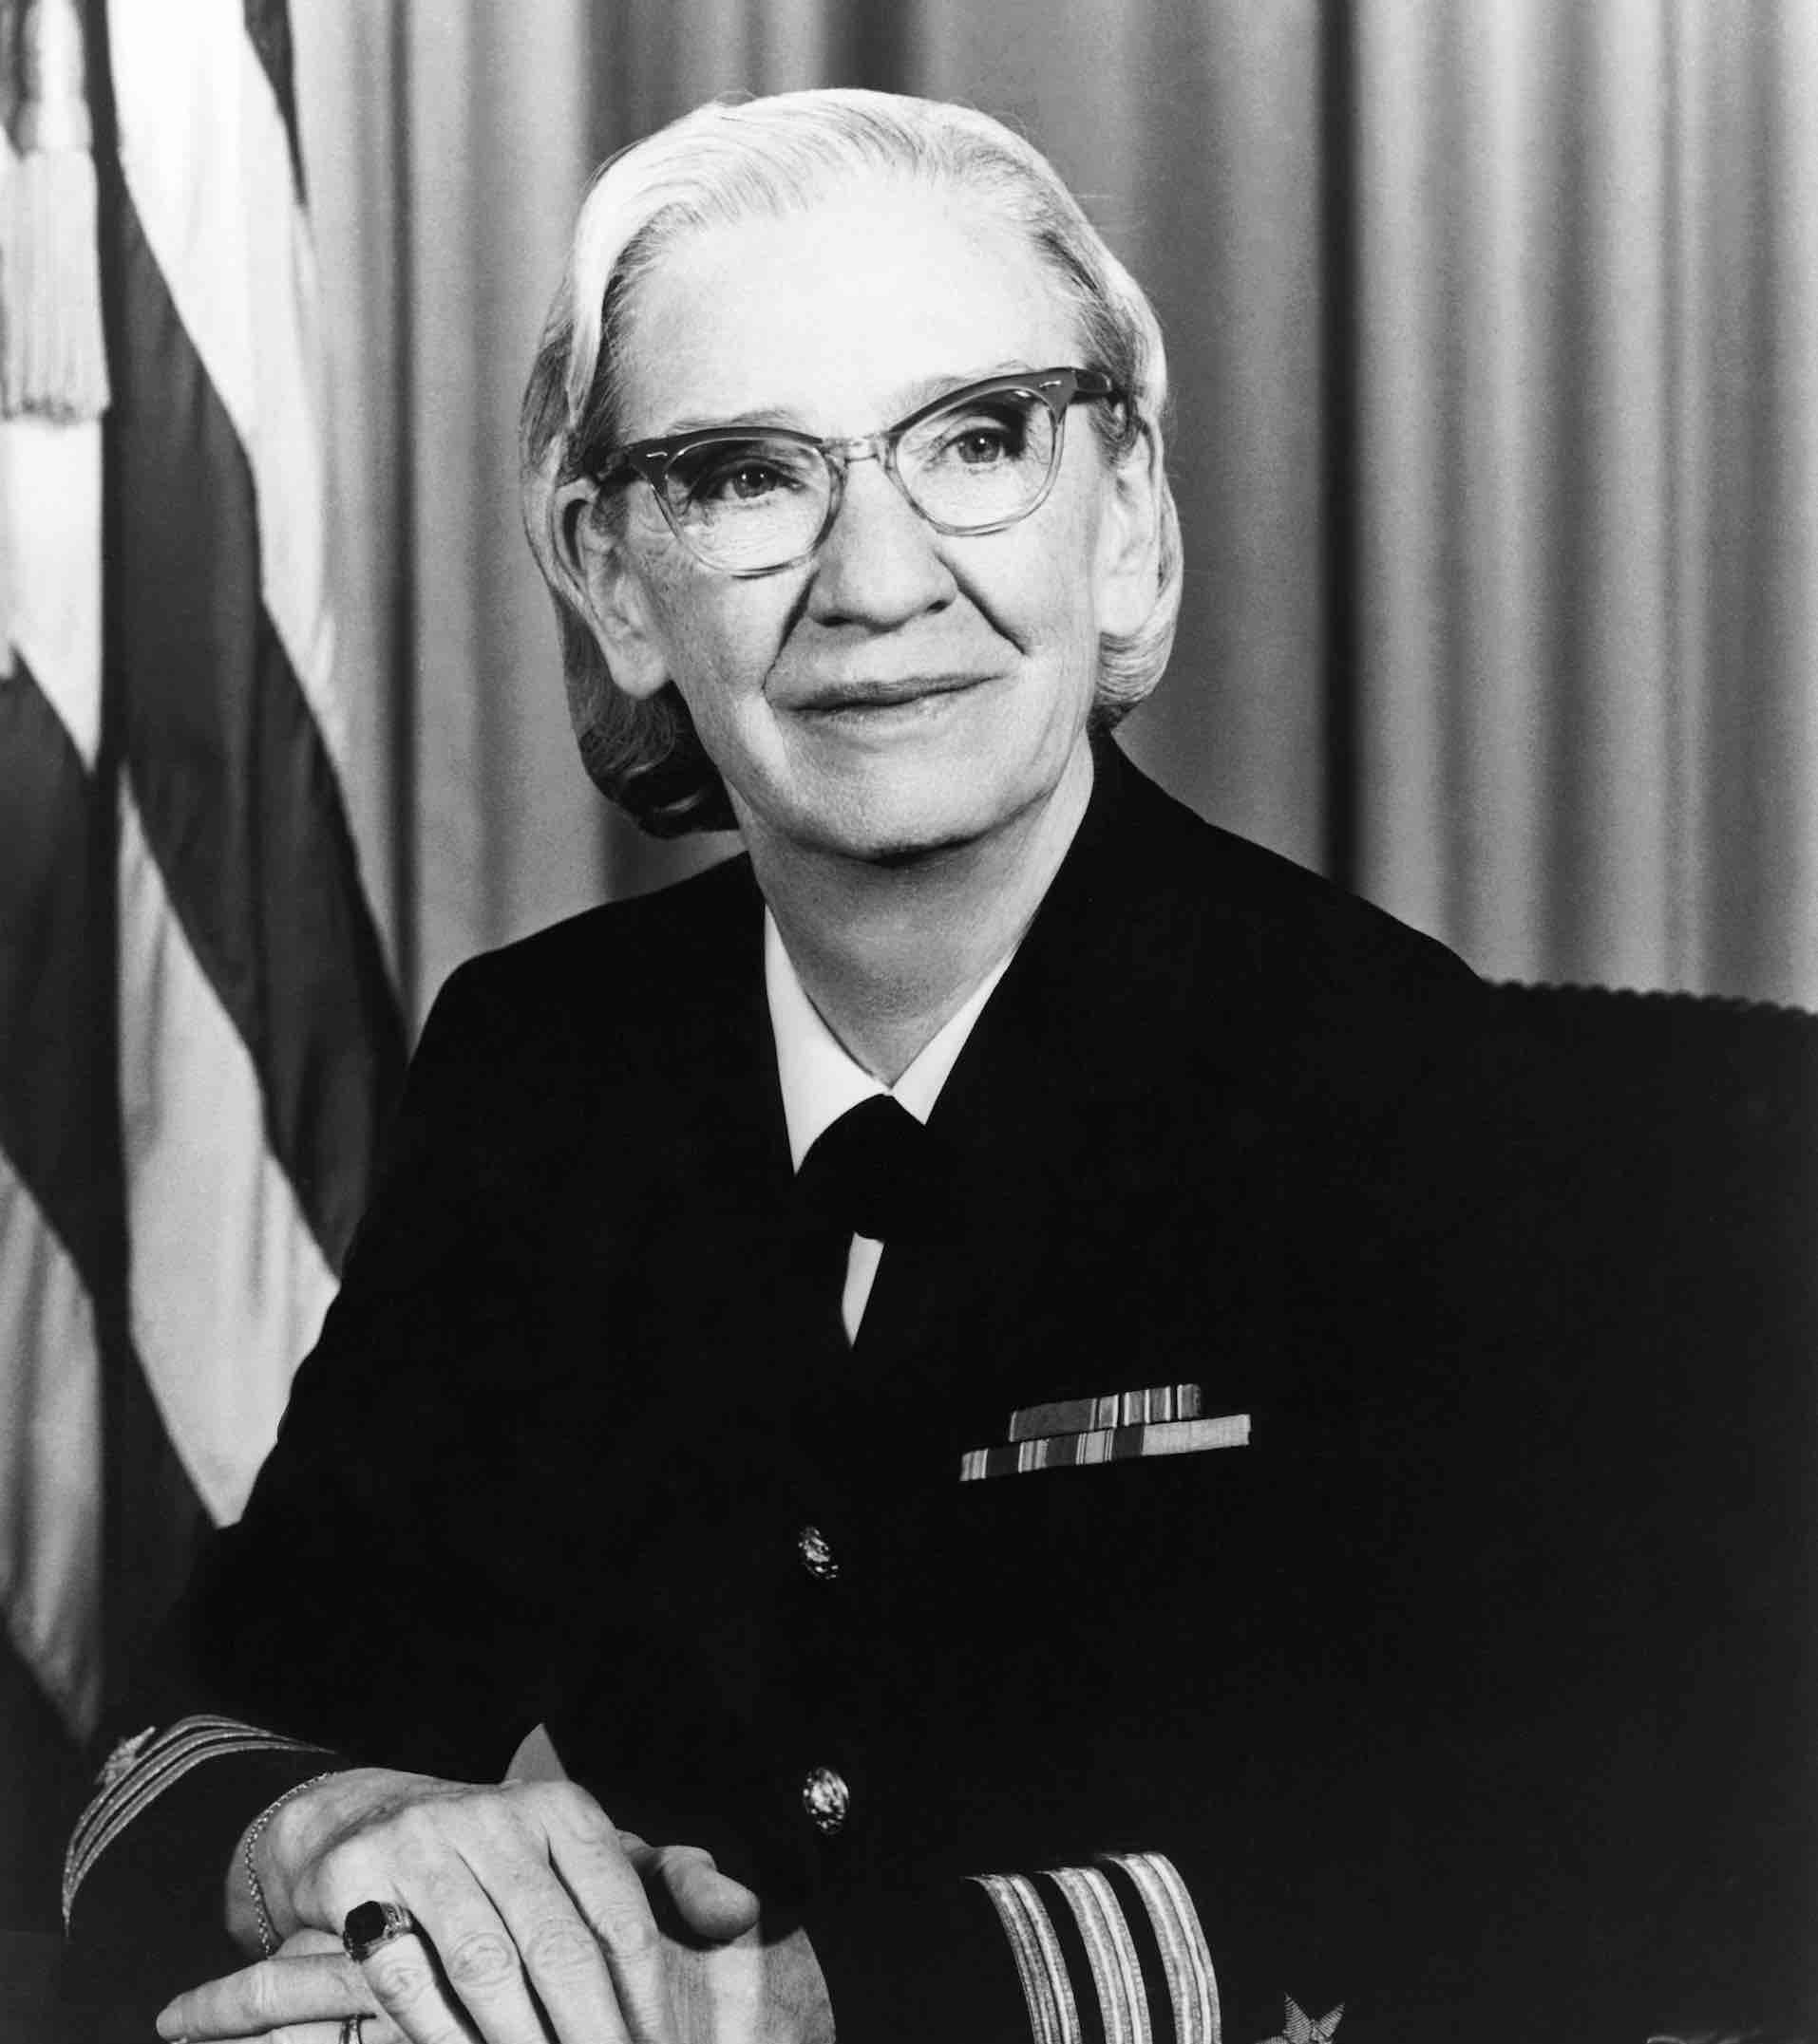

Historical Background
On 8 April 1959, Mary K. Hawes, a computer scientist at Burroughs Corporation, called a meeting of representatives at the University of Pennsylvania to organize a formal meeting on common business languages.
The group asked the Department of Defense to sponsor an effort to create a common business language.
Charles A. Phillips, director of the Data System Research Staff at the DoD, agreed to sponsor the meeting and tasked the delegation with drafting the agenda

Slide 5
Historical Background
COBOL was developed by the Conference on Data Systems Languages (CODASYL), which formed in 1959.
Was partly derived from FLOW-MATIC, the first data-processing language to use English-like keywords

Slide 6
Historical Background
The first version of the COBOL programming language was released in 1960 (COBOL-60)
It was ultimately standardized as a computer language in 1968 (ISO/IEC 1989).
Implemented several revisions and modernizations, including COBOL-61, COBOL-68, COBOL-74 and COBOL-85

Slide 7
Historical Background
COBOL 2002 aimed to make COBOL applications more compatible with modern software development practices by introducing object-oriented features
COBOL 14 introduced new changes, including replacing portable arithmetic results with IEEE 754 data types
The latest standard, COBOL 2023, delivered additional new features focused on improving COBOL's interoperability with modern systems

Slide 8
COBOL Revisions
COBOL Version | Major Change(s)
COBOL-61 | Structural changes; more stable version of COBOL-60
COBOL-61 Extended (1963) | Addition of the SORT verb Modification of arithmetics to accommodate multiple input fields Addition of the CORRESPONDING keyword
COBOL-65 | Inclusion of options for reading, writing, and processing of mass storage files Addition of table handling features, including indexing and search options Deletion of the terms REQUIRED and ELECTIVE

Slide 9
COBOL Revisions (Cont.)
COBOL Version | Major Change(s)
COBOL-68 | Introduction of ANSI COBOL (USA Standard COBOL X3.23) Inclusion of inter-program communication Elimination of type 4 abbreviations (Omission of optional keywords in statements) Elimination of the DEFINE statement inclusion of the SUSPEND statement as additional means of controlling graphic display devices
COBOL-69 | deletion of the EXAMINE statement and; the inclusion of a more powerful statement, INSPECT inclusion of the STRING and UNSTRING statements Deletion of the CONSTANT SECTION of the Data Division

Slide 10
COBOL Revisions (Cont.)
COBOL Version | Major Change(s)
COBOL-70 | Inclusion of the INITIALIZE statement Inclusion of a debugging facility Inclusion of a merge facility Complete revision of the report writer function
COBOL-73 | Revision and extension to the mass storage facility Clarification and extension to the COBOL library facility Enhancement of the INSPECT statement Removal of the restriction on 77 level-numbers that they must precede 01 level numbers

Slide 11
COBOL Revisions (Cont.)
COBOL Version | Major Change(s)
COBOL-76 | Inclusion of a boolean (bit) manipulation facility Inclusion of the DELETE FILE statement Inclusion of the PURGE statement
COBOL-78 | Inclusion of the ROLLBACK statement Inclusion of the REPLACE statement Inclusion of a data base locking facility to maintain data base integrity Inclusion of an inter-program communication facility Inclusion of facility to control input-output in separately compiled programs

Slide 12
COBOL Revisions (Cont.)
COBOL Version | Major Change(s)
COBOL-80 | Deletion of the DATA RECORDS clause Deletion of the CORRESPONDING option Inclusion of an EXIT PERFORM statement Change to the CALL statement to allow languages other than COBOL to be called Semantics for lowercase letters were defined
COBOL-85 | Inclusion of scope terminators (END-IF, END-PERFORM, END-READ) Inclusion of EVALUATE statement Inclusion of CONTINUE statement Introduction of nested subprograms

Slide 13
COBOL Revisions (Cont.)
COBOL Version | Major Change(s)
COBOL 2002 | Object-Oriented COBOL Introduction of user-defined functions Introduction of user-defined data types
COBOL 2014 | Introduction of object finalization (garbage collector) XML processing capabilities Dynamic memory allocation
COBOL 2023 (Latest) | Asynchronous message syntax using SEND and RECEIVE statements XOR logical operator Defined infinite loop with PERFORM UNTIL EXIT

Slide 14

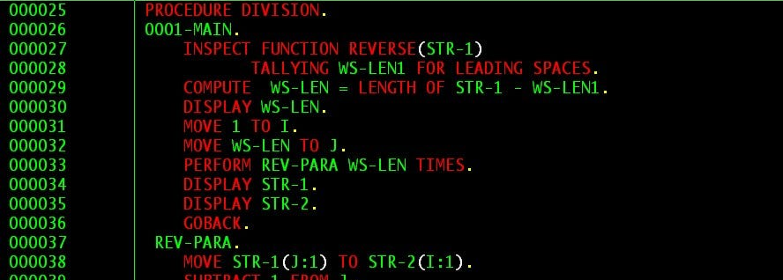
COBOL Program Structure

Slide 15

Program Structure
COBOL has a hierarchical structure that comprises divisions, sections, paragraphs, sentences, verbs and character strings.
The divisional nature of a COBOL system (which comprises four divisions) enables a distinct separation of concerns within COBOL programs
COBOL divisions are as follows:
  Identification division
  Environment division
  Data division
  Procedure division

Slide 16
Identification Division
is the first division of a COBOL program, and is mandatory
assigns the program a name and provides other identification information like author, date written and a brief description of the program's purpose
COBOL programs need a PROGRAM-ID paragraph to function within the identification division

Slide 17
Environment Division
Specifies the runtime environment for a program and defines the input and output resources it will use
Subdivided into two sections:
  Configuration Section (Obsolete)
    provides information about the system configuration, including the computer and compiler features it’s using
  Input-Output Section
    specifies the files and associated devices that the program can interact with
    includes the FILE-CONTROL paragraph and the I-O-CONTROL paragraph

Slide 18
Data
Division
  Houses all variable, file and constant definitions for the program
  Subdivided into four main sections:
    FILE Section
    WORKING-STORAGE Section
    LOCAL-STORAGE Section
    LINKAGE Section

Slide 19
Data
Division
  FILE SECTION - lists every file that the program will read from or write to
  WORKING-STORAGE SECTION - defines variables that maintain their values throughout the run of the program
  LOCAL-STORAGE SECTION - defines variables allocated upon deployment of the program or method and deallocated upon termination; useful for recursive algorithms and reentrant programs
  LINKAGE SECTION - defines data items that pass from one program to another

Slide 20
Procedure
Division
  contains the executable code of the program
  is divided into paragraphs and sections that structure the code into code blocks for better readability and easier maintenance

Slide 21

Variable Declaration

Slide 22
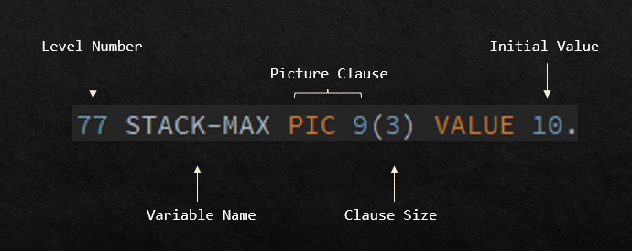

Basic Declaration Structure
Value Clause

Slide 23
Level Number
  Facilitates hierarchy among variables in the data division
  Level meanings:
    01 = Top-level group or record
    02-49 = Subordinate items (05 is commonly used)
    66 = RENAMES clause (aliasing)
    77 = Independent elementary item
    88 = Condition names (like boolean flags)

Slide 24
Defining Data
  Two main parts of defining data in COBOL: USAGE clauses and PICTURE clauses
  PICTURE Clause defines the size, type, and format of your data from a logical/display perspective
  USAGE Clause defines how the data is physically stored in memory

Slide 25
PICTURE Clause Options
PICTURE Clause | Data Type
PIC A | Alphabetic character (A-Z, a-z, space)
PIC 9 | Numeric character (0-9)
PIC X | Alphanumeric character
PIC S9 | Signed number
PIC 9(4)V99 | V = Implied decimal point
PIC N (2002+) | Unicode character

Slide 26
USAGE Clause Options
USAGE Clause | Storage Type | Data Size
DISPLAY | Character format (ASCII/EBCDIC) | 1 byte per character
BINARY/ COMP | Binary integer | 2/4/8 bytes
COMP-1 | Single-precision Float | 4 bytes
COMP-2 | Double-precision Float | 8 bytes
COMP-3 | Binary-coded decimal (BCD) | 1 byte per 2 digits

Slide 27
USAGE Clause Options (COBOL 2002+)
USAGE Clause | Data Type | Data Size
FLOAT-SHORT | IEEE 754 standard floating point | 4 bytes
FLOAT-LONG | IEEE 754 standard floating point | 8 bytes
FLOAT-EXTENDED | IEEE 754 standard floating point | 16 bytes
BINARY-SHORT | Fixed-size binary integer | 2 bytes signed
BINARY-LONG | Fixed-size binary integer | 4 bytes signed
BINARY-DOUBLE | Fixed-size binary integer | 8 bytes signed

Slide 28
USAGE Clause Options (COBOL 2002+)
USAGE Clause | Data Type
POINTER | Memory addresses
OBJECT REFERENCE | References to class instances
NATIONAL | Unicode character
INDEX | Special data type for indexing
FUNCTION-POINTER | Pointer to a procedure
TYPEDEF | Reusable type definitions

Slide 29
Solution Code (Stack)

Slide 30
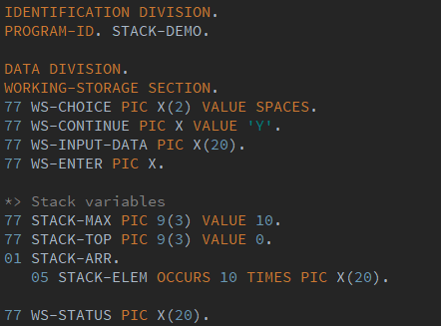
Identification
& Data Division

Slide 31
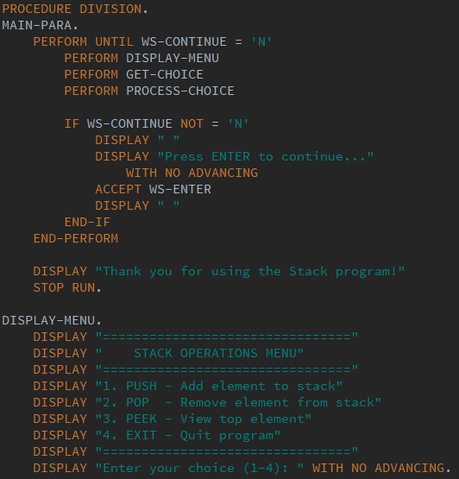
Procedure Division

Slide 32
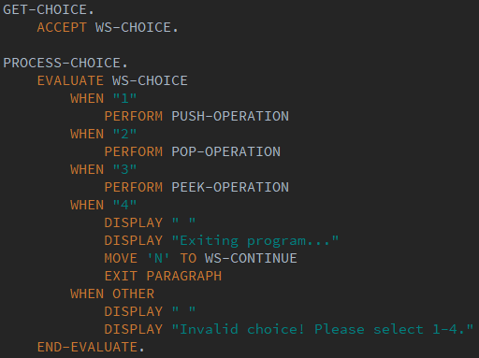
Procedure Division

Slide 33
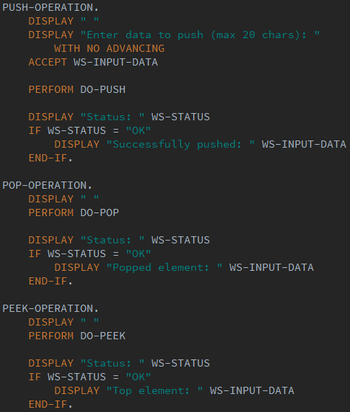
Procedure Division

Slide 34
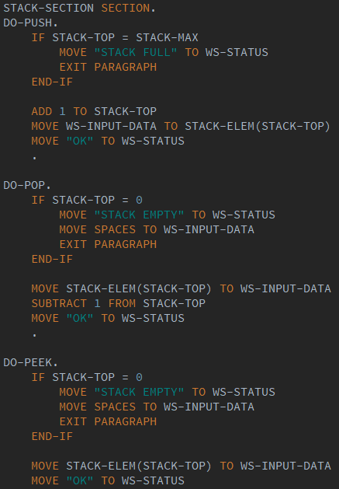
Stack Section

Slide 35
References
IBM Official Website - https://www.ibm.com/think/topics/cobol
History of COBOL - https://timthewebmaster.com/en/articles/cobol-programming-language-history/#-cobol-76

Slide 36
End of Presentation
Thank you for listening

