Slide 1
NLP FINAL PROJECT
Aspect-Based Sentiment Analysis
for Restaurant Reviews
Example output
"The sushi was fresh, but the waiter was rude and the restaurant was too noisy."
Food
Positive
A working NLP system that reads one restaurant review and returns sentiment for Food, Service, Price, and Eating Environment / Ambiance.
Service
Negative
Price
Unknown
Why ABSA?
Ambiance
Negative
Restaurant reviews often contain mixed opinions. ABSA keeps the details visible by assigning a separate sentiment label to each aspect.
The system always returns all four aspects.
3,041
12,164
3
0.8865
4
restaurant reviews
review-aspect rows
model approaches
best macro F1
fixed aspects
Methods compared: Rule-based baseline, TF-IDF Logistic Regression, and DeBERTa-v3-base.

Slide 2
ABSA Restaurant Reviews
02
TEAM ROLES
Each member owns one part of the ABSA system, so the presentation follows the project responsibilities.
This slide can be used when introducing who speaks for dataset/system, rule-based modeling, and traditional ML/model comparison.
N22DCCN141
N22DCDT038
N22DCAT003
Huynh Ba Anh Khoa
Dang Nhat Nam
Ta Quang An
Leader / Deep Learning / App Integration
Traditional Machine Learning
Rule-Based ABSA
- Prepared review-aspect data and DeBERTa-v3-base training
- Built TF-IDF text features and Logistic Regression classifiers
- Defined aspect keywords and sentiment lexicons
- Built Flutter demo, Python API connection, and final materials
- Reported Traditional ML metrics for model comparison
- Implemented negation handling and spaCy dependency parsing
Slides 1-5 and 11-12
Slides 8-10
Slides 6-7
Recommended handoff: Khoa introduces the system, An explains the rule-based baseline, Nam compares models, then Khoa closes with the final model choice.

Slide 3
TASK FRAMING
Whole-review sentiment hides the aspect that changed.
ABSA returns one label per restaurant aspect, so mixed opinions stay visible.
Output table
Input review
Food
Positive
"The sushi was fresh and delicious, but the waiter was rude and the restaurant was too noisy."
Service
Negative
Price
Unknown
Eating Environment / Ambiance
Negative
Project rule: always return all four aspects, using Unknown when an aspect is absent or unclear.
ABSA Restaurant Reviews
02

Slide 4
ABSA Restaurant Reviews
04
RAW DATASET
The original SemEval XML contains human-labeled restaurant review sentences before project mapping.
Source file: backends/data/raw/Restaurants_Train_v2.xml. Each sentence can contain aspect-category tags and polarity annotations.
3,041
5
4
Raw XML example structure
raw review sentences
source categories
polarity labels
<sentence id="3121"> review text + <aspectCategory category="service" polarity="negative"/>
The raw labels are useful, but they must be normalized before all models can produce the same four-aspect output.
Original aspect categories
Original polarity labels
food
1232
positive
2179
anecdotes/misc.
1132
negative
839
service
597
ambience
431
neutral
500
price
321
conflict
195
Next slide: the raw XML is converted into clean wide and long CSV files, with fixed aspects and Positive / Negative / Unknown labels.

Slide 5
ABSA Restaurant Reviews
05
PREPROCESSED DATASET
Raw SemEval annotations are converted into fixed, model-ready ABSA tables.
The preprocessing step makes every model solve the same task: four aspects and three labels for every review.
What was changed
Output schema
Validation rules
Mapped categories
Wide CSV
Non-empty text
food, service, price, ambience -> four project aspects
One review row with columns:
Drop or reject rows with empty review text
Mapped polarities
id | review | Food | Service | Price | Ambiance
Valid columns
positive / negative kept; neutral and conflict become Unknown
Long CSV
Ensure expected fields exist in both CSV formats
Ignored misc.
Four rows per review, one per aspect:
Valid labels
miscellaneous category removed
id | review | aspect | sentiment
Only Positive / Negative / Unknown allowed
Final dataset features
Label distribution after preprocessing
3,041
12,164
4
All labels
Positive 1,633
Negative 640
wide rows
aspect rows
fixed aspects
Unknown 9,891
Result: a consistent ABSA dataset that supports rule-based output, traditional ML training, transformer review-aspect training, and fair evaluation.

Slide 6
PROCESSING
SemEval annotations are reshaped into app-ready and model-ready data.
Two output files support different parts of the system.
Raw XML
Normalize
Map aspects
Fill Unknown
Export CSVs
Restaurant review text with aspect-category annotations.
Clean text, standardize IDs, validate non-empty reviews.
Collapse source categories into Food, Service, Price, Ambiance.
Every review receives all four aspect labels.
Wide table for API output; long table for aspect-pair training.
Wide format
Long format
Validation
restaurant_absa_4_aspects.csv: id, review, and four aspect columns.
restaurant_absa_aspect_rows.csv: one row for each review-aspect pair.
Checks expected columns, valid labels, and non-empty review text before training.
ABSA Restaurant Reviews
04

Slide 7
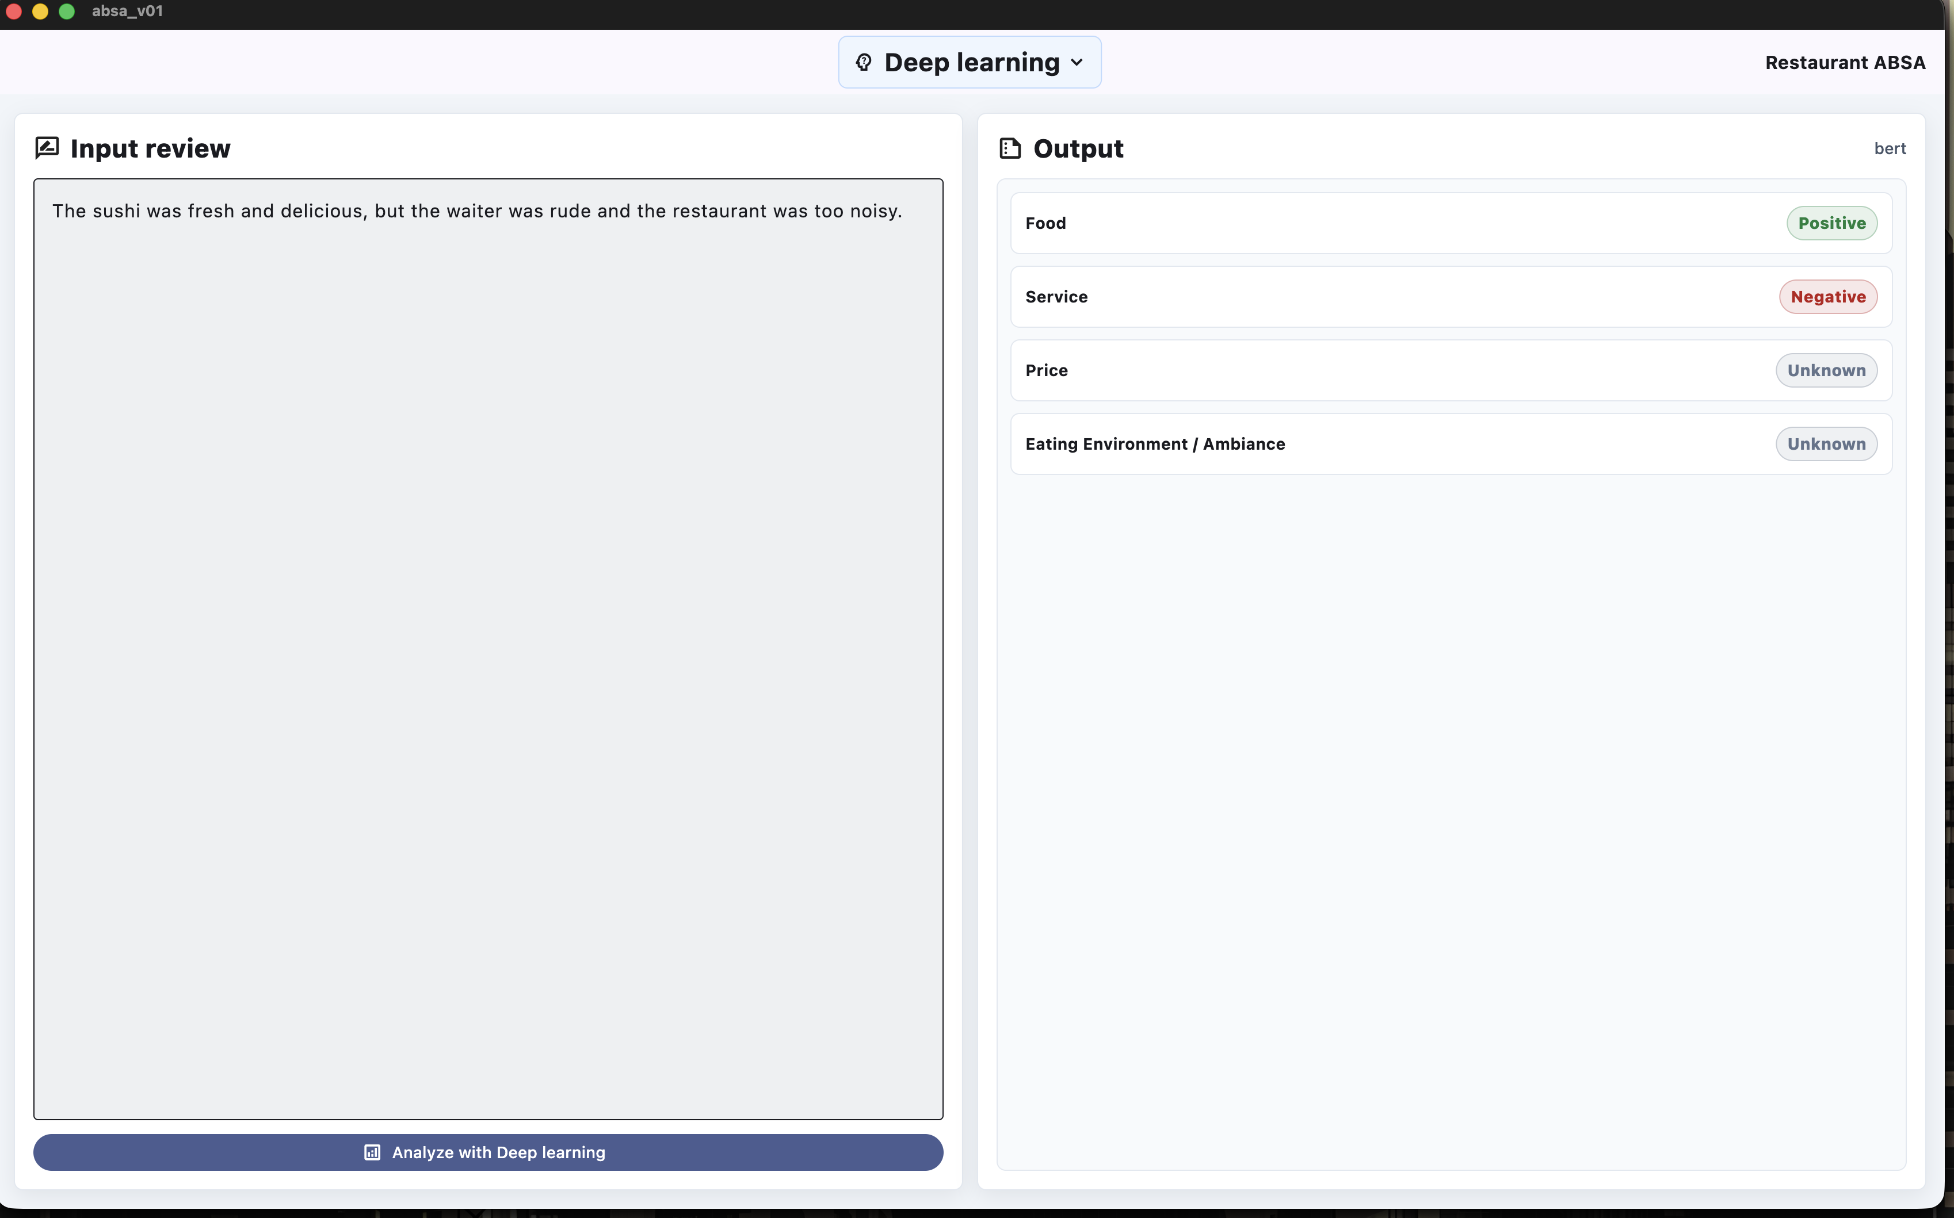
SYSTEM
The same review can flow through three model backends.
The backend exposes /health and /analyze for the Flutter application.
Flutter UI
Python API
Model layer
Structured output
User enters review and selects method.
ThreadingHTTPServer handles JSON and CORS.
rule_based, traditional_ml, or bert.
review, method, and four aspect results.
Demo proof
The app shows the expected four-row aspect output and lets the user switch among rule-based, traditional ML, and deep learning methods.
ABSA Restaurant Reviews
05

Slide 8
MODEL DESIGN
Each model answers the same task with a different level of context.
The comparison is fair because all methods produce the same label space.
Rule-based
Traditional ML
DeBERTa
spaCy dependency parsing, aspect keywords, sentiment lexicons, negation and intensifier rules.
TF-IDF unigrams/bigrams plus one balanced Logistic Regression classifier per aspect.
microsoft/deberta-v3-base receives review + aspect pairs and predicts one of three labels.
Most explainable
Fast learned baseline
Best contextual model
Tradeoff
Transparent rules
Learned lexical patterns
Contextual transformer
ABSA Restaurant Reviews
06

Slide 9
EVALUATION SETUP
Macro F1 is the main score because the dataset is imbalanced.
Final three-model comparison uses the report's fresh 70/30 evaluation setup.
Accuracy
Macro F1
Overall correct predictions; useful but can hide majority-class bias.
Computes F1 per label, then averages equally across Positive, Negative, Unknown.
Weighted F1
Mentioned-aspect eval
F1 weighted by support; reflects the class distribution.
Filters to Positive and Negative examples to test actual sentiment detection.
Evaluation labels: Positive, Negative, Unknown | Aspects: Food, Service, Price, Ambiance
ABSA Restaurant Reviews
07

Slide 10
OVERALL METRICS
DeBERTa wins the final comparison by the metric that matters most.
70/30 fresh evaluation from the final report.
Rule-based
0.853
0.557
0.823
+0.2726
Traditional ML
0.877
0.614
0.859
macro F1 lead over Traditional ML
Rule-based: 0.5572
Traditional ML: 0.6139
DeBERTa: 0.8865
DeBERTa
0.950
0.886
0.951
Accuracy
Macro F1
Weighted F1
ABSA Restaurant Reviews
08

Slide 11
ASPECT PERFORMANCE
The transformer stays strong across all four restaurant aspects.
Macro F1 by aspect highlights whether a method works beyond one easy category.
Food
0.511
0.660
0.897
Food
Best overall aspect: DeBERTa reaches 0.8970 macro F1.
Service
0.580
0.586
0.869
Price
0.669
0.548
0.890
Ambiance
Harder for simpler models because terms are diverse and context-dependent.
Ambiance
0.495
0.533
0.853
Rule-based
Traditional ML
DeBERTa
ABSA Restaurant Reviews
09

Slide 12
PER-LABEL F1
The simple models score well on Unknown but miss real sentiment.
Per-label F1 exposes the imbalance problem better than accuracy.
Positive
0.437
0.612
0.860
What changes
DeBERTa lifts Negative F1 from 0.2955-0.3187 to 0.8263, which is the clearest sign that context helps.
Negative
0.319
0.295
0.826
Unknown
0.916
0.934
0.973
Unknown is high for every model, so it cannot be the only evidence.
Rule-based
Traditional ML
DeBERTa
ABSA Restaurant Reviews
10

Slide 13
KNOWN-ASPECT CHECK
When Unknown is removed, DeBERTa still wins decisively.
Mentioned-aspect evaluation uses the 659 Positive/Negative examples.
Mentioned-aspect macro F1
DeBERTa confusion matrix
Rule-based
0.4025
Positive
Negative
Unknown
Precision 0.9931 | Recall 0.2553
Positive
428
3
25
Traditional ML
0.4838
Precision 0.8374 | Recall 0.3570
Negative
19
157
27
DeBERTa
0.9065
Precision 0.9694 | Recall 0.8560
Unknown
92
17
2884
Rows are true labels; columns are predictions. Most errors are between known sentiment and Unknown.
ABSA Restaurant Reviews
11

Slide 14
CONCLUSION
The project satisfies the dataset, processing, and evaluation requirements.
The strongest method is selected from measured evidence, not only intuition.
Achieved
Evidence
Next work
Public SemEval restaurant dataset
Macro F1 comparison across three methods
More aspect categories
Four fixed aspects and three labels
Aspect-level and per-label charts
More balanced training data
Working Flutter + Python API demo
Mentioned-aspect and confusion analysis
Confidence calibration and error review
Selected final model: DeBERTa-v3-base, because it has the highest macro F1 and handles Positive/Negative labels far better.
ABSA Restaurant Reviews
12

