Slide 1
HBL project – Speaker Detection
Neta Oren and Faisal Omari

Slide 2
Meeting 1 – 9.3
Project description
Project goal
Optional methods (deep learning, machine learning, detecting Marissa’s voice)
References (articles), drive permissions

Slide 3
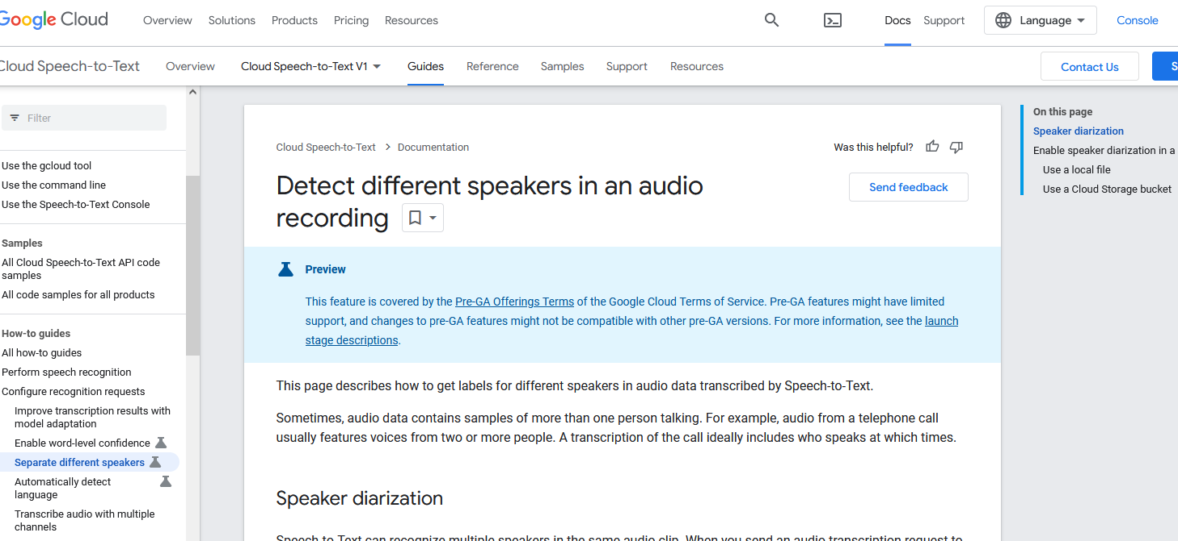
Meeting 2 – 19.3
What we did:
We tried to run a code from article, and check if can successfully apply diarization for the data
We read on the subject and diarization process : 1. speech detection 2. speech segmentation 3. embedding extraction 4. clustering 5. labeling clusters.
Wrote code to convert files to .wav
Tried with Resemblyer library Marissa vs other speakers
Todo: check google tool, and other tools

Slide 4
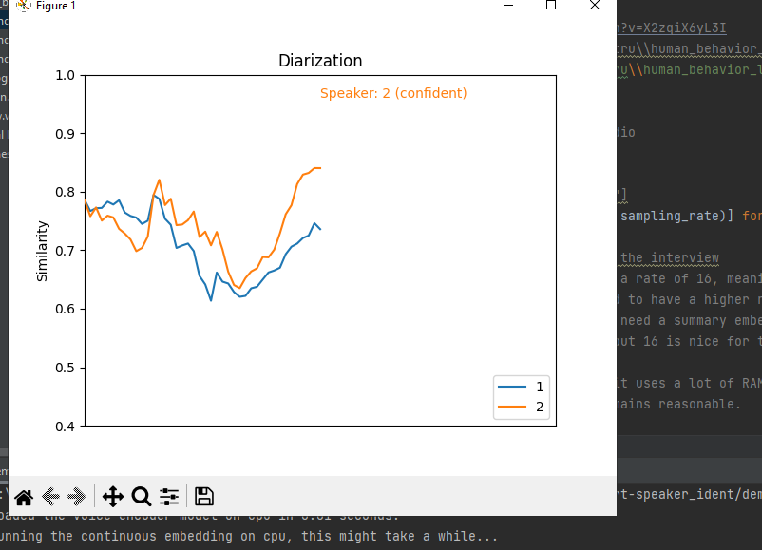
Meeting 3 – 26.3
Detected and separated (both female) speakers with Resemblyzer library, only with given segments
Need to get precise timings
Todo: Training segments
Tried google cloud, but it requires payment

Slide 5
Summary 4 – 2.4
Pulled out correct timings for each speaker
We understood how the library works , uses a pre-trained model weights according to dataset of celebrities recordings. Then uses encoder for embedding of new input
Similarity function is the dot product between the embedding of the speaker and the continuous embedding of the interview
To do: Recognize speakers accurately according to one segment with Marissa patched to all audios in beginning, according to similarity value

Slide 6
Meeting – 16.4
Managed to recognize speakers according to one segment with Marissa patched to all audios in beginning, using only the similarity to the video start of Marissa.
To do:
check in other videos, if the current similarity parameters are global or have to be optimized.
Hysteresis over the timings output, try 2-3 iterations, for the gap between certain to uncertain
Visual representation of the timings

Slide 7
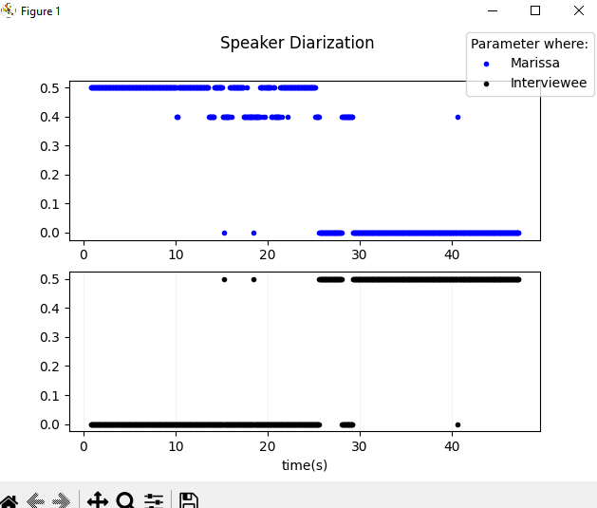
Meeting – 22.4
Applied speaker hysteresis
Added plot for speaker diarization
Todo: improve diarization for noisy videos, where Marissa sounds different
Keep vid with silent pauses, scale up with GPU and more vids

Slide 8
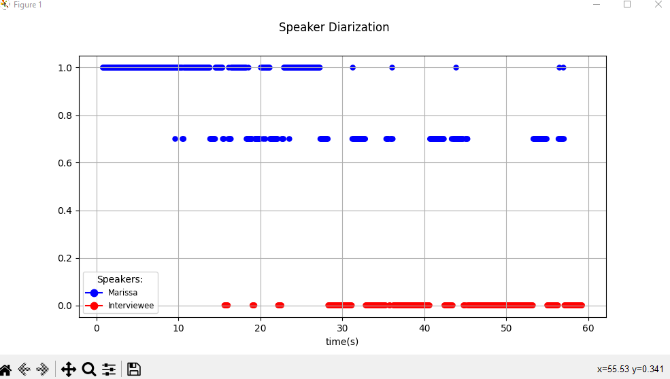
Meeting – 30.4
Applied this week:
Scaling up to use servers
Prepared new environments for GPU
Modified graphs, without silence
trimming
Need to do:
GPU run on full video, check batch size optimization
Run embedding of Marissa only once
One minute check that timing is accurate

Slide 9
Meeting 7.5
Managed to run on university GPU full vid but only on sample rate 2, might not be accurate enough
Got total time window for each speaker
Todo:
Run for smaller vid length – up to 10 mins
optimize code- try to reduce memory use and increase speed
Try again change the equivalent for our batch size
Finish silences insertion to graph, add similarity to output

Slide 10
Meeting 21.5
Kept trying detecting silences, batching, optimized code
Added a noise filter – but it only reduced the accuracy of speaker detection
Overall, got into barriers with the Rezemblyzer library
As a result:
Searched for other libraries meant for speaker diarization
Found : NeMo by NVIDIA, pyannote.audio by pyannote https://pypi.org/project/pyannote.audio/ , https://github.com/NVIDIA/NeMo
For next week: set on a library which also has a speech to text option, start working on it

Slide 11
Meeting 28.5
Installed both libraries – NeMo and Pyannote
Nemo lib is not easy to configure, very general tutorial
Pyannote is more user friendly, managed to run there but diarization is not very accurate, doesn’t look there are options to optimize

Slide 12
Meeting 4.6
Sent NeMo issue regarding whether they have unsupervised option – for unlabeled data.
Searched for options in pyannote to optimize, but can only do so with hours of labeled data
Found SimpleDiarizer, seem to have option for non-labeled data
Tried speechbrain, but they don’t have unlabeled option, they tried and got bad results: https://github.com/speechbrain/speechbrain/issues/657
Todo: check simple diarizer google, Microsoft
Or, use visual

Slide 13
Meeting 11.6
Run pyannote with the excel data files from openface to determine whether it’s the speaker or not
Tested diarization by camera microphone
Checked with Google, Microsoft if they have unsupervised speaker diarization
Camera option to detect microphone – not perfectly synchronized but has potential

Slide 14
Meeting 18.6
Best results are from clean pyannote speaker diarization, without camera microphone or visual data from openface
total success rate for 2:28 m: 138/148s = 93.20%
For next week:
confirm results on more videos
Apply smoothing of the same speaker in a row
Visualization of speaker diarization (vid with audio)
Later: do report (doc), demo, code, website

Slide 15
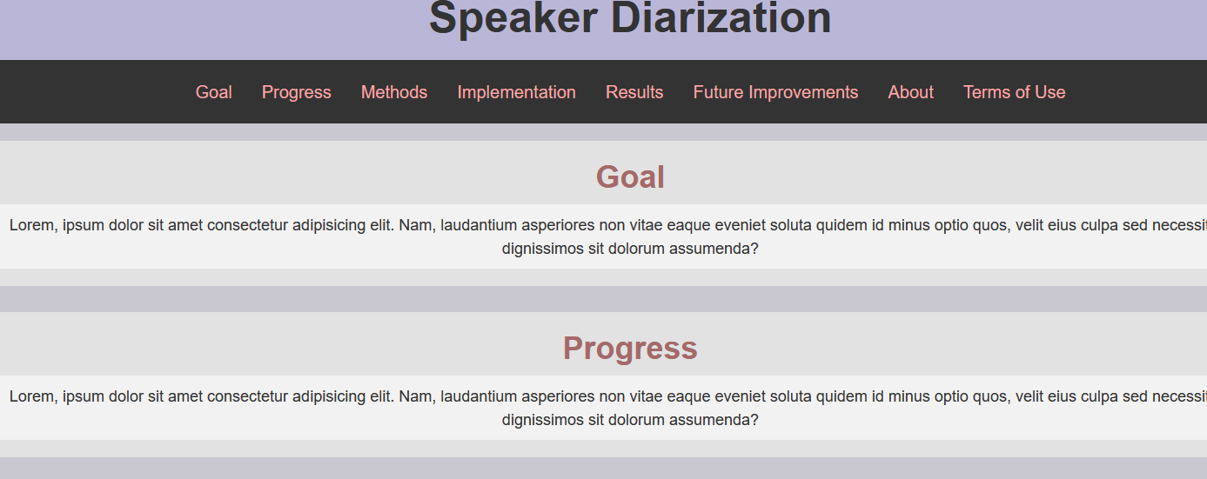
Meeting 25.6
Pyannote works well in audios without background noise
Tried cleaning noise with: Weiner Filter, and Median Filter but both didn’t help to improve diarization
Worked on website for submission:

Slide 16
For next meeting
TODO: ICA signal cleaning , independent component analysis
Use audio analysis on quiet sections with noise, remove that noise
PRATT, program to use for noise cleaning and get params
Check if many audios has the noise, or is it exceptional
in analyzation calculate mis-diarization per second per segment then total

Slide 17
Meeting 6.7
Tested over 30 videos, pyannote works well in 28/30, if not for one camera then the other
Noise cleaning method that worked: noise reduce library, uses spectral cleaning
Added animation
For next meeting:
Diarization for all necessary videos
Finish animation
Automatic script to for diarization to csv
report

Slide 18
Meeting 11.7
Did the following:
Diarization for all necessary videos
Finish animation + plot
Automatic script to for diarization to csv
Report
Website

