Slide 1
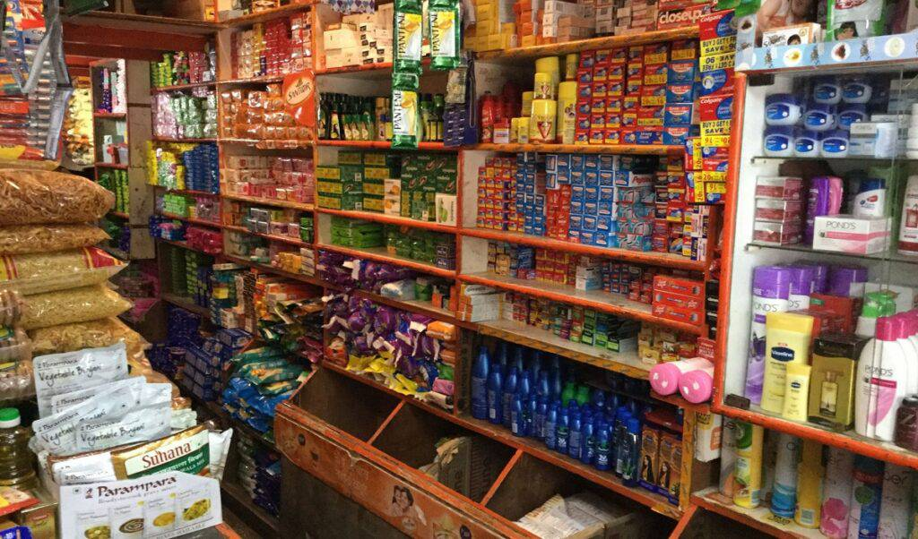
Competitive Brand Analysis
Shina vs. Powai

Slide 2
Retailers across locations
The survey was predominantly taken by retailers in village and majority of them sell both brands.
They are followed by the retailers located in Tier 3 and Tier 2 cities respectively.
In case of single brand retailers, Shina has over-taken Powai by 40% in villages.

Slide 3
Suppliers of retailers
For both the brands, the major segment of suppliers are from nearby and cities.
While Powai has better direct distributor channels, Shina has better nearby and city distribution channels.

Slide 4
Customer and order analysis of retailers
Both brands were sold mostly to customers by the retailers.
The order size was majorly less than 5.
In case of Powai, the order size is higher for retailers selling mostly to shopkeepers compared to Shina in that segment.
Avg. strands sold in one order

Slide 5
Profit margin of retailers
In villages and tier 2, Powai has better profit margin where both brands are sold.
In case of single brand retailers, Shina does better in Tier 2.
In case of tier 3, Shina has higher margin where both brands are sold.
Note: Tier 1 has been excluded due to lack of data.
Avg. profit per unit

Slide 6
Sellers of both brands
Out of almost 200 retailers who sell both brands, 81% of them acknowledge Powai is better.

Slide 7
Recommendations To Powai
In case of single brand retailers, while Powai does better in Tier 3, Shina has over-taken Powai by 40% in villages. Since 80% of multi brand retailers note Powai is better, Powai should reach out to those retailers who are selling only Shina now.
Since most retailers buy from nearby and city wholesalers, Powai should focus on improving these distribution channels.
Retailers mostly sell to customers. Therefore, creating brand awareness through marketing campaigns might incentivise retailers to buy Powai and thereby increase secondary sales.
Powai retailers selling to shopkeepers have high order size compared to Shina of the same category. This warrants more inquiry as to if this segment can be expanded.
Shina has higher average profit per unit in case of Tier 2 - single brand retailers and in tier 3 – multi brand retailers. Powai should analyse if it is possible to provide discount to retailers of these segments and if improvement in distribution channels can reduce costs.
Data collection from Tier 1 for more actionable insights on that category.

