Slide 1
TRAVEL ASSURED
travel insurance company
https://github.com/n2tp1311/da-case-study

Slide 2
BUSINESS PROBLEM
Due to the COVID pandemic, we have had to cut their marketing budget by over 50%. It is more important than ever that we advertise in the right places and to the right people
Right now our company has 1987 customers
1. age: customers has average age of 30 years, (youngest: 25, oldest: 35)
2. employment type: 30% government, 70% private/self-employed type
3. graduate or not: 85% graduate
4. annual income: range 0.3M - 1.8M, average: 0.9M
5. family members: range: 2 - 9 people, average: 5 people
6. chronic diseases: 28%
7. frequent flyer: 20%
8. ever travelled abroad: 20%
9. travel insurance: 40% of customers buy our travel insurance

Slide 3
DATA VIZUALIZATION

Slide 4
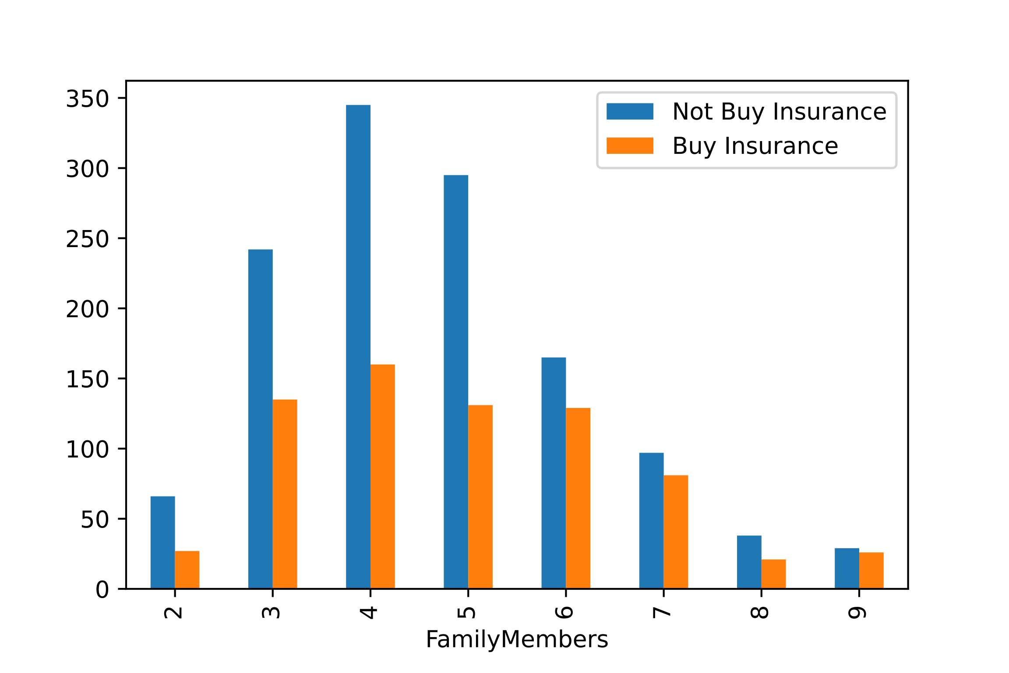
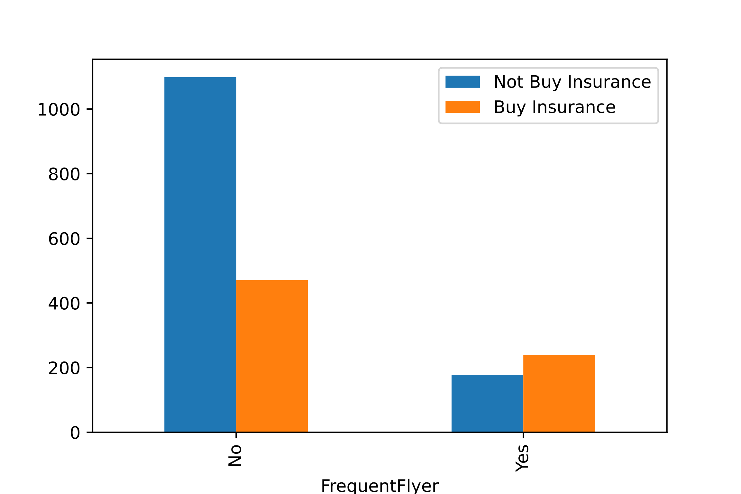
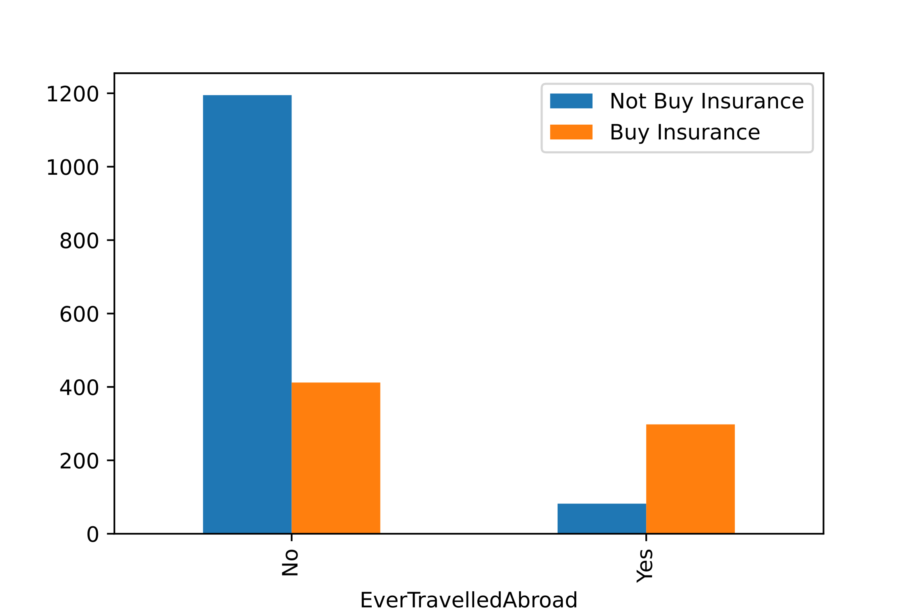
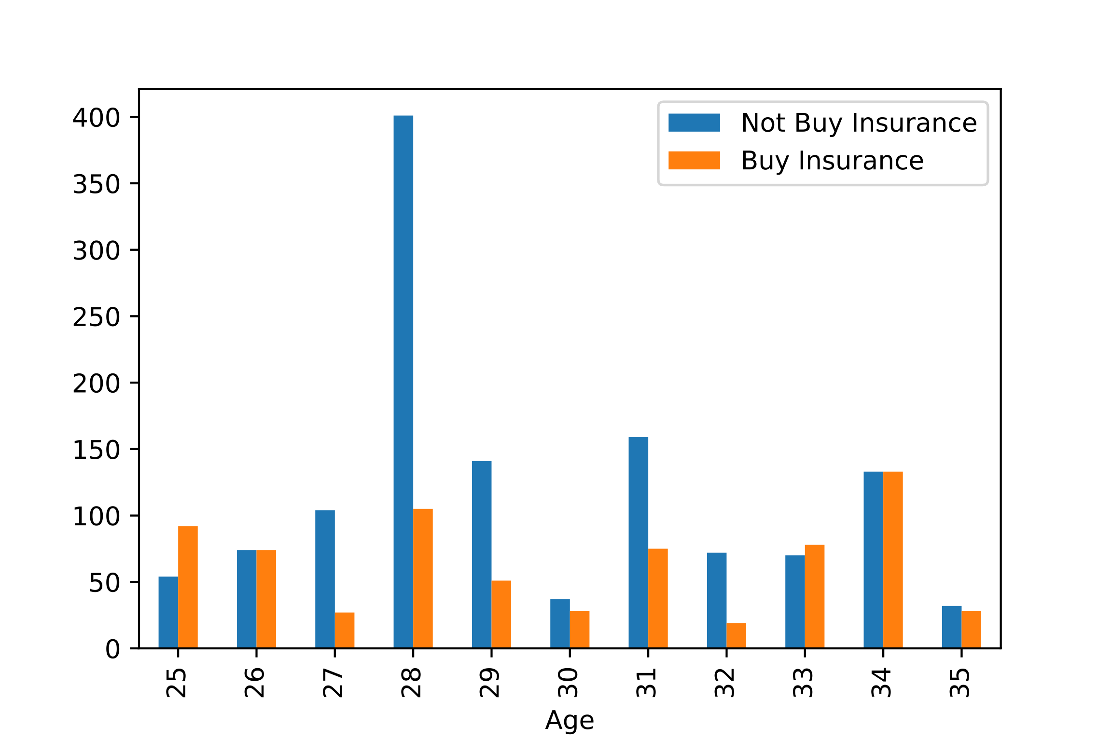
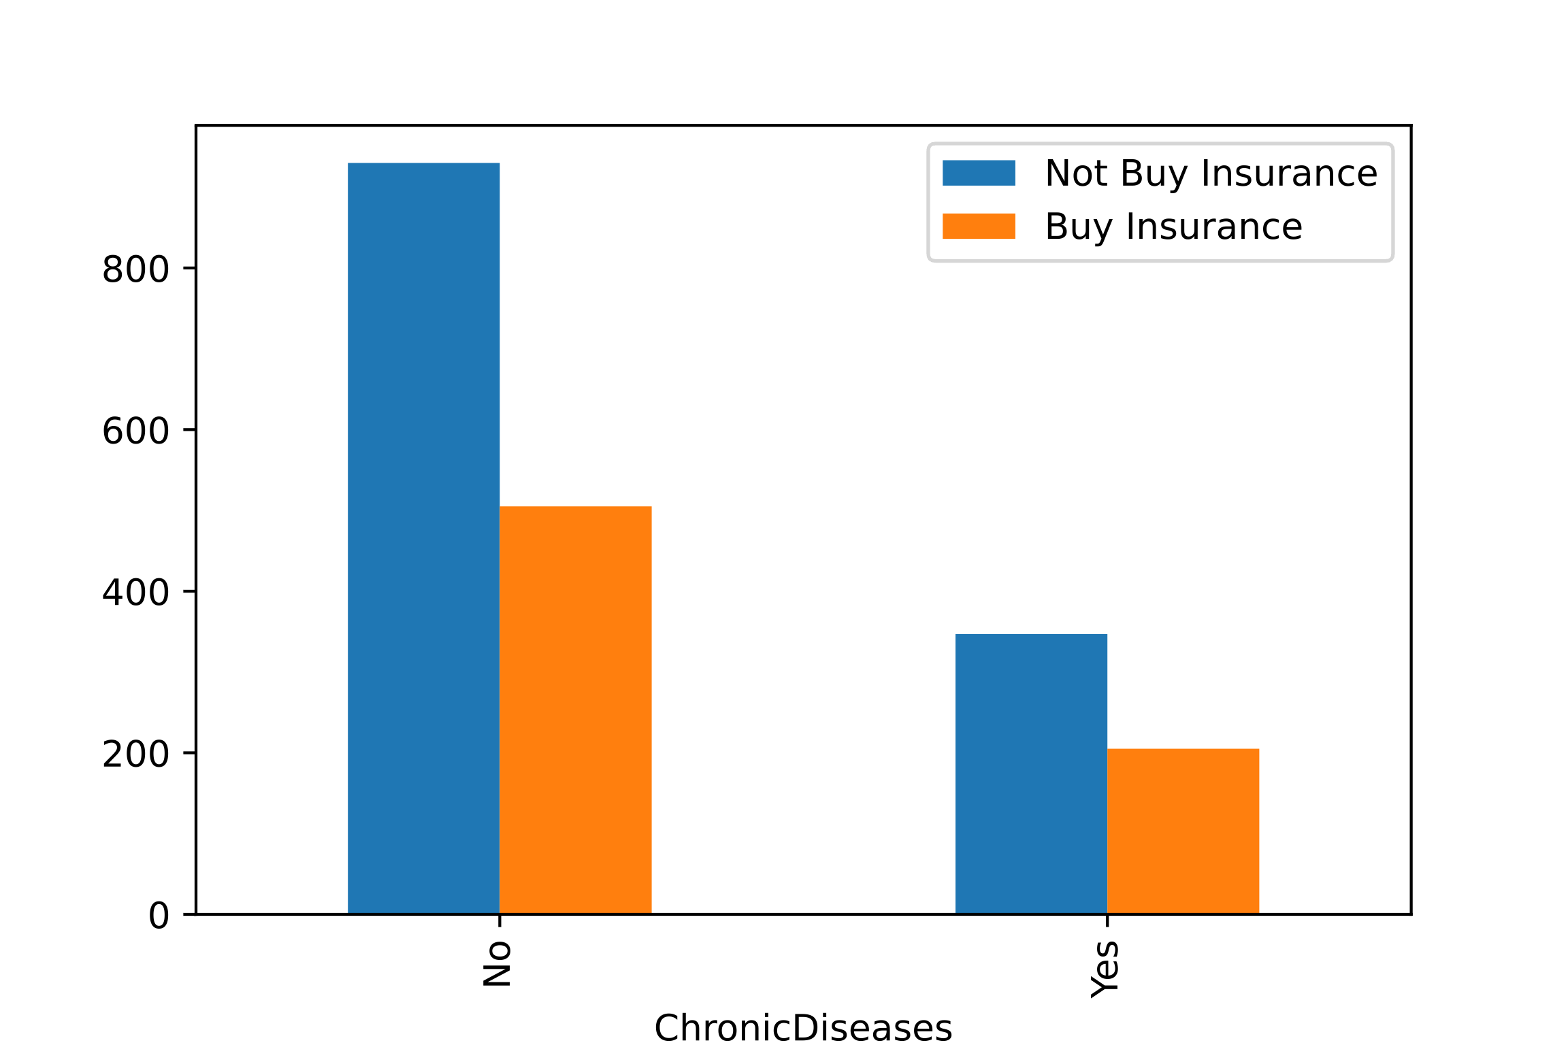
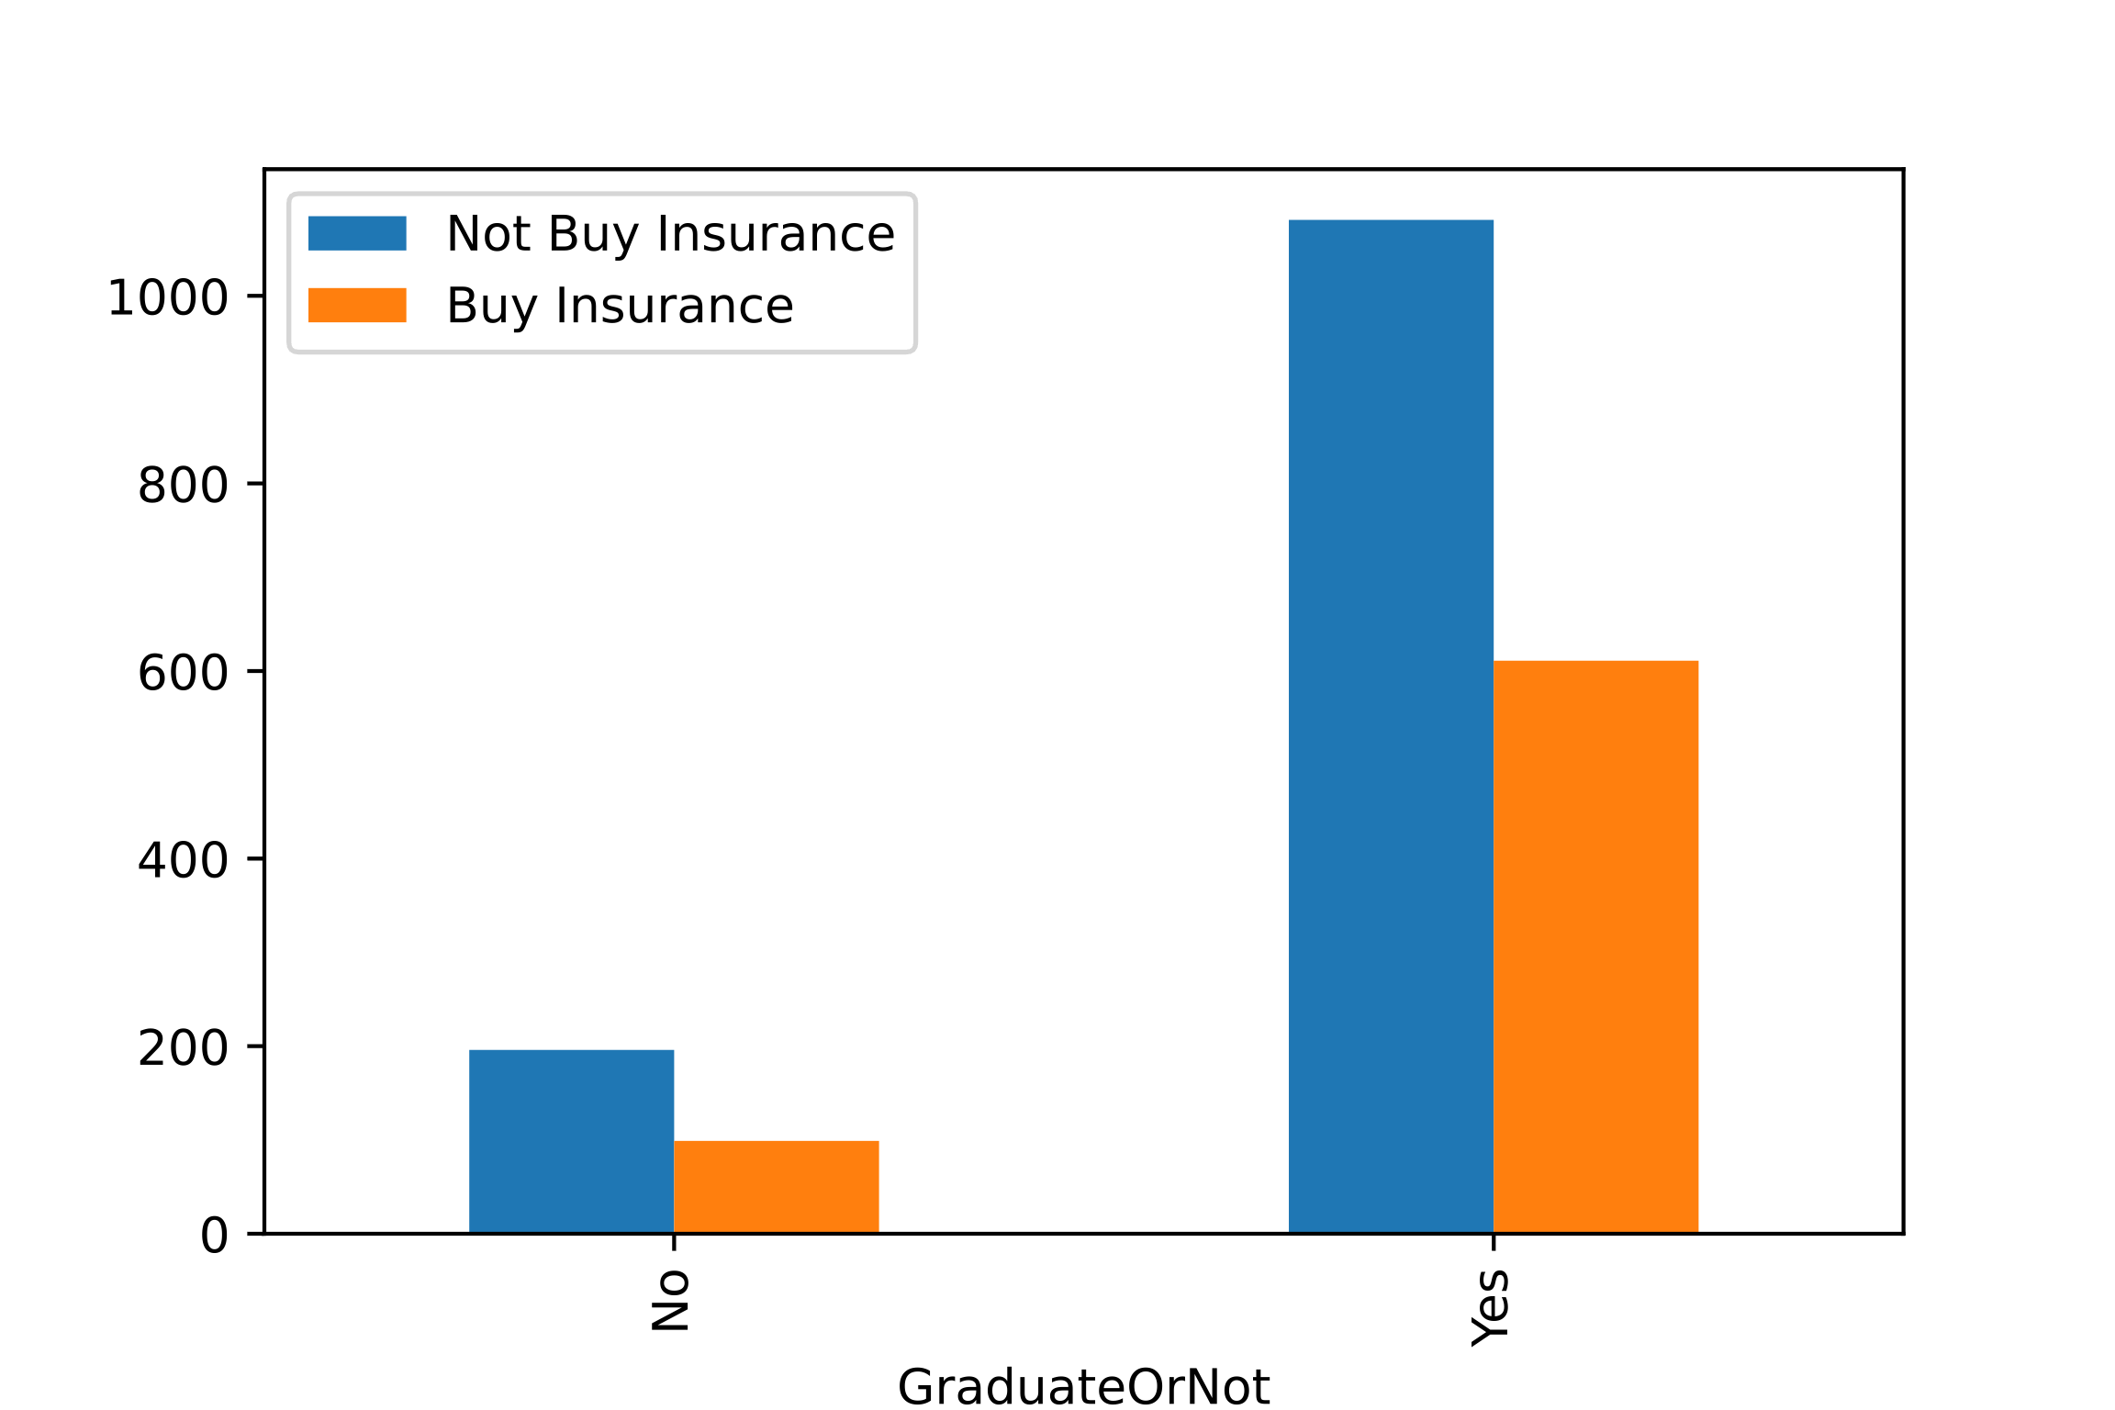
DATA VIZUALIZATION
1. age
2. employment type
3. graduate or not
4. annual income
5. family members
6. chronic diseases
7. frequent flyer
8. ever travelled abroad
shown
choose
ignore
Customers who have travelled abroad are three times (78%) more likely to get travel insurance than those who have not (25%)
People who have annual income greater than 1.3 million has more than 91% chance of getting a travel insurance
Customers who are frequent flyer have 57% to buy travel insurance compared to 30% of customers who aren't
At some age (25, 26, 33, 34): people are more likely to buy travel insurance (> 50%)

Slide 5
KEY FINDINGS
- At some age (25, 26, 33, 34): people are more likely to buy travel insurance (> 50%)
- There is a strong correlation between Annual Income and Travel Insurance
- Especially, people who have annual income greater than 1.3 million has more than 91% chance of getting a travel insurance
- Customers who are frequent flyer have 57% to buy travel insurance compared to 30% of customers who aren't
- Customers who have travelled abroad are three times (78%) more likely to get travel insurance than those who have not (25%)
RECOMMENDATIONS
Offering aggressive promotion for customers who have following characteristics to minimize marketing cost and maximize efficiency marketing strategy.
- Customers who are 25, 26, 33, 34 years old (>50%)
- Frequent flyer (57%)
- Have traveled abroad (78%)
- High income (>=1.3M) (91%)

