Slide 1

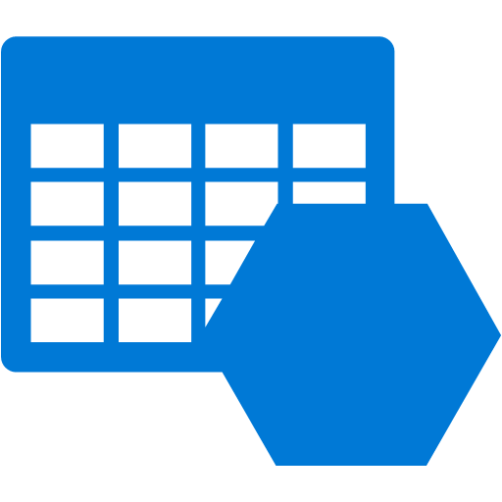
Architecture Diagram
WLD_RG
Storage Account

Slide 2


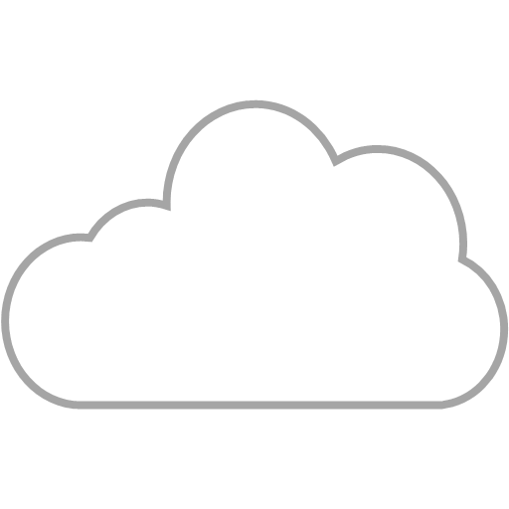


Networking Diagram
PUBLIC
AZURE
O365 ACCOUNT
Usuarios
NSG: Allow traffic from Azure Resources / Outbound IPs
Azure Resource
Storage Account
NSG: IP Filter
Data plane:
https://storageaccountname.<service>.core.windows.net
DevOps
Azure Management
WLD SPN
Management plane:
https://management.azure.com

