Slide 1
JSON Web Tokens (JWT) Attacks
Presenter: Thao Khong
Hanoi, 2025

Slide 2
Contents
Background knowledge
1.1. JSON
1.2. JWTs
{Definition,
Structure,
When to Use,
Pros and Cons,
Create a JWT}
JWT Attack and Defense
2.1. JWT Attacks definition
2.2. JWT Attack Types and Defense

Slide 3
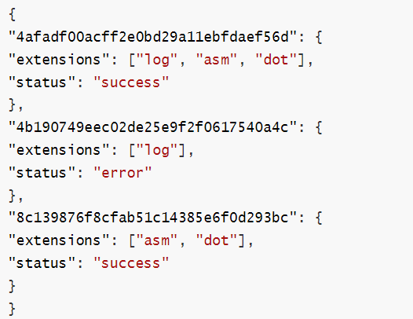
1.1. JSON
JSON (JavaScript Object Notation):
a lightweight, language-independent data format
is designed for data transmission and storage.
Has a similar structure with JavaScript objects
key-value pairs enclosed in curly braces { } separated by commas.

Slide 4
1.2. JWTs
Traditional authentication methods: session – cookie
Session: saves log in state in server side
Cookie: contains session ID in client side (Session and Persistent)
Number of users authenticated ~ cost of storage
Session is recorded on a specific server ➔ user can only access on that server
Do not contain much authentication data
Some vulnerabilities: session hijacking, CSRF,…

Slide 5
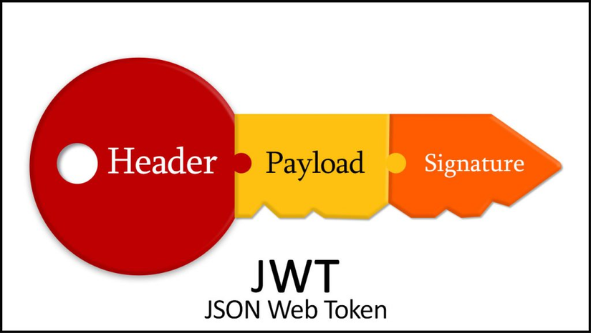
1.2. JWTs
JWT: an open standard (RFC 7519) for transmitting authentication information between a server and a client as a secure JSON string with a digital signature.

Slide 6
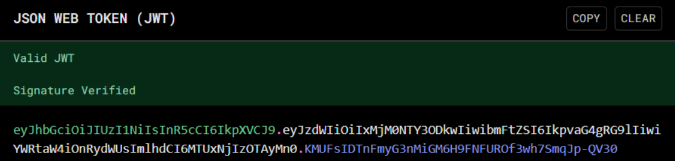
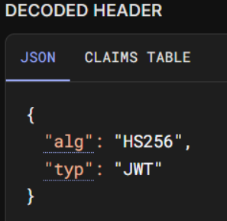
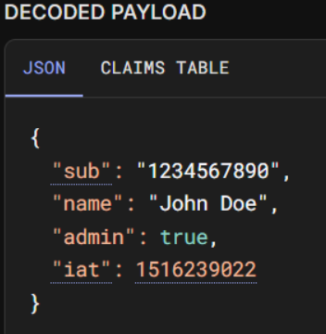
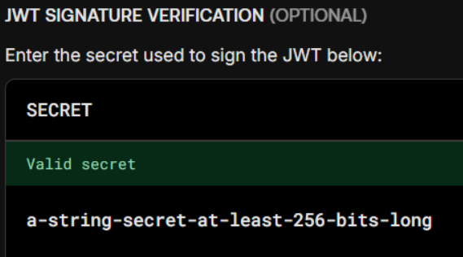
1.2. JWTs
JWT structure:

Slide 7
1.2. JWTs
JWT header:
contains info about token type and encryption algorithms used to create digital signatures for tokens
Base64 encode JSON objects => encode string called header
Often has 2 properties: alg and typ
Ex: HMAC-SHA256 using secret key to sign JWT

Slide 8
1.2. JWTs
JWT payload:
Encoded in based64
Often contains:
iss (issuer): the issuer of the token.
sub (subject): the owner of the token, often the user ID.
aud (audience): the application or API that uses the token.
exp (expiration time): the token's expiration time.
nbf (not before time): the time before which the token is not valid.
iat (issued at time): the time when the token was issued.
jti (JWT ID): a unique ID for each token.
…

Slide 9
1.2. JWTs
JWT signature:
Header + Payload + Secret key
HMAC/RSA
JWT Signature string
➔ Ensure the integrity of the payload

Slide 10
1.2. JWTs
When should JWTs be used:
User authentication: granting access to the web pages or apis
User account management: storing account-related information
Info exchange between apps/ internal micro services: auth.mahcompani.com; mail.mahcompani.com,…

Slide 11
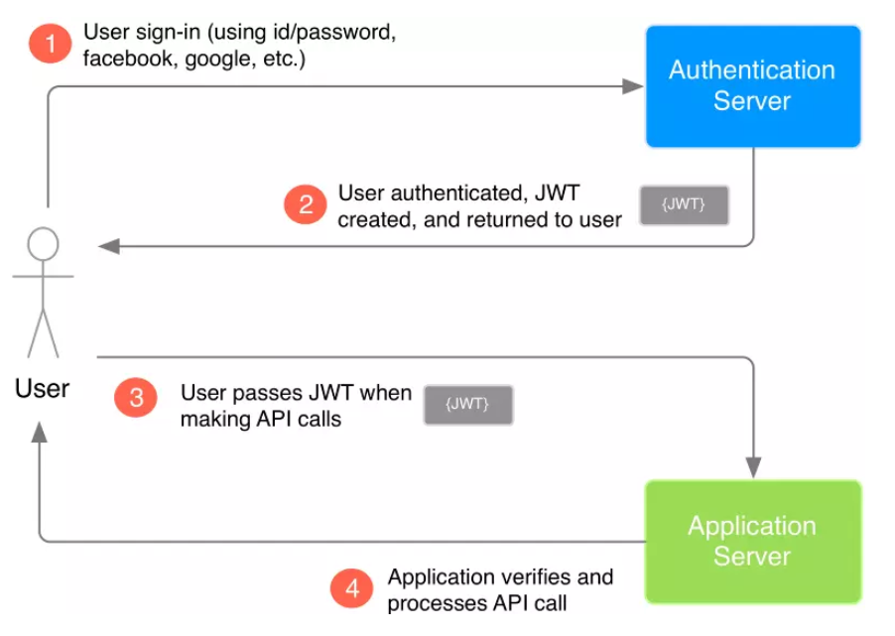
1.2. JWTs
Processing flow:

Slide 12
1.2. JWTs
Pros:
No need to store session data on server, language-independent,…
Compact (Base64-encoded) ➔ easily sent in HTTP headers, URLs, or cookies
Ideal for microservices or single sign-on (SSO) systems
Scales well across distributed systems and load-balanced environments
Flexible structure: add or remove properties easily

Slide 13
1.2. JWTs
Cons:
Payloads are Base64-encoded, not encrypted ➔ risk of data exposure
Non-revocable, large-size token
Can be abused if not handled securely

Slide 14
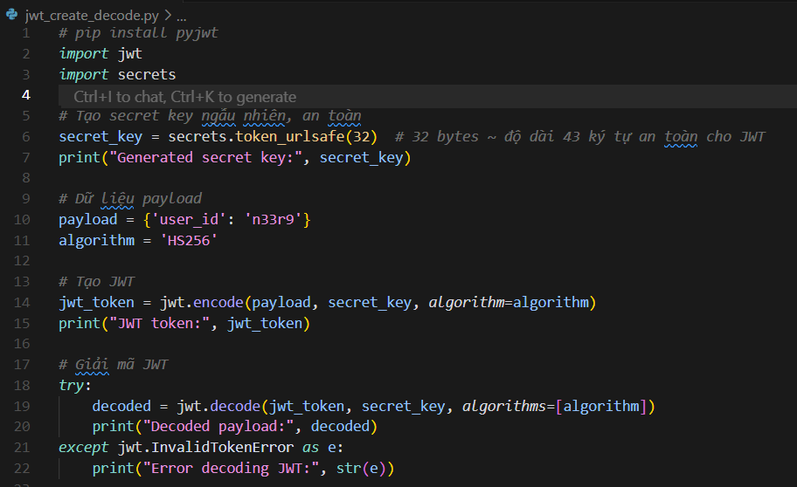
1.2. JWTs
Create a JWT:

Slide 15
2.1. JWT attack definition:
Modified JWTs:
- Impersonate another authenticated user
- Bypass authentication and access controls
User
Server
Achieve malicious goals
Notes:
JWT attacks involve a user sending modified JWTs to the server in order to achieve a malicious goal. Typically, this goal is to bypass authentication and access controls by impersonating another user who has already been authenticated

Slide 16
2.2. JWT attack types and defense:
Type 1: Modify the JWT info value
Issue: decodes a JWT token without verifying its signature = trusts any token's payload even if it’s invalid, expired, or tampered
Risk: An attacker can modify the payload (e.g., change "isAdmin": false to "isAdmin": true) and send the forged token.
Mitigate: validate the token's signature before trusting or decoding its content.

Slide 17
2.2. JWT attack types and defense:
Modify the JWT info value:
Lab 1: https://portswigger.net/web-security/jwt/lab-jwt-authentication-bypass-via-unverified-signature
Lab 2: https://portswigger.net/web-security/jwt/lab-jwt-authentication-bypass-via-flawed-signature-verification

Slide 18
2.2. JWT attack types and defense:
Type 1: Modify the JWT info value:
Some security-related questions:
Does the website verify the signature?
Does the website trust the algorithm specified in the token?

Slide 19
2.2. JWT attack types and defense:
Type 2: Bruteforce the security key
Lab 3: https://portswigger.net/web-security/jwt/lab-jwt-authentication-bypass-via-weak-signing-key
Does the website verify the signature? Yes
Does the website trust the algorithm specified in the token? Yes
Is the security key strong enough? Can we guess it, thencreate the new payload remake the JWT signature? (The goal is to impersonate the administrator)

Slide 20
2.2. JWT attack types and defense:
* JOSE Headers and Self-signed JWTs
JOSE headers: Besides ‘alg’ and ‘typ’
JWK (JSON Web Key): an object JSON to represent a key.
JKU (JWK Set URL): URL contains a set of public courses in the JWK
KID (Key ID): an ID for the public key used to verify the JWT signature...

Slide 21
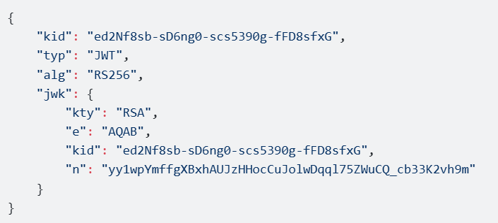
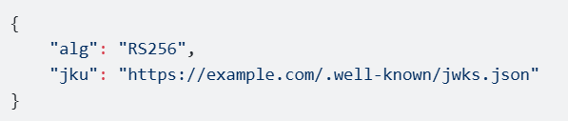
2.2. JWT attack types and defense:
* JOSE Headers and Self-signed JWTs
JOSE headers:

Slide 22
2.2. JWT attack types and defense:
* JOSE Headers and Self-signed JWTs
Self-signed JWTs:
Issuer & Verifier all have the same secret key

Slide 23
2.2. JWT attack types and defense:
Type 3: Attack on JWK parameter in Self-Signed JWTs
Lab 4: https://portswigger.net/web-security/jwt/lab-jwt-authentication-bypass-via-jwk-header-injection
Lab 5: https://portswigger.net/web-security/jwt/lab-jwt-authentication-bypass-via-jku-header-injection
Lab 6: https://portswigger.net/web-security/jwt/lab-jwt-authentication-bypass-via-kid-header-path-traversal

Slide 24
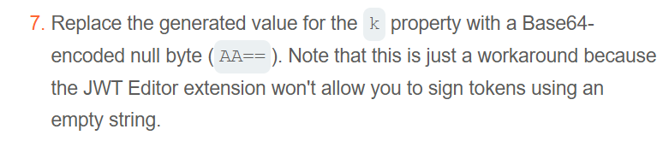
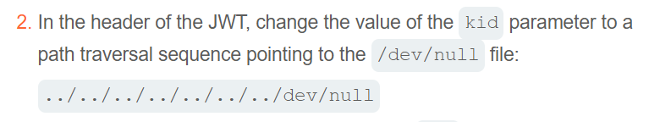
2.2. JWT attack types and defense:
Type 3: Attack on JWK parameter in Self-Signed JWTs
?1 Why Lab 5, we have to generate RSA key, whereas, using the symmetric key for Lab 6?
?2 Lab 6:
How to define this path? Change to this “../../../dev/null”, get the same result

Slide 25
Thank you!

