Slide 1

AIRLINE RESERVATION SYSTEM
Name: Neeraj Eswaran
Roll No: AM2332
Year/Sem: II/III
Subject: Java Programming Concepts

Slide 2
Project Overview
Abstract
Objective
System Architecture
Data Structures Used
Module Completion
Conclusion

Slide 3
Abstract
The Airline Reservation System helps airlines to manage ticket bookings. The airline staff can book tickets for the customer and the customer can view their tickets by logging into their account. This application aims to develop a basic interface for airline reservation that implements functionality like user management, login, verifying username and password, ticket booking, saving ticket information and viewing the tickets.

Slide 4
Objective
The objective of this project is to create an Airline Reservation System to provide a facility for seamless booking operations for both customers and airline staff, ensuring accuracy, efficiency, and a smooth user experience.

Slide 5
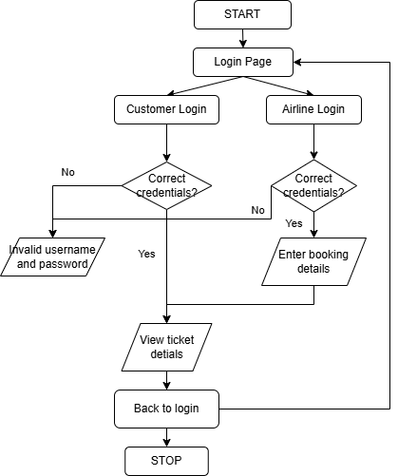
Architecture Diagram

Slide 6
Modules

Slide 7
LoginType
This module serves as the application's entry page, allowing users to select between Airline Login and Customer Login options. It provides a straightforward interface to guide users to the appropriate authentication pathway, ensuring a seamless and user-friendly experience for accessing airline or customer-specific functionalities.

Slide 8
LoginPage
This module implements the application's login page, enabling users to input their username and password. It securely validates the provided credentials against stored data, ensuring authorized access. Upon successful verification, users are directed to their respective dashboards, maintaining a seamless and secure authentication process for both airline and customer accounts.

Slide 9
Ticket
This is the application's ticket page, accessible to both airlines and customers. It provides detailed ticket information, including the passenger's name, flight details, and seat number.
This page ensures all users can quickly access and verify essential ticket-related information.

Slide 10
AirlineReservation
This is the main class which implements ActionListener for all buttons.
This class delegates between all the other classes in order to execute the application.
It loads the window and performs UI interaction operations using swing.

Slide 11
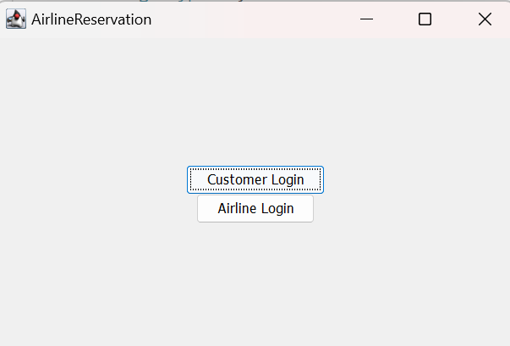
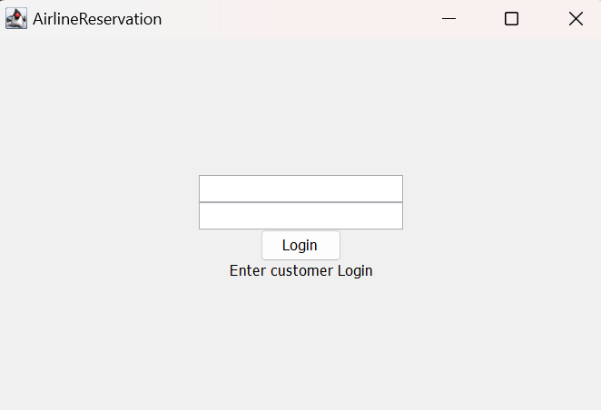
Results and discussion

Slide 12
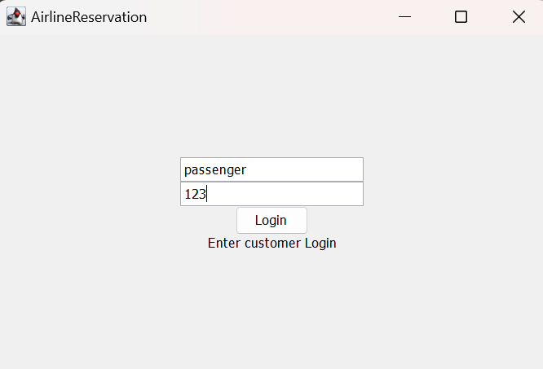
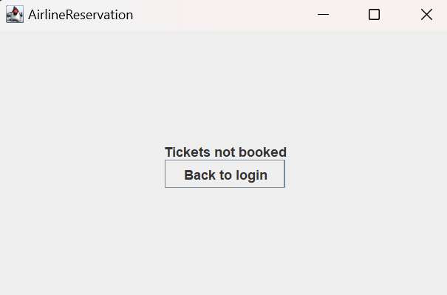
Results and discussion

Slide 13
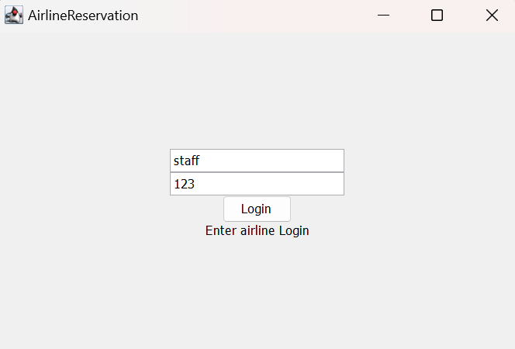
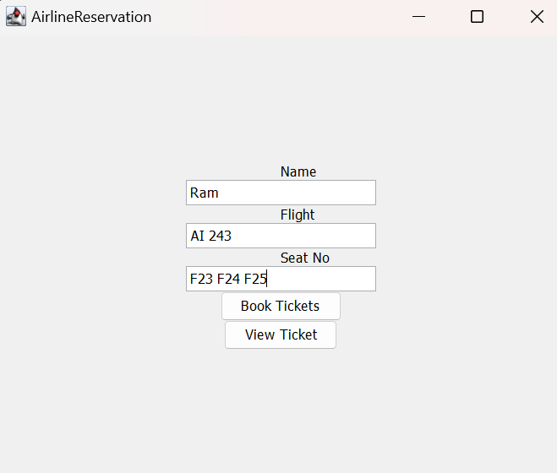
Results and Discussion

Slide 14
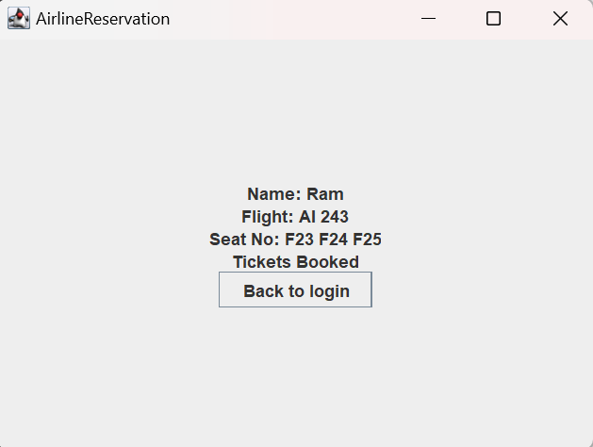
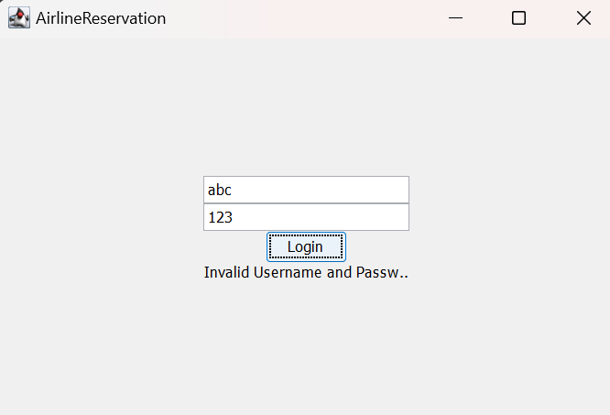
Results and Discussion

Slide 15
Conclusion
This application enables both the airlines and the customer to book tickets seamlessly. It manages login credentials, ticket details and helps them to manage ticket booking using a desktop interface. The Airline Reservation System provides a foundational framework for managing airline ticket bookings and user accounts. By implementing features such as secure login, ticket booking, and ticket viewing, the application addresses essential requirements for an efficient reservation process.

Slide 16
Thank You

Slide 17
Any Queries???

