Slide 1
Image Recognition using Gaussian Mixture Algorithm in OpenCV
Roll No: AM2332
Name: Neeraj Eswaran

Slide 2
Abstract
Photography necessitates the segmentation of the foreground from background in order to create good images. Here we use a novel approach introduced in newer versions of OpenCV to perform background subtraction. The background subtraction algorithms also play a very important role in training robust machine learning algorithms to subtract background and create portrait effects.

Slide 3
Objective
The objective is to develop a program that can detect the background using OpenCV. The background is detected and cropped algorithmically without deep learning.

Slide 4
Problem Statement
Develop a program that can crop out the background of a car in a photograph algorithmically and also avoid deep learning which requires huge amount of data.

Slide 5
Literature Survey
Article | Author | Advantages
Review of background subtraction methods using Gaussian mixture model for video surveillance systems | Kalpana Goyal & Jyoti Singhal | Ability to handle dynamic backgrounds, Robustness, Noise reduction, Proven success in video surveillance
Adaptive background mixture models for real-time tracking | C. Strauffer & W.E.L. Grimson | Robust background modelling, Adaptability, Real-Time Performance, Foreground Detection, Generalization

Slide 6
Literature Survey
Article | Author | Advantages
On the number of components in a Gaussian mixture model | Geoffrey J. McLachlan Suren Rathnayake | Different components in the mixture have different advantages.
Deep Gaussian mixture models | Cinzia Viroli, Geoffrey J. McLachlan | Uses deep learning for gaussian mixtures

Slide 7
Literature Survey
Article | Author | Advantages
Background subtraction techniques: a review | Massimo Piccardi | Methods such as Mixture of Ganssians and KDE prove very good model accuracy
Evaluation of background subtraction techniques for video surveillance | Sebastian Brutzer, Benjamin Hoferlin, Gunther Heideman | New evaluation data set with accurate ground truth annotations and shadow masks, precise in-depth evaluation of background subtraction methods

Slide 8
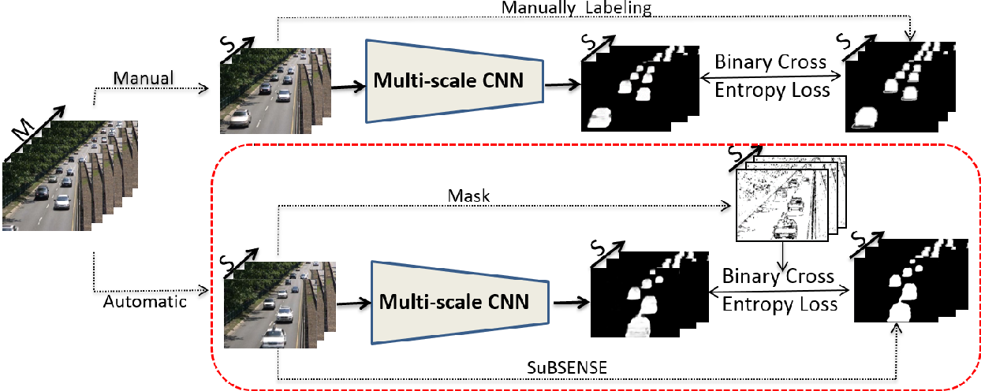
Existing System
Deep Learning Based Background Cropping:
Involves using a large set of labeled datasets with background which are used to train a deep learning model that can easily detect background.

Slide 9
Existing System
Deep Learning Based Background Cropping:
In order to implement background cropping using Deep Learning, the dataset consists of a set of images and a set of corresponding images with their background removed. The deep learning model learns from the two images about which part of the image constitutes the foreground and which part of the image constitutes the background. Hence, the foreground and background can be separated.

Slide 10
Existing System
A model is constructed to classify the region of image as background and foreground. It makes use of labeled datasets.
The model has layers. The layers distinguish between foreground and background using human labeled data.
The model is trained on the training set and checked on the testing set. If the results match, the model has been trained.

Slide 11
Limitations of Existing System
It consumes huge amount of data.
Data has to be labeled properly.
Takes lots of resources and training time.
The statistics for the model are complicated to understand.
The model cannot account for all images and lighting types.

Slide 12
Proposed System
Background Subtraction using OpenCV’s grabcut
It uses OpenCV’s Gaussian Mixture Model to extract background and crop the foreground by statistically computing and segmenting the image using Gaussians. When we use OpenCV’s grabcut() function, it returns the cropped image where the background of the image appears black.

Slide 13
Advantages
Advantages:
Since it is an algorithm, it does not require model training. It directly processes the Image and returns a mask.
It is easy to use.
It is based on feature extraction and does not require any data.
It is an inbuilt library in OpenCV.

Slide 14
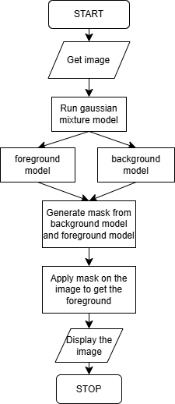
Architecture Diagram

Slide 15
Modules
image
mask
backgroundModel and foregroundModel
grabCut()
imshow()

Slide 16
Module Description
Module 1 – image
Converts the .jpg file into an array of RGB values.
These values are used to perform computations on the image.
The values are stored as 8bit integers.
Each of the RGB values has a range of 0 to 255

Slide 17
Module Description
Module 2 – mask
It stores the part of the image that is detected as foreground.
The mask is used to extract the foreground from the image.

Slide 18
Module Description
Module 3 – backgroundModel and foregroundModel
It describes the model using which the background and foreground are segmented.
An array that represents both the models are passed to the OpenCV grabcut() function in order to crop the image.

Slide 19
Module Description
Module 4 – grabCut()
It takes the image, mask, backgroundModel and foregroundModel as arguments and returns a mask for the detected foreground.
This mask can be converted and used to extract the foreground of the image.
It is a part of the OpenCV library.

Slide 20
Module Description
Module 5 – imshow():
It is used to display the image which is passed as an array of RGB values.
It is a part of the pyplot library.

Slide 21
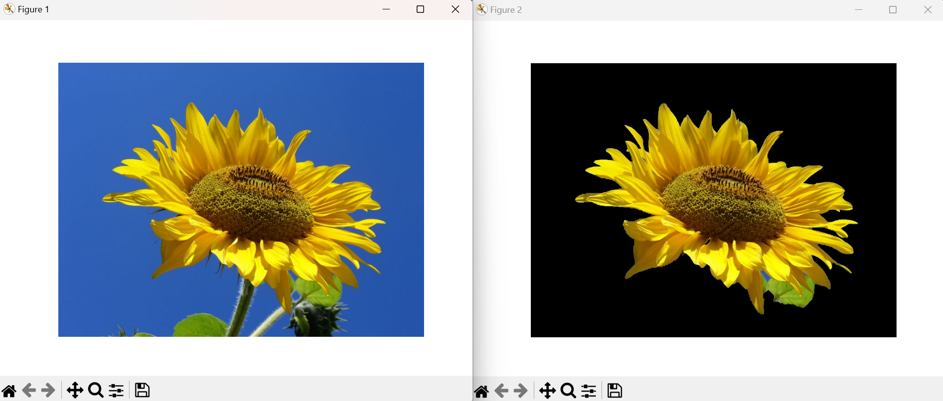
Implementation Screenshot
Extracting a sunflower from its image

Slide 22
Conclusion
We have developed a simple program to demonstrate the Gaussian Mixture Algorithm of extracting foreground by using OpenCV to process the image and show the output using pyplot. We successfully removed the background of the given sunflower image using gaussian mixture model.

Slide 23
Future Enhancement
Real-time execution:
The algorithm can be implemented by hand in order to allow high performance so that real-time footage can be handled.
Replace the background with another image:
Instead of subtracting the background we can replace it with another image.

Slide 24
References
https://docs.opencv.org/4.x/d1/dc5/tutorial_background_subtraction.html
https://www.geeksforgeeks.org/python-foreground-extraction-in-an-image-using-grabcut-algorithm/

Slide 25
Thank You

Slide 26
Any Queries???

