Slide 1
Math Workshop
Nelson Rengifo
COP 1500 – Deepa Devasenapathy

Slide 2
Goal of Project
Project Goal: Generate arithmetic problems for math practice.
Allow users to choose difficulty levels and problem types.
Present 15 questions per run.
Implement a timer to tract the time taken for each session.
Provide immediate feedback on user answers (correct/incorrect) and display the correct answer if needed.
Calculate and display user's score as a percentage.
Allow users to exit program if desired.
Catch potential exceptions.

Slide 3
Software Requirements
Operating System: Windows, MacOS, Linux).
Python: Version 3.
Terminal or Command Prompt: To execute the program via the command line.
Input: keyboard, mouse, monitor.
Processor: Intel Core i3.
RAM: 2GB.

Slide 4
Why this project?
I chose this project with the aim of creating a practical math practice experience, inspired by the concept of the "Quick Math" mobile app. The motivation was to enhance the learning process by providing immediate feedback by displaying correct answers for incorrectly solved problems, making the practice more instructive.

Slide 5
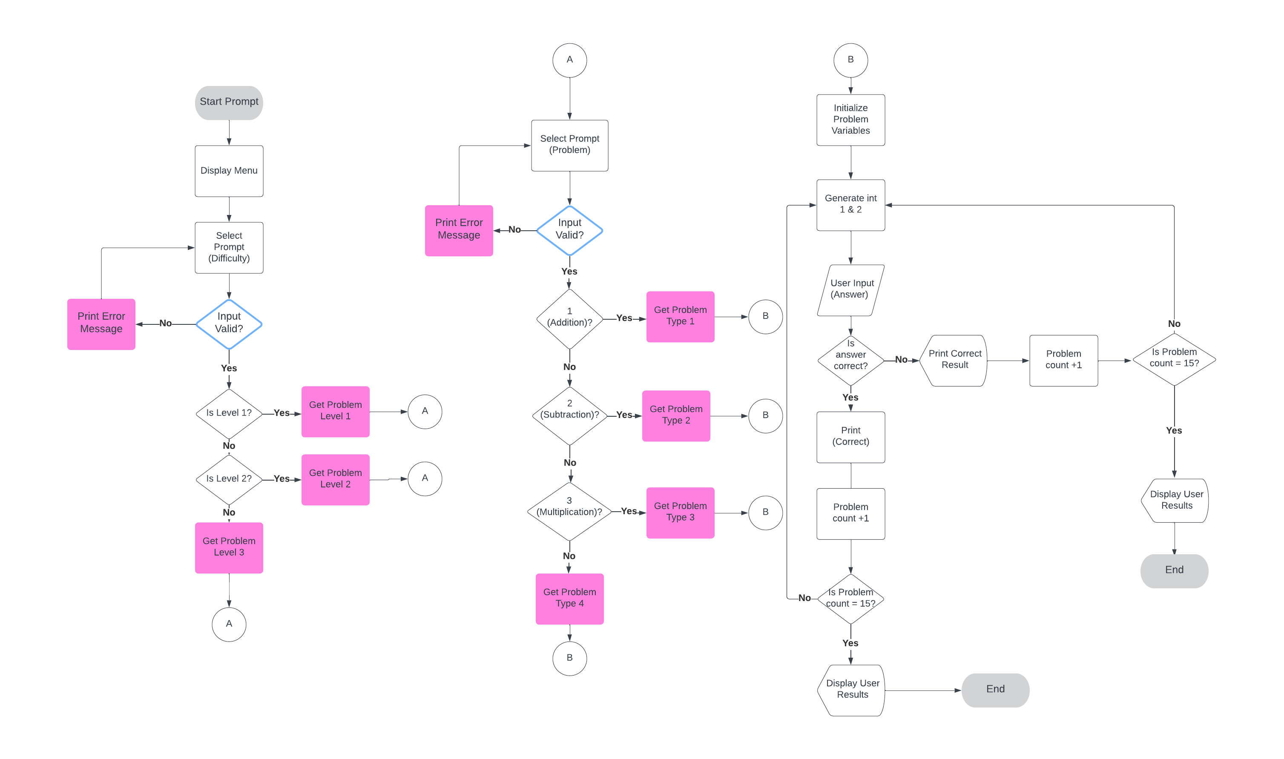
Program Flow Diagram
Main Menu

