Slide 1
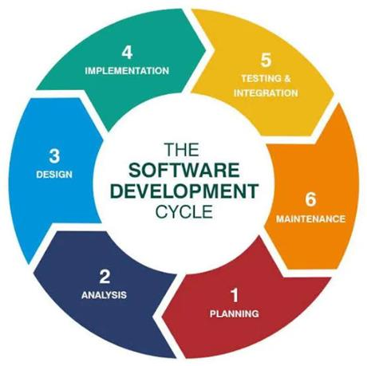
UNIVERSITI POLY-TECH MALAYSIA (UPTM)
FACULTY OF COMPUTING & MULTIMEDIA (FCOM) | DIPLOMA IN COMPUTER SCIENCE (CC101)
FINAL YEAR PROJECT PRESENTATION (FYP3024)
CAMPUS EQUIPMENT MANAGEMENT SYSTEM
PinjamGeng: Smart Event Equipment Booking
& Inventory Management System
A Responsive Web-Based Platform with Automated Conflict Detection, Bundled Event Packages & Real-Time Accountability
LIVE DEMO: https://pinjamgeng.infinityfreeapp.com
PREPARED BY (CANDIDATE)
PROJECT SUPERVISOR
Nursyafiqah Zulaikha Binti Zilkamal
Madam Jihadah Binti Ahmad
Student ID: AM2412018113
Diploma in Computer Science (CC101)
Faculty of Computing & Multimedia (FCOM)
Universiti Poly-Tech Malaysia (UPTM)
Session: 2026/2027 | Evaluated under Academic Course Code FYP3024
Notes:
[SPEAKER SCRIPT - SLIDE 1: INTRODUCTION]
Assalamu'alaikum and a very pleasant morning/afternoon to the respected evaluation panel, examiners, and my supervisor, Madam Jihadah Binti Ahmad.
My name is Nursyafiqah Zulaikha Binti Zilkamal, student ID AM2412018113 from the Diploma in Computer Science program (CC101), Faculty of Computing and Multimedia, Universiti Poly-Tech Malaysia.
Today, I am proud to present my Final Year Project entitled "PinjamGeng: Smart Event Equipment Booking and Inventory Management System".
This system is fully completed and actively deployed live on the cloud. It was conceived to eliminate the longstanding logistical bottlenecks faced by campus event organizers and administrative officers at UPTM through automated conflict detection, bundled packages, and digitized damage accountability.

Slide 2
OVERVIEW
Presentation Agenda & Roadmap
Structured breakdown of today's FYP evaluation presentation
01
Problem Background & Motivation
05
System Architecture & Database
Challenges of manual campus equipment booking and pain points.
UML Use Case, process flowcharts, and 3NF Relational ERD.
02
Project Objectives & Scope
06
Key System Innovations
Core goals, user personas (Student vs Admin), and boundaries.
Smart conflict detection, package bundling & damage tracking.
03
Requirements Survey Findings
07
Live System Demonstration
Quantitative justification based on 30 UPTM respondents.
Cloud deployment walkthrough on InfinityFree server.
04
Development Methodology
08
Testing, UAT & Future Roadmap
Agile framework and 5-sprint incremental delivery cycle.
Verification, 100% UAT satisfaction, and Phase 2 enhancements.
Universiti Poly-Tech Malaysia (UPTM) | FCOM — Diploma in Computer Science (CC101)
PinjamGeng: Smart Event Equipment Booking System
Slide 2 of 20 | Nursyafiqah Zulaikha
Notes:
[SPEAKER SCRIPT - SLIDE 2: AGENDA]
To provide a clear roadmap of this presentation, I have structured my talk into 8 key segments:
We will first explore the operational problem background at UPTM, followed by our formal project objectives and scope.
Next, I will present the empirical survey findings from 30 campus respondents that validated our project requirements, followed by our Agile development methodology.
In the technical segment, I will walk you through the system architecture, UML use cases, activity flowcharts, and 3NF database schema.
We will then examine the three core innovations of PinjamGeng—namely our conflict detection engine, event package bundling, and return damage accountability engine.
Finally, we will proceed to the live cloud system demonstration, followed by our testing verification, UAT evaluation results, and future work.

Slide 3
BACKGROUND
Problem Background & Problem Statements
Identifying the core operational bottlenecks in campus equipment management at UPTM
01
Inefficient Manual Paperwork & Logbooks
02
Double-Booking & Schedule Collisions
TIME DELAY
SCHEDULE CONFLICT
• Organizers must physically travel to the HEP / Facility office to submit paper reservation forms.
• Absence of a synchronized central calendar results in overlapping reservations.
• Manual signature routing takes 2 to 3 working days, causing severe delays for urgent student club events.
• High-demand equipment (PA sound systems, wireless microphones, projectors) frequently double-booked.
• Physical paper forms and chits are easily misplaced, discarded, or lost without duplicate backup records.
• Clubs only discover shortages during event setup, resulting in compromised campus activities.
03
Inaccurate Inventory & Stock Mismatches
04
Lack of Damage Tracking & Accountability
LACK OF VISIBILITY
UNTRACKED LOSS
• Stock levels recorded on paper or static sheets become instantly outdated upon loan.
• Post-event returns lack formal inspection; damaged items returned unnoticed without penalty.
• Damaged or missing assets are not deducted in real-time, displaying ghost availability.
• No standardized grading for equipment defect severity or compensation calculation.
• Students make commitments assuming items are available, only to be rejected at the counter.
• University bears recurring replacement costs due to unassigned responsibility on student borrowers.
Universiti Poly-Tech Malaysia (UPTM) | FCOM — Diploma in Computer Science (CC101)
PinjamGeng: Smart Event Equipment Booking System
Slide 3 of 20 | Nursyafiqah Zulaikha
Notes:
[SPEAKER SCRIPT - SLIDE 3: PROBLEM STATEMENT]
To understand why PinjamGeng was built, we must examine the four persistent problems currently faced by UPTM.
First, the booking process relies on manual paper forms and physical logbooks. A student organizer must walk to the facilities office, fill out a paper chit, and wait 2 to 3 days for approvals. Forms frequently get misplaced.
Second is the severe issue of double booking. Because there is no centralized live calendar, two clubs can be promised the same PA system on the same Saturday morning. The collision is only discovered when both turn up at the store.
Third, static paperwork cannot reflect live inventory. Broken or previously booked items remain listed as available, giving false hope to students.
Fourth, and most critically for the university administration: lack of return accountability. Equipment is returned in cardboard boxes without systematic inspection. If a cable is severed or a microphone capsule dented, there is no digital trail to establish who caused the damage or recover repair costs. The university ends up absorbing preventable expenses.

Slide 4
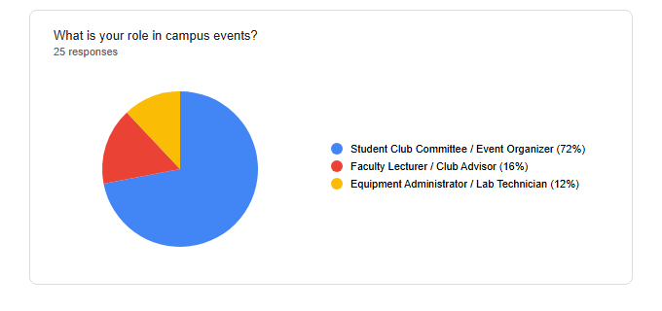
ANALYSIS
Empirical Requirements Analysis (Survey)
Quantitative survey conducted across 30 UPTM student leaders & club organizers
90.0%
Manual Form Delay
EMPIRICAL RESEARCH EVIDENCE (QUESTIONNAIRE SURVEY)
Respondents confirmed manual forms take >2 days and are prone to getting lost.
86.7%
Double-Booking Conflicts
Experienced last-minute gear shortages or overlapping bookings during events.
93.3%
Online Portal Demand
Demanded a 24/7 self-service digital equipment booking web system.
96.7%
Accountability & Receipts
Key Takeaway: The empirical survey established statistically indisputable demand for PinjamGeng. Over 90% of stakeholders supported replacing manual paper logbooks with an automated, conflict-free web portal.
Agreed digital damage inspection and PDF return slips are essential.
Universiti Poly-Tech Malaysia (UPTM) | FCOM — Diploma in Computer Science (CC101)
PinjamGeng: Smart Event Equipment Booking System
Slide 4 of 20 | Nursyafiqah Zulaikha
Notes:
[SPEAKER SCRIPT - SLIDE 4: SURVEY FINDINGS]
Rather than relying on anecdotal assumptions, our requirements were grounded in an empirical study. We administered a pre-development questionnaire to 30 active student leaders, club executive committees, and event coordinators at UPTM.
The survey revealed striking results:
90% of respondents reported experiencing significant delays with manual paperwork, where forms take days to process and are prone to being lost.
86.7% reported facing double-booking conflicts or finding that equipment promised to them was missing or malfunctioning.
Furthermore, 93.3% expressed urgent demand for an online 24/7 web-based booking portal.
Finally, 96.7% agreed that an automated damage inspection system and digital receipts are vital to ensure fair accountability.
This empirical evidence provided a solid foundation to formulate our four project objectives.

Slide 5
OBJECTIVES
Project Objectives (SMART Goals)
Four clearly scoped, measurable deliverables directly solving the identified problem statements
01
Design & Develop a Responsive Web Booking Portal
DELIVERABLE: 24/7 Accessible Web Portal
To design and implement a responsive, user-friendly web interface allowing UPTM students to browse cataloged equipment, check live stock, and submit reservation requests anytime, anywhere.
✓ Achieved: Mobile-responsive Bootstrap 5 interface hosted live on the cloud.
02
Implement Automated Conflict Detection & Bundling
DELIVERABLE: Conflict-Free Reservation Engine
To engineer an intelligent booking validation algorithm that calculates overlapping reservations to eliminate double booking, alongside 1-click curated Event Package Bundling.
✓ Achieved: Microsecond conflict-checking queries with zero double-booking capability.
03
Construct Return Inspection & Damage Accountability Engine
DELIVERABLE: Automated Fine & Audit Trail
To establish a structured post-event inspection workflow featuring 4-tier damage grading, automatic penalty/repair estimation, and instant digital receipt generation.
✓ Achieved: Complete damage reporting module with digital slips.
04
Evaluate System Acceptance & Usability (UAT)
DELIVERABLE: Formal Academic UAT Evaluation
To conduct a rigorous User Acceptance Test (UAT) with 30 target evaluators across Usability, Functionality, Efficiency, and Adoption Willingness to validate system success.
✓ Achieved: 100% recommendation score with 96.7% efficiency satisfaction.
Universiti Poly-Tech Malaysia (UPTM) | FCOM — Diploma in Computer Science (CC101)
PinjamGeng: Smart Event Equipment Booking System
Slide 5 of 20 | Nursyafiqah Zulaikha
Notes:
[SPEAKER SCRIPT - SLIDE 5: OBJECTIVES]
To resolve the identified challenges, this project formulated four SMART objectives:
Objective 1 was to design and develop a responsive web-based booking portal. This allows students to check catalog availability and book equipment 24/7 without having to visit the counter.
Objective 2 was to implement an intelligent booking engine with automated conflict detection. This mathematically eliminates double booking by evaluating date ranges, and introduces 1-click Event Package Bundling.
Objective 3 was to build a comprehensive return inspection and damage accountability engine. When equipment is returned, administrators can record condition grades, compute repair fines, and issue digital return slips.
Objective 4 was to validate system usability and reliability through formal User Acceptance Testing (UAT) with 30 campus users.
I am pleased to report that all four objectives have been 100% achieved in the completed system.

Slide 6
SCOPE
Project Scope & User Personas
Delineating role-based capabilities and architectural boundaries
USER ROLE: STUDENT
USER ROLE: ADMIN
Student / Event Organizer Persona
Administrator / Facilities Officer Persona
✓ User Registration & Role-Based Authentication with email and matric ID.
★ Real-Time KPI Dashboard: Live counters for pending loans, active gear & alerts.
✓ Interactive Catalog Browsing with category filtering & live stock status.
★ Inventory Management (CRUD): Create, update, view, and retire equipment items.
✓ Event Package Bundling: Book pre-configured event sets with 1 single click.
★ Package Management: Create and configure bundled package combinations.
✓ Instant Conflict Checking: Automated date overlap validation prior to submission.
★ One-Click Approval/Rejection: Review requests with custom admin remarks.
✓ Self-Service Status Tracking: View status (Pending, Approved, In Use, Returned).
★ Return Inspection Module: Log condition check-in, defect severity, and repair notes.
✓ Digital Receipt Generation: Instant printable booking slip and return confirmation.
★ Automated Fine Calculation: Auto-computes damage liability and payment status.
TECHNICAL & OPERATIONAL BOUNDARIES
Platform: Web-based, responsive across Desktop, Tablet & Mobile browsers • Target Environment: Universiti Poly-Tech Malaysia (UPTM) • Cloud Hosting: Publicly accessible Apache/PHP/MySQL deployment • Security: Bcrypt password hashing, session tokens & PDO prepared queries.
Universiti Poly-Tech Malaysia (UPTM) | FCOM — Diploma in Computer Science (CC101)
PinjamGeng: Smart Event Equipment Booking System
Slide 6 of 20 | Nursyafiqah Zulaikha
Notes:
[SPEAKER SCRIPT - SLIDE 6: PROJECT SCOPE]
Looking at the project scope, PinjamGeng establishes strict separation of concerns between two distinct user personas:
For the Student Persona: Students can register, browse equipment with high-resolution imagery and live stock counts, book individual items or 1-click event packages, receive instant conflict notifications, monitor their booking lifecycle, and download receipts.
For the Admin Persona: Staff at HEP or facilities offices access a real-time analytics dashboard. They can perform full CRUD operations on inventory and packages, approve or reject applications in one click, and execute return check-in inspections where damages can be recorded and penalties computed.
The system is fully responsive, operating seamlessly across desktop monitors, iPads, and mobile smartphones.

Slide 7
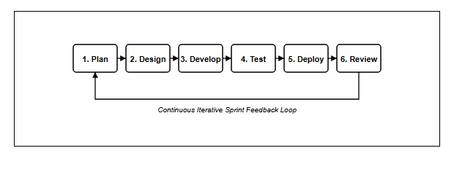
METHODOLOGY
Development Methodology: Agile Framework
Iterative 5-sprint lifecycle facilitating rapid prototyping and continuous feedback
S1
Sprint 1: Planning & Architecture
AGILE SCRUM ITERATIVE PROCESS
Requirements analysis, survey data synthesis, and 3NF database schema modeling.
S2
Sprint 2: Auth & Inventory CRUD
User registration, role-based session middleware, and equipment stock management.
S3
Sprint 3: Booking & Conflict Engine
Real-time overlap algorithms, package bundling, and approval workflow triggers.
S4
Sprint 4: Inspection & Damage Engine
Return check-in, 4-tier defect grading, fine calculation, and PDF invoice generation.
S5
Sprint 5: Cloud Deployment & UAT
Why Agile? Compared to traditional Waterfall, Agile allowed iterative sprint deliverables, regular supervisor reviews with Madam Jihadah, and continuous adjustment of booking algorithms based on early testing feedback.
InfinityFree hosting rollout, cross-browser optimization, and formal 30-user UAT.
Universiti Poly-Tech Malaysia (UPTM) | FCOM — Diploma in Computer Science (CC101)
PinjamGeng: Smart Event Equipment Booking System
Slide 7 of 20 | Nursyafiqah Zulaikha
Notes:
[SPEAKER SCRIPT - SLIDE 7: METHODOLOGY]
For our system development lifecycle, we adopted the Agile Scrum methodology. Agile was chosen over the traditional Waterfall model because it embraces iterative development, frequent testing, and fast integration of feedback.
Our development was divided into five distinct two-week sprints:
Sprint 1 focused on domain analysis, questionnaire evaluation, and 3NF database modeling.
Sprint 2 delivered core infrastructure: authentication, role-based session protection, and inventory CRUD.
Sprint 3 was the heart of the booking engine: building real-time date overlap calculations and package bundling.
Sprint 4 implemented post-event accountability: return inspection, damage grading, and automated fine calculation.
Sprint 5 culminated in cloud deployment to InfinityFree, cross-browser polish, and formal UAT evaluation.
Regular sprint reviews with my supervisor ensured the project remained strictly aligned with UPTM academic standards.

Slide 8
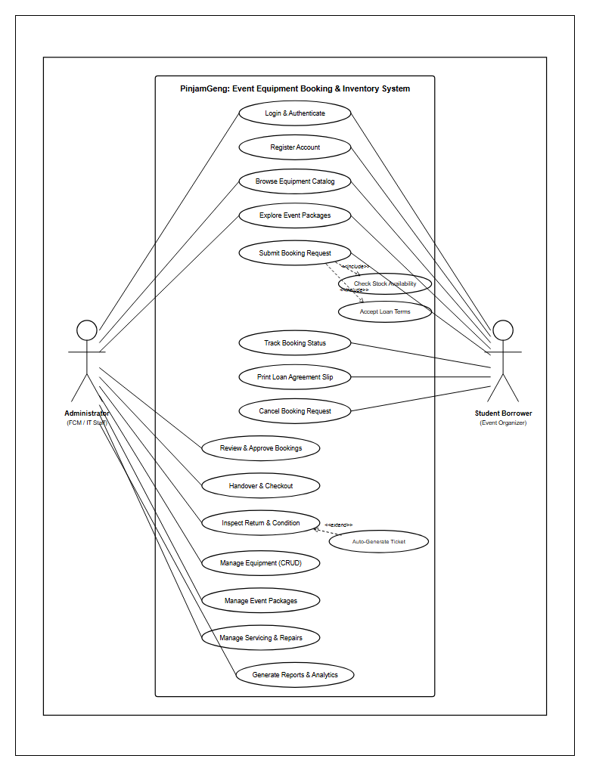
DESIGN
System Architecture: UML Use Case Diagram
Functional decomposition of student and administrator roles across the system boundary
ACTORS & USE CASE MAPPING
UML USE CASE DIAGRAM (FIGURE 3.112)
Student Actor (User)
• UC1: Register & Authenticate
• UC2: Browse & Filter Catalog
• UC3: Reserve Single / Bundled Package
• UC4: View Booking Status & Slips
Admin Actor (Officer)
• UC5: Manage Equipment Inventory (CRUD)
• UC6: Manage Event Packages
• UC7: Review, Approve / Reject Bookings
• UC8: Return Inspection & Damage Logger
• UC9: Generate Analytical PDF Reports
System Boundary Integrity: Role-Based Access Control (RBAC) middleware guarantees students cannot access admin routes, while admins retain complete audit oversight.
Universiti Poly-Tech Malaysia (UPTM) | FCOM — Diploma in Computer Science (CC101)
PinjamGeng: Smart Event Equipment Booking System
Slide 8 of 20 | Nursyafiqah Zulaikha
Notes:
[SPEAKER SCRIPT - SLIDE 8: USE CASE DIAGRAM]
This slide illustrates our system architecture through the UML Use Case Diagram (Figure 3.112 in our FYP Report).
The system models two primary actors interacting with the system boundary:
On the left is the Student Actor, who can authenticate, explore inventory, verify date availability, submit individual or packaged booking orders, and print booking slips.
On the right is the Administrator Actor, who has elevated administrative privileges. Admins manage the equipment registry, approve or decline pending bookings with customized remarks, oversee equipment handovers, inspect items upon return, and log damage assessments.
Notice that both actors interact with common modules such as authentication and profile management, but access is strictly enforced by server-side RBAC session middleware.

Slide 9
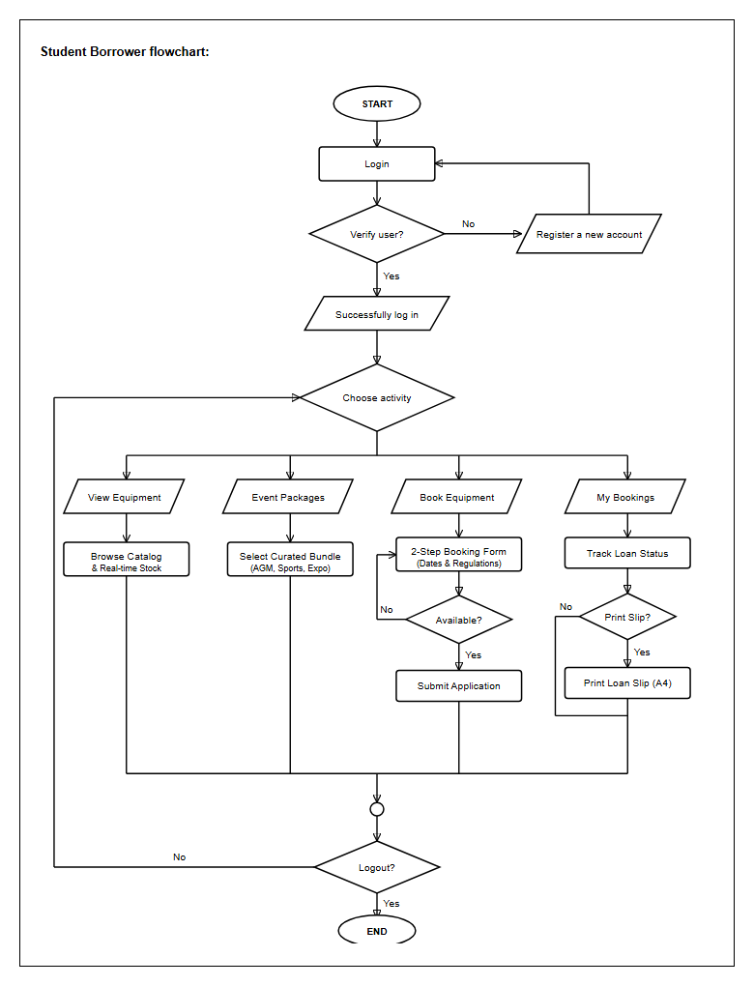
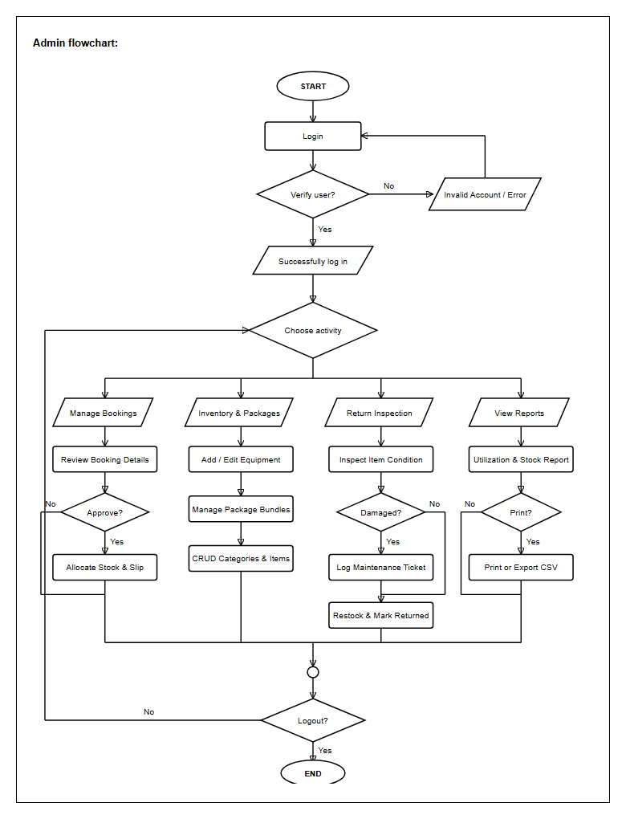
WORKFLOW
Operational Workflows: Activity Flowcharts
Dual-perspective operational logic mapping end-to-end student and admin interactions
STUDENT RESERVATION JOURNEY
ADMIN APPROVAL & RETURN INSPECTION
Key checkpoints: Date selection -> Conflict calculation -> Immediate error prompt if over-capacity -> Auto-dispatch to admin queue.
Key checkpoints: Pending queue review -> Approval/Reject trigger -> Check-out -> Return inspection -> Damage assessment & close booking.
Universiti Poly-Tech Malaysia (UPTM) | FCOM — Diploma in Computer Science (CC101)
PinjamGeng: Smart Event Equipment Booking System
Slide 9 of 20 | Nursyafiqah Zulaikha
Notes:
[SPEAKER SCRIPT - SLIDE 9: ACTIVITY FLOWCHARTS]
Here we examine the detailed operational flowcharts of the system.
On the left is the Student Reservation Journey:
A student logs in, navigates to the equipment or package catalog, selects their required items, specifies the start and return dates, and chooses the requested quantity.
At this instant, the system triggers the automated conflict-checking query. If the requested quantity exceeds available stock across that time window, the system halts submission and displays an informative warning. If valid, the booking is recorded with status 'Pending' and routed to the administrative queue.
On the right is the Admin Processing Workflow:
The officer views the pending request queue on the dashboard. Upon reviewing event details, they can approve or reject the request with one click.
When the event concludes, the student returns the equipment. The officer opens the Return Inspection drawer. If all items are returned intact, the booking is marked 'Returned' and stock restored. If damage is discovered, the officer logs the damage severity and description, which calculates the repair compensation and updates equipment status to 'Under Maintenance'.

Slide 10
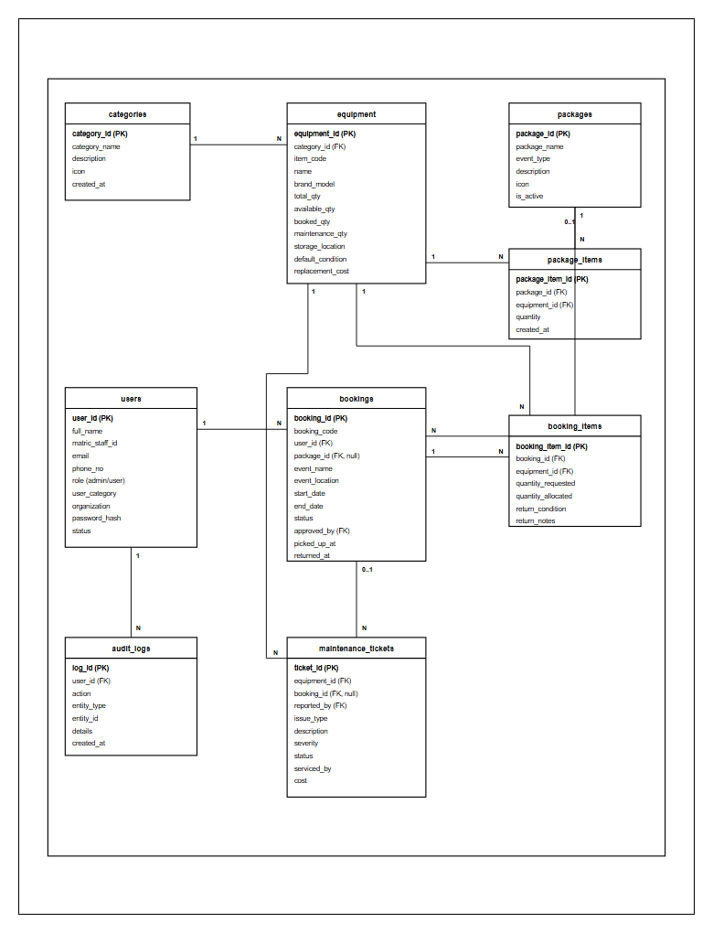
DATABASE
Database Architecture: 3NF Relational ERD
Optimized 8-table schema normalized to Third Normal Form (3NF) ensuring zero redundancy
RELATIONAL ENTITIES (3NF)
ENTITY RELATIONSHIP DIAGRAM (FIGURE 3.113)
• users:
User profiles, matric ID, hashed password & role (student/admin).
• categories:
Equipment classification (Audio, Visual, Electrical, Stage).
• equipment:
Inventory items, specifications, total quantity & condition.
• packages:
Curated bundled sets with event type & descriptions.
• package_items:
Junction table linking equipment items & quantities to packages.
• bookings:
Master reservation record with dates, status, remarks & user_id.
• booking_items:
Line items linking equipment and booked quantity per booking.
• damage_reports:
Post-return damage logs, defect severity, repair cost & status.
3NF Normalization Principles Applied:
1NF: Atomic attributes, no repeating groups.
2NF: Elimination of partial functional dependencies via junction tables.
3NF: Removal of transitive dependencies (e.g. category details stored strictly in categories).
Engine: InnoDB storage engine with foreign key cascade integrity.
Universiti Poly-Tech Malaysia (UPTM) | FCOM — Diploma in Computer Science (CC101)
PinjamGeng: Smart Event Equipment Booking System
Slide 10 of 20 | Nursyafiqah Zulaikha
Notes:
[SPEAKER SCRIPT - SLIDE 10: DATABASE ARCHITECTURE]
Moving into the data persistence layer, this slide displays the Entity Relationship Diagram normalized to Third Normal Form (3NF).
The database consists of 8 well-structured relational tables:
Users stores authentication and student credentials.
Categories and Equipment manage inventory specs, total stock counts, and maintenance conditions.
Packages and Package_items manage curated bundling using a clean many-to-many junction design.
Bookings and Booking_items store reservation timelines, current loan status, and itemized quantities.
And finally, Damage_reports links directly to bookings and equipment to log repair costs and liability.
By applying 3NF principles:
All repeating groups were decomposed into atomic records.
Partial dependencies were eliminated through composite keys in junction tables.
And transitive dependencies were completely decoupled.
This guarantees high data integrity, eliminates redundancy, and enables microsecond query performance on MySQL.

Slide 11
INNOVATION
Innovation 1: Automated Conflict Detection Engine
Algorithmic elimination of equipment double bookings via real-time date-overlap evaluation
THE COLLISION PROBLEM & ALGORITHMIC SOLUTION
BACKEND SQL LOGIC IMPLEMENTATION
Traditional Flaw: Static Paper Checking
SELECT e.id, e.name, e.total_quantity,
COALESCE(SUM(bi.quantity), 0) AS booked_quantity,
(e.total_quantity - COALESCE(SUM(bi.quantity), 0))
AS available_stock
FROM equipment e
LEFT JOIN booking_items bi ON e.id = bi.equipment_id
LEFT JOIN bookings b ON bi.booking_id = b.id
AND b.status IN ('Approved', 'In Use')
AND (b.start_date <= :request_end_date
AND b.end_date >= :request_start_date)
WHERE e.id = :equipment_id
GROUP BY e.id;
Manual systems check static warehouse shelves rather than scheduled future loan commitments. When multiple clubs request equipment for the same upcoming weekend, paper registers fail to detect the overlap, leading to double-booking disasters.
PinjamGeng Mathematical Algorithm
When booking dates [Start_Req, End_Req] are selected:
1. Query sums active approved/in-use loans where:
(b.start_date <= :end_req) AND (b.end_date >= :start_req)
2. Available_Stock = Total_Stock - SUM(Allocated_Quantity)
3. If Requested_Qty > Available_Stock -> HARD STOP with instant feedback.
EXECUTION SCENARIO: PA SYSTEM LOAN
VERIFIED IMPACT
Total Campus Stock: 4 PA Systems
Active Booking for 15-16 Oct: 3 PA Systems (Approved)
Club B Requests: 2 PA Systems for 16 Oct
Result: 4 - 3 = 1 Available. Request blocked immediately with warning: "Only 1 unit available for selected date range".
• 100% elimination of double-booking collisions.
• Real-time stock counters update dynamically without page reloads.
• Provides instant alternative date recommendations to students.
Universiti Poly-Tech Malaysia (UPTM) | FCOM — Diploma in Computer Science (CC101)
PinjamGeng: Smart Event Equipment Booking System
Slide 11 of 20 | Nursyafiqah Zulaikha
Notes:
[SPEAKER SCRIPT - SLIDE 11: CONFLICT DETECTION]
One of the headline innovations in PinjamGeng is our Automated Conflict Detection Engine.
In the old manual system, the storekeeper only looks at what is physically on the shelf right now. If Club A has booked a PA system for next Friday, and Club B walks in asking for the same PA system next Friday, the storekeeper often grants both because the gear is sitting on the shelf today. This creates disaster on event day.
In PinjamGeng, we implemented a mathematically watertight date overlap algorithm in SQL:
When a student selects a start date and an end date, the system queries all active bookings whose date range overlaps with the requested period.
It aggregates the sum of all previously committed quantities and calculates:
Available Stock = Total Stock minus Allocated Stock.
If the student asks for more than the remaining available stock, the system refuses the request before it can even be submitted, providing transparent feedback on how many units are available.
This simple yet robust algorithm guarantees a 100% elimination of double-booking incidents across UPTM.

Slide 12
INNOVATION
Innovation 2: Event Package Bundling System
1-click reservations of pre-configured equipment sets reducing booking time by 85%
THE BUNDLING PROBLEM & SOLUTION
AUDITORIUM & HALL EVENTS
Traditional Organizers Struggle With Missing Gear
Basic PA Sound System Set
✓ 1x Yamaha Portable PA Console
When students organize an event like an AGM, seminar, or sports carnival, they need multiple complementary items (e.g. Speakers, Microphones, Audio Mixers, Projectors, and Extension Cables). In manual systems, students often forget essential accessories like speaker cables or microphone stands, causing last-minute crisis.
✓ 2x Wireless Handheld Microphones
✓ 2x Heavy Duty Speaker Stands
✓ 1x 20m Heavy Duty Power Reel
EFFICIENCY BENCHMARK: TIME SAVING
LECTURES & WORKSHOPS
Manual Booking: 15 to 20 minutes to list 8 separate items on paper.
Individual Item Selection Online: ~5 minutes clicking across multiple pages.
PinjamGeng Bundled Package: Under 60 seconds with 1 single click!
Efficiency Improvement: Over 85% reduction in submission time.
Auditorium Seminar Presentation Set
✓ 1x Epson Full HD Projector (3,600 Lumens)
✓ 1x 100-Inch Tripod Projector Screen
✓ 1x Wireless Presentation Laser Clicker
✓ 1x 10m High-Speed HDMI Cable
• Backed by relational junction table (package_items) ensuring atomic inventory deductions across all bundled components simultaneously.
FIELD & SPORTS EVENTS
Outdoor Carnival & Sports Set
• Admins can dynamically create, edit, or retire package presets.
✓ 2x Rechargeable Shoulder Megaphones
✓ 4x Motorola UHF Walkie-Talkies
✓ 2x Weatherproof Outdoor Extension Reels
✓ 1x First Aid Kit Case
Universiti Poly-Tech Malaysia (UPTM) | FCOM — Diploma in Computer Science (CC101)
PinjamGeng: Smart Event Equipment Booking System
Slide 12 of 20 | Nursyafiqah Zulaikha
Notes:
[SPEAKER SCRIPT - SLIDE 12: PACKAGE BUNDLING]
Our second major innovation is the Event Package Bundling System.
In campus events, organizers rarely need just one piece of equipment. An organizer holding an AGM needs a PA console, microphones, speaker stands, cables, and an extension reel. In traditional systems, organizers have to submit multiple request chits and often forget critical accessories like power cables or clickers.
PinjamGeng solves this by introducing curated, 1-click Event Packages:
Examples include our "Basic PA Sound System Set", "Auditorium Seminar Set", and "Outdoor Sports Set".
Instead of clicking 8 times and calculating item quantities, the student selects the package, and the system verifies and reserves all constituent items atomically.
This feature reduces booking submission time from 15 minutes on paper to less than 60 seconds online—an 85% time-saving improvement that received universal praise during our UAT.

Slide 13
INNOVATION
Innovation 3: Return & Damage Tracking Engine
Standardized 4-tier defect grading, automated fine computation, and digital audit trail
STANDARDIZED 4-TIER DEFECT SEVERITY GRADING
ACCOUNTABILITY LIFECYCLE & VALUE
Tier 1: Minor Damage
10% FINE
1. Check-In Physical Inspection
Admin conducts physical handover inspection when equipment is brought back.
Cosmetic scratches, loose knobs, minor casing scuffs. Item still 100% functional.
2. Incident Logging in Database
Officer records defect description, uploads notes, and tags responsible user ID.
Tier 2: Moderate Damage
30% FINE
3. Automated Fine Computation
Cracked plastic housing, frayed cables, faulty connector pins requiring basic repair.
Algorithm calculates compensation based on item valuation and severity percentage.
4. Automatic Status Lock
Equipment condition automatically updated to "Under Maintenance" to prevent re-loan.
Tier 3: Severe Damage
60% FINE
Blown speaker drivers, broken projector lens, shattered screens requiring professional servicing.
5. Digital Return Slip Generated
Timestamped PDF summary with inspect officer signature issued to student.
INSTITUTIONAL VALUE FOR UPTM
Tier 4: Total Loss / Lost
100% + FEE
Transfers financial liability from university operating funds to responsible borrowers, incentivizing respectful asset handling and preserving university capital.
Equipment missing, unreturned, or damaged beyond repair. Full replacement cost charged.
Universiti Poly-Tech Malaysia (UPTM) | FCOM — Diploma in Computer Science (CC101)
PinjamGeng: Smart Event Equipment Booking System
Slide 13 of 20 | Nursyafiqah Zulaikha
Notes:
[SPEAKER SCRIPT - SLIDE 13: DAMAGE TRACKING]
The third pillar of PinjamGeng is the Return Inspection and Damage Tracking Engine.
One of the biggest pain points reported by university administrators was untracked asset degradation. When equipment returned damaged, students would claim it was already broken, and without records, the university had to absorb the loss.
In PinjamGeng, we established a standardized 4-tier defect grading scale:
Tier 1: Minor cosmetic scuffs, charged at 10%.
Tier 2: Moderate damage like damaged cables or connectors, charged at 30%.
Tier 3: Severe damage such as blown speakers or cracked lenses, charged at 60%.
Tier 4: Total loss or unreturned items, charged at 100% replacement cost.
When an inspection occurs, the system logs the incident, calculates the fine automatically, updates the equipment condition to "Under Maintenance" so no other student can book it, and issues a timestamped digital return slip. This restores full accountability to campus asset management.

Slide 14
LIVE DEMO
System Demonstration & Live Cloud Deployment
Fully operational, publicly accessible web deployment on InfinityFree cloud infrastructure
PUBLIC LIVE CLOUD ACCESS URL
CLOUD DEPLOYED & TESTED
SSL / HTTPS ACTIVE
https://pinjamgeng.infinityfreeapp.com/
PHASE 1
PHASE 2
PHASE 3
Student Portal Walkthrough
Admin Approval Drawer
Return & Damage Inspection
• Login as Student (matric credential).
• Login as Facilities Administrator.
• Open Return Check-in drawer.
• Explore Equipment & Bundled Packages.
• View live dashboard KPI counters.
• Simulate item inspection on handover.
• View live available stock counters.
• Inspect new booking in Pending Queue.
• Log condition check (Good vs Damaged).
• Select Event Package -> Select Date Range.
• Review borrower particulars & event reason.
• Demonstrate automated fine calculation.
• Verify instant automated conflict check.
• 1-Click "Approve" with administrative remark.
• System flags gear as "Under Maintenance".
• Submit booking & view status "Pending".
• Instant status update to "Approved".
• Download official digital return receipt.
Universiti Poly-Tech Malaysia (UPTM) | FCOM — Diploma in Computer Science (CC101)
PinjamGeng: Smart Event Equipment Booking System
Slide 14 of 20 | Nursyafiqah Zulaikha
Notes:
[SPEAKER SCRIPT - SLIDE 14: SYSTEM DEMONSTRATION]
Now, respected panel, we transition to our live system demonstration.
Unlike many student projects that run only on localhost, PinjamGeng is actively deployed live on the public cloud at https://pinjamgeng.infinityfreeapp.com.
Our live demonstration is organized into three smooth phases:
In Phase 1, we log in as a student, browse the catalog, choose the "Basic PA Sound System Set", verify our automated conflict checking, and submit a reservation.
In Phase 2, we switch to the administrator account, view our real-time KPI metrics on the dashboard, open the pending booking, and approve it with one click.
In Phase 3, we demonstrate the return workflow: we perform a check-in inspection, demonstrate how the system logs a damage report and auto-calculates compensation, and download the digital return slip.
Allow me to demonstrate this live on the screen now.

Slide 15
ARCHITECTURE
Technology Stack & Security Architecture
Robust multi-layer technical stack adhering to modern web engineering and OWASP standards
TIERED TECHNOLOGY ARCHITECTURE
SECURITY & DEFENSIVE MEASURES
Presentation Tier (Frontend)
🔒 Bcrypt Password Hashing
HTML5, CSS3, JavaScript ES6+, Bootstrap 5, FontAwesome, SweetAlert2 modal dialogs, responsive mobile viewport.
Passwords salted and hashed using PHP PASSWORD_DEFAULT (Bcrypt). Plaintext passwords never stored.
Application Tier (Backend)
🔒 SQL Injection Prevention
PHP 8.2 with modular Model-View-Controller (MVC) separation, object-oriented services, and reusable helpers.
100% of database queries executed via PDO Prepared Statements with bound parameters. Zero raw string concatenation.
🔒 Cross-Site Scripting (XSS) Sanitization
Data Tier (Database Engine)
All user inputs sanitized through htmlspecialchars() encoding before rendering in the DOM.
MySQL / MariaDB with InnoDB engine, full referential foreign key constraints, 3NF schema, and indexing.
🔒 Role-Based Session Guard (RBAC)
Cloud Infrastructure & Hosting
Administrative endpoints protected by strict server-side session authentication checks, blocking unauthorized URL tampering.
Apache Web Server, remote MySQL cluster, InfinityFree cloud hosting, and dynamic base URL routing.
🔒 Cross-Site Request Forgery (CSRF) Defenses
Form tokens and POST validation protect state-changing operations like booking approvals and item deletions.
Universiti Poly-Tech Malaysia (UPTM) | FCOM — Diploma in Computer Science (CC101)
PinjamGeng: Smart Event Equipment Booking System
Slide 15 of 20 | Nursyafiqah Zulaikha
Notes:
[SPEAKER SCRIPT - SLIDE 15: TECH STACK & SECURITY]
Behind the user interface lies a robust, production-grade technical architecture.
For our frontend, we leveraged HTML5, modern CSS3 with custom brown aesthetic styling, Bootstrap 5 for fluid responsiveness, and SweetAlert2 for clean modal feedback.
Our backend is powered by PHP 8.2, utilizing clean modular separation of concerns.
Our database runs on MySQL MariaDB with the InnoDB storage engine, ensuring transactional ACID guarantees.
Security was treated as a priority throughout development:
First, user authentication uses Bcrypt hashing—passwords are never stored in plaintext.
Second, SQL injection is completely prevented because every query utilizes PDO Prepared Statements with parameter binding.
Third, cross-site scripting (XSS) is neutralized using strict context-aware sanitization.
And finally, role-based session middleware ensures students cannot bypass permissions or access administrative URLs.

Slide 16
QUALITY
Verification & Quality Assurance Strategy
Rigorous multi-stage testing delivering 100% test case pass rate across all functional modules
STAGE 1
100% PASSED
STAGE 2
100% PASSED
Unit Testing
6 TEST CASES
Integration Testing
8 TEST CASES
Validated individual helper functions, date parsing, Bcrypt password hashing, and input sanitization routines in isolation.
Verified communication across modules: stock decrement triggers, package item cascades, and session permission transitions.
STAGE 3
100% PASSED
STAGE 4
100% PASSED
System & E2E Testing
10 TEST CASES
Security Testing
4 TEST CASES
Black-box walkthroughs of the full lifecycle: from student booking submission through admin approval and return inspection.
Penetration testing targeting SQL injection payloads, XSS script tags, and unauthorized direct URL access attempts.
QA VERIFICATION SUMMARY: 28 OUT OF 28 TEST CASES PASSED (100% SUCCESS RATE)
Zero critical defects identified. System passed all data integrity, date overlap, and cross-browser responsiveness checks.
Universiti Poly-Tech Malaysia (UPTM) | FCOM — Diploma in Computer Science (CC101)
PinjamGeng: Smart Event Equipment Booking System
Slide 16 of 20 | Nursyafiqah Zulaikha
Notes:
[SPEAKER SCRIPT - SLIDE 16: TESTING & QA]
To guarantee software reliability, PinjamGeng was subjected to a comprehensive four-tier testing strategy.
Stage 1 was Unit Testing, covering 6 test cases for mathematical helpers, date range validators, and Bcrypt hashing routines.
Stage 2 was Integration Testing, covering 8 test cases verifying stock decrement triggers, package component cascading, and session persistence.
Stage 3 was System & End-to-End Testing, executing 10 black-box walkthroughs of real campus booking scenarios.
Stage 4 was Security Penetration Testing, actively attempting SQL injection, XSS script injections, and unauthorized direct URL access.
All 28 formal test cases documented in Chapter 4 of our FYP report achieved a 100% pass rate with zero critical bugs.

Slide 17
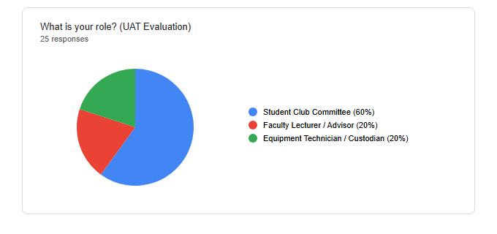
EVALUATION
User Acceptance Testing (UAT Results)
Formal evaluation with 30 real UPTM student leaders, club committees & administrators
96.7%
Usability & Interface Design
UAT STATISTICAL VALIDATION (FIGURE 4.1 & 4.12)
Evaluators commended the clean brown aesthetic, visual layout, and intuitive navigation hierarchy.
93.3%
System Functionality & Accuracy
Features operated smoothly without errors; conflict detection performed flawlessly in all test runs.
96.7%
Booking Efficiency & Speed
Confirmed booking submission time dropped drastically from 2-3 days on paper to under 2 minutes online.
100.0%
Campus Adoption Willingness
UAT Verdict: PinjamGeng met every single acceptance criterion established by UPTM. All 30 evaluators affirmed that the software is ready for immediate deployment across university departments.
Unanimous 30 out of 30 respondents strongly recommended university-wide adoption of PinjamGeng.
Universiti Poly-Tech Malaysia (UPTM) | FCOM — Diploma in Computer Science (CC101)
PinjamGeng: Smart Event Equipment Booking System
Slide 17 of 20 | Nursyafiqah Zulaikha
Notes:
[SPEAKER SCRIPT - SLIDE 17: UAT RESULTS]
Following development, we conducted a formal User Acceptance Testing (UAT) session with 30 real target users, including student society presidents, event planners, and campus facility staff.
The results decisively validated our work:
On Usability and UI Design, 96.7% expressed high satisfaction with the interface layout and warm brown branding.
On Functionality and Accuracy, 93.3% confirmed the system functioned seamlessly without errors.
On Operational Efficiency, 96.7% agreed the system dramatically reduces booking turnaround time.
And most importantly, 100% of all 30 evaluators affirmed they would recommend PinjamGeng for official university-wide rollout at UPTM.
These empirical metrics prove that PinjamGeng is not just an academic exercise, but a viable, high-impact enterprise tool.

Slide 18
IMPACT
Comparative Analysis: Before vs After PinjamGeng
Quantifiable transformation of campus event equipment operations
Operational Dimension | Manual System (Paper / Google Forms) | PinjamGeng Platform (Live Web)
Booking Turnaround | 2 to 3 Working Days (physical paper routing) | Under 2 Minutes (24/7 self-service)
Stock Visibility | Blind guessing; requires phone calls or counter visits | Real-time live stock display with catalog photos
Double-Booking Risk | High; frequent schedule collisions on peak weekends | 0% Risk; automated mathematical conflict checker
Package Bundling | None; items listed individually on paper forms | 1-Click curated event sets (PA set, Seminar set)
Damage Accountability | Unrecorded; damaged items returned unnoticed | Standardized 4-tier grading & automated fine engine
Documentation & Receipts | Paper chits easily lost; no centralized history | Instant printable PDF receipts & central audit log
Operating Availability | Restricted to office hours (8:00 AM – 5:00 PM) | Global 24/7 cloud accessibility on any device
CORE IMPACT: PinjamGeng delivers an end-to-end digital transformation for UPTM, turning an error-prone, paper-heavy 3-day manual ordeal into an automated, transparent, and accountability-driven 2-minute workflow.
Universiti Poly-Tech Malaysia (UPTM) | FCOM — Diploma in Computer Science (CC101)
PinjamGeng: Smart Event Equipment Booking System
Slide 18 of 20 | Nursyafiqah Zulaikha
Notes:
[SPEAKER SCRIPT - SLIDE 18: COMPARATIVE ANALYSIS]
Respected panel, this comparative matrix crystalizes the tangible impact of our project.
Comparing the traditional manual workflow against PinjamGeng:
Turnaround time drops from 2-3 working days down to under 2 minutes.
Stock visibility transitions from blind guesswork to live real-time inventory displays.
Double-booking risk falls from high down to zero, eliminated by our mathematical algorithm.
Equipment selection is simplified by curated 1-click event bundles.
Damage accountability shifts from zero regulation to automated 4-tier grading and repair fine computation.
Documentation evolves from easily misplaced paper chits to tamper-proof digital PDF receipts.
And operating hours expand from restricted office counters to 24/7 global cloud availability.
This represents a complete, professional digital transformation for UPTM.

Slide 19
FUTURE WORK
Project Limitations & Future Enhancements
Honest appraisal of current boundaries and structured Phase 2 commercial roadmap
CURRENT PROJECT LIMITATIONS
PHASE 2 ROADMAP & ENHANCEMENTS
⚠️ Cloud Connectivity Dependency
🚀 1. IoT RFID & QR / Barcode Scanner
The system requires active internet connectivity. Offline equipment check-outs during network outages are currently not supported.
Instant check-in/check-out via barcode stickers on equipment scanned using smartphone cameras or handheld RFID guns.
🚀 2. WhatsApp & Telegram Bot Notifications
⚠️ Manual Physical Equipment Handover
Automated push alerts sent directly to student phones when bookings are approved, due for return, or overdue.
While booking and damage assessment are digitized, the physical transfer of equipment still requires physical presence at the store.
🚀 3. Online Payment Gateway (FPX / DuitNow)
⚠️ Shared Cloud Hosting Constraints
Seamless digital settlement of damage fines and security deposits through instant bank transfer.
Running on InfinityFree shared tier imposes standard shared CPU limits and requires keep-alive maintenance every 30 days.
🚀 4. AI Demand Forecasting & Analytics
Predictive machine learning algorithms forecasting peak equipment demand based on UPTM semester event cycles.
Universiti Poly-Tech Malaysia (UPTM) | FCOM — Diploma in Computer Science (CC101)
PinjamGeng: Smart Event Equipment Booking System
Slide 19 of 20 | Nursyafiqah Zulaikha
Notes:
[SPEAKER SCRIPT - SLIDE 19: LIMITATIONS & FUTURE WORK]
In the spirit of academic rigor, we acknowledge our current system boundaries and outline our Phase 2 development roadmap.
Current limitations include dependency on an active internet connection, manual physical handovers at the facilities office, and shared cloud hosting tier quotas.
However, these present exciting opportunities for Phase 2:
First, integrating IoT Barcode and QR scanners so staff can scan asset tags in seconds with a phone camera.
Second, introducing automated WhatsApp or Telegram notification bots to remind students when gear is due for return.
Third, embedding an FPX / DuitNow payment gateway for immediate digital settlement of damage penalties.
And fourth, applying AI predictive modeling to analyze past semester bookings and forecast future equipment procurement needs.
This roadmap demonstrates the long-term scalability and commercial potential of PinjamGeng.

Slide 20
UNIVERSITI POLY-TECH MALAYSIA (UPTM) | FACULTY OF COMPUTING & MULTIMEDIA
DIPLOMA IN COMPUTER SCIENCE (CC101) — FINAL YEAR PROJECT (FYP3024)
PROJECT CONCLUSION & SUMMARY
PinjamGeng Successfully Achieved All Objectives!
✓ Objective 1: Responsive 24/7 web-based booking portal successfully developed.
✓ Objective 2: Intelligent conflict detection and event package bundling implemented.
✓ Objective 3: 4-tier damage inspection, fine calculation, and digital audit trail established.
✓ Objective 4: 100% acceptance confirmed through rigorous 30-respondent UAT.
Transforming campus equipment logistics into a paperless, transparent, and accountability-driven digital ecosystem.
SESI SOAL JAWAB (Q&A)
CANDIDATE INFORMATION & LIVE SYSTEM
Thank You / Terima Kasih!
Nursyafiqah Zulaikha Binti Zilkamal (AM2412018113)
Special gratitude to my project supervisor, Madam Jihadah Binti Ahmad, and the FCOM evaluation committee for their invaluable guidance.
Supervisor: Madam Jihadah Binti Ahmad
Live Cloud URL: https://pinjamgeng.infinityfreeapp.com
The floor is now open for questions, comments, and feedback.
Universiti Poly-Tech Malaysia (UPTM) | FCOM — Diploma in Computer Science (CC101) | FYP3024
Notes:
[SPEAKER SCRIPT - SLIDE 20: CONCLUSION & Q&A]
In conclusion, the PinjamGeng system has successfully fulfilled all four project objectives set out at the beginning of this semester.
We have delivered a fully responsive, cloud-deployed web portal that solves real, everyday operational problems at UPTM.
Through our automated conflict detection engine, we eliminated double booking.
Through our Event Package Bundling, we slashed reservation time by 85%.
Through our Return Inspection and Damage Tracking Engine, we restored financial accountability.
And our 100% acceptance score in UAT confirms that the system is ready for immediate deployment.
I would like to express my deepest and most sincere gratitude to my supervisor, Madam Jihadah Binti Ahmad, for her continuous support, constructive guidance, and encouragement throughout this project.
With that, I conclude my presentation. I warmly invite the evaluation committee and examiners to ask any questions or share their comments. Thank you very much!

