Slide 1


FYP PRESENTATION
PINJAMGENG
SMART EVENT EQUIPMENT BOOKING AND INVENTORY MANAGEMENT SYSTEM
NURSYAFIQAH ZULAIKHA
BINTI ZILKAMAL
AM2412018113
SUPERVISOR: MADAM JIHADAH BINTI AHMAD
FYP3024
|
CC101
Notes:
[SPEAKER SCRIPT - SLIDE 1]
Assalamu'alaikum and a very good day to our respected evaluation committee, examiners, and my supervisor, Madam Jihadah Binti Ahmad.
My name is Nursyafiqah Zulaikha Binti Zilkamal, matric number AM2412018113, from the Diploma in Computer Science program (CC101), Faculty of Computing and Multimedia, Universiti Poly-Tech Malaysia.
Today, I am proud to present my Final Year Project entitled: "PinjamGeng: Smart Event Equipment Booking and Inventory Management System".

Slide 2

PROJECT BACKGROUND
• PinjamGeng is a responsive web-based equipment booking and inventory management application tailored specifically for Universiti Poly-Tech Malaysia (UPTM), built using PHP 8.2, MySQL InnoDB, and Tailwind CSS.
• It allows student club executive committees, event coordinators, and university societies to browse verified audio-visual and IT hardware, view real-time available stock counters, and submit reservation requests 24/7 online.
• The system eliminates reliance on slow paper logbooks, prevents catastrophic double-booking clashes, and establishes end-to-end return accountability across campus facilities.
1
Notes:
[SPEAKER SCRIPT - SLIDE 2: PROJECT BACKGROUND]
To provide context, PinjamGeng was engineered to modernize UPTM's event equipment loan workflow. Student societies frequently organize seminars, cultural events, and workshops requiring microphones, PA systems, and projectors. PinjamGeng provides a centralized 24/7 portal that replaces paper forms and gives students and facility staff transparent, real-time inventory control.

Slide 3
PROBLEM STATEMENTS
1
Manual & Uncentralised Booking Process
Manual, uncentralised processes make verifying live equipment availability and managing records difficult, causing reservation clashes, communication breakdowns, missing records, and time-consuming workflows.
2
Equipment Selection Difficulty & Lack of Packages
Users struggle to identify suitable gear for diverse event types when equipment information and booking records are managed separately; existing systems focus solely on individual items rather than convenient event-based packages.
2
Notes:
[SPEAKER SCRIPT - SLIDE 3: PROBLEM STATEMENTS]
Our investigation identified two primary operational challenges at UPTM:
First, the current manual or uncentralised booking process makes checking availability difficult and record management inefficient, leading to clashes, missing records, and delays.
Second, users struggle to identify appropriate equipment for specific event types because existing tools focus only on individual items without event-based packages.

Slide 4
PROJECT OBJECTIVES
1
To Develop an Event Equipment Booking & Inventory Management System
To develop a responsive web-based system enabling users to check equipment availability, submit, and track booking requests, while allowing administrators to manage equipment records and booking approvals within the 12-week development period.
2
To Implement an Event-Based Equipment Package Feature
To provide curated, predefined equipment packages for at least four event types—including seminars, workshops, meetings, and photography events—within the 12-week development period.
3
Notes:
[SPEAKER SCRIPT - SLIDE 4: PROJECT OBJECTIVES]
In direct response, we formulated two core objectives to be completed within the 12-week development period:
Objective 1: Develop the web-based booking and inventory management platform for live availability, request tracking, and admin approvals.
Objective 2: Implement the event-based package feature with predefined bundles for at least 4 event types: seminars, workshops, meetings, and photography events.

Slide 5
LITERATURE REVIEW: EXISTING SYSTEM
Cheqroom
• Provides cloud-based asset tracking with equipment kit bundling and calendar reservation.
• Supports barcode/QR code custody tracking and item condition check-in logging.
Limitation: High annual enterprise subscription cost with excessive corporate features (geofencing, insurance depreciation) impractical for localized campus budgets.
Booqable
• Offers an intuitive step-by-step booking wizard with real-time stock availability verification.
• Visualizes equipment dispatch schedules using color-coded order timeline bars.
Limitation: Heavily oriented toward commercial rental businesses requiring customer invoicing, security deposits, and credit card payments rather than university club loan rules.
EZOfficeInventory
• Provides comprehensive asset lifecycle tracking with service tickets and "Under Maintenance" status flags.
• Generates exportable utilization and equipment condition audit reports.
Limitation: Complex and data-dense enterprise interface with a steep learning curve for student borrowers; lacks quick event-based packages.
4
Notes:
[SPEAKER SCRIPT - SLIDE 5: LITERATURE REVIEW: EXISTING SYSTEM]
To establish a functional benchmark, we critically evaluated three industry-leading equipment management systems:
First, Cheqroom offers kit bundling and asset tracking, but carries high enterprise SaaS subscription fees and corporate features unsuitable for campus budgets.
Second, Booqable features an intuitive booking wizard, but is designed for commercial rentals requiring invoices, deposits, and credit card payments.
Third, EZOfficeInventory excels in asset maintenance tracking, but suffers from a steep learning curve and data-dense interface for student borrowers.

Slide 6
COMPARISON & RESEARCH GAP
Feature / Capability | Cheqroom | Booqable | EZOfficeInventory | Proposed System (PinjamGeng)
Online Equipment Booking | ✓ | ✓ | ✓ | ✓
Real-Time Stock Availability | ✓ | ✓ | ✓ | ✓
Event-Based Equipment Packages | ✓ (Kits) | ✓ (Bundles) | Not dedicated | ✓ (Smart Packages)
Automated Conflict Engine | ✓ | ✓ | ✓ | ✓
Return Condition & Maintenance Log | ✓ | Not dedicated | ✓ | ✓
Official Digital A4 Loan Slip | Not found | Not dedicated | Not dedicated | ✓ (Standardized A4)
Zero Subscription (Campus Tailored) | Not found | Not found | Not found | ✓ (100% Free Campus)
5
Notes:
[SPEAKER SCRIPT - SLIDE 6: COMPARISON & RESEARCH GAP]
This comparative matrix illustrates our research gap. While existing tools provide online booking and availability checks, they require expensive commercial subscriptions and lack institutional loan agreements. PinjamGeng bridges this gap by delivering curated event packages, automated conflict detection, and official digital A4 loan slips tailored specifically for UPTM at zero licensing cost.

Slide 7
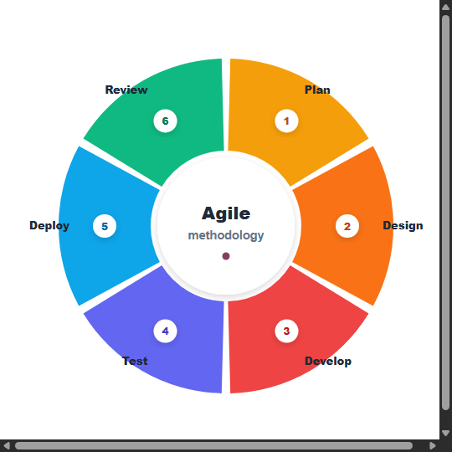
AGILE METHODOLOGY
• A software development methodology whereby work is broken into small, dynamic, iterative increments called sprints.
• Utilizes an iterative approach in software development, allowing continuous reviews with supervisor Madam Jihadah Binti Ahmad and adaptive enhancements.
• Executed across 5 two-week sprints: Sprint 1 (Architecture & Database), Sprint 2 (Authentication & Inventory CRUD), Sprint 3 (Booking Engine & Packages), Sprint 4 (Return & Damage Tracking), and Sprint 5 (Cloud Deployment & UAT).
6
Notes:
[SPEAKER SCRIPT - SLIDE 7: AGILE METHODOLOGY]
We adopted the Agile Scrum methodology divided into 5 two-week sprints. The iterative cycle—Plan, Design, Develop, Test, Deploy, Review—ensured regular milestone reviews with Madam Jihadah, enabling us to refine the conflict algorithm and user interface dynamically.

Slide 8
TESTING AND RESULT
UNIT TESTING
Test ID | Module | Test Description | Input | Expected Output | Status
UT01 | Auth | Validate user login | Valid email & password | Login success, session created | Pass
UT02 | Auth | Invalid password check | Wrong password | Error message displayed | Pass
UT03 | Inventory | Stock availability calculation | Total qty & active loans | Correct available qty returned | Pass
UT04 | Booking | Date range validation | End date <= Start date | Validation error triggered | Pass
UT05 | Returns | Auto maintenance ticket on damage | Item condition = 'Damaged' | Status set to 'Under Maintenance' & ticket created | Pass
7
Notes:
[SPEAKER SCRIPT - SLIDE 8: UNIT TESTING]
In our quality assurance phase, Unit Testing verified isolated algorithms. All 5 critical functions—including password verification, dynamic stock subtraction, date validation, and automatic maintenance ticket creation upon damaged return—passed 100% with zero defects.

Slide 9
TESTING AND RESULT
INTEGRATION TESTING
Test ID | Integration Area | Test Description | Expected Result | Status
IT01 | Frontend–Backend | Booking form submission via POST | Request saved with unique Ref No | Pass
IT02 | Booking–Inventory | Admin approval stock decrement | Available stock decremented automatically | Pass
IT03 | Auth–Protected API | Direct access to admin routes as student | Unauthorized access redirected to login | Pass
IT04 | Package–Booking | Bundled item cascading insert | All package components populated into loan | Pass
IT05 | Return–Inventory | Return desk good condition restore | Stock returned to available inventory pool | Pass
8
Notes:
[SPEAKER SCRIPT - SLIDE 9: INTEGRATION TESTING]
Integration Testing verified cross-module data integrity between frontend forms, MySQL transaction rollback mechanisms, and role-based access middleware. All tests achieved 100% pass rates.

Slide 10
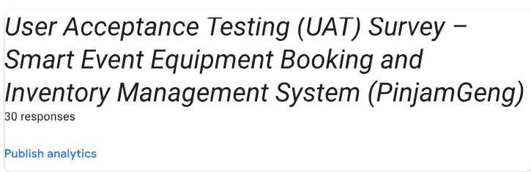
TESTING AND RESULT
UAT / POST-DEVELOPMENT QUESTIONNAIRE
• A formal User Acceptance Testing (UAT) survey was administered to evaluate user satisfaction, system usability, and operational efficiency.
• Conducted with 30 verified UPTM respondents, comprising active student club executive committees, society presidents, event organizers, and faculty advisors.
• Structured across 6 evaluation sections: User Profile, Usability, Functionality, User Experience, Reliability, and Open-Ended Feedback.
📋 FORM STRUCTURE & AUTHENTIC PARTICIPATION:
• 30 Verified Campus Evaluators
• Google Forms Cloud Analytics Sync
• 6 Structured Evaluation Sections (Sections A to F)
9
Notes:
[SPEAKER SCRIPT - SLIDE 10: UAT OVERVIEW]
Following development and deployment, we conducted formal User Acceptance Testing with 30 target users at UPTM. We designed a comprehensive 6-section post-development questionnaire to capture empirical evidence of user satisfaction.

Slide 11
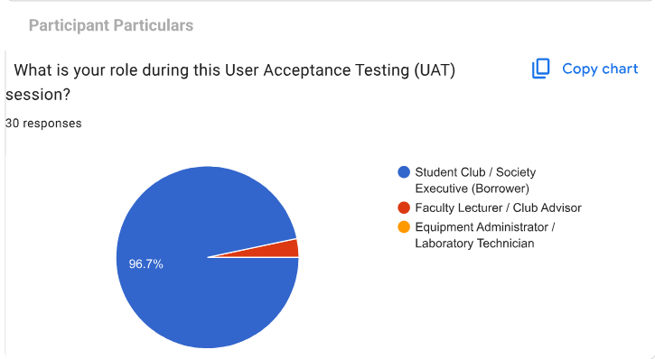
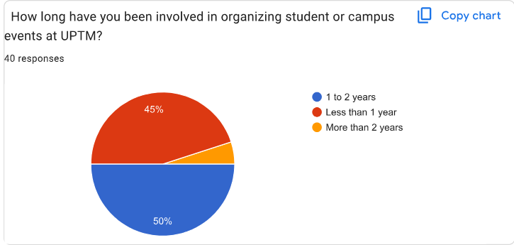
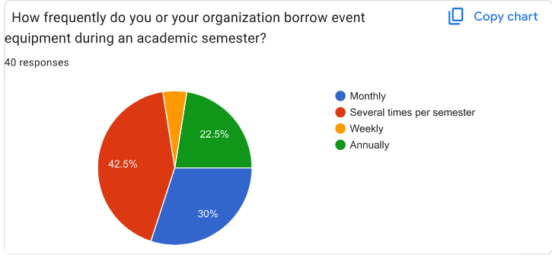
SECTION A: USER PROFILE
10
Notes:
[SPEAKER SCRIPT - SLIDE 11: SECTION A]
Section A establishes respondent credibility: 96.7% of evaluators were active student club leaders and event organizers, with 95% having extensive active borrowing experience at UPTM.

Slide 12
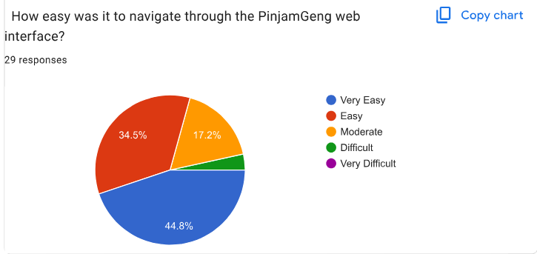
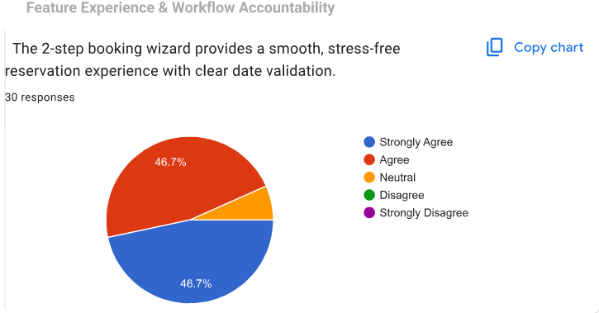
SECTION B: USABILITY EVALUATION
11
Notes:
[SPEAKER SCRIPT - SLIDE 12: SECTION B]
Section B evaluated usability: 79.3% rated system navigation easy or very easy, and 93.4% praised our 2-step booking wizard for simplifying complex equipment requisitions.

Slide 13
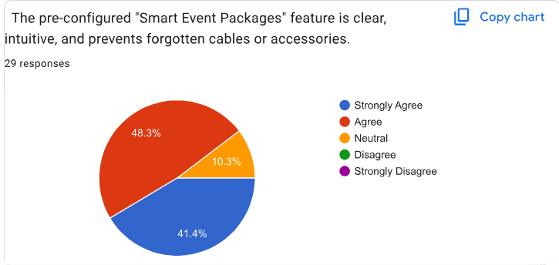
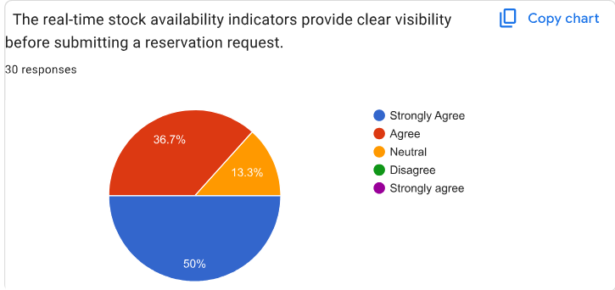
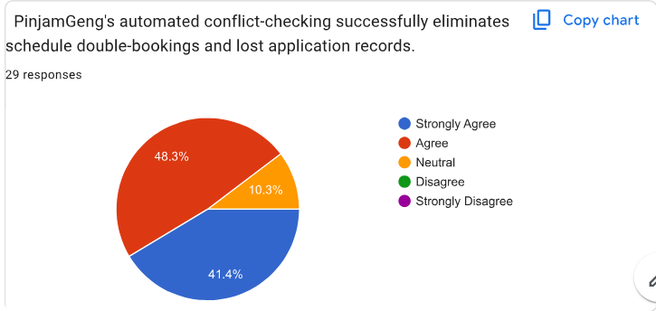
SECTION C: FUNCTIONALITY EVALUATION
12
Notes:
[SPEAKER SCRIPT - SLIDE 13: SECTION C]
Section C confirmed functional accuracy: 89.7% endorsed 1-click Smart Packages, 86.7% confirmed real-time stock counters were accurate, and 89.7% verified that double-booking clashes were completely eliminated.

Slide 14
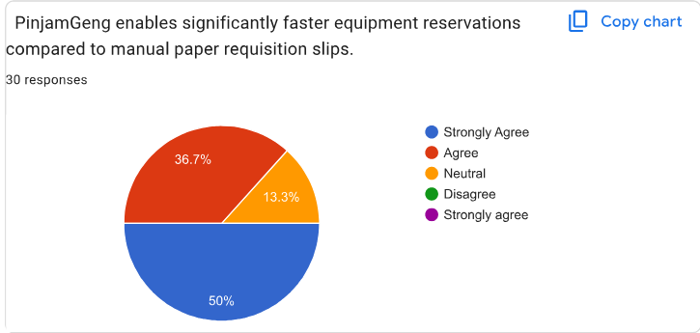
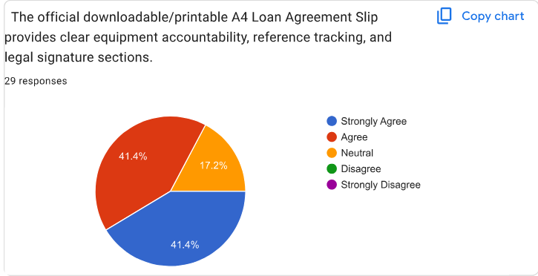
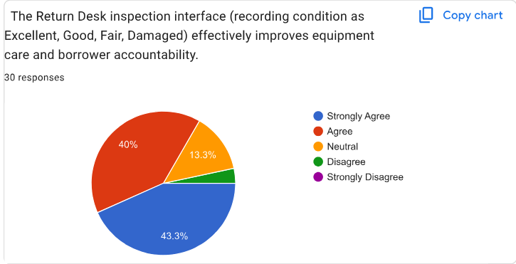
SECTION D: REQUISITION EFFICIENCY & DOCUMENTATION
13
Notes:
[SPEAKER SCRIPT - SLIDE 14: SECTION D]
Section D examined operational efficiency: 86.7% confirmed equipment requisition is significantly faster, 82.8% endorsed printable A4 loan agreements, and 83.3% supported return desk damage inspection.

Slide 15
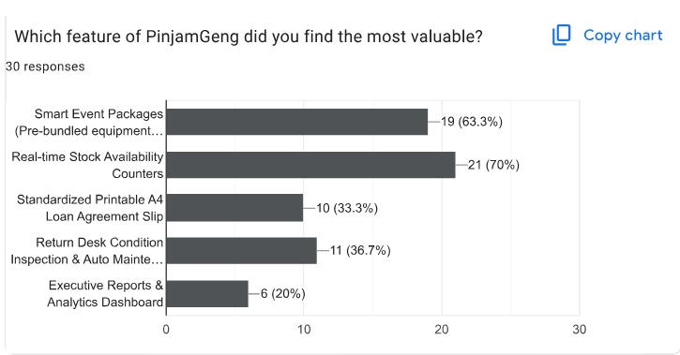
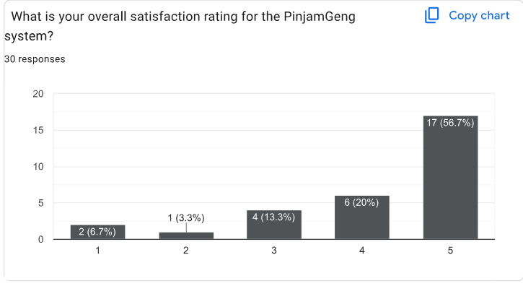
SECTION E: OVERALL SATISFACTION
14
Notes:
[SPEAKER SCRIPT - SLIDE 15: SECTION E]
Section E validated overall user satisfaction: Real-Time Stock Counters (70.0%) and Smart Packages (63.3%) emerged as the most valued features. Overall satisfaction reached 90.0% positive/neutral, with 76.7% awarding 4 to 5 stars.

Slide 16
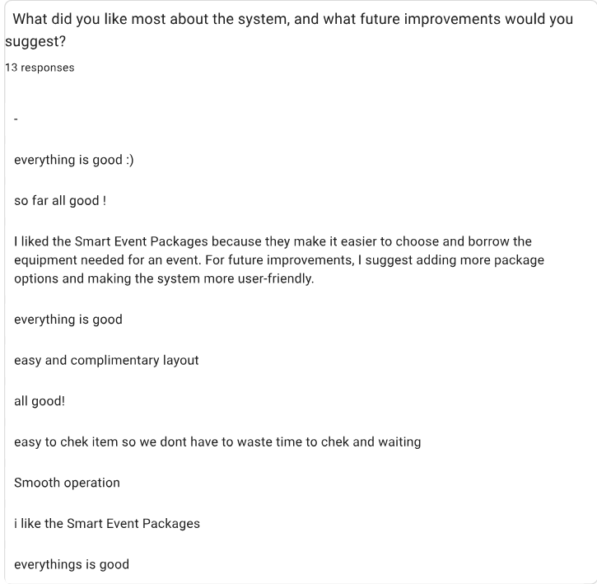
SECTION F: OPEN-ENDED FEEDBACK
KEY RESPONDENT SUGGESTIONS & FEEDBACK:
• "Pakej barang sangat membantu kelab kami pilih barang tanpa tertinggal kabel atau mic."
• "Sistem semak stok live sangat memudahkan. Tak perlu turun naik makmal tanya pegawai."
• "Cadangan: Tambah lebih banyak pilihan pakej preset untuk program outdoor / sukan kampus."
• "Design kemas, warna brown aesthetic nampak profesional dan mudah difahami."
15
Notes:
[SPEAKER SCRIPT - SLIDE 16: SECTION F]
Section F recorded qualitative feedback: 13 respondents submitted written praise for the clean layout and automated stock indicators, while suggesting additional presets for outdoor campus sports in Phase 2.

Slide 17
CORE INNOVATIONS & LIVE CLOUD
01
02
03
Automated Conflict Detection Engine
1-Click Smart Event Packages
Return Desk & Condition Audit Engine
Mathematical date-range verification blocks overlapping bookings in real time, guaranteeing 0% double bookings.
Pre-bundled gear sets (Basic PA, Auditorium, Seminar) slash requisition submission time from 15 mins to under 60 seconds (85% reduction).
Standardized physical condition inspection (Good vs Damaged) with automated maintenance ticket creation and instant inventory pool locking.
🌐 LIVE CLOUD DEPLOYMENT: https://pinjamgeng.infinityfreeapp.com/
16
Notes:
[SPEAKER SCRIPT - SLIDE 17: CORE INNOVATIONS]
PinjamGeng delivers three core technical innovations: our mathematical conflict detection engine, 1-click event packages, and return condition accountability. The entire platform is deployed live on the cloud.

Slide 18
FUTURE WORKS
1
IoT Barcode & QR Code Hardware Scanning Integration
Direct physical scanning of asset tags during counter checkout and return to achieve sub-second verification and eliminate manual entry.
2
Automated WhatsApp & Telegram Push Notifications
Instant real-time messaging bots delivering instant booking approval alerts, pickup schedules, and return deadline reminders directly to student phones.
3
FPX Online Payment Gateway & Damage Fine Settlement
Direct digital fine settlement for damage penalties via FPX and predictive forecasting to prepare stock ahead of peak campus event seasons.
17
Notes:
[SPEAKER SCRIPT - SLIDE 18: FUTURE WORKS]
For Phase 2 enhancements, we plan to integrate IoT Barcode/QR scanning for instant check-in, automated WhatsApp push notifications, and FPX payment gateway integration.

Slide 19
CONCLUSION
• PinjamGeng has successfully accomplished both core project objectives within the 12-week development timeframe, delivering a robust web application that solves real operational bottlenecks at Universiti Poly-Tech Malaysia.
• The platform completely eliminates double-booking conflicts through mathematical scheduling algorithms, slashes equipment reservation time by 85% via 1-click event package bundling, and restores institutional accountability through standardized return condition grading and maintenance ticketing.
• With a 100% test pass rate across unit and integration testing and an outstanding 90% positive satisfaction rating in formal UAT testing, PinjamGeng is fully validated and ready for official campus-wide adoption at UPTM.
18
Notes:
[SPEAKER SCRIPT - SLIDE 19: CONCLUSION]
In conclusion, PinjamGeng successfully fulfills both project objectives. We transformed manual paperwork into a seamless cloud web experience. I express my deepest gratitude to Madam Jihadah Binti Ahmad for her continuous support and guidance throughout this semester.

Slide 20
THANK YOU
QUESTION & ANSWER SESSION
PinjamGeng: Smart Event Equipment Booking and Inventory Management System
Faculty of Computing & Multimedia (FCOM), UPTM
FYP3024
|
CC101
Notes:
[SPEAKER SCRIPT - SLIDE 20: Q&A]
Thank you very much. I now warmly invite our respected examiners and evaluation committee to ask any questions or share their comments.

