Slide 1
Lending Club
Nicolae Tecu
Thinkful Data Science Bootcamp
Supervised Learning Capstone

Slide 2
Goal
Construct/discuss a model for assigning quality grade to Lending Club loans

Slide 3
Motivation
Quality (grade) appears to be an important decision in pricing a loan
Questions a lender needs to answer:
Should we consider the loan?
What is the quality of the loan?
What is the probability of default?
What is the recovery rate?
What interest rate should I charge?
This type of analysis can be useful to assess:
Evolution and fairness of loan issuance practices

Slide 4
Data
Lending Club loan data
https://www.lendingclub.com/info/download-data.action
2007-2011
Loans issued during period, data filled out post period
42537 loans x 143 “features”
E.g. amount, term, grade, etc.

Slide 5
Preparing to model

Slide 6
What does the data look like?
Categorical features
Grade, term, employment length, homeownership type, etc.
Continuous features
Loan amount, annual income, length of credit history, etc.

Slide 7
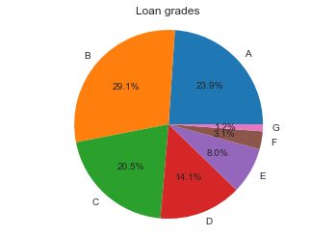
Loan grades

Slide 8
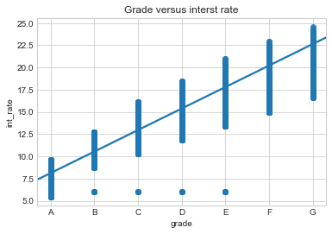
Grade impacts interest rates

Slide 9
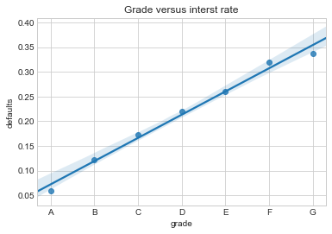
Grade is a reflection of default rate

Slide 10
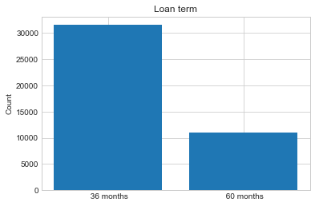
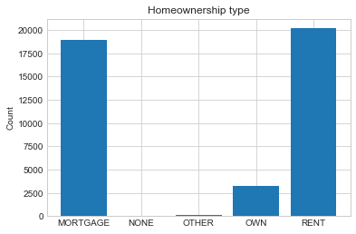
Term of loan & homeownership type

Slide 11
Modeling assumptions: Lender process
Assumptions:
Based on variables V
Assign grade and
Where
Variables V have to be known at the time of loan decision
Variables V have to have reasonable number of categories if not continuous
Therefore we:
Remove irrelevant features
Examples: title of the loan (not quantifiable), etc.
Remove inappropriate features
Some of the features were not available/known at the time the loan was made (or at least look so to me)
Examples: recoveries, collections last 12 months, etc.

Slide 12
Features
Continuous
Categorical
Amount of loan
Annual income
Debt to income
Revolving balance on all accounts
Revolving credit line utilization
Open accounts
Public records
Total accounts
Loan as percent of annual income (created by NT)
Term of loan (36 or 60 months)
Homeownership type
Verification of income

Slide 13
Modeling assumptions Structure of question
Define ‘high’ and ‘low’ quality of loans of roughly equal size
Avoid unbalanced sample
High quality = A
Low quality = D or E or F
Quantiles for continuous variables
10; but 20 gives similar results
Similar to how LC approaches e.g. loan amount (see appendix)

Slide 14
Models

Slide 15
Objectives
Good cross validation score
Interpretability
Do the results make sense?
Simplicity
Number of parameters

Slide 16
Diagnostics
Overfitting inclination:
Full-sample score vs. Train/test score
Train/test: 75% train, 25% test, randomized indices
Feature ranks
Are the ranks of the features robust/consistent across models?

Slide 17
Model candidates
Logistic Regression (simple, interpretable)
Random Tree (not so simple, interpretable)
SVM (not so simple, not interpretable)
Random Forest (complex, not interpretable)

Slide 18
Choose Logistic Regression
LR model is a good choice because
It is conceptually simple
It is interpretable
It has just as good predictive power as the other options.

Slide 19
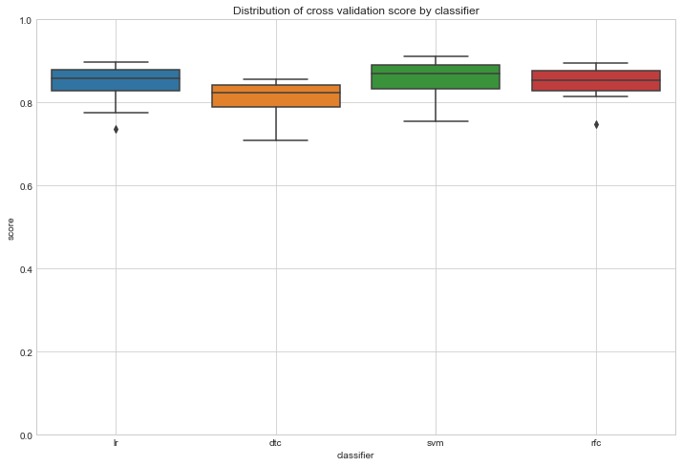
LR has good relative cross validation characteristics
DTC does worst
RFC works best (via dispersion)
LR is simpler and has similar performance.

Slide 20
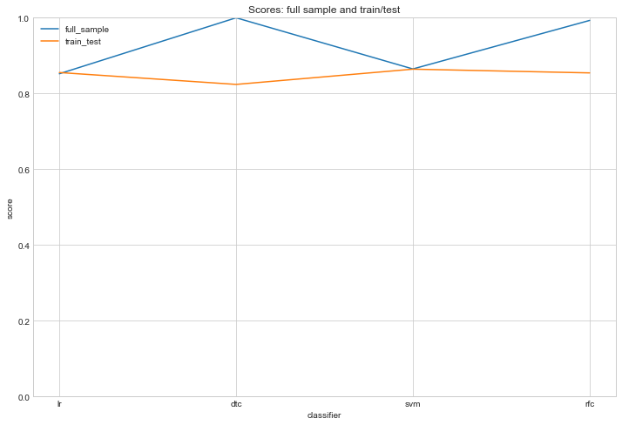
LR over-fits little
Both DTC and RFC have an inclination to over-fit.

Slide 21
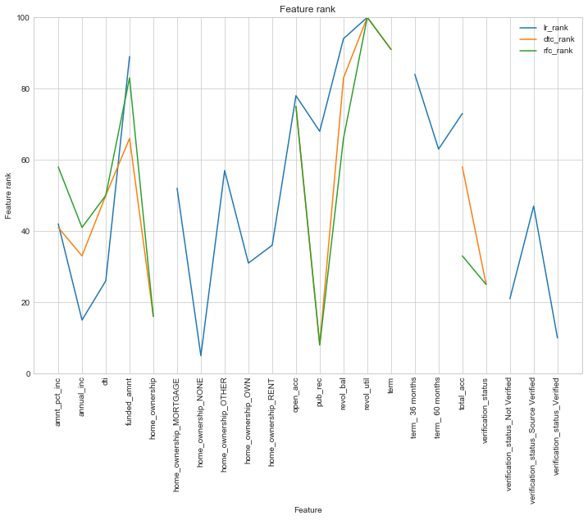
LR ranks have same shape as other classifiers
All 3: similar ranking for importance of features.
Most important features:
Revolving credit line utilization
Revolving balance
Size of loan
Number of open accounts

Slide 22
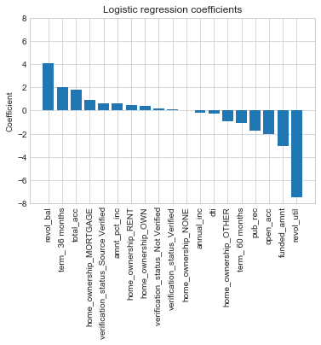
LR coefficients make sense

Slide 23
Possible extensions
Construct new features (e.g. “FICO” score)
Add and remove features to stress test model
Compare to the same model applied to years post 2011
Multiclass (grade =A,…,G) version

Slide 24
Appendix

Slide 25
Lending Club – methodology (1)
https://www.lendingclub.com/public/rates-and-fees.action
https://www.lendingclub.com/foliofn/rateDetail.action
https://www.orchardplatform.com/blog/credit-variables-explained-credit-grades-on-lendingclub-and-prosper/
“These rates are set based on the originator’s underwriting assessment for the individual borrower. The higher the expected risk of default, the higher the interest rate is set in order to offset this risk. The assessment of the credit grade decision includes FICO, loan term (shorter term is considered better), proprietary models, and the loan amount requested by the borrower.”

Slide 26
Discussion: grade vs default and recovery
LC seems to compute a grade and assign an interest rate based on the grade.
Ultimately, the interest rate will reflect
Idiosyncratic default probability, recovery rate
Systemic default probability
Financing rate
Lender has choice of model:
Compute a default probability and a recovery rate, assign grade and then interest rate
Pro: more direct
Contra: conflates systemic & idiosyncratic factors, difficult to get accurate estimates for default and recovery
Assign grade, use the grade to get probability and recovery rate
Pro: focuses on relative attractiveness of loans, separates systemic component
Contra: indirect estimate for default and recovery

Slide 27
Lending Club – methodology (2)
Based on various variables
Assign grade
Assign interest rate based on base interest rate and adjustment for grade
This suggests the second approach, where the grade is used for relative loan quality adjustments.
If probability of default and recovery rate is computed before grade, there is no need for grade assignment.

Slide 28
Modeling caveat – sampling bias
Model will not represent ‘objective’ grades, but ones that incorporate biases of LC decision making (we are not considering loans made by other organizations)

Slide 29
Feature rank construction
Use
LR: abs(coefficients) (since data is normalized to the interval [0,1])
DTC, RFC: feature importance
Sort descending
Take rank
Rank max rank to be 100

