Slide 1
Lending Club Loan Grades
Nicolae Tecu
Thinkful Data Science Bootcamp
Supervised Learning Capstone
February 3, 2018

Slide 2
Goal
Construct and discuss a model for assigning quality grade to Lending Club loans

Slide 3
Motivation
Quality (grade) is important in pricing of loans
Questions a lender needs to answer:
Should we consider the loan?
What is the quality of the loan?
What is the probability of default?
What is the recovery rate?
What interest rate should I charge?
This type of analysis can be useful to assess:
Evolution and fairness of loan issuance practices

Slide 4
Preparing to model

Slide 5
Data
Lending Club loan data (see appendix)
2007-2011
Loans issued during period, data filled out post period
42537 loans x 143 “features”
E.g. amount, term, grade, etc.
Categorical features (e.g. grade, term, employment length, homeownership type)
Continuous features (e.g. Loan amount, annual income, length of credit history)

Slide 6
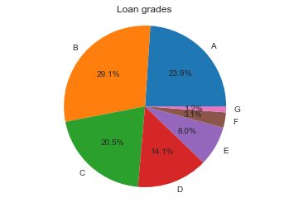
Loan grades

Slide 7
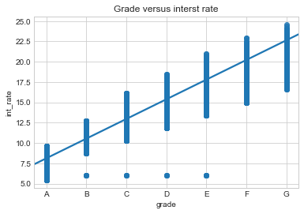
Grade impacts interest rates

Slide 8
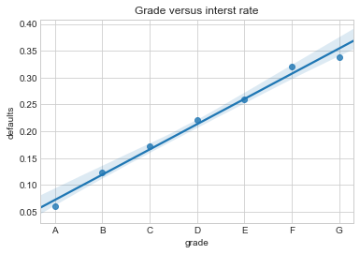
Grade is a reflection of default rate

Slide 9
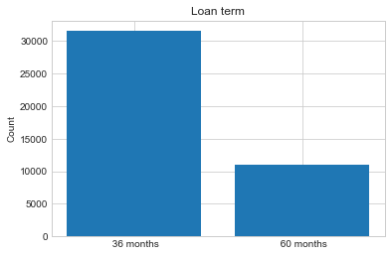
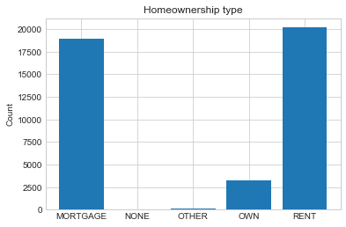
Term of loan & homeownership type

Slide 10
Modeling assumptions: Lender process
Assumptions:
Based on variables V
Assign grade
Where
Variables V have to be known at the time of loan decision
Variables V have to have reasonable number of categories if not continuous
Therefore we:
Remove irrelevant features
Examples: title of the loan (not quantifiable), etc.
Remove inappropriate features
Some of the features were not available/known at the time the loan was made (or at least look so to me)
Examples: recoveries, collections last 12 months, etc.

Slide 11
Features
Continuous
Categorical
Amount of loan
Annual income
Debt to income
Revolving balance on all accounts
Revolving credit line utilization
Public records
Total accounts
Loan as percent of annual income (created by NT)
Term of loan (36 or 60 months)
Homeownership type
Verification of income
Open accounts

Slide 12
Modeling assumptions Structure of question
Define ‘high’ and ‘low’ quality of loans of roughly equal size
Avoid unbalanced sample
High quality = A
Low quality = D and E and F
Quantiles for continuous variables
10; but 20 gives similar results
Similar to how LC approaches e.g. loan amount (see appendix)

Slide 13
Research question
What are the factors that determine whether a loan is high quality versus low quality?
4 categorical features (values either 0 or 1)
7 “quantized” features (values in [0,1])
NOTE: the question as an implicit bias, as we are modeling LC methodology, not objective grades for loans.

Slide 14
Models

Slide 15
Objectives
“Predictive” accuracy
Good cross validation score
Interpretability
Do the results make sense?
Simplicity
Number of parameters

Slide 16
Diagnostics
Overfitting inclination:
Full-sample score vs. Train/test score
Train/test: 75% train, 25% test, randomized indices
Feature ranks
Are the ranks of the features robust/consistent across models?

Slide 17
Model candidates
Logistic Regression (simple, interpretable)
Random Tree (not so simple, interpretable)
SVM (not so simple, not interpretable)
Random Forest (complex, not interpretable)

Slide 18
We choose Logistic Regression
LR model is a good choice because
It is conceptually simple
It is interpretable
It has just as good predictive power as the other options.

Slide 19
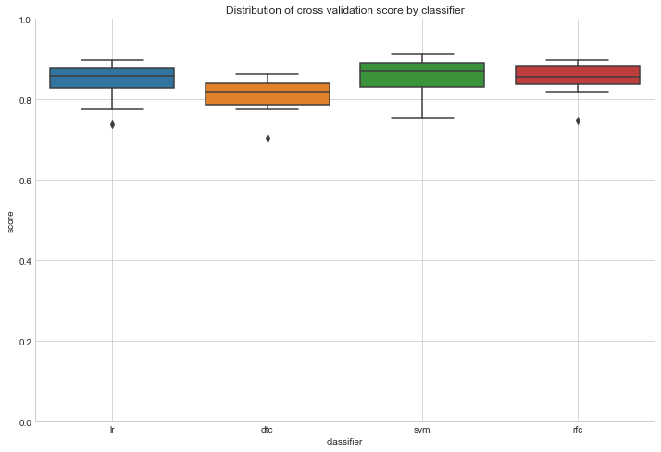
LR has good relative cross validation characteristics

Slide 20
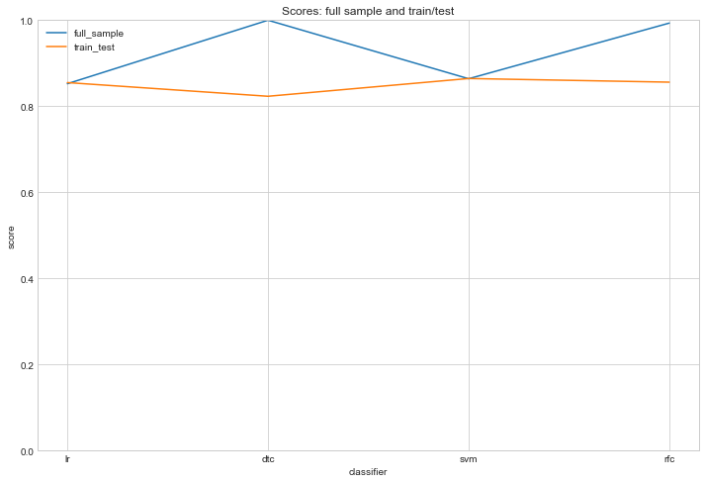
LR does over-fit less than DTC & RFC

Slide 21
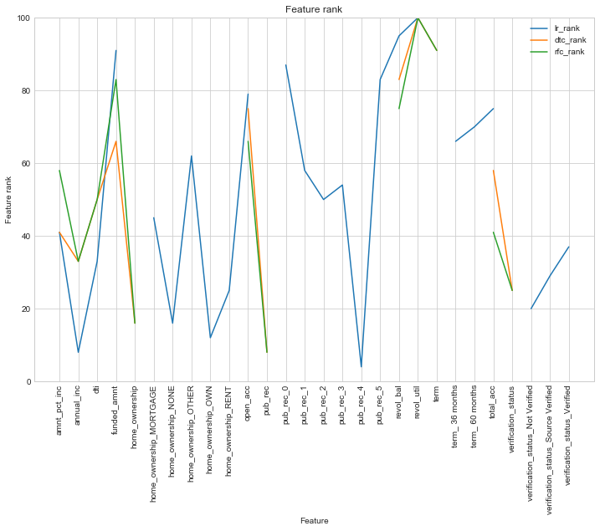
LR ranks have same shape as other classifiers
Important features for DTC and RFC tend to be important for LR.

Slide 22
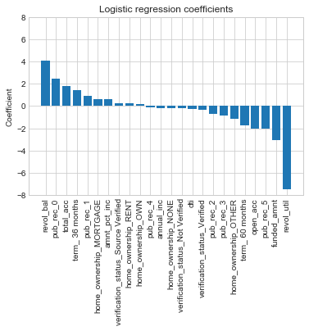
LR interpretation not unreasonable

Slide 23
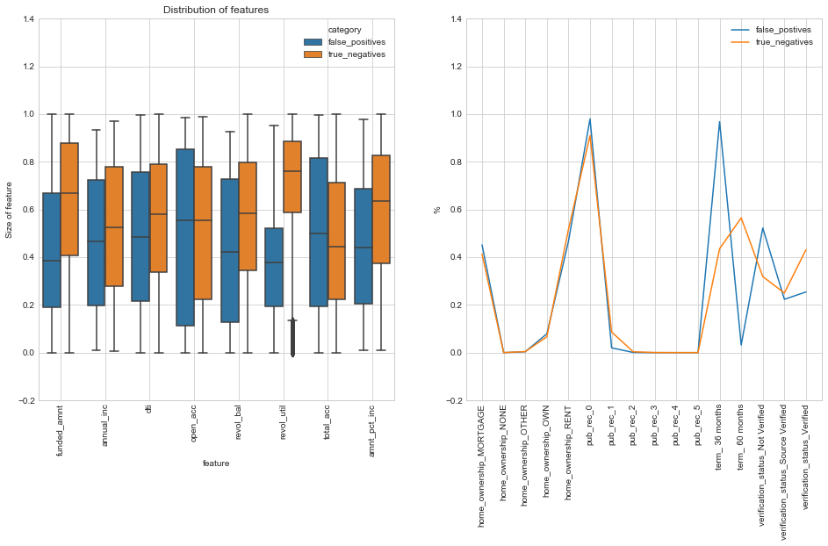
False positives reveal need for cross-feature interactions, but no obvious choice

Slide 24
Possible extensions
Construct new features (e.g. “FICO” score-like)
Add and remove features to stress test model
Compare to the same model applied to years post 2011
Multiclass (grade =A,…,G) version

Slide 25
Appendix

Slide 26
Lending Club – methodology (1)
https://www.lendingclub.com/public/rates-and-fees.action
https://www.lendingclub.com/foliofn/rateDetail.action
https://www.orchardplatform.com/blog/credit-variables-explained-credit-grades-on-lendingclub-and-prosper/
“These rates are set based on the originator’s underwriting assessment for the individual borrower. The higher the expected risk of default, the higher the interest rate is set in order to offset this risk. The assessment of the credit grade decision includes FICO, loan term (shorter term is considered better), proprietary models, and the loan amount requested by the borrower.”

Slide 27
Discussion: grade vs default and recovery
LC seems to compute a grade and assign an interest rate based on the grade.
Ultimately, the interest rate will reflect
Idiosyncratic default probability, recovery rate
Systemic default probability
Financing rate

Slide 28
Modeling caveat – sampling bias
Model will not represent ‘objective’ grades, but ones that incorporate biases of LC decision making (we are not considering loans made by other organizations)

Slide 29
Feature rank construction
Use
LR: abs(coefficients) (since data is normalized to the interval [0,1])
DTC, RFC: feature importance
Sort descending
Take rank
Rank max rank to be 100

Slide 30
Feature definitions
Revol_util: Revolving line utilization rate, or the amount of credit the borrower is using relative to all available revolving credit.
Revol_bal: Total credit revolving balance
Open_acc: number of open accounts in borrowers credit file
Pub_reg: number of derogatory public records
Total_acc: total number of accounts in borrower credit file

