Slide 1
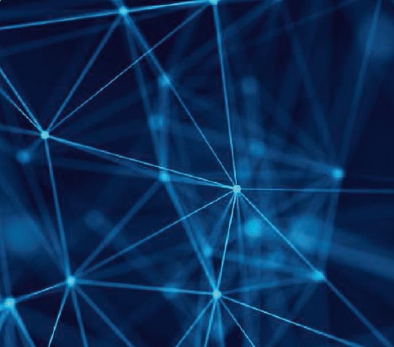
Neurotechnology
Artamonova Anastasiya PIN-24

Slide 2
Unknown words:
Consciousness, recognition – сознание
Neuroprosthetics – нейропротезирование
Limb – конечность
Augmented reality – дополненная реальность
Strengthening - укрепление
Board – плата
Primarily – в первую очередь
Convey - передать

Slide 3
Neurotechnology
is any technology that has a fundamental impact on how people understand the brain and various aspects of consciousness, mental activity, higher mental functions. It also includes technologies that are designed to improve and correct brain functions and allow researchers and doctors to visualize the brain.

Slide 4
The most promising industries are:
Neuromedical engineering. Development of neuroprosthetics of organs, including artificial sensory organs, development of rehabilitation means using neurotechnologies, which help to develop the lost mobility of limb.
Neuroeducation. Development of neurointerfaces and technologies of virtual and augmented reality in education, development of educational programs and devices, creation of devices for strengthening memory and analysis of use of brain resources.
Neuroentertainment and sports. Development of brainpower - brain exercises, the creation of games using neurogadgets, including neurodevelopmental games.
Neurocommunications and marketing. Development of neuromarketing technologies (complex methods of studying the behavior of buyers, possibilities of influencing it, as well as reactions to such effects using neurotechnologies), prediction of behavior based on neuro-biometric data.
Neuroassistants. Development of natural language understanding technology, development of deep machine learning (machine learning based on neural networks that help improve algorithms such as speech recognition, computer vision and natural language processing)creation of personal electronic assistants (web services or applications acting as virtual secretary) and hybrid human-machine intelligence.

Slide 5
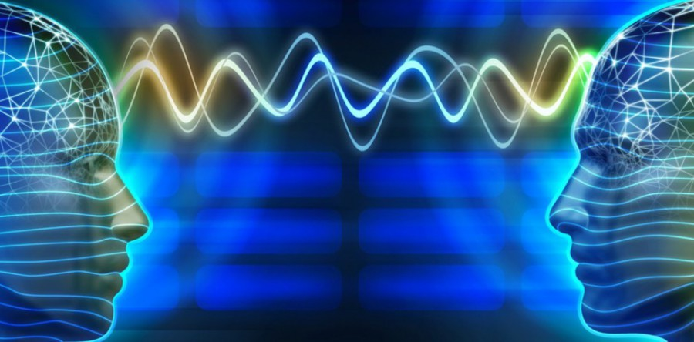
Even though neurotechnologies are a fairly new field, they highlight the following trends:
A device that will allow the completely paralyzed and unable to tell people to become part of society: to communicate on the Internet and even to find work.

Slide 6
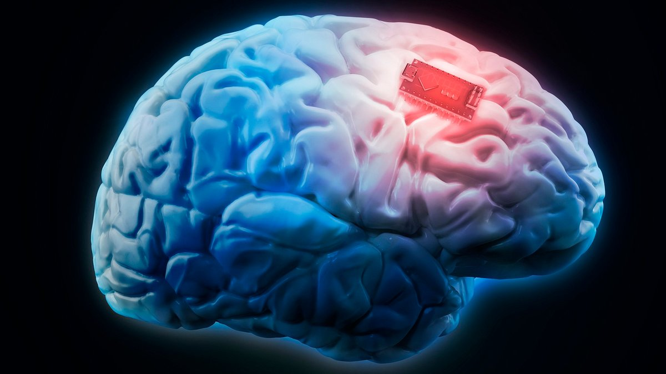
Boards that are implanted directly into the brain. This technology will be applied primarily to the treatment of various diseases, but it can be used in virtual games in theory.

Slide 7
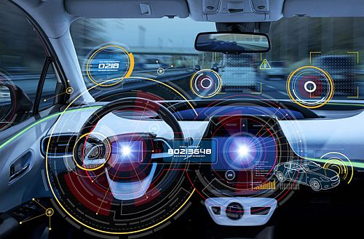
Neuro-interfaces for sharing emotions that can convey your sorrow or laughter directly to someone, rather than using a set of smiley faces. There will also be neuroassistants - improved versions of the current vocal helpers, who will take over some of their owner’s tasks, remind them about the meeting, notice the error in planning.

Slide 8
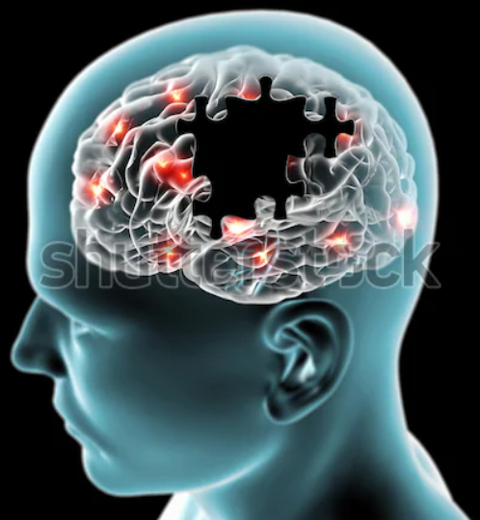
Finding neurotechnological solutions to prevent degenerative brain diseases. According to the World Health Organization, the cost of treating patients with neurodegenerative diseases amounts to 20% of the total cost of health care in Russia.

Slide 9
