Slide 1
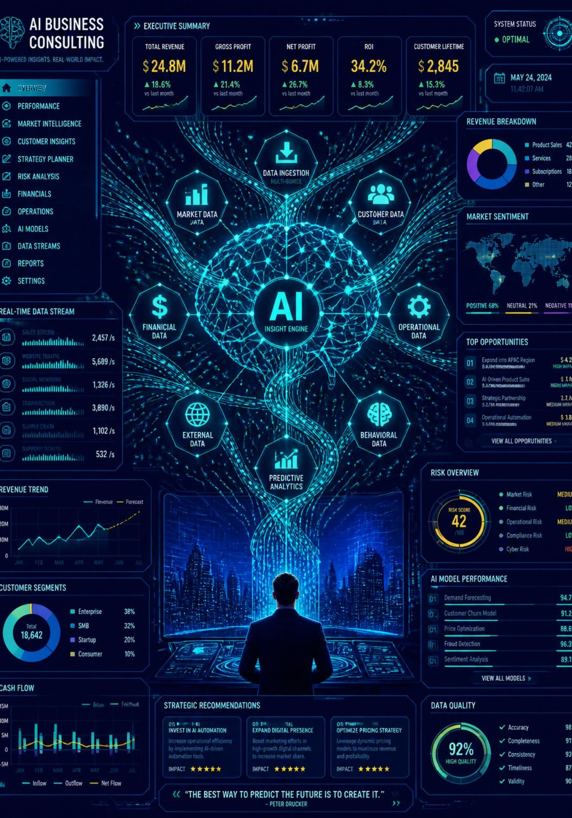





AI Management Consultant
Multi-Agent AI System for Business Intelligence & Strategic Decision Making
PYTHON
STREAMLIT
OPENAI AGENTS SDK
PANDAS
REPORTLAB

Slide 2


Introduction & Problem Statement
Businesses generate large amounts of sales and operational data, but converting this data into useful business decisions can be difficult and time
-consuming.
Key Challenges
Product Profitability
Time-Consuming Analysis
Market & Competitor Analysis
Difficult to identify profitable and unprofitable
products
Manual business analysis takes time
Market and competitor analysis is difficult
Hidden Business Risks
Lack of Strategic Direction
Business risks may remain hidden
Raw data does not directly provide strategic
decisions
Raw Business Data
Analysis Challenge
Business Decision

Slide 3







Objectives
Automate Business Data Analysis
Analyze Product & Business Performance
Identify Trends & Anomalies
Perform Financial Analysis
Analyze Market & Competitors
Generate Strategic Recommendations
Provide an Executive-Level Business Report

Slide 4
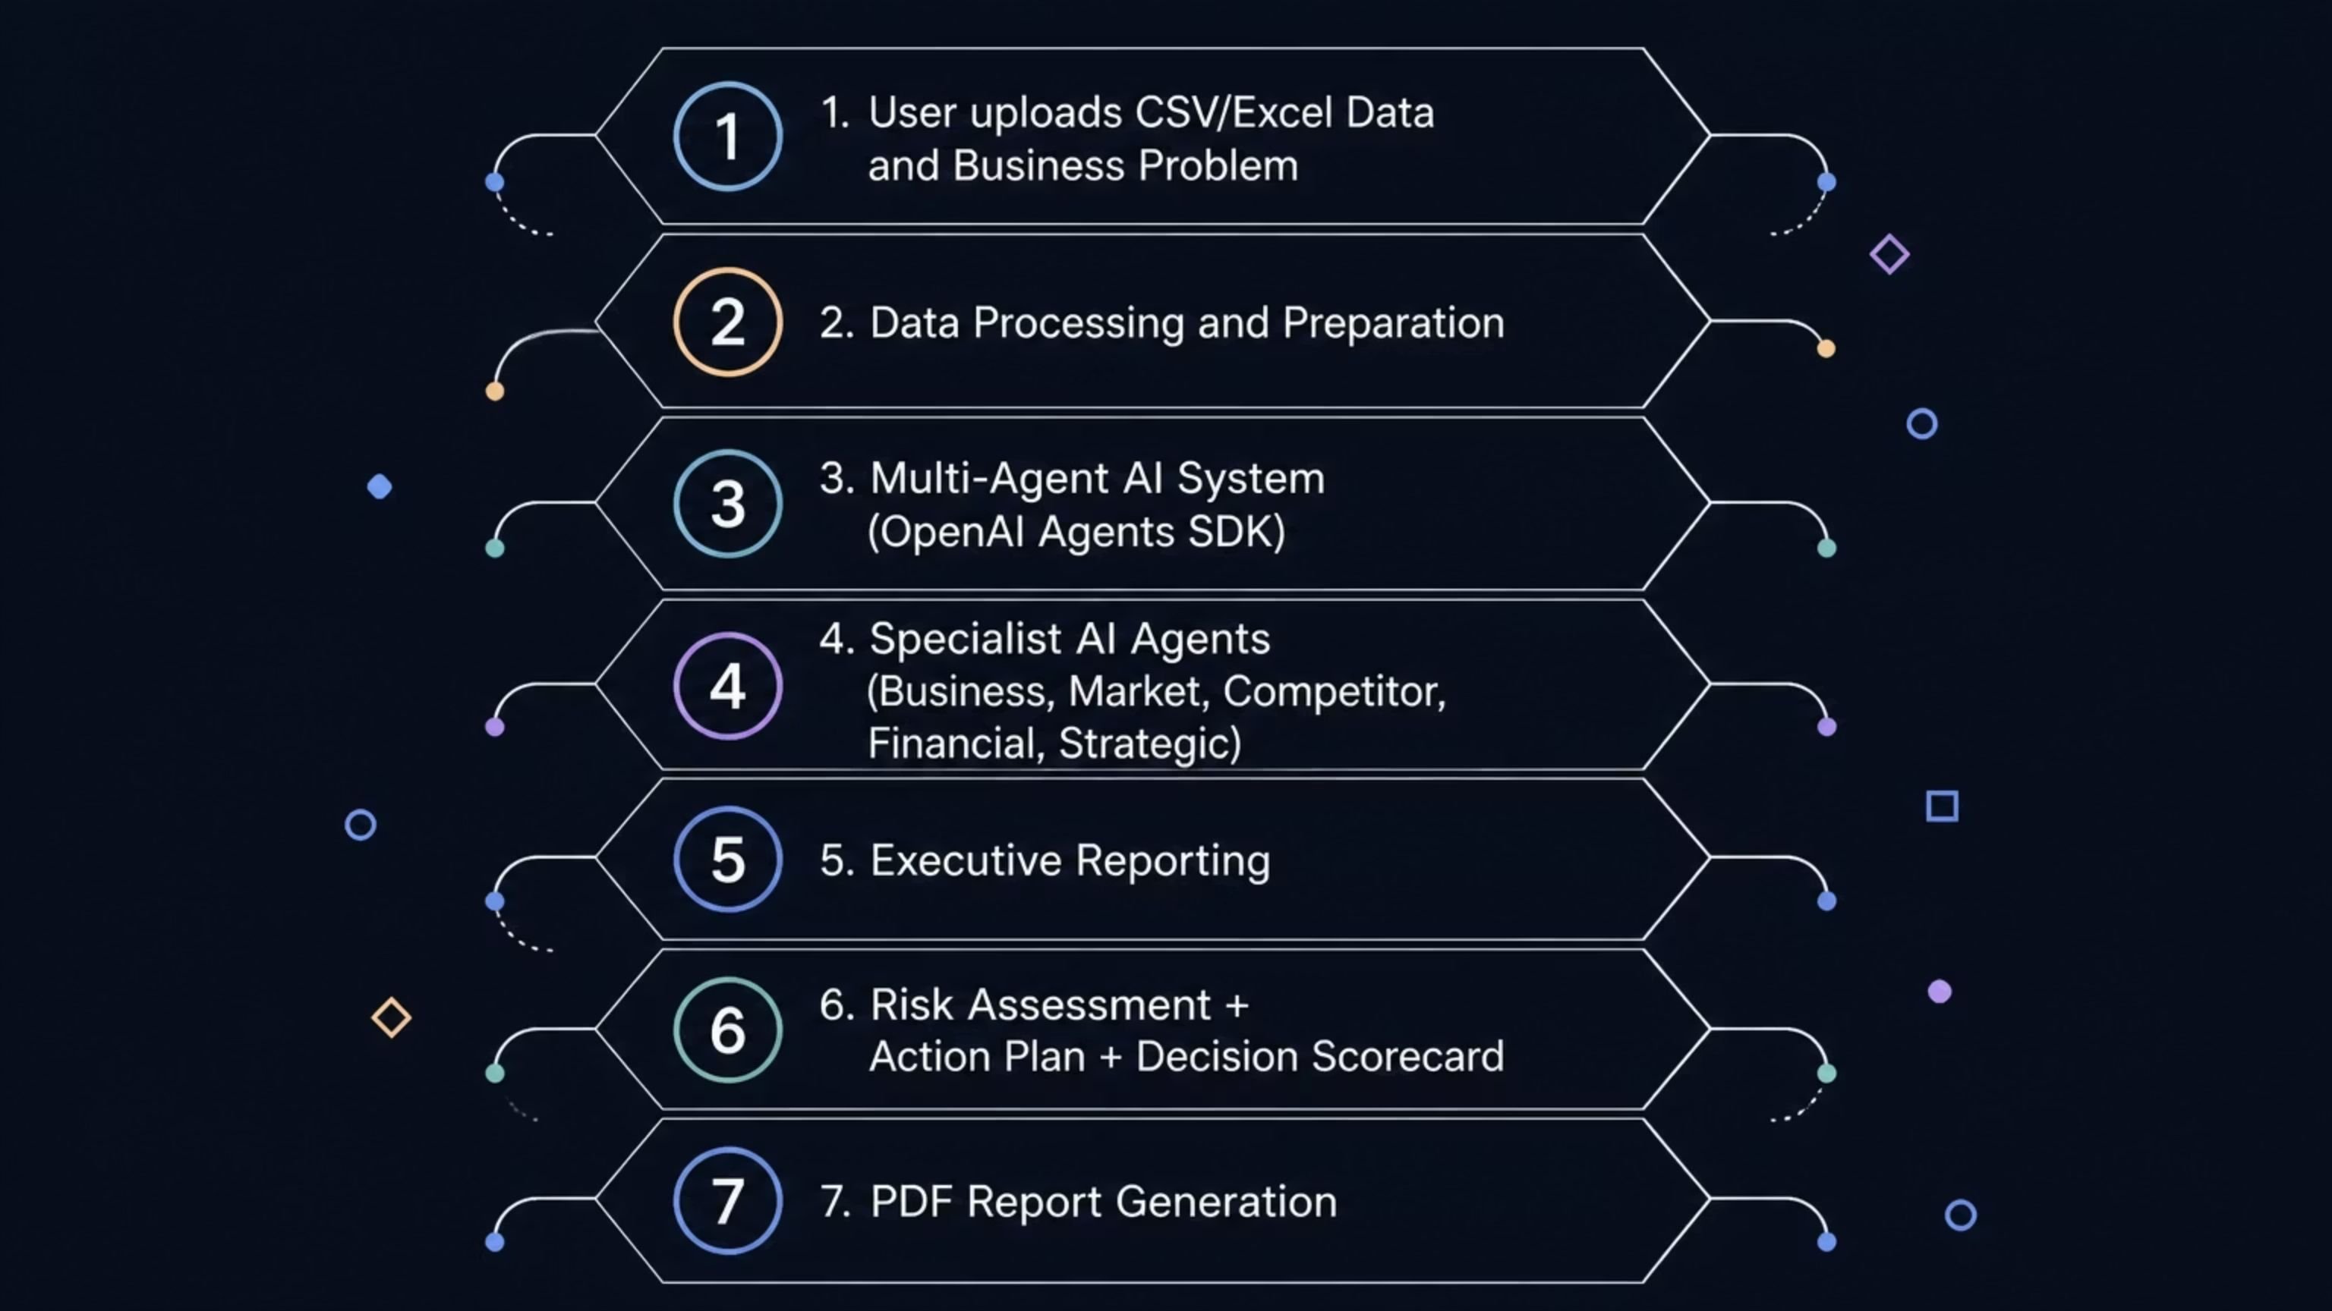
System Architecture
OpenAI Agents SDK is used for multi-agent orchestration.

Slide 5





Multi-Agent AI System
Business Analysis Agent
Market Research Agent
Competitor Benchmarking Agent
Business data and KPI analysis
Product performance
Revenue and profitability
Market trends
Market opportunities
Business environment
Competitor comparison
Pricing and positioning
Competitive analysis
Financial Analysis Agent
Strategic Recommendations Agent
Costs and margins
Financial performance
Profitability
Combines analytical findings
Generates practical recommendations
Supports management decisions

Slide 6

Data Processing & Business Analysis
Validation
Cleaning
KPI Extraction
Trend Analysis
CSV/Excel

Slide 7
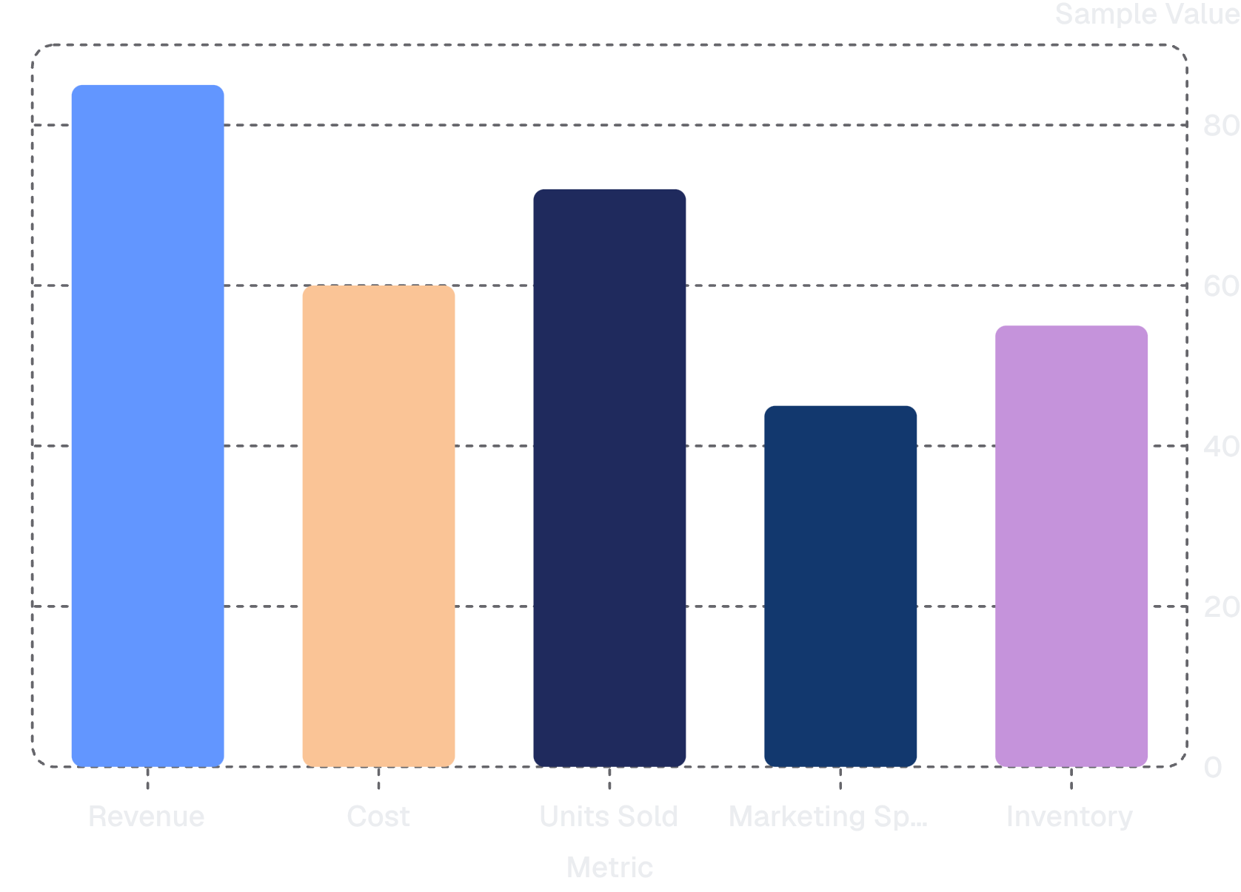
Analyzed Metrics
Revenue
Units Sold
Inventory
Cost
Marketing Spend
Product Performance

Slide 8
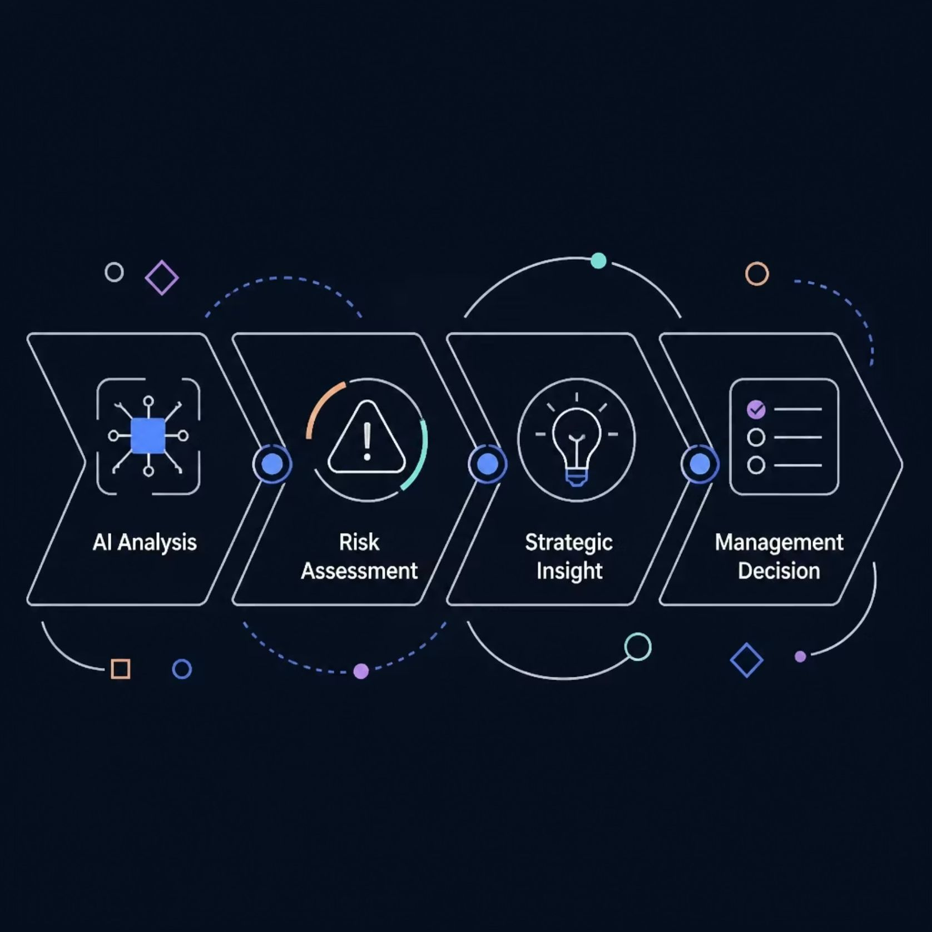

AI Insights, Risk & Decision Support
The system converts analysis into business intelligence.
AI Analysis Outputs
Best-performing areas
Worst-performing areas
Trends and anomalies
Risk Categories
Financial risks
Market risks
Operational risks
Customer risks

Slide 9










Strategic Recommendations & Action Plan
The system provides practical recommendations instead of only presenting data.
Prioritized Business Actions
Marketing & Inventory Recommendations
Profitability Improvement
Risk Mitigation
Expected Benefits
KPIs to Monitor
Suggested Timelines
Example Action Roadmap
Immediate Actions
Short-Term Actions
Long-Term Actions

Slide 10
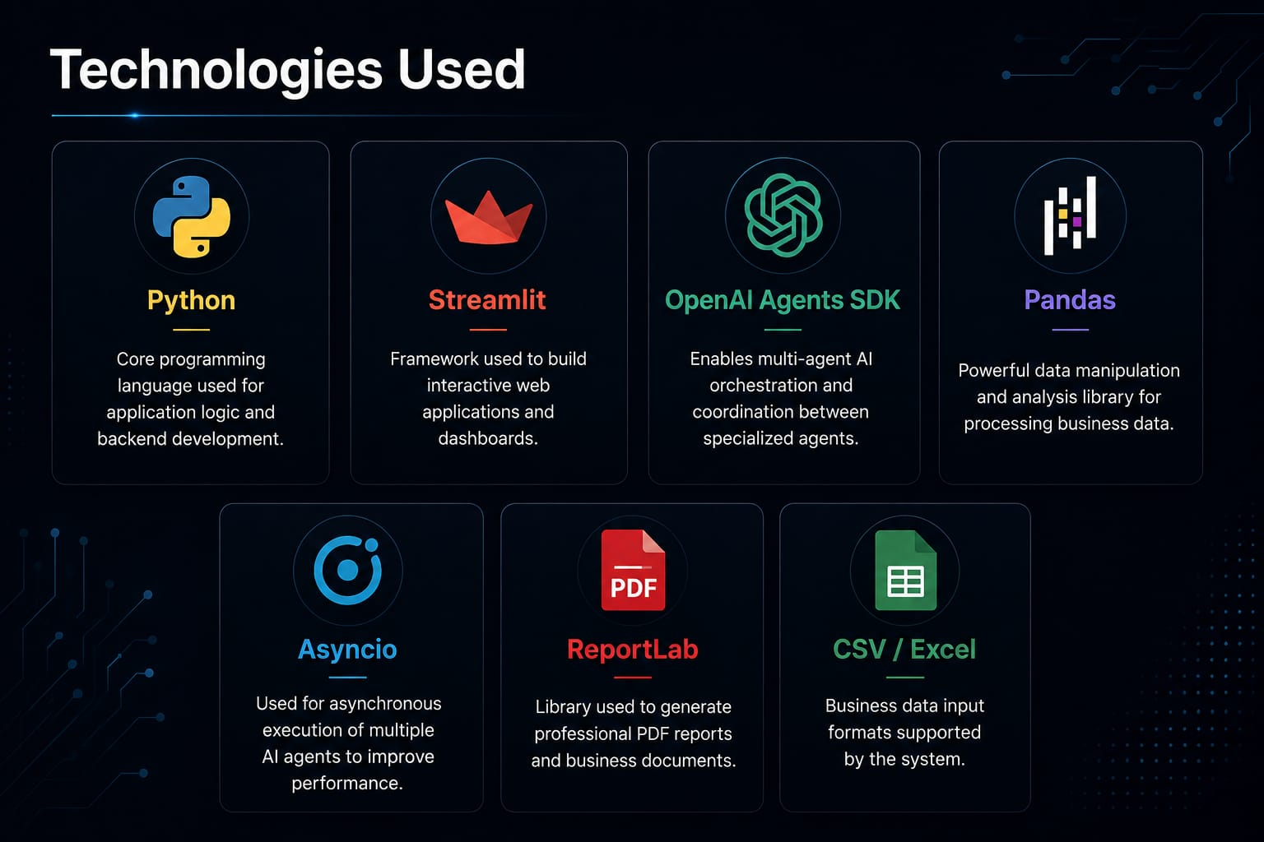

Slide 11
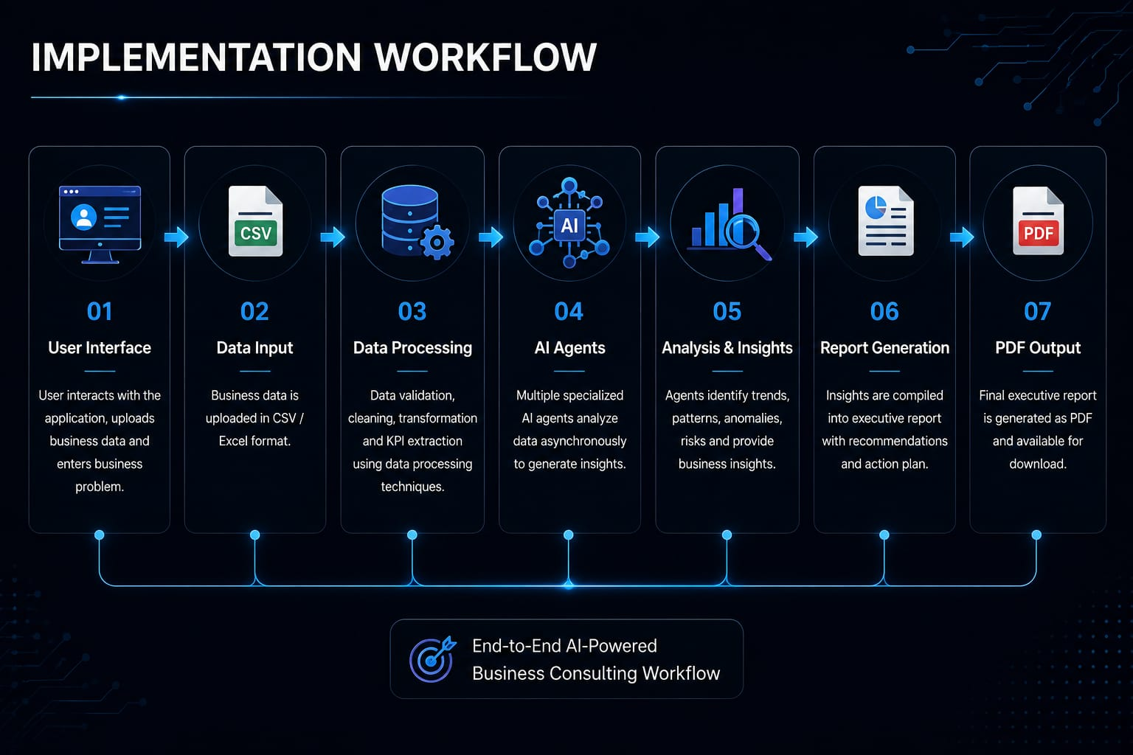

Slide 12
Conclusion & Future Scope
Key Outcomes
Future Scope
Automates business analysis
Coordinates multiple specialized AI agents
Converts business data into actionable insights
Provides risk assessment and strategic recommendations
Generates executive-ready reports
Real-time market data integration
Live competitor intelligence
Advanced forecasting
Database/API integration
More specialized AI agents
Automated recurring business reports
Thank You

