Slide 1
PROJECT PRESENTATION
EMBEDDED
DATA LOGGER
Real-time temperature & humidity monitoring
with local data storage
Presented by: Tharun. A
Department: ECE – Final Year
Institution: ______________________________
ESP32 • DHT22 • OLED • microSD

Slide 2
EMBEDDED DATA LOGGER
Problem Statement & Proposed Solution
THE PROBLEM
THE SOLUTION
Manual measurement of environmental conditions takes time and may miss important changes. Without a record of readings, it is difficult to review trends, compare conditions, or identify unusual temperature and humidity levels.
Build an ESP32-based embedded data logger that reads temperature and humidity from a DHT22 sensor, shows live values on an OLED display, and saves timestamped readings to a microSD card for later analysis.
Core idea: sense → display → timestamp → store
ESP32 • DHT22 • OLED • microSD
02

Slide 3
EMBEDDED DATA LOGGER
Project Objectives
01
Measure
Read ambient temperature and relative humidity using the DHT22 sensor.
02
Display
Show current readings and time on a compact OLED screen.
03
Record
Save readings to a microSD card for offline review.
04
Timestamp
Attach date/time information to recorded measurements.
05
Demonstrate
Validate the system through simulation and serial output.
ESP32 • DHT22 • OLED • microSD
03

Slide 4
EMBEDDED DATA LOGGER
System Block Diagram
OLED DISPLAY
OLED (SSD1306)
Live values + time
I²C: SDA 21, SCL 22
DHT22 SENSOR
ESP32 CONTROLLER
DHT22 SENSOR
ESP32
RTC / TIME
TIME SOURCE
Temperature +
relative humidity
Reads, processes,
formats and logs data
System / NTP*
Timestamp
Temperature + humidity
Read, process, control
Timestamp source
microSD MODULE
microSD CARD
SPI: CS 5, SCK 18,
MISO 19, MOSI 23
Log file storage
*Timestamp accuracy depends on the code's configured clock/time synchronization.
Power supplied to all modules as required by their voltage specifications.
ESP32 • DHT22 • OLED • microSD
04

Slide 5
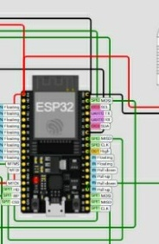



EMBEDDED DATA LOGGER
Components Used
ESP32 development board
DHT22 sensor
ESP32 development board
DHT22 sensor
Main controller; reads the sensor and manages display and storage.
Measures ambient temperature and relative humidity.
Main controller; processes sensor data and coordinates peripherals.
Measures ambient temperature and relative humidity. Data pin: GPIO 15.
OLED display (SSD1306)
MicroSD card module
Displays current readings and status using I²C.
Stores logged readings in a file for later analysis.
OLED display (SSD1306)
microSD module + card
MicroSD card
Connecting wires + USB supply
Displays readings and time over I²C. SDA 21, SCL 22.
Stores readings; SPI pins CS 5, SCK 18, MISO 19, MOSI 23.
Provides removable storage for recorded data.
Provide signal connections and power.
Software libraries
WiFi, DHT, Adafruit SSD1306/GFX, SPI and SD libraries.
Component visuals are cropped from the supplied Wokwi simulation screenshot.
Note: the supplied code includes Wi-Fi/time-related libraries; actual time synchronization depends on the configured time source.
ESP32 • DHT22 • OLED • microSD
05

Slide 6
EMBEDDED DATA LOGGER
Project Implementation
01 Wiring
01 Hardware wiring
DHT22 data → GPIO 15. OLED I²C → SDA 21 and SCL 22. microSD SPI → CS 5, SCK 18, MISO 19 and MOSI 23.
1
Connect DHT22 data to ESP32 GPIO 15. Connect OLED through I²C (SDA 21, SCL 22). Connect microSD through SPI (CS 5, SCK 18, MISO 19, MOSI 23).
1
02 Libraries
Use the libraries present in the sketch: WiFi, time, DHT, SPI, SD, Adafruit GFX and Adafruit SSD1306.
2
02 Library setup
Include the Wi-Fi, DHT, SPI, SD, Adafruit GFX/SSD1306 and time libraries in the project.
2
03 Initialization
Start Serial, initialize the DHT22 and OLED, initialize SPI and mount the SD card. Handle initialization failures.
3
03 Initialization
Start serial output, initialize the sensor and OLED, mount the SD card, and prepare the logging file.
3
04 Logging loop
Read sensor values, get the current timestamp, update the OLED/serial output, then append the data to microSD.
4
04 Sampling loop
Read sensor values, obtain a timestamp, update the OLED and append the reading to the SD log.
4
The wiring and pin definitions should match the actual circuit before running on physical hardware.
ESP32 • DHT22 • OLED • microSD
06

Slide 7
EMBEDDED DATA LOGGER
Control Logic / Working Flow
START
Power on ESP32
START
Power on the ESP32
INITIALIZE
Start DHT22, OLED, SPI and SD
INITIALIZE
Start DHT22, OLED, SPI and SD
READ
Read temperature and humidity
READ
Sample temperature and humidity
CHECK
Validate sensor values / SD status
FORMAT
Add timestamp and format values
TIMESTAMP
Get time from configured clock source
DISPLAY
Update OLED with current values
OUTPUT
Refresh OLED and serial monitor
SAVE
Append record to microSD
SAVE + REPEAT
Write record to microSD; wait and repeat
REPEAT
Wait for the logging interval
Recommended: show an error message if the sensor read or SD-card write fails.
Error handling should check sensor validity and SD-card availability before saving each record.
ESP32 • DHT22 • OLED • microSD
07

Slide 8
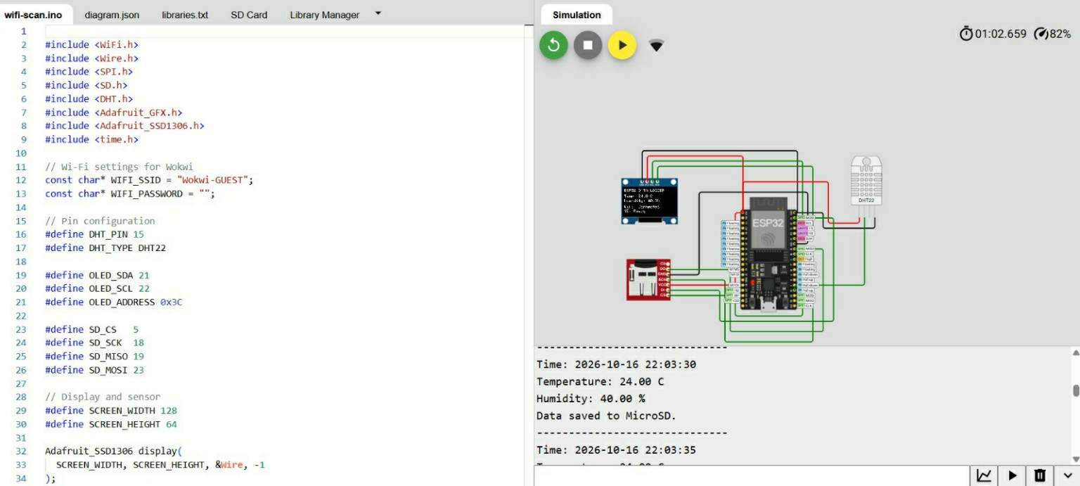
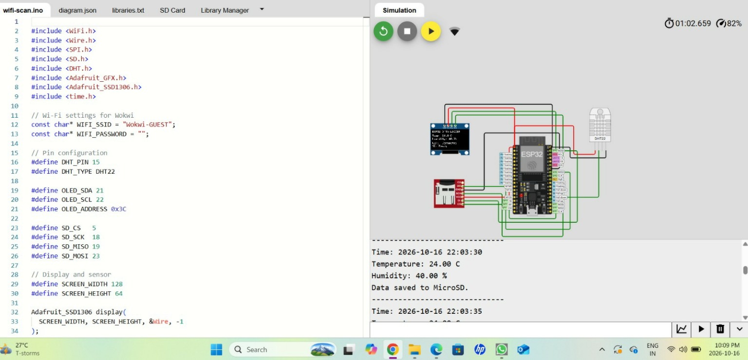
EMBEDDED DATA LOGGER
Simulation Output
Simulation shows live temperature/humidity output and the message “Data saved to MicroSD.”
Observed in the provided simulation: temperature and humidity readings are printed, and the console reports that data was saved to microSD.
ESP32 • DHT22 • OLED • microSD
08

Slide 9
EMBEDDED DATA LOGGER
Advantages
Automated logging
Live monitoring
Local storage
Reduces repeated manual measurements.
Values are visible on the OLED display.
Data can be reviewed without an internet connection.
Compact design
Expandable platform
Low-cost prototype
ESP32 combines processing and connectivity in one board.
Can be adapted for many indoor monitoring applications.
Uses widely available modules and open-source libraries.
ESP32 • DHT22 • OLED • microSD
09

Slide 10
EMBEDDED DATA LOGGER
Future Scope
• Add a real-time clock (RTC) module or robust NTP synchronization for accurate timestamps.
• Upload logs to a cloud dashboard using Wi-Fi and MQTT/HTTP.
• Add threshold alerts for high temperature or humidity.
• Create charts and reports from CSV log files.
• Improve reliability with sensor-error checks, SD-card checks and power-loss recovery.
• Use a battery and deep-sleep mode for portable, energy-efficient monitoring.
Possible applications: laboratories, greenhouses, storage rooms, classrooms and equipment enclosures.
ESP32 • DHT22 • OLED • microSD
10

Slide 11
EMBEDDED DATA LOGGER
Conclusion
The Embedded Data Logger demonstrates how a microcontroller can collect, display and store environmental data automatically.
SENSE
DISPLAY
STORE
DHT22 measures temperature and humidity.
OLED presents current values clearly.
microSD keeps a local record for later review.
Overall, the prototype provides a practical foundation for environmental monitoring and can be enhanced with connectivity, alerts and more robust timekeeping.
ESP32 • DHT22 • OLED • microSD
11

Slide 12
✓
THANK YOU
Questions & Discussion
EMBEDDED DATA LOGGER • ESP32 + DHT22 + OLED + microSD

