Slide 1
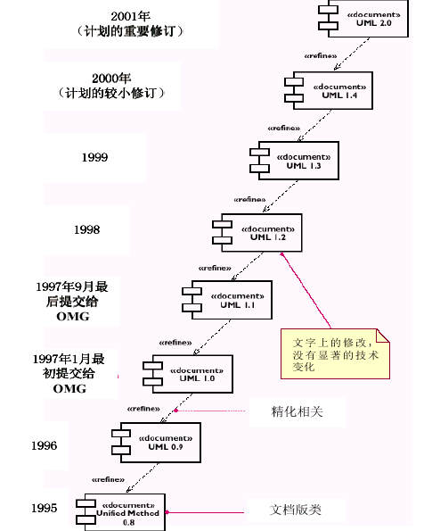
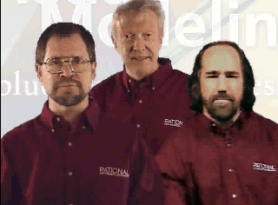
UML(Unified Modeling Language)
Grady Booch Ivar Jacobson James Rumbaugh

Slide 2
UML模型
UML是一种可视化建模语言
UML不是一种开发方法，不局限于特定开发过程
State
Diagrams
State
Diagrams
use-case
Diagrams
Class
Diagrams
State
Diagrams
State
Diagrams
Object
Diagrams
Activity
Diagrams
Scenario
Diagrams
Scenario
Diagrams
Deployment
Diagrams
Sequence
Diagrams
Models
Scenario
Diagrams
结构建模
行为建模
体系结构建模
Scenario
Diagrams
State
Diagrams
Component
Diagrams
Collaboration
Diagrams
State
Diagrams
Component
Diagrams
State
Diagrams
Component
Diagrams

Slide 3
结构建模
图
  类图（Class Diagrams）
  对象图(Object Diagrams)
内容
  类
  实例、对象
  关系：依赖、泛化、关联
  修饰：构造型、标记值、约束

Slide 4
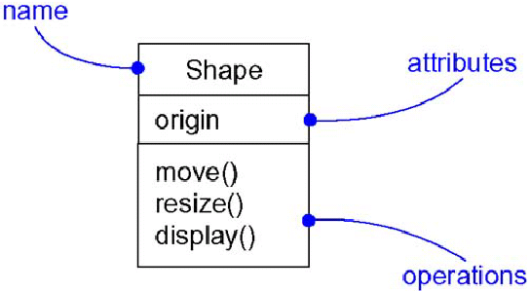
类（Class）

Slide 5
实例（Instances）
抽象的具体表现
可使用一组操作，操作结果存储在状态中
对象是类的实例，是类的具体表示
实例与对象多同义
  所有对象都是实例
  但有些实例不是对象（关联的实例是链，不是对象）
  类名加下划线表示对象
  实例名+抽象名

Slide 6
关系(Relationship)
事物之间的联系
图形上：一条线，不同线表示不同种类的关系
三种关系
  关联（Association）
  依赖关系（Dependency）
    A依赖B——A使用B，B的变化会影响到A
    B在A的操作的参数中
  泛化（Generalization）
    Is a kind of关系，父/子关系
    类和接口间的泛化指明继承关系
    子类的对象可以被用在父类对象可能出现的任何地方
    子类对象继承父类的属性和操作
    根类、基类：没有父类，至少有一个子类
    叶子类：没有子类的类

Slide 7
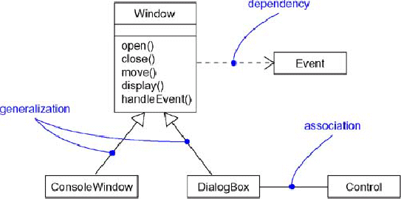
关系：示例

Slide 8
关联(Association)
关联的修饰
  名称
  角色
  多重性
  聚合

Slide 9
关联：名称、角色、多重性
name
multiplicity
Person
1..*
Work For
*
Company
employee
employer
role

Slide 10
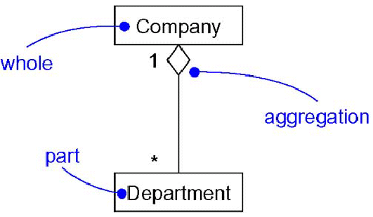
关联：聚合(Aggregation)
has a, 整体/部分关系
一种特殊的关联

Slide 11
类图：示例
*
Described by
SalesLineItem
quantity
0..1
Record sale of
subtotal
1..*
Sale
Logs completed
Store
stocks
item
datetime
*
1
AddSale
1
*
Total()
Initated by
*
Paid by
*
Employee
Describes
Payment
Cashier
amount
Product Specification
Description
1
Proce
CashPayment
CreditPayment
UPC

Slide 12
对象图(Object diagram)
对象是类的实例，是类的实例
图形表示
:Transaction
Tran:Transaction
Tran
对象图显示某些时刻对象和对象之间的关系

Slide 13
对象图：示例
p1:Product Specification
p2:Product Specification
Proce=30
Proce=20
UPC=123456
UPC=123000
S1:SalesLineItem
S1:SalesLineItem
Quantity=2
Quantity=6
Subtotal=60
Subtotal=120
Sale
Logs completed
:Store
2004.6.10
*
1
Total=180
Initated by
Paid by
*
Employee
:CreditPayment
:Cashier
Amount=180
张三

Slide 14
行为建模
图
  用例图
  交互图（协作图，顺序图）
  活动图
  状态图

Slide 15
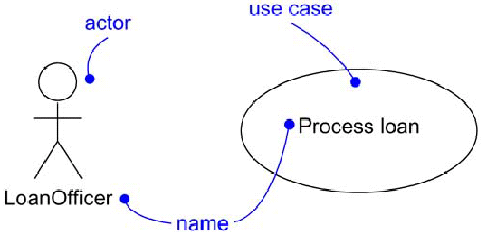
用例图
用例（Use-Case）
  是系统的一种行为，它为执行者产生一定的价值结果。用例描述执行者想要系统完成的事情。用例应该是一个完整的任务。
参与者(Actor)
  是同系统交互的所有事物，如人、其它软件、数据存储、硬件设备或网络。每个执行者定义一种特定角色。
贷款员

Slide 16
用例图：示例
订单处理
订购货物
运送货物
获取订单状态
运输公司
客户
获取目录
取消订单
发送货物
客户代表
退货
供应商

Slide 17
用例：事件流
描述完成用例功能需要的步骤
  前置条件
  事件流
    基本路径
    可选路径
  后置条件

Slide 18
事件流：示例
订购货物用例描述
前置条件：一个合法的客户已登录到系统
事件流：
基本路径
  1，当客户选择订购货物时用例开始
  2，客户输入自己的姓名和地址
  3，客户输入产品代码
    a) 系统显示产品描述和价格
    b) 系统在客户订单中添加该产品的价格
  循环结束
  4，客户输入信用卡支付信息
  5，客户选择提交
  6，系统检验输入的信息，把该订单作为未完成的订单保存，同时向记账系统提供支付信息
  7，支付确认后，订单也被标记为已确认，返回客户一个订单ID，用例结束

Slide 19
事件流：示例（续）
可选路径
在选择提交（第5步）前的任何时候，客户可选择“取消”。这次订购没被保存，用例结束。
在第6步，如果有任何不正确的信息，系统提示客户修改这些信息
在第7步，如果支付每被确认，系统将提示客户去支付信息或取消。如果客户选择修正信息，就回到基本路径的第4步，否则用例结束。
后置条件
如果订单没有被取消，它将被保存在系统里，并做上标记

Slide 20
交互图：顺序图（Sequence Diagram）
描述执行系统功能的各个角色之间相互传递消息的顺序关系，是强调消息的时间顺序的交互图。
内容
  对象
  对象生命线
  激活（控制焦点）
  消息
  各种图都有的注解和约束
Tran:Transaction
Tran
:Transaction

Slide 21
顺序图：示例
: Student
registrationForm
registrationManager
math 101
math 101
section 1
1: fill in info
2: submit
3: add student to math 101
4: add student
5: are you open?
6: add student

Slide 22
交互图：协作图（Collaboration Diagram）
除了描述对象间的关联外，还显示对象间的消息传递
不同于顺序图的特性
  路径：一个对象如何与另一个对象相连
    几种构造型
      关联association,自身self, 全局global, 局部local，参数parameter
  有顺序号
    顺序号前可加迭代表达式或条件子句
    迭代：消息及其任何嵌套按照给定的表达式重复
    *[I:=1..n]
    条件：消息执行与否取决于一个布尔表达式的值
    [x>0]

Slide 23
协作图：示例
1.2. display course offerings( )
1.3. display blank schedule( )
1. create schedule( )
2. select 4 primary and 2
alternate offerings( )
: RegisterForCoursesForm
: Course Catalog
: Student
1.1. get course offerings( )
2.1. create schedule
with offerings( )
1.1.1.1. get course offerings( )
1.1.1. get course offerings(forSemester)
: RegistrationController
: CourseCatalogSystem
2.1.2. add schedule(Schedule)
2.1.1. create with offerings( )
: Student
：Schedule

Slide 24
状态图（State Diagram）
描绘对象的状态、触发状态转换的事件、以及对象的行为（对事件的响应）。
  事件：指某个时刻所发生的事情，是对引起对象从一种状态转换到另一种状态的现实世界中的事件的抽象。
  状态：指对象在其生命周期中的某个特定阶段所处的某种情形。
  行为：指对象达到某种状态时所做的一系列处理操作
每个类的动态行为用一张状态图来描绘，各个类的状态图通过共享事件合并起来，从而构成系统的动态模型。
初始事件
状态1
DO：行为1
事件1[条件1]
状态2
DO：行为2
结束事件

Slide 25
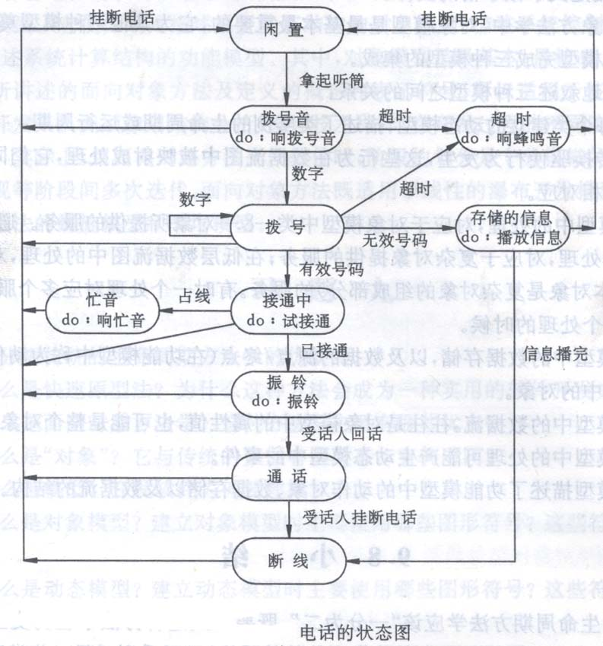
状态图：示例

Slide 26
活动图（Activity Diagram）
状态图的一个变体，但状态是计算过程的活动状态（计算过程中命令的执行或工作流中活动的进行），而不是普通对象状态。
活动图本质上是一个流程图，表示从活动到活动的控制流。
分支与汇合
用于操作建模与过程（工作流）建模

Slide 27
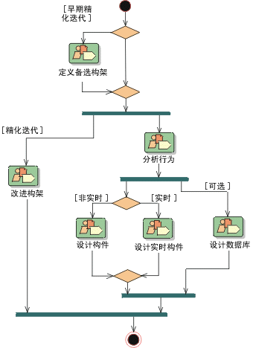
活动图：示例
RUP中的分析设计工作流

Slide 28
部署图（Deploy Diagram）
表示系统运行时包含的节点以及节点间的联系，节点包含构件的配置，每个构件必须存在于某个节点上。
节点(Node)
Course
Catalog

Slide 29
部署图：示例
ATM
应用服务器
ATM客户机
Internet
银行储户
局域网
ATM系统部署图
ATM
数据服务器

Slide 30
构件图（Component Diagram）
系统建模过程中将可重用的块包装成具有可替代性的物理单元，这些单元称为构件
构件图用构件及构件间的接口和依赖关系来表示设计元素的具体实现
组件(Compoment)
CourseRegister

Slide 31
构件图：示例
财务系统.exe
教学管理.exe
课程管理.dll
成绩管理.dll
人事管理.dll
课程
开设课程
选课注册
教师
学生

Slide 32
RUP(Rational Unified Process)概述
用例驱动
以架构为中心
迭代和增量开发过程
Notes:
In this module, we take a high-level look at the Rational Unified Process, our process for the UML that supports and encourages the best practices we discussed earlier.
Software development is the process of developing a software system from requirements. A software process provides a disciplined approach to assigning tasks and responsibilities within a development organization, to ensure production of a high-quality software product that meets the needs of its end users within a predictable schedule and budget. The Rational Unified Software Process is a software process which incorporates the six principles for software development we have just examined. It codifies them into a formal, written set of procedures and practices that are complete, thorough, and self-consistent.
This module provides a very high level view of the Rational Unified Process. The process itself contains much more detail about each item discussed here.
We will focus on the major concepts and definitions of the major terms. We will also describe the notation and terminology used in the definition of the process.

Slide 33
RUP是用例驱动的
角色：系统外并与系统交互的人或事
用例：系统执行的动作集合，并能为角色提供可观察的值
客户
查询余额
提款
取款机的部分用例
Notes:
Managing requirements is one of the six best practices already discussed. In particular, the Rational Unified Process captures and manages functional requirements in a Use-Case model. Use-Cases are a key concept within the process. They are used throughout the development cycle as a driver for many activities, flowing information through several models, and encouraging consistency across these models.
An actor can be a human being or another system or a device; anything external with which the system interacts.
A Use-Case describes functionality from the user’s point of view. A bank customer can use a cash machine to withdraw money or check the balance of her account. Each Use-Case (oval) represents something that the system does to provide value to the bank’s customer, the Customer. The collected Use-Cases constitute the use-case model and represent all the possible ways of using the system. The use-case model is a model of the system’s intended functions and its environment, and it serves as a contract between the customer and the developers.
The use-case model is complemented by non-functional specifications covering some of the aspects that cannot be easily conveyed by a Use-Case, or that apply to many or all Use-Cases; for example, high-level product requirements, development constraints, safety or security attributes, and so on.
The notation used for representing the use-case model in diagrams is standard notation provided by the UML.
The goal of the next few slides is to give students an overall understanding of what it means to say that the RUP is use-case driven, without getting bogged down into the details of use-case development. Only the most basic terminology and symbols are used.
The example model is incomplete. You might ask students what other Use-Cases they would expect a cash machine to provide.

Slide 34
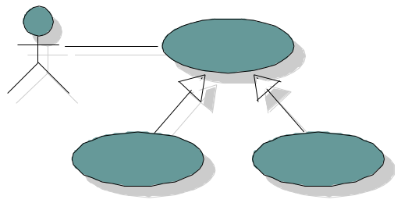
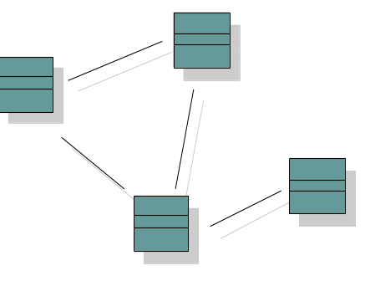
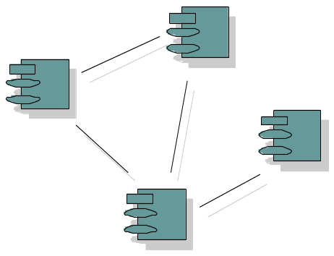
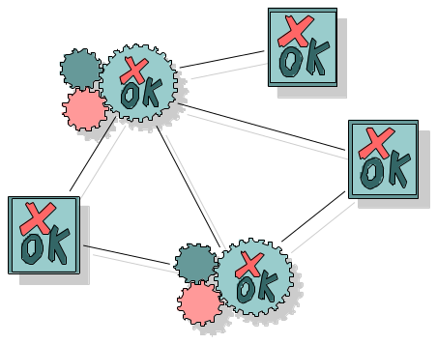
用例驱动
用例模型
实现
完成
验证
设计模型
实现模型
测试模型
Notes:
Emphasize that the focus of this course will be on how the Use-Case Model affects the development of the Design Model.
Remember, use-case-driven is a key characteristic (and benefit) of the Rational Unified Process.
Use-Case Driven: The Use cases serve as a unifying thread throughout system development
The same use-case model is used in requirements, analysis & design, implementation and test.
Use cases defined for a system are the basis for the entire development process. They provide the unifying thread through the system and define the behavior performed by a system. Use cases play a role in each of the core process workflows:
The use-case model is a result of the requirements workflow. In this early process you need the use cases to model what the system should do from the user's point of view.
In analysis and design use-cases are realized in a design model. You create use-case realizations which describe how the use-case is performed in terms of interacting objects in the design model. This model describes, in terms of design objects, the different parts of the implemented system, and how the parts should interact to perform the use cases.
During implementation the design model is the implementation specification. Because use cases are the basis for the design model, they are implemented in terms of design classes.
During test the use cases constitute basis for identifying test cases and test procedures. The system is verified by performing each use case.
Use cases have other roles as well:
Basis for planning an iterative development.
Foundation for what is described in user manuals.
Definition of ordering units. For example, a customer can get a system configured with a particular mix of use cases.

Slide 35
用例驱动的优点
用例能被项目各方人员理解
  用户、开发人员、测试人员等
用例驱动过程的许多活动
  设计模型的创建与验证
  测试用例和测试过程的基础
  迭代计划
  用户文档的编制，如用户手册
  系统部署
  用户界面的定义和原型
Notes:
The important point to get across is that Use-Cases permeate all parts of RUP and are a key mechanism in accomplishing the Managing Requirements best practice.

Slide 36
RUP是以架构为中心的
架构是早期迭代的重点
  建立、验证和确定架构的基线是精化阶段的主要目标
逻辑视图
实现视图
分析与设计人员
程序员
用户
用例视图
进程视图
部署视图
系统集成员
系统工程人员
Notes:
Use of component-based architectures is one of the six best practices already discussed. Architecture is used in the Rational Unified Process as a primary artifact for conceptualizing, constructing, managing, and evolving the system under development. The Rational Unified Process emphasizes early development and validation of software architecture as a core concept. It defines two primary artifacts related to architecture: the Software Architecture Description (SAD) which describes the architectural views relevant to the project and the Architectural Prototype. The Rational Unified Process also defines a worker, called the Architect, who is responsible for the architecture. The bulk of the activities related to architectural design are described in the analysis and design workflow, but it spills over to the requirements workflow, the implementation workflow, and the project management workflow.
Architecture was defined and explained in the Best Practices module already presented. Here we assume that the student remembers this material. You may wish to briefly review the definition of architecture and relate it to blueprints,etc.

Slide 37
迭代与增量开发
开始
精化
构造
过渡
时间
生命期目标
生命期架构
初始运行能力
产品发布
四个阶段
  开始（Inception） -定义项目范围
  精化（Elaboration） -项目计划、 需求、架构
  构造（Construction） -软件产品
  过渡（Transition） - 软件产品过渡给用户
Notes:
During Inception, we define the scope of the project, what is included, and what is not. This is done by identifying all the actors and Use-Cases, and by drafting the most essential Use-Cases (usually approximately 20% of the complete model). A business plan is developed to determine whether resources should be committed to the project.
During Elaboration, we focus on two things: get a good grasp of the requirements (90% complete) and establish an architectural baseline. If we have a good grasp of the requirements and the architecture, we can eliminate a lot of the risks and will have a good idea what amount of work remains to be done. Detailed cost/resource estimations can be made at the end of Elaboration.
During Construction, we build the product in several iterations up to a beta release.
During Transition, we transition the product to the end user and focus on end user training, installation, and support.
The amount of time spent in each phase varies. For a very complex project with a lot of technical unknowns and unclear requirements, Elaboration may include 3-5 iterations. For a very simple project where requirements are known and the architecture is simple, Elaboration may include only a single iteration.
The student notes are quite extensive. There is no need to go into that much detail in class. The important thing is to understand how the RUP uses phases to organize the life cycle.
You can also mention that we deliberately chose names that do not match the waterfall names (analysis, design, implementation, and test) to emphasize that they are NOT the same as the waterfall phases.
Some ways of describing the phases in common terminology:
Inception - bid and proposal
Elaboration - Building blueprints
Construction - I think I’m done
Transition - how do users react?

Slide 38
迭代与阶段
开始
精化
构造
过渡
初始迭代
架构迭代
架构迭代
开发迭代
开发迭代
开发迭代
过渡迭代
过渡迭代
次里程碑: 发布
迭代是一系列明确的具有建立计划和评估准则的活动，将产生一个可执行的发布（内部或外部）
Notes:
Within each phase, there is a series of iterations. The number of iterations per phase will vary. Each iteration results in an executable release encompassing larger and larger subsets of the final application.
An internal release is kept within the development environment and (optionally) demonstrated to the stakeholder community. An external release is provided to stakeholders (usually users) for installation in their own environment. External releases are much more expensive (they require user documentation and technical support) and normally occur only during the transition phase.
The end of an iteration marks a minor milestone. It is a point in time when technical results are assessed and future plans revised as necessary.

Slide 39
主要工作流及产生的模型
业务建摸
业务用例模型
业务对象模型
由…自动化
需求
用例模型
由…实现
分析与设计
设计模型
由…完成
实现
实现模型
由…验证
测试
测试模型
Notes:
The Rational Unified Process is a model-driven approach. Several models are needed to fully describe the evolving system. Each major workflow produces one of those models. The models are developed incrementally across iterations.
The Business Model is a model of what the business processes are and the business environment. It can be used to generate requirements on supporting information systems.
The Use-Case Model is a model of what the system is supposed to do and the system environment.
The Design Model is an object model describing the realization of Use-Cases. It serves as an abstraction of the implementation model and its source code.
The Implementation Model is a collection of components, and the implementation subsystems that contain them.
The Test Model encompasses all of the test cases and procedures required to test the system.
You can relate this back to previous slides that describe the system model and the many diagrams needed to fully communicate its content. One can consider all of the models listed here, taken together, to be “the system model.”
The only model that is a little different is the business model. It describes the business at large, not just the automated part. The other models describe the information system that supports the business model.
It is a good idea to point out that each of these models is incrementally developed across many iterations.

Slide 40
迭代模型
一次迭代经
历所有的工
作流
阶段
过程工作流
开始
精化
构造
过渡
业务建摸
需求
分析与设计
实现
测试
部署
支持工作流
配置与变化管理
项目管理
工作流
一组逻辑
相关的活动
环境
初始迭代(s)
迭代1
迭代2
迭代n
迭代n+1
迭代n+2
迭代m
迭代m+1
迭代
Notes:
This graphic illustrates how phases and iterations, or the time dimension, relates to the development activities performed, or the workflow dimension. The relative size of the color area indicates how much of the activity is performed in each phase/iteration.
Each iteration involves activities from all workflows. The relative amount of work related to the workflows changes between iterations. For instance, during late Construction, the main work is related to Implementation and Test and very little work on Requirements is done.
Note that requirements are not necessarily complete by the end of Elaboration. It is acceptable to delay the analysis and design of well-understood portions of the system until Construction because they are low in risk.
Can iterations overlap?
No. Our model is to show no overlap among iterations. In a large project, several teams may work in parallel on their portions of the iteration, but we do not consider these to be separate iterations.
How many iterations should you have?
It depends on many factors. Err on the side of too many iterations.
Animation note: The callouts and black rectangle appear 2 seconds after the slide.

