Slide 1


20 Years of Onion Routing
For a Better Internet
Nathan Freitas
nathan@freitas.net @n8fr8
https://torproject.org
https://guardianproject.info

Slide 2
20 Years of Onion Routing
"Internet Communication Resistant to Traffic Analysis," 1997 Navy Research Lab Review, Washington, DC, April 1997, pp. 109-111.
Determining who is talking to whom (called traffic analysis) is an important source of intelligence information. As military grade communication devices increasingly depend on the public communications infrastructure, it is important to use that infrastructure in ways that are resistant to traffic analysis. It may also be useful to communicate anonymously, for example when gathering intelligence from public databases.
We describe bidirectional and real-time Anonymous Connections that are strongly resistant to eavesdropping and traffic analysis attacks by both insiders and outsiders. If necessary, communication is made anonymous by removing identifying information from the data stream. These anonymous connections have been prototyped in a system that protects the privacy of communication over the Internet and, in particular, the World Wide Web.
Anonymous connections can protect both identity and location in many switched communication systems, such as wired, cellular, or satellite phone networks.
http://www.onion-router.net/Publications.html#new-slides

Slide 3
Intelligence Information
Traffic Analysis
Identity
Location

Slide 4
ANONYMITY
but also...
CONFIDENTIALITY
AUTHENTICATION

Slide 5
You can't tell who did what
“Who wrote this blog post?”
“Who's been viewing my site?”
“Who's been chatting with who?”

Slide 6
Indistinguishable within a set
Alice1
Alice2
Alice3
Bob
Alice4
Alice5
....
Alice6
Attacker can't tell which
Alice is talking to Bob!
Alice7
Alice8

Slide 7
Encryption just protects content.
Anonymity protects metadata.
Alice
“Hi, Bob!”
“Hi, Bob!”
<gibberish>
Bob
attacker

Slide 8
Anonymity isn't steganography:
Attacker can tell that Alice is talking; just not to whom.
Anonymity
network
Alice1
Bob1
Alice2
Bob2
...
AliceN

Slide 9
Anonymity is not wishful thinking...
“You can't prove it was me!”
“Promise you won't look!”
“Promise you won't remember!”
“Promise you won't tell!”
“I didn't write my name on it!”
“Isn't the Internet already anonymous?”

Slide 10
Anonymity serves different interests for different user groups.
Anonymity
Private citizens
“It's privacy!”

Slide 11
Regular citizens don't want to be watched and tracked.
Blogger
Alice
Hostile Bob
“I sell the logs.”
Incompetent Bob
8-year-old
Alice
“Oops, I lost the logs.”
Indifferent Bob
Sick
Alice
“Hey, they aren't
my secrets.”
Name, address,
age, friends,
interests
(medical, financial, etc),
unpopular opinions,
illegal opinions....
Consumer
Alice
(the network can track too)
....
Oppressed
Alice

Slide 12
Anonymity serves different interests for different user groups.
Businesses
Anonymity
“It's network security!”
Private citizens
“It's privacy!”

Slide 13
Businesses need to keep trade secrets.
Competitor
“Oh, your employees are reading
our patents/jobs page/product sheets?”
Competitor
“Hey, it's Alice! Give her the 'Alice' version!”
AliceCorp
Compromised
network
“Wanna buy a list of Alice's suppliers?
What about her customers?
What about her engineering department's
favorite search terms?”

Slide 14
Anonymity serves different interests for different user groups.
“It's traffic-analysis
resistance!”
Governments
Businesses
Anonymity
“It's network security!”
Private citizens
“It's privacy!”

Slide 15
Law enforcement needs anonymity to get the job done.
Investigated
suspect
“Why is alice.localpolice.gov reading my website?”
Officer
Alice
Sting
target
“Why no, alice.localpolice.gov!
I would never sell counterfeits on ebay!”
Organized
Crime
“Is my family safe if I
go after these guys?”
Witness/informer
Alice
Anonymous
tips
“Are they really going to ensure
my anonymity?”

Slide 16
Governments need anonymity for their security
Untrusted
ISP
“What will you bid for a list of
IP addresses that get email from .mil?”
Agent
Alice
Compromised
service
“What does the CIA Google for?”
Coalition
member
Alice
Shared
network
“Do I really want to reveal my
internal network topology?”
Defense in
Depth
“What about insiders?”

Slide 17
Anonymity serves different interests for different user groups.
Blocked users
“It's reachability!
“It's traffic-analysis
resistance!”
Governments
Businesses
Anonymity
“It's network security!”
Private citizens
“It's privacy!”

Slide 18
One is the loneliest number...
Alice's small
anonymity net
...
Citizen
Alice
“One of the 25 users
on AliceNet.”
Municipal
anonymity net
Officer
Alice
Investigated
suspect
“Looks like a cop.”
AliceCorp
AliceCorp
anonymity net
Competitor
“It's somebody at
AliceCorp!”

Slide 19
“Anonymity loves company!”
Shared
anonymity net
...
Citizen
Alice
“???”
Officer
Alice
Investigated
suspect
“???”
AliceCorp
Competitor
“???”

Slide 20
Currently, bad actors on the Internet are doing fine
Trojans
Viruses
Exploits
Botnets
Zombies
Espionage
DDoS
Extortion
Phishing
Spam
Consumer
Alice
Blogger
Alice
Sick
Alice
Oppressed
Bob
Consumer
Bob

Slide 21
IP addresses can be enough to bootstrap knowledge of identity.
Alice
18.244.x.x
Hotlinked ad
Amazon order
Facebook post

Slide 22
Tor is not the first or only design for anonymity.
Low-latency
High-latency
Single-hop
proxies
Chaum's Mixes
(1981)
Crowds
(~96)
anon.penet.fi (~91)
V1 Onion
Routing (~96)
ZKS
“Freedom”
(~99-01)
Remailer networks:
cypherpunk (~93),
mixmaster (~95),
mixminion (~02)
Java Anon Proxy
(~00-)
Tor
(01-)
...and more!

Slide 23
Low-latency systems are vulnerable to end-to-end correlation attacks.
Low-latency: Alice1 sends: xx x xxxx x
Bob2 gets: xx x xxxx x
Alice2 sends: x x xx x x
Bob1 gets: x x x x x x
match!
match!
Time
High-latency: Alice1 sends: xx x xxxx
Alice2 sends: x x xx x x
Bob1 gets: xx xxxx .....
Bob2 gets: x xxxxx .....
These attacks work in practice. The obvious defenses are expensive (like high-latency), useless, or both.

Slide 24
Still, we focus on low-latency, because it's more useful.
Billions of people use the web, messaging, media streaming and other applications everyday.

Slide 25
The Tor Project, Inc.
501(c)(3) non-profit organization dedicated to the research and development of tools for online anonymity and privacy
online anonymity software and network
open source project
active research environment

Slide 26
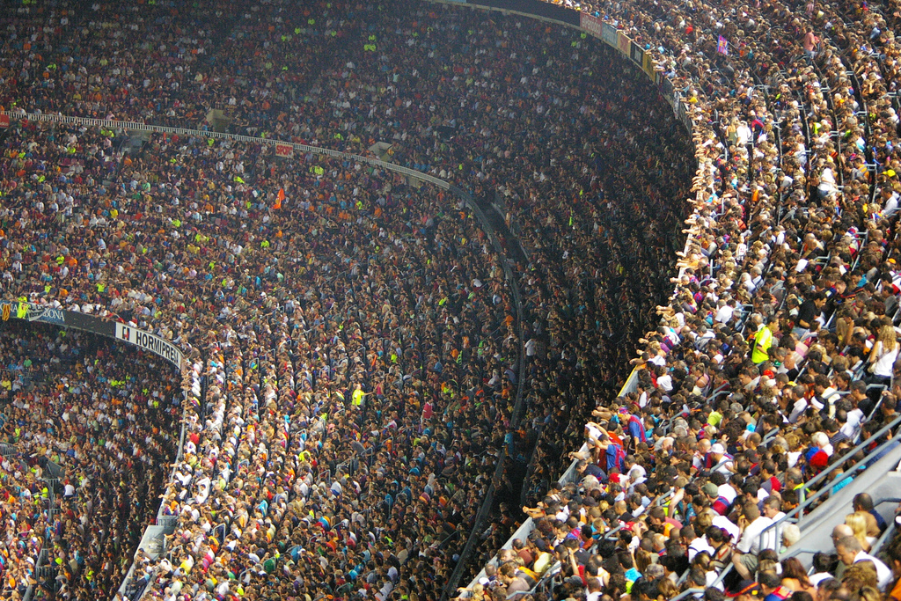
Estimated ~1,000,000 daily Tor users

Slide 27
The simplest designs use a single relay to hide connections.
Alice1
Bob1
E(Bob3,“X”)
“Y”
Relay,
Proxy,
VPN
Alice2
Bob2
E(Bob1, “Y”)
“Z”
“X”
E(Bob2, “Z”)
Alice3
Bob3

Slide 28
But a single relay is a single point of failure.
Alice1
Bob1
E(Bob3,“X”)
“Y”
Evil
Relay
Alice2
Bob2
E(Bob1, “Y”)
“Z”
“X”
E(Bob2, “Z”)
Alice3
Bob3
Eavesdropping the relay works too.

Slide 29
So, add multiple relays so that no single one can betray Alice.
Alice
Bob
R1
R3
R4
R5
R2

Slide 30
A corrupt first hop can tell that Alice is talking, but not to whom.
Alice
Bob
R1
R3
R4
R5
R2

Slide 31
A corrupt final hop can tell that somebody is talking to Bob, but not who.
Alice
Bob
R1
R3
R4
R5
R2

Slide 32
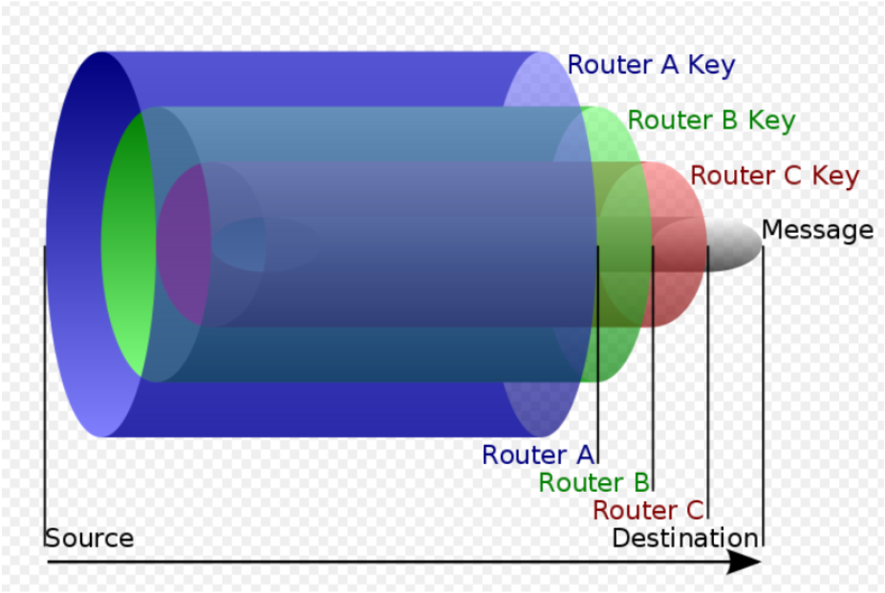
Photo courtesy Wikimedia Commons

Slide 33
Alice makes a session key with R1
...And then tunnels to R2...and to R3
Alice
Bob
R1
R3
Bob2
R4
R5
R2

Slide 34
Tor anonymizes TCP streams only: it needs other applications to clean high-level protocols.
SSH
SOCKS
Tor network
Tor client
Web
browser
Web
scrubber
HTTP
SOCKS
SOCKS
IRC
client

Slide 35
Tor is currently the largest strong anonymity network ever deployed.

Slide 36
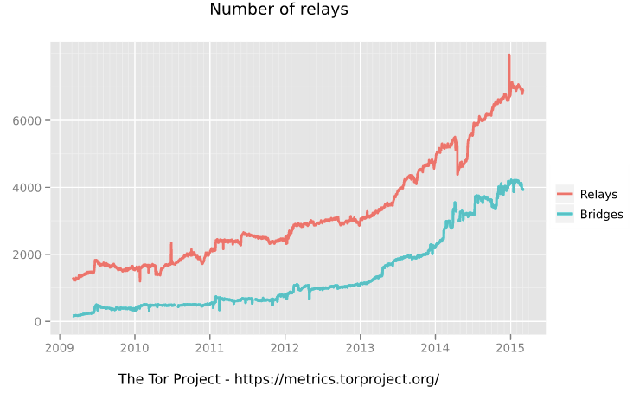

Slide 37
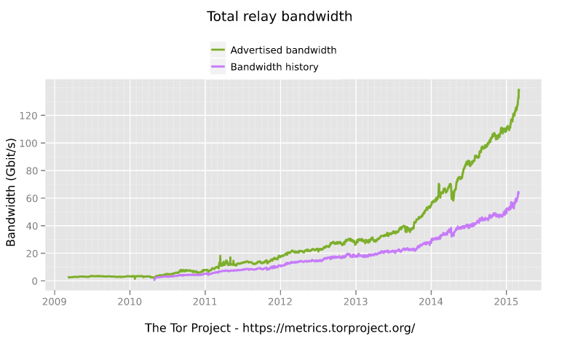

Slide 38
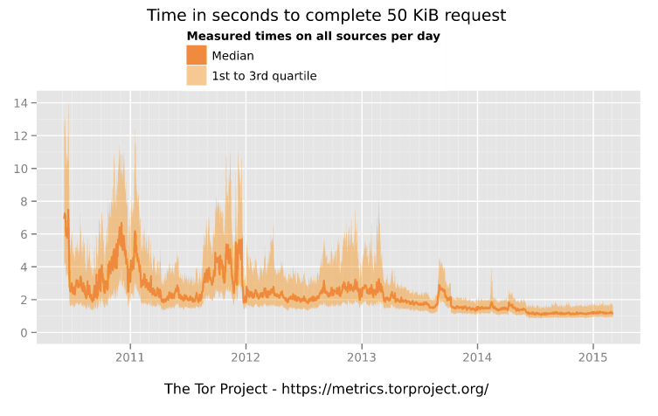

Slide 39
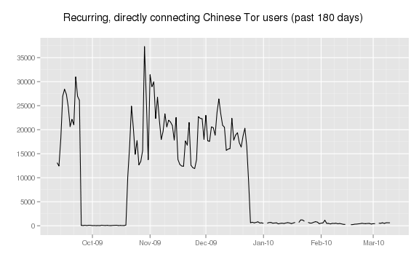

Slide 40
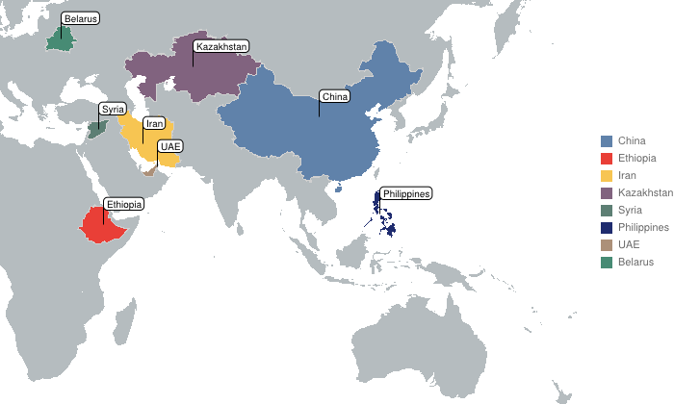
Tor protocol is targeted and filtered

Slide 41
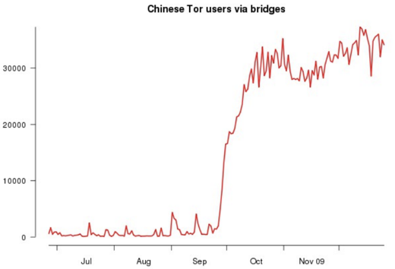
Tor Bridges Help!

Slide 42
Problem: Abusive users get the whole network blocked.
Nice
Alice
cloudflare
Tor network
X
Jerk
Alice
yelp
X
X
Some IRC
networks

Slide 43
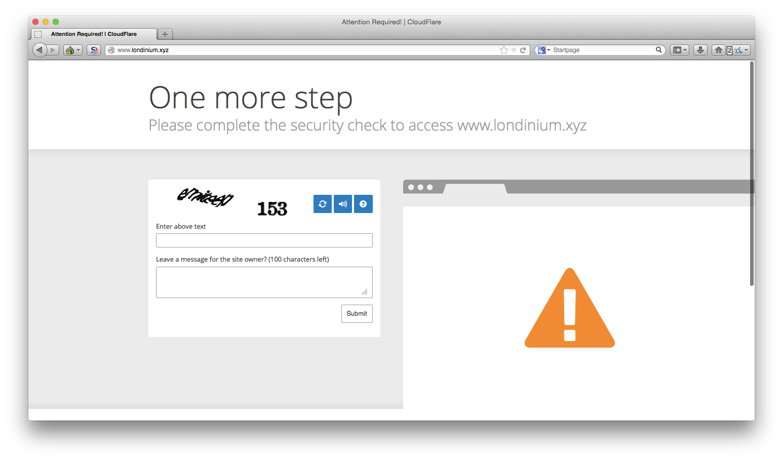
The Great Cloudflare Captcha Kerfuffle of 2016....

Slide 44

Tor doesn't magically encrypt the Internet
Operating Systems and Applications leak your info
Browser Plugins, Cookies, Extensions, PDF, SVG, and apps all conspire against you

Slide 45
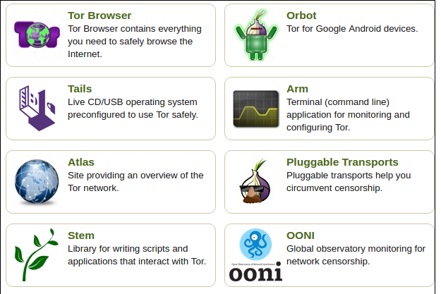
Tor Official & Community Apps
https://www.torproject.org/projects/projects

Slide 46
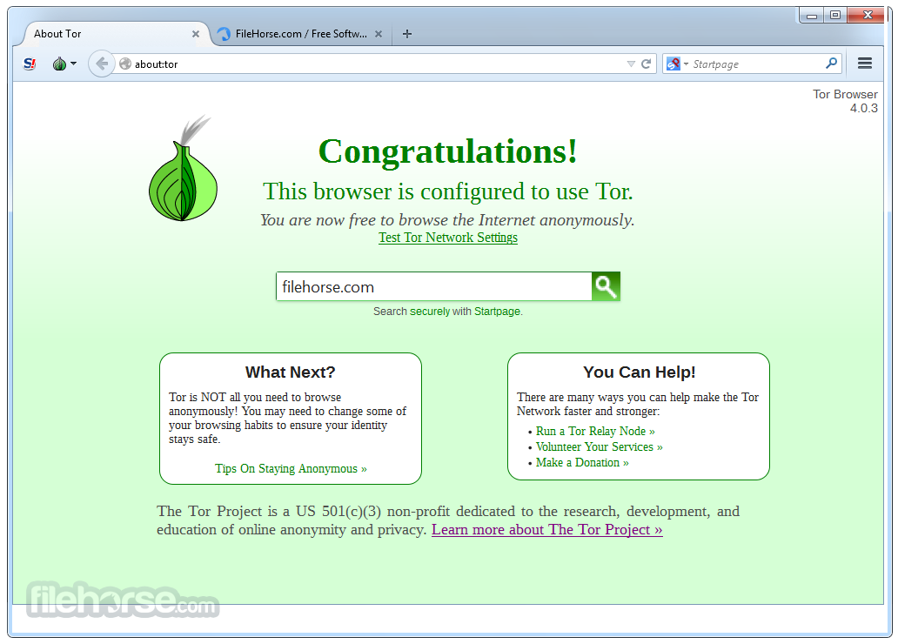
Tor Browser

Slide 47
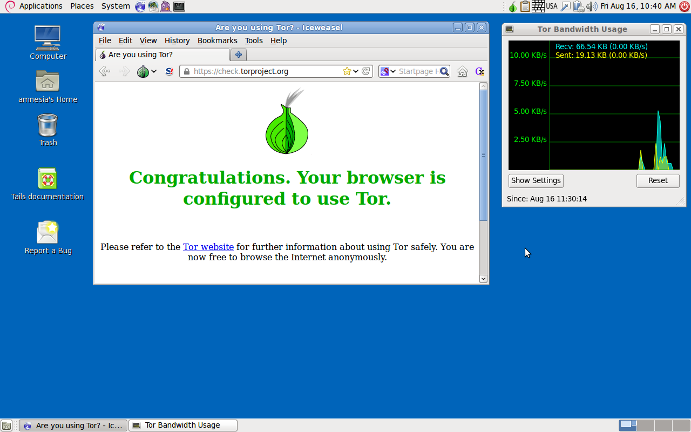
TAILS

Slide 48
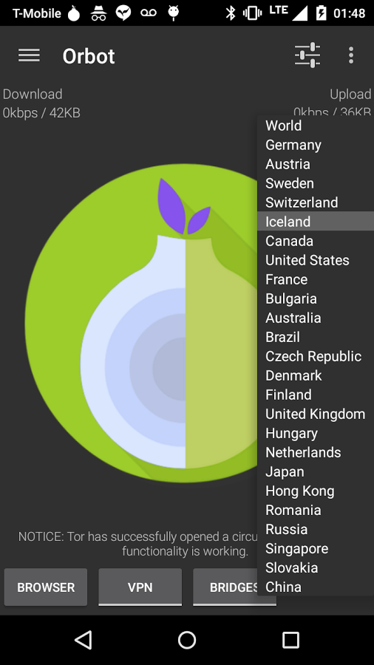
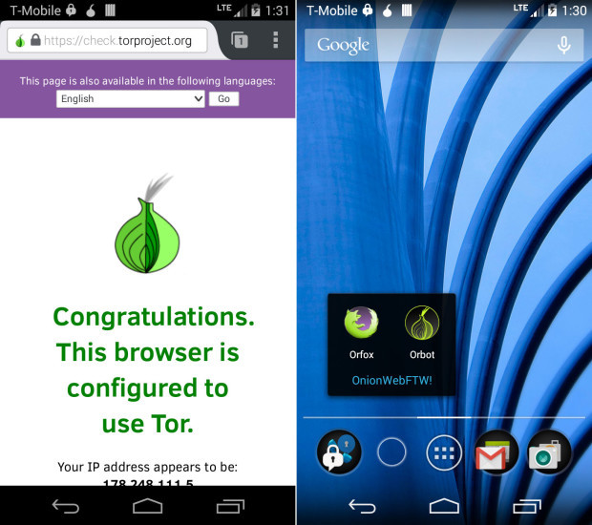
Orbot + Orfox (Android)

Slide 49
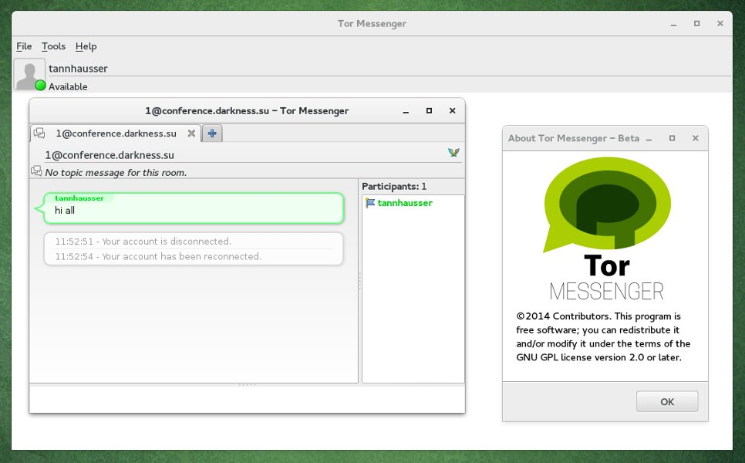
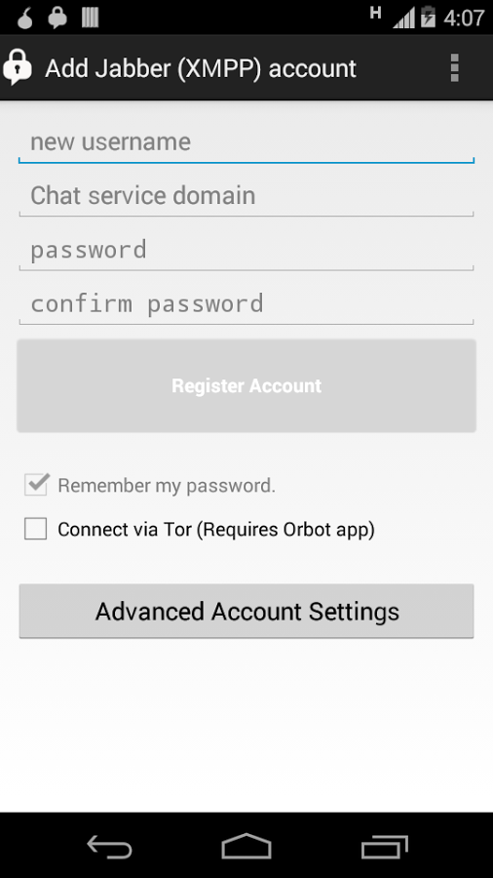
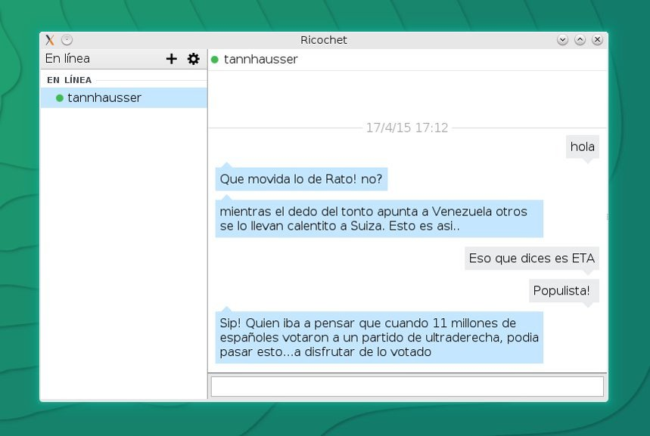
Messaging over Tor

Slide 50
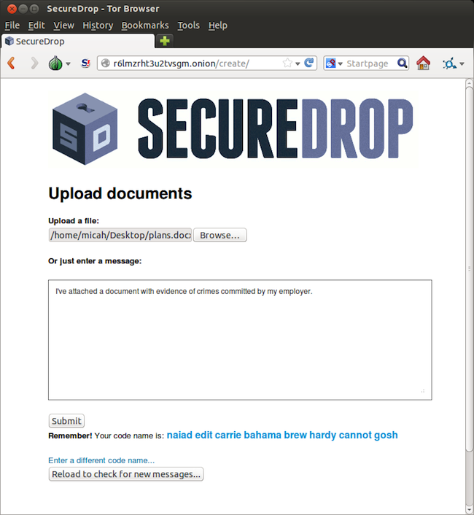
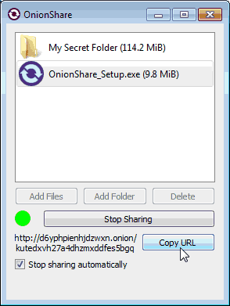
File Sharing over Tor

Slide 51
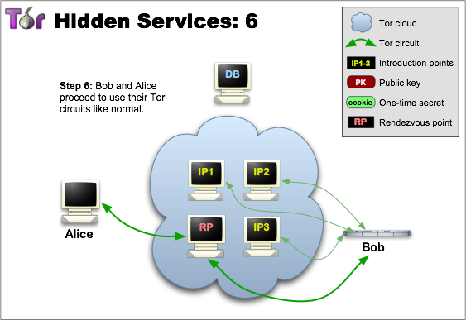
Hidden Services aka “Onion Sites”
Developed by US NRL and Finnish Defense
Hides location and routing information of both the server and client
DHT Directory design

Slide 52
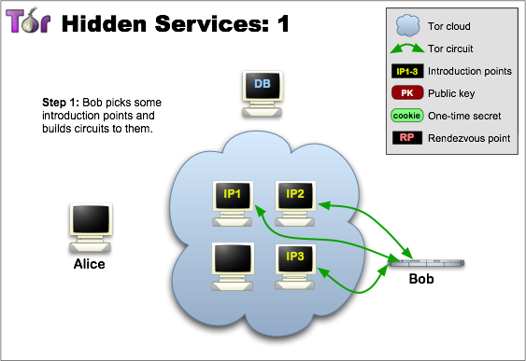
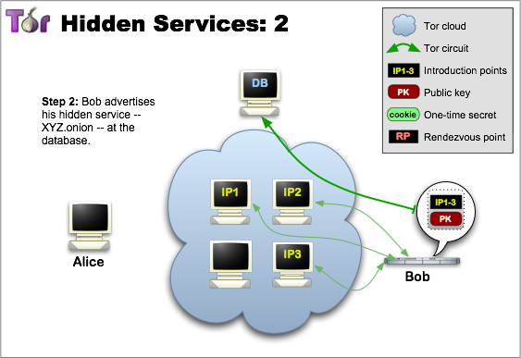

Slide 53
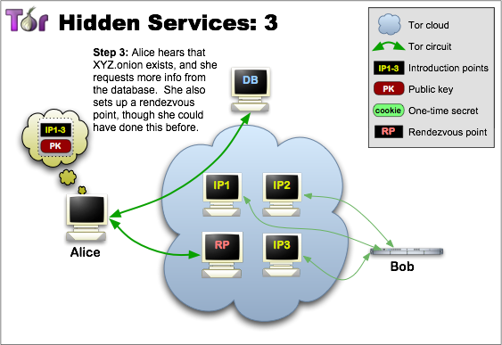
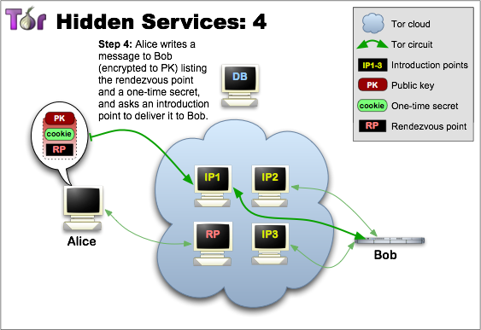

Slide 54
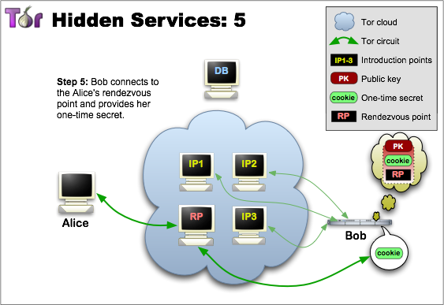

Slide 55
On the way to anonymity,
Tor has significantly improved
confidentiality and authentication
options for production internet services.
Enter Facebook...

Slide 56
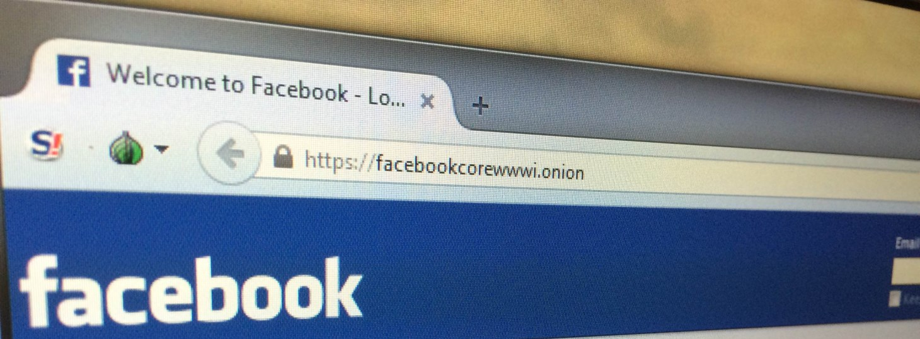
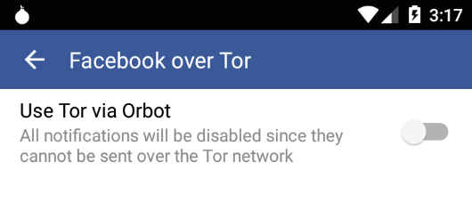
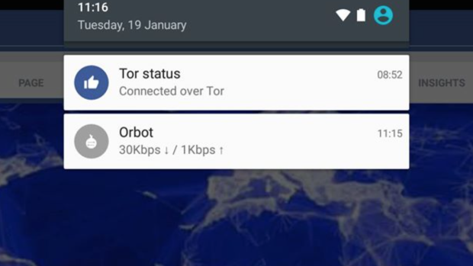
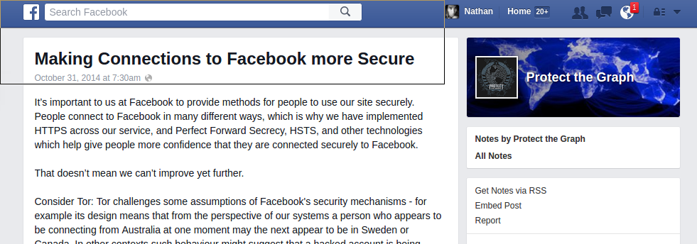

Slide 57
Facebook chose Tor because it was the best option to make their users more secure.
Tor makes the Internet more secure through confidential and authenticated communication channels
for any app or site.
Anonymity is for everyone.

