Slide 1
Node Governance
Control Which Nodes Can Be Used in Workflows

Slide 2
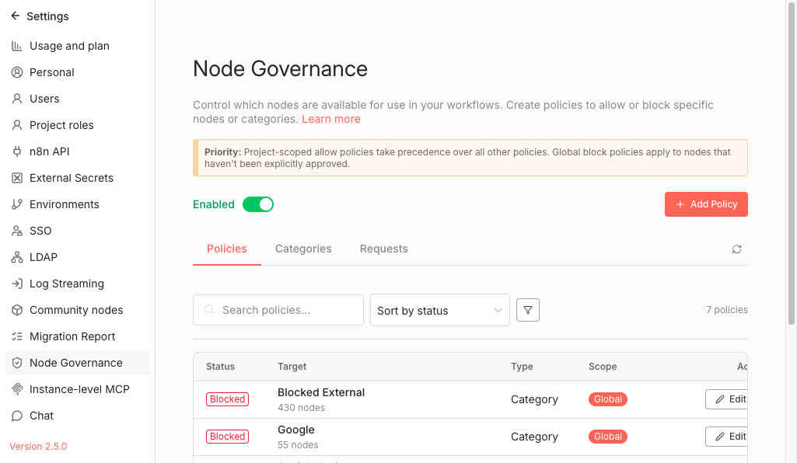
Settings Overview
Settings → Node Governance
→ Enable/Disable feature globally
→ Priority notice explaining policy precedence
→ Three tabs: Policies, Categories, Requests
→ Priority: Project ALLOW > Global BLOCK > Global ALLOW > Project BLOCK

Slide 3
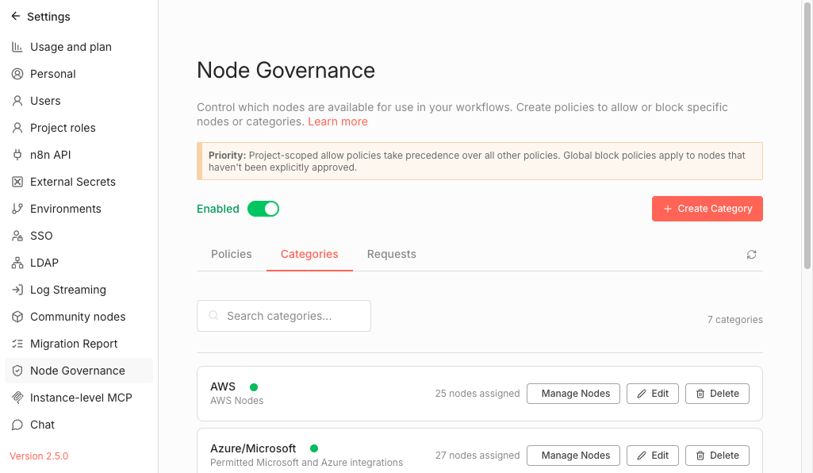
Categories Tab
Group related nodes for bulk policy management
→ AWS - 25 nodes
→ Azure/Microsoft - 27 nodes
→ Blocked External - 430 nodes
→ Google - 55 nodes
→ Block entire category instead of individual nodes

Slide 4
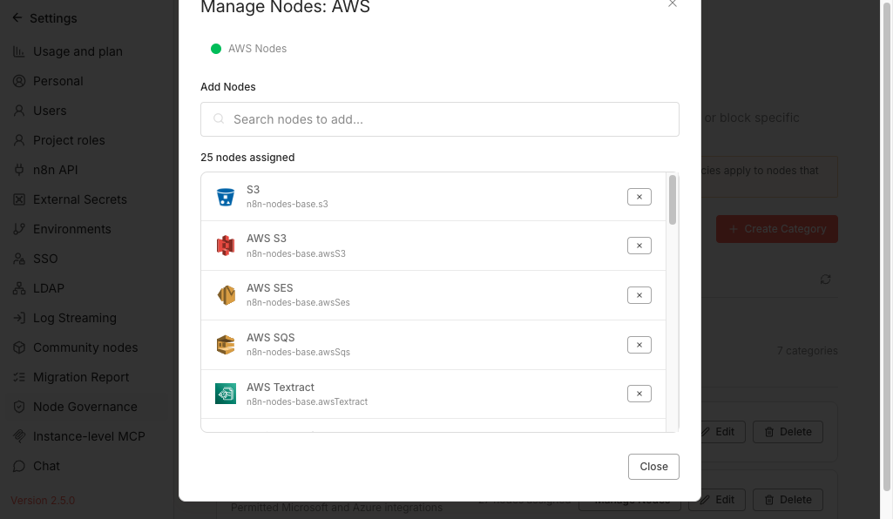
Manage Category Nodes
Add or remove nodes from a category
→ Search to find nodes to add
→ View all assigned nodes
→ Click X to remove a node
→ Node type names shown for clarity

Slide 5
Policies Tab
Define what's allowed and what's blocked
→ Status: Blocked (red) or Allowed (green)
→ Target: Single Node or Category
→ Scope: Global or Project-specific
→ Edit or delete existing policies

Slide 6
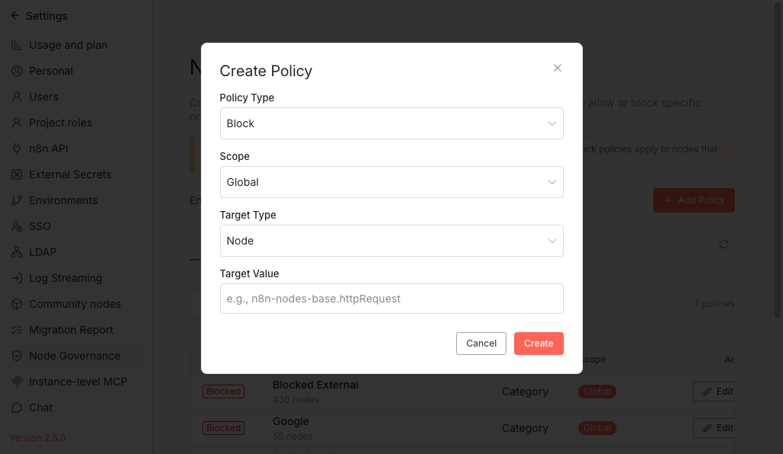
Create Policy
Granular control over node access
→ Policy Type: Block or Allow
→ Scope: Global or Specific Projects
→ Target Type: Single Node or Category
→ Target Value: e.g., n8n-nodes-base.ssh

Slide 7
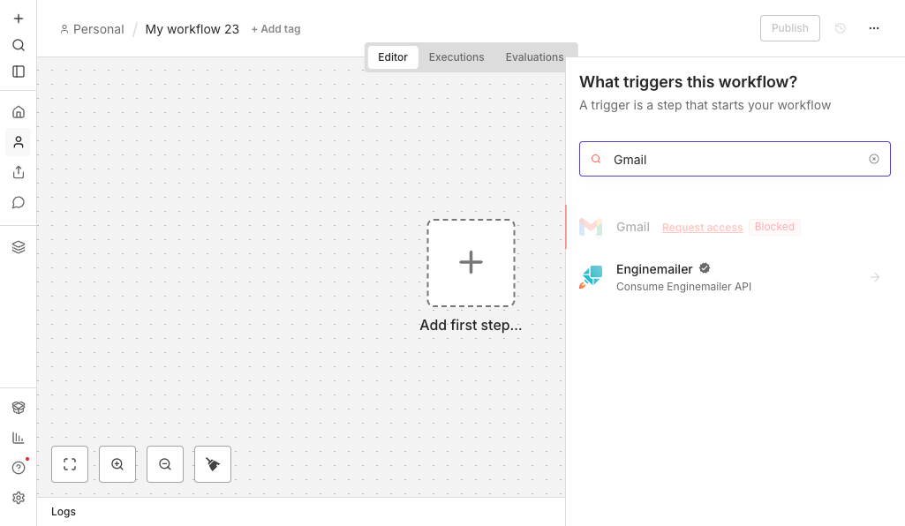
Node Creator Integration
Real-time governance status when adding nodes
→ Blocked nodes show 'Blocked' badge
→ 'Request access' link appears
→ Users can still see blocked nodes
→ Prevents accidental use of restricted nodes

Slide 8
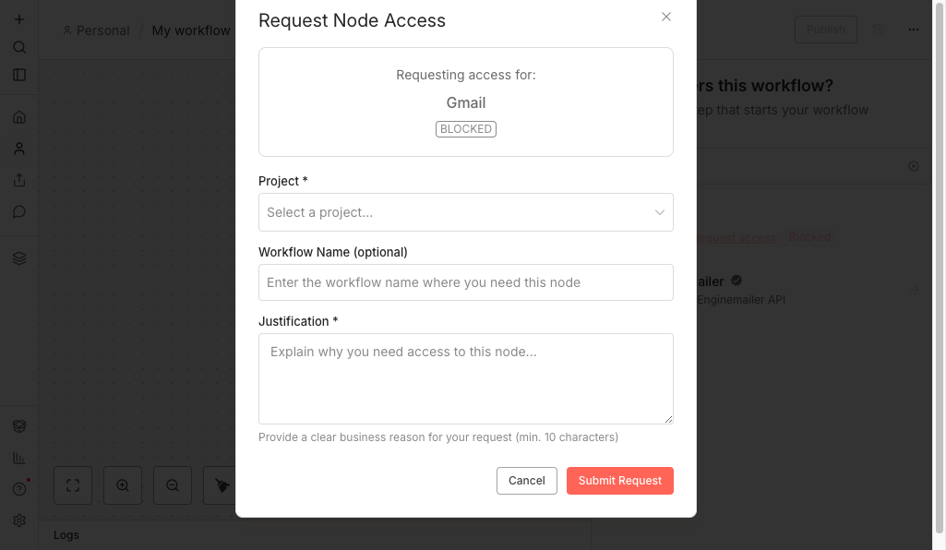
Request Node Access
Users provide business justification
→ Project - Which project needs access
→ Workflow Name - Optional context
→ Justification - Required business reason
→ Creates audit trail for compliance

Slide 9
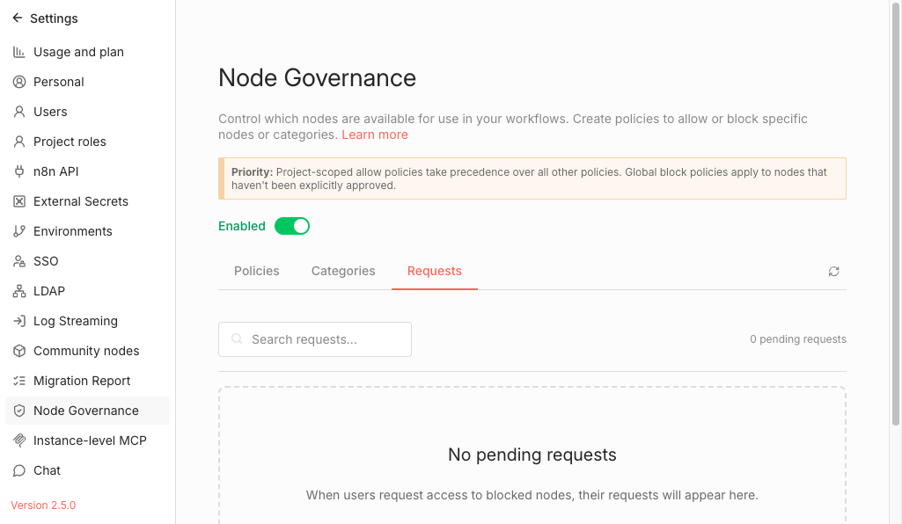
Admin Review
Approve or reject access requests
→ Pending requests appear with badge count
→ View user info and justification
→ Approve or Reject with comment
→ Full audit trail maintained

Slide 10
Key Benefits
Security
Compliance
Flexibility
Block risky nodes like SSH, Execute Command, Code execution
Audit trail for all access requests and approvals
Global or project-specific policies with priority system
Visibility
Categories
Self-Service
Users see blocked status in real-time when adding nodes
Manage hundreds of nodes with bulk category policies
Users can request access with business justification
Questions?

