Slide 1

MicroORMs
Nathan Kelley
http://www.devsolo.com
@devsolo

Slide 2
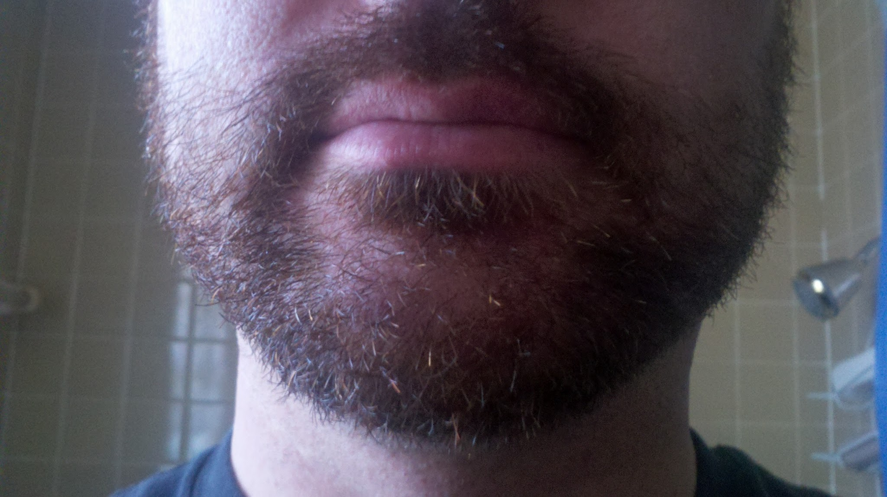

Slide 3

Senior Application Developer

Slide 4
Current Batch of MicroORMs
  Massive - Rob Connery (TekPub)
  Dapper - Sam Saffron (StackOverflow)
  Simple.Data - Mark Rendle
  ServiceStack.OrmLite - Software
  PetaPoco - Top 10 Software

Slide 5
The End

