Slide 1
Project 2 – Design of a 4-bit Multiplier

Slide 2
Background
ALU – Fundamental building block of a CPU
Digital circuit capable of performing arithmetic and logic operations
The multiplier in an ALU is built using adders and designed using the ‘add-and-shift’ algorithm
Notes:
Arithmetic Logic Unit
Performs addition, subtraction, multiplication, and division
Can be designed to be very basic and provide only a few functions or much more complex and provide many more complex functions like finding square roots
A multiplier circuit is part of an ALU

Slide 3
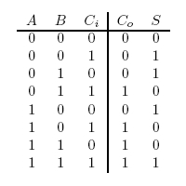
Background
Adder – A digital circuit that performs addition on numbers
Full Adder – An adder that accounts for carry-in and carry out values
Notes:
A and B are the two numbers being added
S is the sum
Co is the carryout
Ci is the carryin. We are grounding the carryin because we won’t be adding anything with a carry.

Slide 4
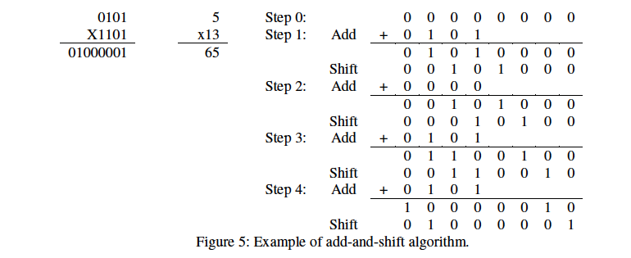
Background
Add and Shift Algorithm

Slide 5
4-Bit Multiplier Theory
Using two 74194 shift registers, we were able to set the Multiplicand and the Multiplier.
SLSI and SRSI were kept clear. Modes of operation, S0 and S1, are were the same for both shift registers.
The outputs of the multiplier were used as inputs for a 4:1 MUX.

Slide 6
4-Bit Multiplier Theory
Purpose of the 4:1 MUX is to select which bit the multiplier is multiplying the multiplicand by.
Accomplished via 74163 synchronous up counter. The two least significant bits were used as select lines to the 4:1 MUX. When the counter reached the fourth clock pulse, the third most significant being inverted, which was fed to the LOAD line. With all outputs ‘1111’, the counter went back to state zero and started over again.
Counter was cleared on first clock pulse.

Slide 7
4-Bit Multiplier Theory
Both multiplicand and multiplier go through four AND gates to the full adder.
CarryIn for the full adder is grounded to zero.
The shift register is shifting right. This is caused by our carryOut value set to the most significant bit.

Slide 8
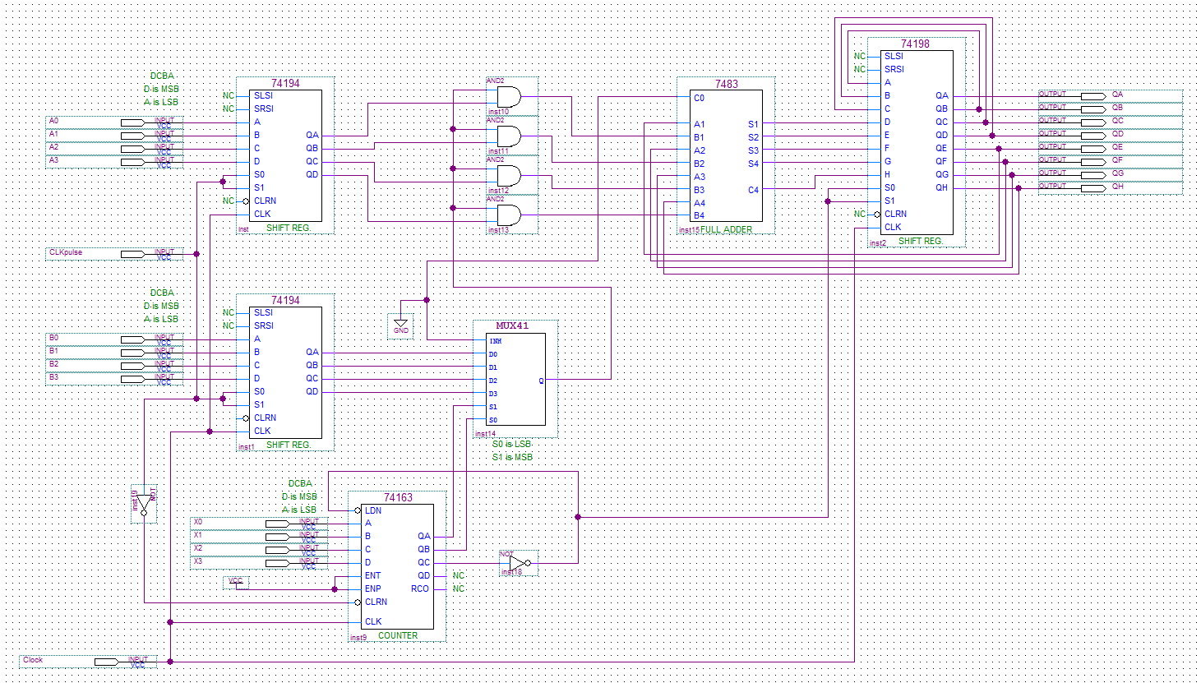
Implementation
Notes:
Top: multiplicand
Bottom:multiplier D having the MSB
S0 and s1 were set to high on both 4 bit shift registers to be loaded on the first pulse

Slide 9
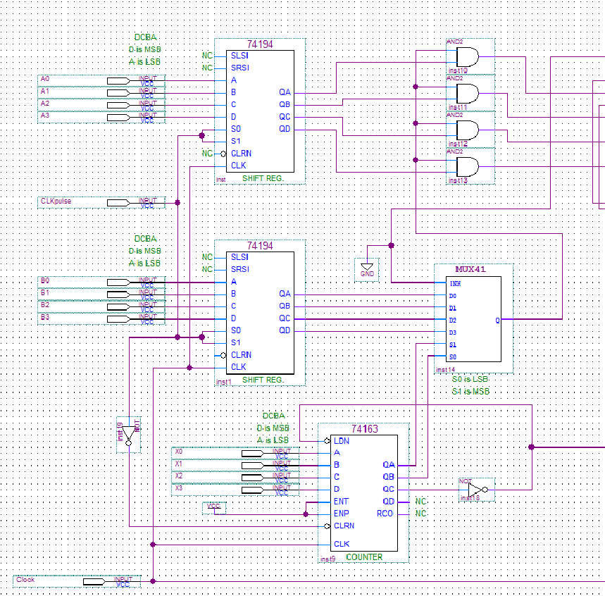
Implementation
Notes:
the 2 LSB’s of the counter as select lines for the 4:1 MUX that was connected to the multiplier
The counter was cleared on the first clock pulse to being the counter operation from zero and then once the counter reached 4, the second-to-most significant bit was inverted and fed to the LOAD’ pin that would load ‘1111’ into the counter and cause the counter to go back to state 0 and count up once again.
This way, Each value of the multiplier was multiplied (one at a time) to each term of the multiplicand and sent to the full adder

Slide 10
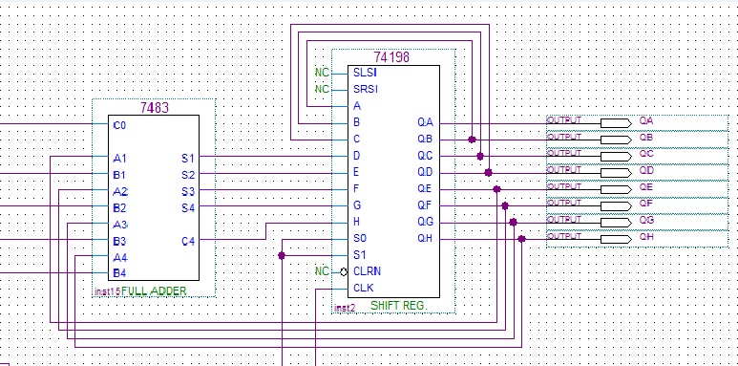
Implementation
Notes:
The c0 on the full adder is grounded because the carryout from the anded signal is always ‘0’
The full adder takes the value of the multiplicand and one digit of the multiplier and sum it with the 4 MSB’s in the shift register
The 4MSB’s of the shift register outputs holds the carryout from the previous sum as the MSB which performs the right shift necessary For the 8-bit register S0 and S1 needed to be high only for the clock pulses where the shift operation needed to be done so they were taken from the inverted output of the second-to-most significant bit of the up counter.

Slide 11
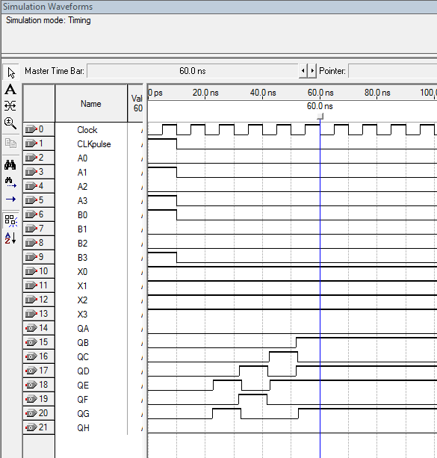
Simulation
10 times 9 where 10 is the multiplicand and 9 is the multiplier
A3 A2 A1 A0= 1010 : ten
B3 B2 B1 B0 = 1001: 9
Result :
QH QG QF QE QD QC QB QA = 01011010
= 64+16+8+2=90
Notes:
The simulation was done as a waveform using quartus CLK pulse was set to 1 at the beginning to load the shift registers

Slide 12
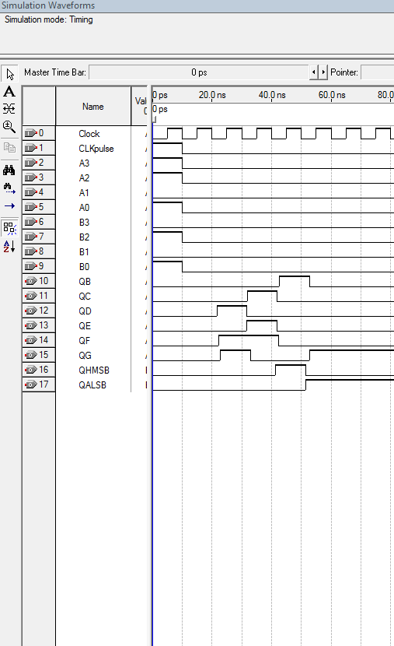
Simulation

