Slide 1
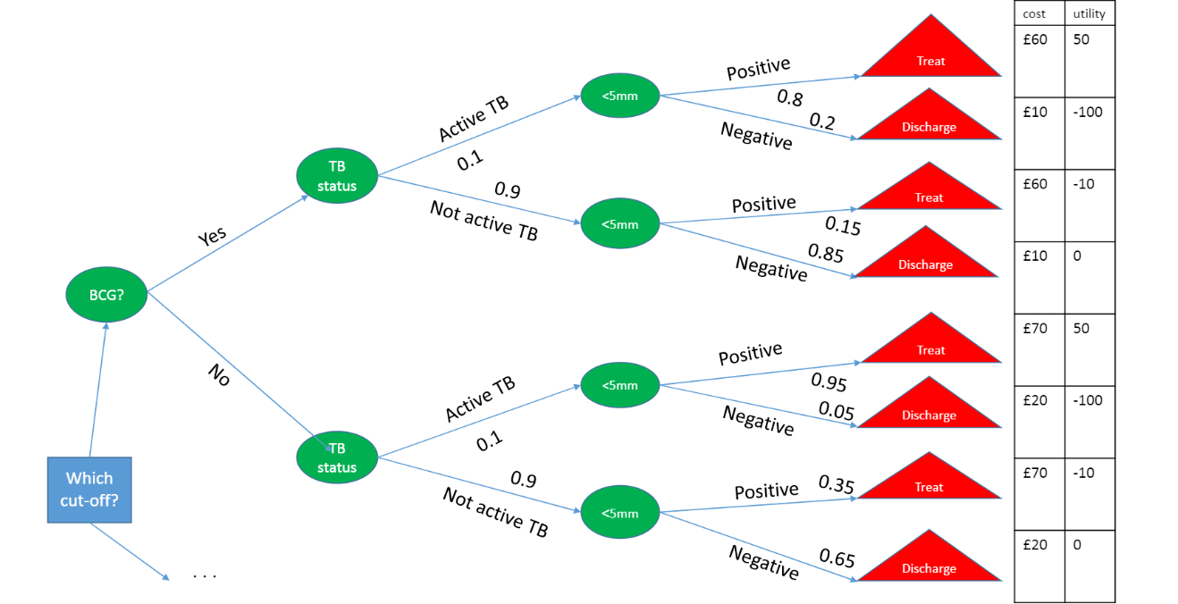

Slide 2
E(Cost) = £50
E(Utility) = 20

Slide 3
E(Cost) = £50
E(Utility) = 20
E(Cost) = £17.5
E(Utility) = -1.5
E(Cost) = £67.5
E(Utility) = 42.5
E(Cost) = £37.5
E(Utility) = -3.5

Slide 4
E(Cost) = £20.75
E(Utility) = 0.65
E(Cost) = £40.5
E(Utility) = 1.1

