Slide 1

Data Management in
Dr N Green
June 2017
DIDE, Imperial College

Slide 2


Slide 3
Names for the early steps of “Data Science”
Data munging
Data wrangling
Web scraping
Data pulling
Pre-processing
Data cleansing
Data harmonising
Data cleaning
https://www.datacamp.com/community/blog/an-introduction-to-cleaning-data-in-r

Slide 4
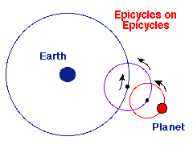
Epicycle of Analysis (Art of Data Science, Peng)
There are 5 core activities of data analysis:
Stating and refining the question
Exploring the data (EDA)
Building formal statistical models
Interpreting the results
Communicating the results

Slide 5
Epicycle of Analysis (Art of Data Science, Peng)
There are 5 core activities of data analysis:
Stating and refining the question
Exploring the data (EDA)
Building formal statistical models
Interpreting the results
Communicating the results

Slide 6
EDA
“There are no routine statistical questions, only questionable statistical routines.”—Sir David Cox
“Far better an approximate answer to the right question, which is often vague, than an exact answer to the wrong question, which can always be made precise.”—John Tukey

Slide 7
Exploratory Data Analysis
(From Art of Data Science) Formulate your question:
Read in your data
Look at the top and the bottom of your data
Check your "n"s
Validate (with at least one external data source)
Make a plot
Try the easy solution first
Follow up…

Slide 8
“Mise en place”!
rm(list=ls())
getwd()
setwd("<location of your dataset>")
.Rpofile: file for customising start-up

Slide 9

OpenRefine
https://github.com/OpenRefine/OpenRefine/wiki/Documentation-For-Users

Slide 10
Validation
Check basic characteristics
Validate with another (external) data source if possible
Make a simple plot (boxplot, (paired) scatter plot,…)

Slide 11
Reading data from GitHub
library(readr)
conception <- read_csv("https://raw.githubusercontent.com/n8thangreen/ONS/master/conception-under18.csv")
View(conception)

Slide 12
Validation type | How it works | Example
Check digit | The last couple of digits can be used as a 'check sum' that can detect if errors have occurred | Bar code readers in shops
Type check | Checks the data is in the right format | Numbers in currency cell must be a monetary value with two decimal points
Length check | Checks the data is an acceptable length | A PIN for online banking needs to be four (or six) characters long
Lookup table | Checks that the value provided matches an item in a set list | A limited set of values, such as the seven days of the week
Presence check | Checks that data has been entered into a field | In most databases a key field cannot be left blank
Range check | Checks that a value falls within the specified range | An online gift certificate purchase must be more than or equal to £5 but less than or equal to £50
Spell check | Looks up words in a dictionary | A search engine often recommends a correct spelling if a word is spelt wrong
Input mask | Checks that data has been entered with the correct amount of characters and/or numbers | National insurance numbers need to be in the format: YY XX XX XX Y, where Y = letter and X = number
Duplicate | Checks that a value has not been repeated | A primary key value can only be entered once
http://www.bbc.co.uk/education/guides/

Slide 13
Variables types and indexing
numeric Numeric data (approximations of the real numbers, ℝ)
integer Integer data (whole numbers, ℤ)
factor Categorical data (simple classifications, like gender)
ordered Ordinal data (ordered classifications, like educational level)
character Character data (strings)
raw Binary data

Slide 14
typeof() # what is it?
length() # how long is it? What about two dimensional objects?
attributes() # does it have any metadata?
# Example
x <- "dataset"
typeof(x)
attributes(x)
y <- 1:10
typeof(y)
length(y)
attributes(y)
z <- c(1L, 2L, 3L)
typeof(z)

Slide 15
Useful functions
head() - see first 6 rows
tail() - see last 6 rows
dim() - see dimensions
nrow() - number of rows
ncol() - number of columns
str() - structure of each column
names() - will list the names attribute for a data frame (or any object really), which gives the column names.
table()
unique(); duplicated()

Slide 16
Dates

Slide 17
String normalisation
library(stringr)
str_trim(" hello world ")
## [1] "hello world"
str_trim(" hello world ", side = "left")
## [1] "hello world "
str_trim(" hello world ", side = "right")
## [1] " hello world“
toupper("Hello world")
## [1] "HELLO WORLD"
tolower("Hello World")
## [1] "hello world"

Slide 18
String matching (regular expressions)
gender <- c("M", "male ", "Female", "fem.")
grepl("m", gender)
## [1] FALSE TRUE TRUE TRUE
grep("m", gender)
## [1] 2 3 4
grepl("m", gender, ignore.case = TRUE)
## [1] TRUE TRUE TRUE TRUE
grepl("m", tolower(gender))
## [1] TRUE TRUE TRUE TRUE
grepl("^m", gender, ignore.case = TRUE) ## [1] TRUE TRUE FALSE FALSE

Slide 19
text <- "We want to develop new regular expression."
grep("want|develop", text, value=TRUE)
[1] "We want to develop new regular expression."

Slide 20
Running example
library("stringr", lib.loc="~/R/win-library/3.2")
conception$Name
conception$Name <- str_trim(conception$Name)
conception$Name <- gsub(pattern = " UA", replacement = "", conception$Name)

Slide 21
Consistent data
Missing values
age <- c(23, 16, NA)
mean(age)
## [1] NA
mean(age, na.rm = TRUE)
## [1] 19.5
Checks
is.na()
is.nan()
na.omit()
complete.cases(x)

Slide 22
Running example
apply(conception, 2, function(x) any(is.na(x)))
data$Name <- toupper(conception$Name)
chartr(“AIai", "@!@!", conception$Name)

Slide 23
Outliers
What’s realistic? Permissible (integrity)?
(Outliers: An Evaluation of Methodologies, Dhiren Ghosh, Andrew Vogt, https://www.amstat.org/sections/srms/proceedings/y2012/files/304068_72402.pdf)
What to do?
Imputation: substitution mean, logistic regression prediction, matching
Truncation, removal, Winsorising, scaling, judgement

Slide 24
Subsetting
X[1]
x[-c(1, 5)]
x[c(TRUE, TRUE, FALSE, FALSE)]
x[which(x > 3)]
z[c("a", "d")]
df <- data.frame(x=1:3, y=3:1, z=letters[1:3])
df[df$x == 2, ]

Slide 25
The apply() family
lapply()
Loop over a list and evaluate a function on each element
sapply()
Same as lapply but try to simplify the result
apply()
Apply a function over the margins of an array
tapply()
Apply a function over subsets of a vector
mapply()
Multivariate version of lapply

Slide 26
Examples
x <- matrix(rnorm(200), 20, 10)
apply(x, 2, mean)
x <- list(a = 1:5, b = rnorm(10))
lapply(x, mean)
sapply(x, mean)
x <- c(rnorm(10), runif(10), rnorm(10, 1))
f <- gl(3, 10)
tapply(x, f, mean)
rowSums = apply(x, 1, sum)
rowMeans = apply(x, 1, mean)
colSums = apply(x, 2, sum)
colMeans = apply(x, 2, mean)

Slide 27
“Tidy” data
Happy families are all alike; every unhappy family is unhappy in its own way [Leo Tolstoy]
A dataset is said to be tidy if it satisfies the following conditions
observations are in rows
variables are in columns
contained in a single dataset.

Slide 28
TB incidence data
tb <- read.csv(file = "http://stat405.had.co.nz/data/tb.csv", header = TRUE, stringsAsFactors = FALSE)
Except for iso2 and year, the rest of the columns headers are actually values of a lurking variable, in fact combination of two lurking variables, gender and age.)

Slide 29
Reshape(2)
Create categorical values
data$zipGroups <- cut(data$zipCode,breaks=quantile(data$zipCode))
install.packages("Hmisc")
library(Hmisc)
data$zipGroups <- cut2(data$zipCode, g=4)
table(data$zipGroups)

Slide 30
Transformations
absolute value
abs(x)
square root
sqrt(x)
ceiling(3.4) is 4
ceiling(x)
floor(3.4) is 3
floor(x)
rounding
round(x, digits=n)
signif(3.475, digits=2) is 3.5
signif(x, digits=n)
natural logarithm
log(x)
exponentiating x
exp(x)
*useful for table formatting

Slide 31
Sorting
data <- data.frame( "column1"=sample(1:5), "column2"=sample(6:10), "column3"=sample(11:15))
data <- data[sample(1:5),]
data$column2[c(1,3)]<-NA
sort(data$column1, decreasing=FALSE)
sort(data$column2, decreasing=FALSE, na.last=TRUE)
data[order(data$column1),]

Slide 32
Running example
conception <- conception[order(conception$Name),]
conception <- within(conception, new <- `Number of Conceptions`*2)
conception <- conception[order(conception $`Conception rate per 1,000 women in age group`),]
conception <- conception[order(conception $`Conception rate per 1,000 women in age group`, decreasing = T),]

Slide 33
Merging/Joins
df1 = data.frame(id=sample(1:10), x=rnorm(10))
df2 = data.frame(id=sample(1:10), x=rnorm(10))
df3 = data.frame(id=sample(1:10), x=rnorm(10))
dfs = list(df1, df2, df3)
plyr::join_all(dfs)

Slide 34
Melt and cast
head(mtcars)
install.packages("reshape2")
library(reshape2)
mtcars$carname <- rownames(mtcars)
carMelt <- melt( mtcars, id=c("carname", "gear", "cyl"), measure.vars=c("mpg", "hp"))
cylData <- dcast(carMelt, cyl ~ variable)
cylData <- dcast(carMelt, cyl ~ variable, mean)

Slide 35
Running example
head(reshape2::melt(conception,id.vars="Name"))

Slide 36
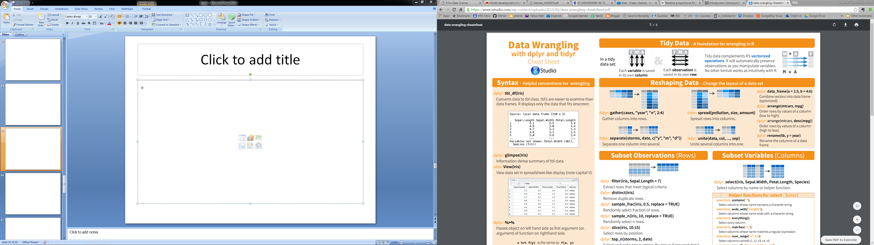
Cheat sheets

Slide 37

RStudio
Loads of really useful features, that are being added-to all the time:
Keyboard short cuts
Drop-down menus
Data sorting, pop-out windows
Linting, static code analysis
Searches: files, functions, text
…

Slide 38
Thanks

