Slide 1
Artefacts
https://docs.google.com/document/d/1Qqc1jaZ3kVgYFFwHNZ0iWlH59VxQOEePim3AP7InSjM/edit

Slide 2
System use case for Smart City project 1.1 (Users)
Title: System use case for Smart City 1.1 project (Users)
Account Opening
Account Closing
View Information
Search Result
Request user access

Slide 3
System use case for Smart City project 1.1 (Admin)
Title: System use case for Smart City 1.1 project (Admin)
Account Opening
Account Closing
Upload/Edit/Delete Information

Slide 4
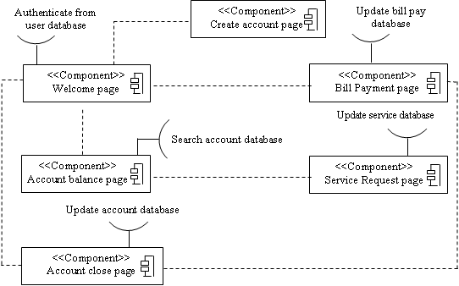
Component diagram for Smart City 1.1 - Hark
<<Component>>
Home Page/ Welcome Page
<<Component>>
Login Page
<<Component>>
User City Information Page
<<Component>> Request information page
Search for user information in database
Authentication User database
User database
<<Component>> Create account page
<<Component>>
View other user information page
<<Component>> Account close page

Slide 5
Data Flow diagram for Smart City 1.1
WELCOME PAGE
LOG IN
MAIN PAGE
LOG OUT
USER
REQUEST ACCESS TO OTHER USER TYPES
CITY INFORMATION
SEARCH
ACCOUNT CREATION
RESULTS PAGE
ACCOUNT PAGE
FORGOT DETAILS
RETRIEVE DETAILS

Slide 6
UI - Sharen/Schech/Raj

Slide 7
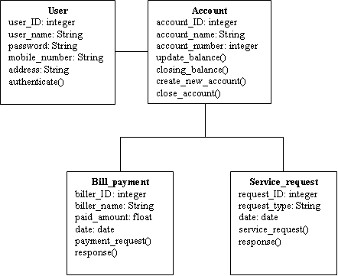
Class Diagram for Smart City 1.1 - Raj

Slide 8
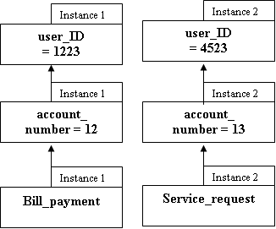
Object diagram for Smart City 1.1 - Oliver

Slide 9
Sequence Diagram for Smart City 1.1 - Hark
User
Homepage/Login
Validate User
Database
Logging in
Validate User
User access
User views City information
City Information
City Information

Slide 10
Statechart Diagram for Smart City 1.1 - Log in
Start
Idle
Log in
Input login details
Check login details against database
If unsuccessful
Error
(pop up)
Intermediate
states
Initialize
state
Notify if log in was successful or not
Cancel
Login
If successful
Show main page
Final
State
End

Slide 11
Statechart Diagram for Smart City 1.1 - Search (Users)
Start
Idle
Search
Put in search term
Search term in database
Intermediate
states
Initialize
state
Retrieve relevant information
Cancel
Search
Display search result
Final
State
End

Slide 12
Statechart Diagram for Smart City 1.1 - Upload/Edit/Delete Information (Admin)
Start
Idle
Edit/Upload/Delete
Input changes
Confirm changes
If unsuccessful
Error
(pop up)
Intermediate
states
Initialize
state
Notify if changes are successful or not
Cancel
Edit/Upload/Delete
If successful
Return to initial page
Final
State
End

Slide 13
Entity relationship diagram- 1.1 - Schech
Name
D.O.B
Mobile number
Address
Specific Info
Request other user type
User
Has
User type
Username
Password
Login /Logout
Performs
Actions
Search categories
View account
View city information
View user related information

Slide 14
Software testing (verification & validation) - Raj

