Slide 1
Defense
Second-Hand Car Recommendation For Bangladesh Using Machine Learning
Supervisor
Dr. Mohammad Aman Ullah
Chairman & Associate Professor of CSE
Team Members
C201051 – Khurshedul Alam
C201067- Haiman Nath
C201082 – Nazimul Islam Rifat
Institution : International Islamic University Chittagong
Department : Computer Science & Engineering

Slide 2
In modern times, recommendation systems have become significant tools for online users to easily get information on e-commerce websites as per users’ preferences.
Recommendation system plays a vital role in second hand car market.
The study of a recommendation system combined with content-based techniques will lead us to obtain an effective and efficient solution to the secondhand car recommendation system.
Analyzing tasks of Content-based will be implemented though ML algorithms.
It performs with diverse conditions of users
Scalable for large datasets and evolving markets.
INTRODUCTION

Slide 3
Context in Bangladesh marketplace for Recommendation
Increasing imported car prices.
Middle-class families aim for affordability and reliability, making used cars an attractive option.
Second-hand car market is informal and underdeveloped compared to global standards
Smaller size of the market
Play a transformative role in addressing buyer concerns and streamlining decision-making processes
Using potentiality of machine learning in recommendation
Consumers struggle to balance multiple constraints , leading to decision fatigue
Some countries use AI-powered platforms to simplify car buying decisions.
BACKGROUND

Slide 4
Machine Learning for Car Price Prediction :
In these sector we preview three papers where in one paper they use ML algo(Random forest ML model) for car price on another they shallow machine learning techniques. And in other one they showed the accuracy will be good under random forest than decision tree also we get some more papers on it they also work with linear regression.
Machine Learning for Recommendations :
On these we preview two papers. Where in one we got the ellaborated idea about context based and content based recommendation system and in another paper they survey about these techniques and finding out about it usage in big sectors for classifications and recommendation. PROMETHEE method for comparison tasks.
Fuzzy Logic in Recommendation System :
On these sector we get a paper where it informed us about the fuzzy logic work and showing us the way it worked. In a food recommendation model we also find it.
Related Work

Slide 5
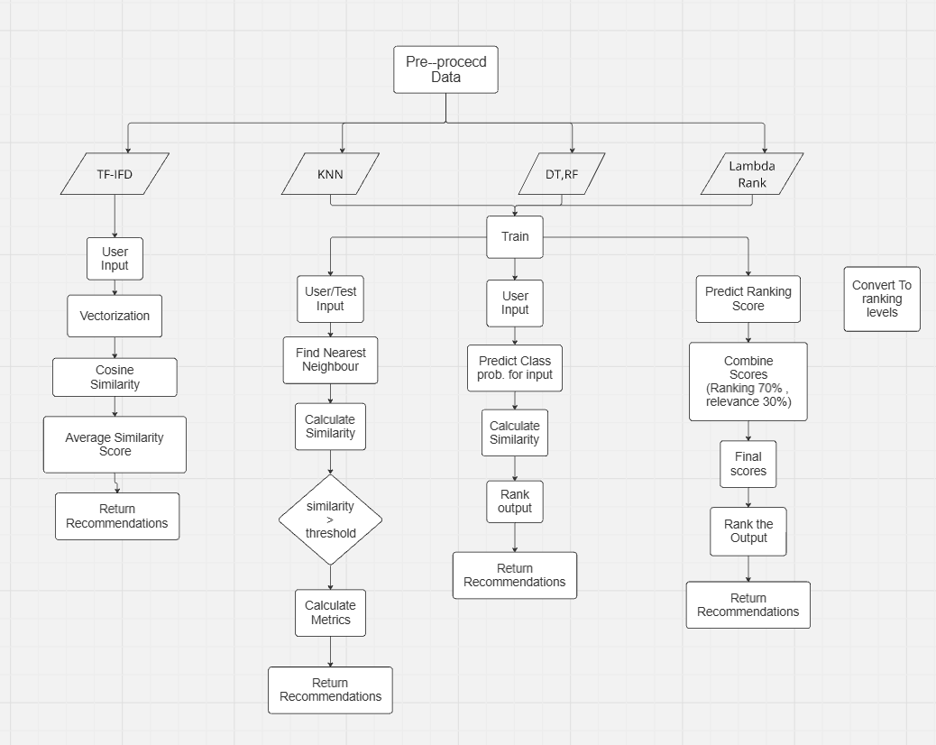
METHODOLOGY
/
ARCHITECTURE

Slide 6

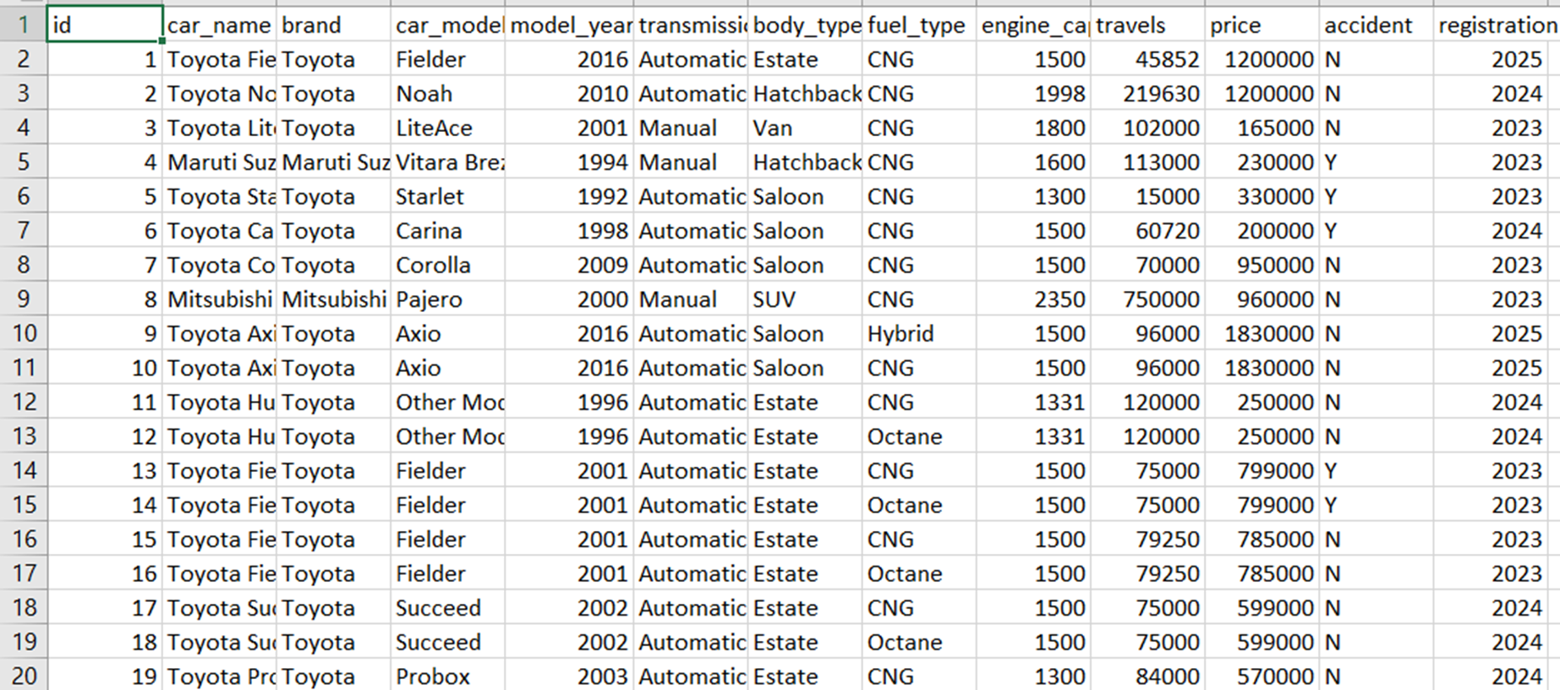

Slide 7

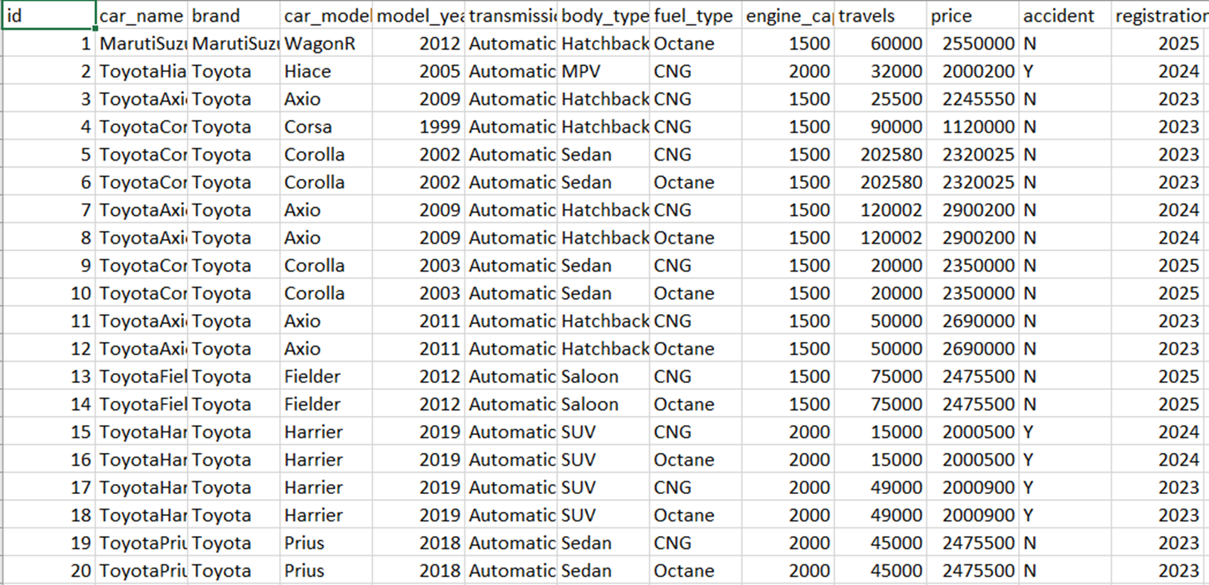

Slide 8
It firstly measure Euclidean distance between user preference and training data. Then calculate similarity of features. If similarity is greater then threshold then it will give us that data as recommendation.
Firstly it convert all data into a numerical . Then the user preferences also take will also convert in numerical values. euclidean distance will be measure and the rest will be same.
Euclidean Distance = √( (X− B1)2 + (Y−B2)2 ) [(X,Y) test features]
Similarity = Matching features/Total features
Good recommendation = threshold < Similarity
KNN
(K Nearest Neighbour)

Slide 9
Dataset | Accuracy | Precision | Recall | F1_score
Bikroy1 | 99.0% | 97.7% | 83.0% | 89.7%
Bikroy2 | 99.8% | 99.8% | 92.8% | 96.2%
Results Of KNN

Slide 10
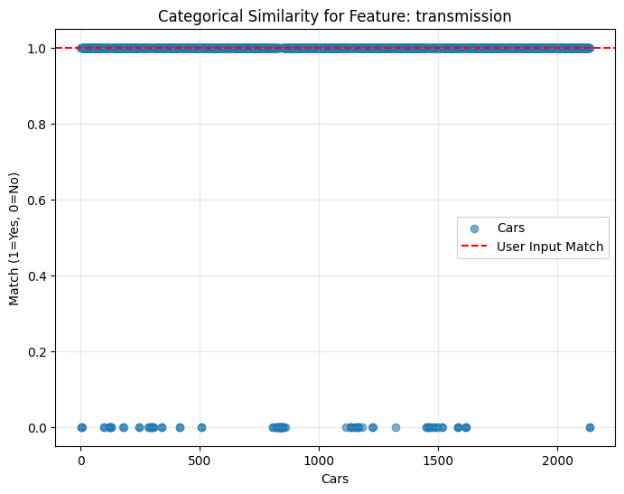
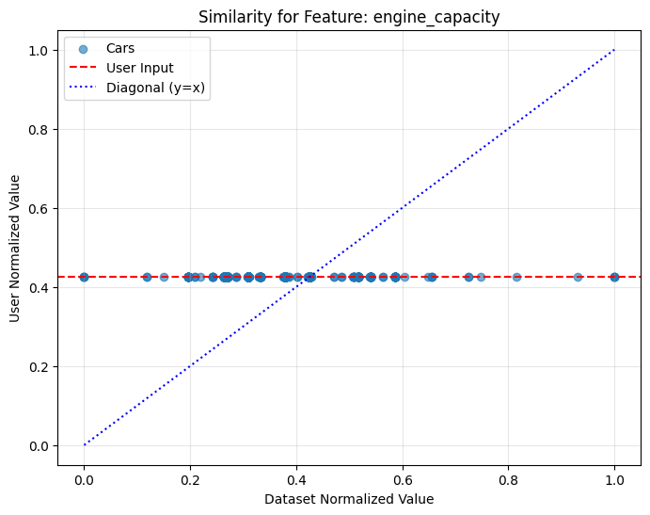
Some Visualizations of KNN

Slide 11
Recommendations For Bikroy1
Value | Attribute
body_type | Saloon
transmission | Automatic
engine_capacity | 1500cc
price | 3000000
car_age | 6
Index | Model | Price | Model_year | Body_type | Engine_cc | Travels | Fuel_type | Similarity
1299 | Allion | 3000000 | 2018 | Saloon | 1500 | 30000 | Octane | 1.00000
2031 | Allion | 2980000 | 2018 | Saloon | 1500 | 40300 | Petrol | 0.86667
2032 | Allion | 2980000 | 2018 | Saloon | 1500 | 40300 | Octane | 0.86667
2038 | Allion | 2970000 | 2018 | Saloon | 1500 | 37873 | Octane | 0.80000
2037 | Allion | 2970000 | 2018 | Saloon | 1500 | 37873 | Petrol | 0.80000

Slide 12
Recommendations For Bikroy2
Value | Attribute
body_type | Saloon
transmission | Automatic
engine_capacity | 1500cc
price | 3050000
car_age | 4
Index | Model | Price | Model_year | Body_type | Engine_cc | Travels | Fuel_type | Similarity
129 | Axio | 3340000 | 2020 | Saloon | 1500 | 48000 | Octane | 0.98899
128 | Axio | 3340000 | 2020 | Saloon | 1500 | 48000 | CNG | 0.98899
219 | Allion | 3450000 | 2020 | Saloon | 1500 | 1780 | Octane | 0.98481
218 | Allion | 3450000 | 2020 | Saloon | 1500 | 1780 | Hybrid | 0.98481
1095 | Axio | 2275000 | 2014 | Hatchback | 1500 | 82111 | Petrol | 0.96756

Slide 13
In this recommendation model, DT and RF work together.
Training DT and RF with 80% training data
Testing DT and RF with 20% test data
Predicting class probabilities of the input sample, e.g user preferences, for DT and RF
Calculating similarity scores for DT and RF and combining them both to calculate combined similarity scores
Sort or rank the output by discending order as per combined similarity scores
Demonstrating the top 5 results as recommendations
Model using
Decision Tree(DT)
&
Random Forest(RF)

Slide 14

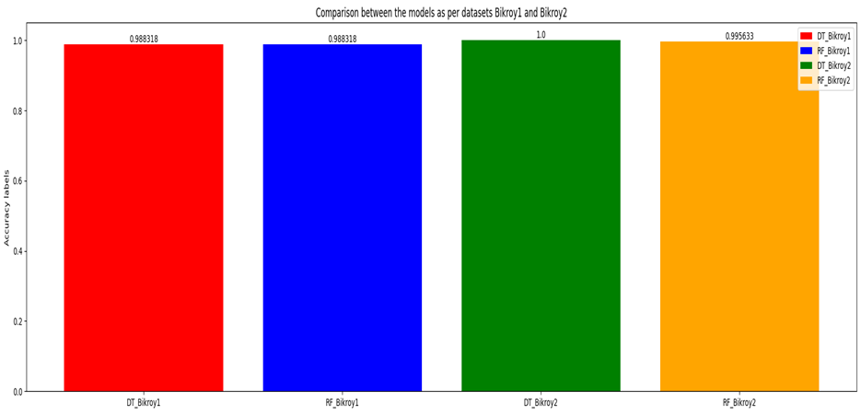
Accuracy
Accuracy
Comparison
Comparison
Results of model
Decision Tree(DT)
&
Random Forest(RF)

Slide 15
Recommendations For Bikroy1
Attribute | Value
Model Year | 2020
Transmission | Automatic
Body Type | SUV
Fuel Type | CNG
Engine Capacity | 1500 cc
Travels | 30,000 km
Price | 45,000
Accident History | No
Registration Year | 2024
Brand | Toyota
dataset_index | similarity_score_dt | similarity_score_rf | similarity_score_combined
2134 | 100.0 | 94.00 | 97.0000
0 | 100.0 | 94.00 | 97.0000
1 | 100.0 | 94.00 | 97.0000
2133 | 100.0 | 94.00 | 97.0000
2132 | 100.0 | 94.00 | 97.0000
... | ... | ... | ...
178 | 0.0 | 0.03 | 0.0075
1983 | 0.0 | 0.03 | 0.0075
2077 | 0.0 | 0.02 | 0.0050
847 | 0.0 | 0.02 | 0.0050
812 | 0.0 | 0.00 | 0.0000
dataset_index | car_name | brand | car_age | price | travels
2134 | Toyota Alphard 2006 | Toyota | 16 | 3000000 | 206693
0 | Toyota Fielder 2011 | Toyota | 8 | 1200000 | 45852
1 | Toyota Noah 2005 | Toyota | 14 | 1200000 | 219630
2133 | Toyota Alphard 2006 | Toyota | 16 | 3000000 | 206693
2132 | Toyota Alphard 2006 | Toyota | 16 | 3000000 | 206693

Slide 16
Recommendations For Bikroy2
Attribute | Value
Model Year | 2020
Transmission | Automatic
Body Type | SUV
Fuel Type | CNG
Engine Capacity | 1500 cc
Travels | 30,000 km
Price | 45,000
Accident History | No
Registration Year | 2024
Brand | Toyota
Dataset Index | Similarity Score (DT) | Similarity Score (RF) | Combined Similarity Score
1142 | 100.0 | 99.0 | 99.5
1141 | 100.0 | 99.0 | 99.5
1 | 100.0 | 99.0 | 99.5
2 | 100.0 | 99.0 | 99.5
3 | 100.0 | 99.0 | 99.5
... | ... | ... | ...
620 | 0.0 | 0.0 | 0.0
577 | 0.0 | 0.0 | 0.0
353 | 0.0 | 0.0 | 0.0
267 | 0.0 | 0.0 | 0.0
311 | 0.0 | 0.0 | 0.0
dataset_index | Car Name | Brand | Car Age | Price | Travels
1142 | Toyota Fielder Wxb Mica Blue 2019 | Toyota | 5 | 2,880,417 | 70,759
1141 | Toyota Fielder Wxb Mica Blue 2019 | Toyota | 5 | 2,880,417 | 70,759
1 | Toyota Hiace 2005 | Toyota | 19 | 2,000,200 | 32,000
2 | Toyota Axio 2009 | Toyota | 15 | 2,245,550 | 25,500
3 | Toyota Corsa 1999 | Toyota | 25 | 1,120,000 | 90,000

Slide 17
Here we use LambdaRank, one of the LTR algorithms developed by Chris Burges, using the LightGBM framework. The model works as follows:
calculating relevance scores using dataset and user preferences
converting relevance scores to discrete ranking levels
training the LambdaRank model using LGBMRanker from LightGBM
predicting ranking scores
combining ranking scores of 70% and relevance scores to get final scores
rank the output by sorting it by descending order
demonstrating the top 5 results as recommendations
Model using LTR

Slide 18
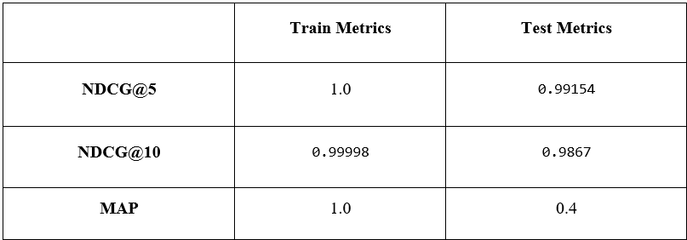

LTR metrics for dataset Bikroy1
Results of model using LTR
LTR metrics for dataset Bikroy2

Slide 19
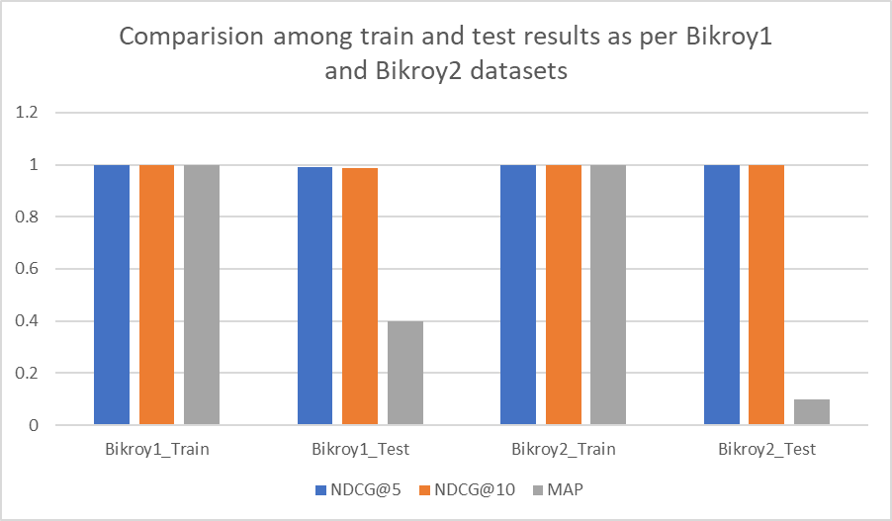
Comparison
Results of model using LTR

Slide 20
Recommendations For Bikroy1
Attribute | Value
Brand | Audi
Price | 38,000
Travels | 35,000
Car Age | 2019
Engine Capacity | 1,700
Accident | No
Data Index | Ranking Score | Relevance Score | Final Score
1480 | 1.000000 | 1.000000 | 1.000000
1481 | 0.999976 | 1.000000 | 0.999983
837 | 0.658178 | 0.996536 | 0.759685
834 | 0.652876 | 0.999685 | 0.756918
1504 | 0.644148 | 0.993073 | 0.748826
Data Index | Car Name | Brand | Car Age | Price | Travels
1480 | Nissan Sunny 1994 | Nissan | 30 | 120,000 | 115,000
1481 | Nissan Sunny 1994 | Nissan | 30 | 120,000 | 115,000
837 | Daihatsu Rocky 1989 | Daihatsu | 35 | 175,000 | 61,000
834 | Kia 1994 | Kia | 30 | 125,000 | 3,085
1504 | Chery Car Nice Condition 2006 | Chery | 18 | 230,000 | 72,180

Slide 21
Recommendations For Bikroy1
Attribute | Value
Brand | Audi
Price | 38,000
Travels | 35,000
Car Age | 2019
Engine Capacity | 1,700
Accident | No
Data Index | Ranking Score | Relevance Score | Final Score
38 | 1.000000 | 1.000000 | 1.000000
16 | 0.652981 | 0.999047 | 0.756801
14 | 0.650799 | 0.999047 | 0.755273
1101 | 0.650147 | 0.998977 | 0.754796
17 | 0.641474 | 0.999047 | 0.748746
Data Index | Car Name | Brand | Car Age | Price | Travels
38 | Toyota Fielder X Octane Drive 2017 | Toyota | 7 | 80,560.0 | 25,600.0
16 | Toyota Harrier ADVANCE 2019 | Toyota | 5 | 2,000,900.0 | 49,000.0
14 | Toyota Harrier 2019 | Toyota | 5 | 2,000,500.0 | 15,000.0
1101 | Toyota Fielder G 2014 | Toyota | 10 | 2,142,612.0 | 51,514.0
17 | Toyota Harrier ADVANCE 2019 | Toyota | 5 | 2,000,900.0 | 49,000.0

Slide 22
1.Combines multiple attributes (e.g., car name, price category, engine capacity, travel category) into a single string for each car in the dataset.
2. Initializes the Tf-Idf Vectorizer, to Converts the combined textual features into a sparse matrix of numerical feature vectors. where the importance of each term (word) is measured by its relevance within the dataset.
3.Calculates pairwise cosine similarity between all vectors in the TF-IDF matrix, resulting in a similarity matrix.
4.Filters the cars in the dataset based on the user's preferences stored in buyer preferences.
5.Calculates the mean similarity score for each car in the dataset against all filtered cars.
6.Selects the top n indices for recommendation and calculate average similarity.
TF-IDF with Cosine Similarity

Slide 23
Results of
TF-IDF with Cosine Similarity
Preferences | Similarity Score Bikroy1 | Similarity Score Bikroy2
Highest Price : 2000000 | 79.65% | 27.09%
Maximum Age : 10
Kilometer Travel :15000
Minimum Engine capacity : 2500

Slide 24
Recommendations
ID | Car Name | Price | Engine Capacity (cc) | Age
832 | Toyota Hiace GL DIESEL AMBULANCE 2015 | 1550000 | 3000 | 9
1887 | Toyota Hiace Ambulance 2015 | 1390000 | 2000 | 9
1886 | Toyota Hiace Ambulance 2015 | 1390000 | 2000 | 9
1438 | Toyota Hiace AMBULANCE 2015 | 970000 | 1500 | 9
827 | Toyota Hiace Diesel 2005 | 1290000 | 2500 | 19
ID | Car Name | Price | Engine Capacity (cc) | Age
562 | Nissan Rogue 2016 | 1351295.0 | 2500 | 8
782 | BMW 5 Series 2016 | 1616458.0 | 3000 | 8
380 | Mitsubishi Eclipse 2018 | 910277.0 | 2500 | 6
798 | Mitsubishi ASX 2024 | 1884091.0 | 3500 | 0
414 | Nissan Murano 2017 | 1896646.0 | 2500 | 7

Slide 25
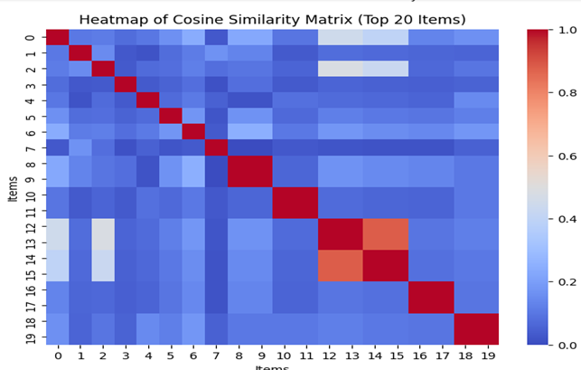
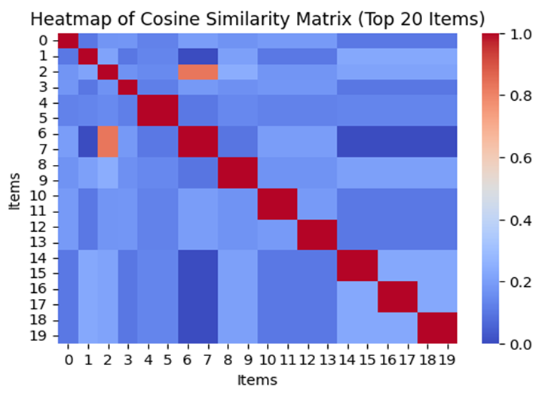
Some Visualizations of TF-IFD
Bikroy1
Bikroy2

Slide 26
Accuracy Across Models
Model | Accuracy (Bikroy1) | Accuracy (Bikroy2)
DT | 98.83% | 100%
RF | 98.83% | 99.563%
KNN | 99.0% | 99.8%
Model | PORTIONS | NDCG@5 (Bikroy1) | NDCG@10 (Bikroy2) | MAP (Bikroy1) | NDCG@5 (Bikroy2) | NDCG@10 (Bikroy2) | MAP (Bikroy2)
LTR | Train | 1.0 | 0.99998 | 1.0 | 1.0 | 0.99998 | 1
 | Test | 0.9915 | 0.9867 | 0.4 | 0.9999 | 0.9998 | 0.1
TF-IFD – Its accuracy vary according to user preferences. Because of it’s a unsupervised learning.

Slide 27
Comparison With Previous Work
Datasets | PROMETHEE | DT(weighted avg) | RF(weighted avg) | KNN
Precision for Website A Data | 0.94 | N/A | N/A | N/A
Precision for Website B Data | 0.93 | N/A | N/A | N/A
Precision for Website C Data | 0.91 | N/A | N/A | N/A
Precision for Bikroy1 Dataset | N/A | 0.99 | 0.98 | 0.98
Precision for Bikroy2 Dataset | N/A | 1.0 | 0.99 | 0.99
Average Precision | 0.93 | 0.99 | 0.98 | 0.98
Recall for Website A Data | 0.93 | N/A | N/A | N/A
Recall for Website B Data | 0.92 | N/A | N/A | N/A
Recall for Website B Data | 0.91 | N/A | N/A | N/A
Recall for Bikroy1 Dataset | N/A | 0.99 | 0.99 | 0.83
Recall for Bikroy2 Dataset | N/A | 1.0 | 1.0 | 0.92
Average Recall | 0.92 | 0.99 | 0.99 | 0.88

Slide 28
KNN-
Incorrect Feature Representation
Unnormalized Data
Improper Encoding
Imbalanced Features(Higher variance)
Numerical errors ( threshold)
DT & RF –
improper normalization
Improper Encoding
miss-classification
LTR-
improper normalization
Improper Encoding
Mis ranked items
TF-IFD –
Smaller datasets reduced recommendation accuracy
Rare terms dominate TF-IDF
Performance drops with low data variation
Error Analysis

Slide 29
Optimize the model to handle large-scale datasets with numerous attributes and diverse vehicle categories
Leverage deep learning techniques to overcome current limitations and improve scalability.
Incorporate real-time user feedback to enhance recommendation relevance
Combine content-based, collaborative filtering, and context-aware approaches for superior performance.
Future Scope

Slide 30
Thank You
Any Question From Audience?

