Slide 1
nBlocksStudio Solving a simple Motion Control Automation Use Case
Nikolaos Chalikias
06/12/2020
Notes:
Hello,
In this presentation we solve a Motion Control Automation use case, to demonstrate, nBlocksStudio... Diagram to Microprocessor executable workflow

Slide 2
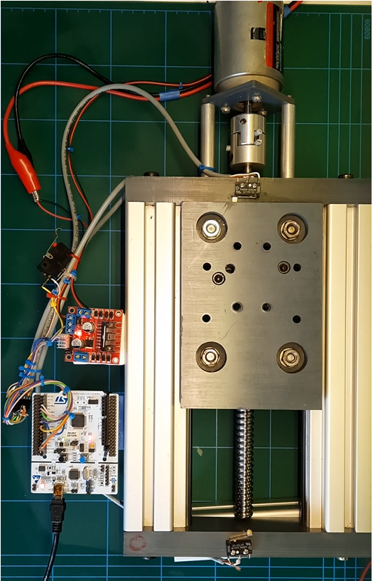
A LINEAR MOTION STAGE DRIVEN BY A DC-MOTOR AND BALL-SCREW
MOVING
CARRIAGE
LEFT
END-SWITCH
DC MOTOR
RIGHT
END-SWITCH
BALL SCREW
COUPLER
L298 MOTOR
DRIVER
BOARD
START-SWITCH
MICROPROCESSOR
BOARD
Notes:
An example of a simple motion control automation, implemented with nBlocksStudio.
The Mechanical frame
A Linear motion stage made with Aluminum profiles, 14mm hardened shafts, A carriage with V-Groove ball bearings, Ball screw & Nut, a Shaft-Coupler and the DC-Motor
Interface to electronics:
The End micro-switches
A brushed DC 24VA Motor
The Electronics
The Microcontroller board, is a low cost Nucleo STM32F401.
The Motor Driver is a low cost L298 breakout board
Our use case is:
To Start moving the carriage right when the Start button is pressed.
When the right endswitch is reached the motion is reversed.
Then when the left endswitch is reached, the motion stops

Slide 3
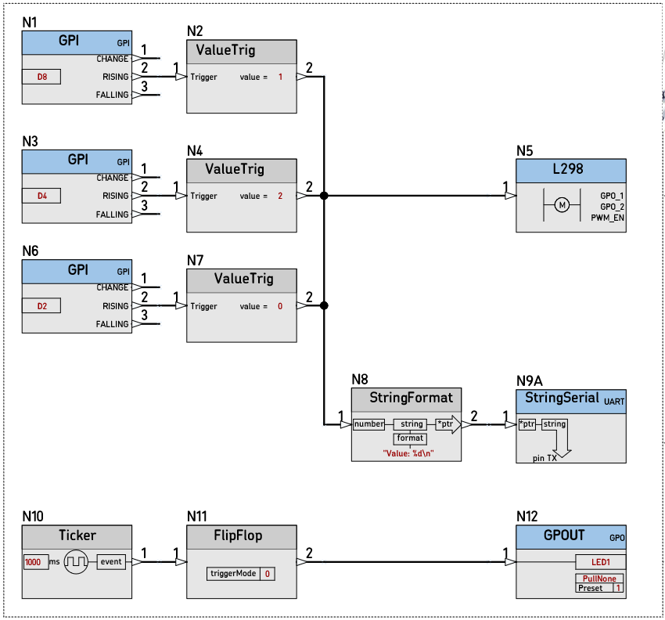
SIMPLE LINEAR MOTION AUTOMATION WITH nBlocksStudio
nBlocksStudio
Notes:
We are using an nBlocksStudio Schematic Diagram.
The differences from our previous video example with LPC1768 Microprocessor are:
The different Pins used for the Switch Inputs
The different Output pins for the Motor driver breakout board

Slide 4
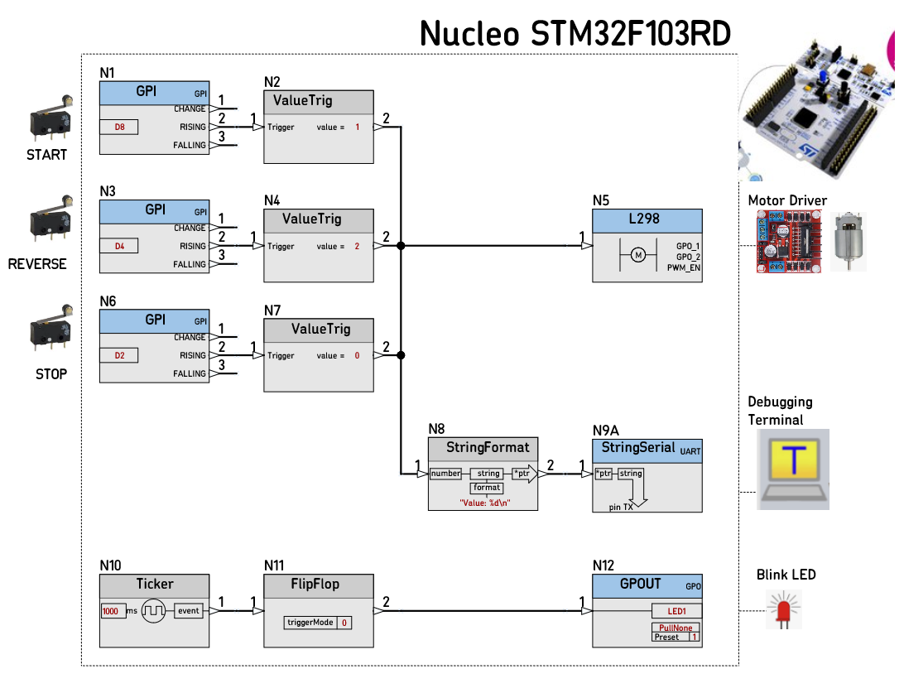
Notes:
When the Schematic Design is complete, we are ready for the next step

Slide 5
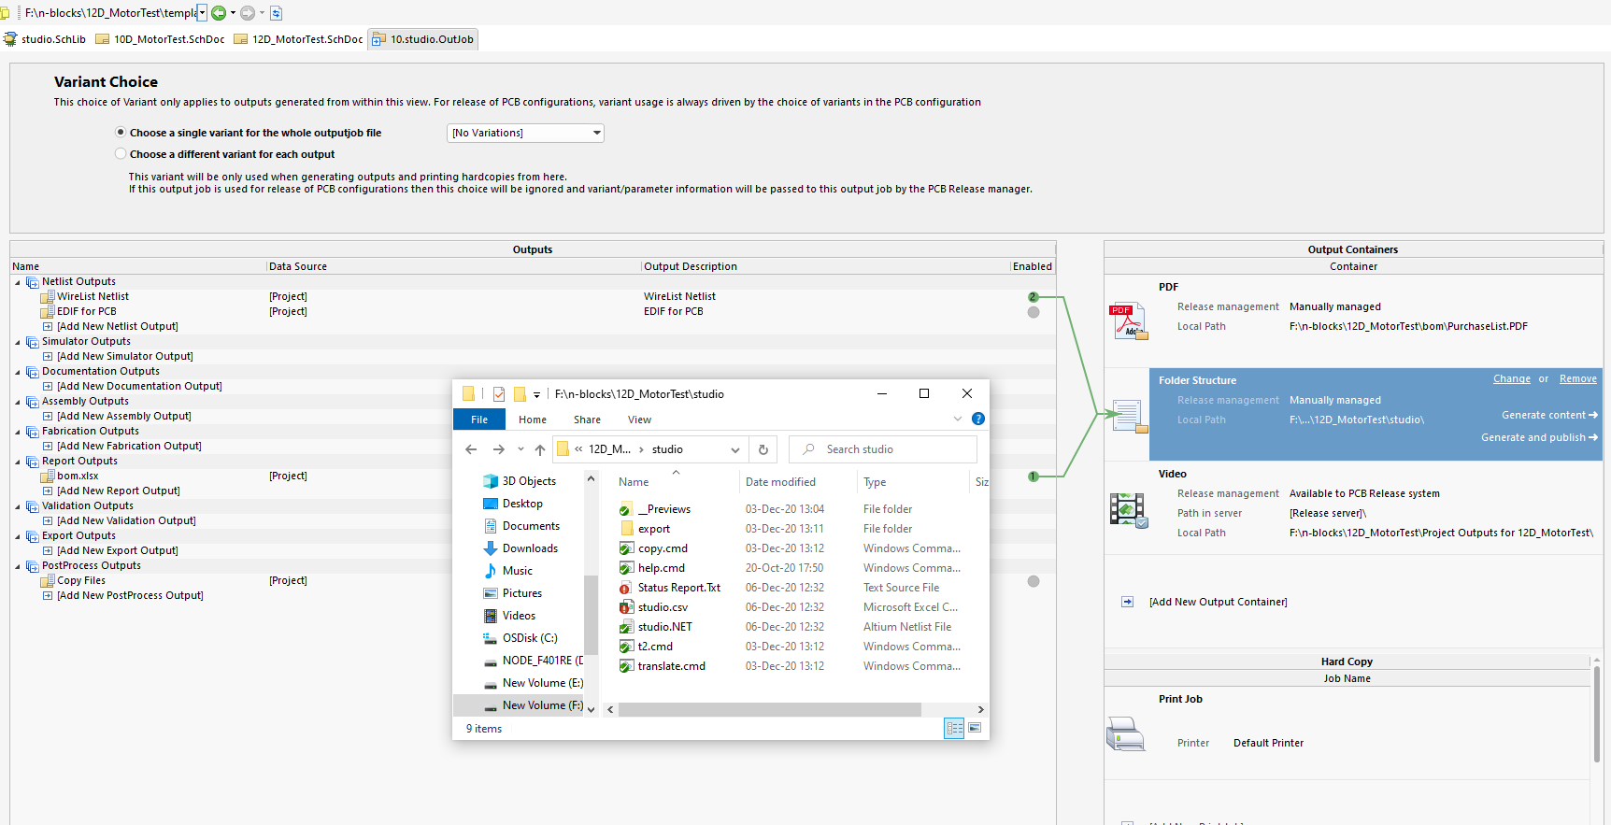
Notes:
We export the Design, and 2 files are created:
The .NET file that contains the Netlist information
The .CSV file that contains the parameters for each Node
These 2 files will be processed in the next step, from the Command Line tool.
This tool is the nBlocksStudio-Translator!

Slide 6
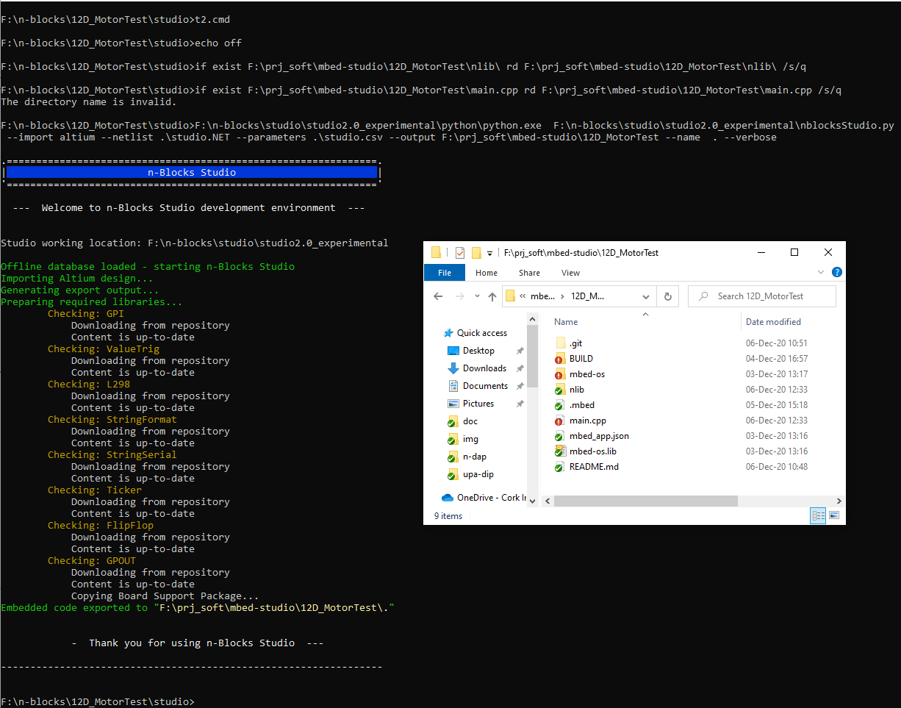
Notes:
The nBlocksStudio Translator tool, will create a new Folder with contents:
The autogenerated main.cpp file, containing our design and
The nLib subfolder with:
all the Libraries and C++ for each Node
The nBlocksStudio Kernel
The contents of the nLib subfolder are git version controlled and are downloaded from remote github repositories.
This allows to lock a design on specific library version(s)
Or
Use the latest.
If there is no Internet connection, the nLib content can be created from local sources.

Slide 7
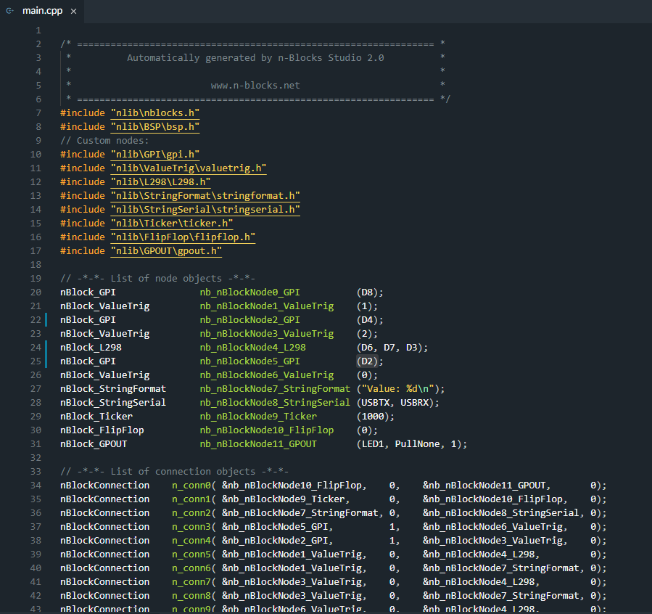
Notes:
This is the newly created main.cpp.
The size is small and is easy to review and understand.
It is also possible to update some parameters before compilation to facilitate debugging.

Slide 8
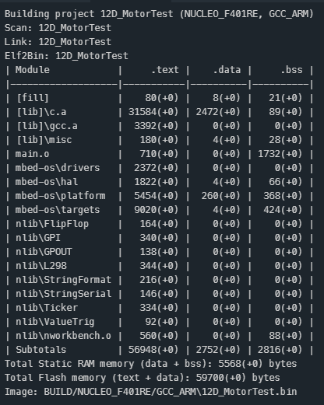
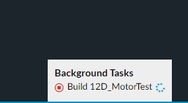
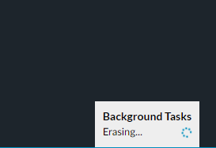
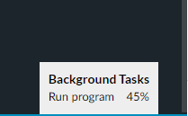
Notes:
The Next step is the compilation and the executable download to our microprocessor.
The IDE in use is mbed-studio and we have set it up for the GCC Compiler.
ARM AC6 compiler is also an option.
The IDE can compile and erase/flash/run the executable in a single step

Slide 9
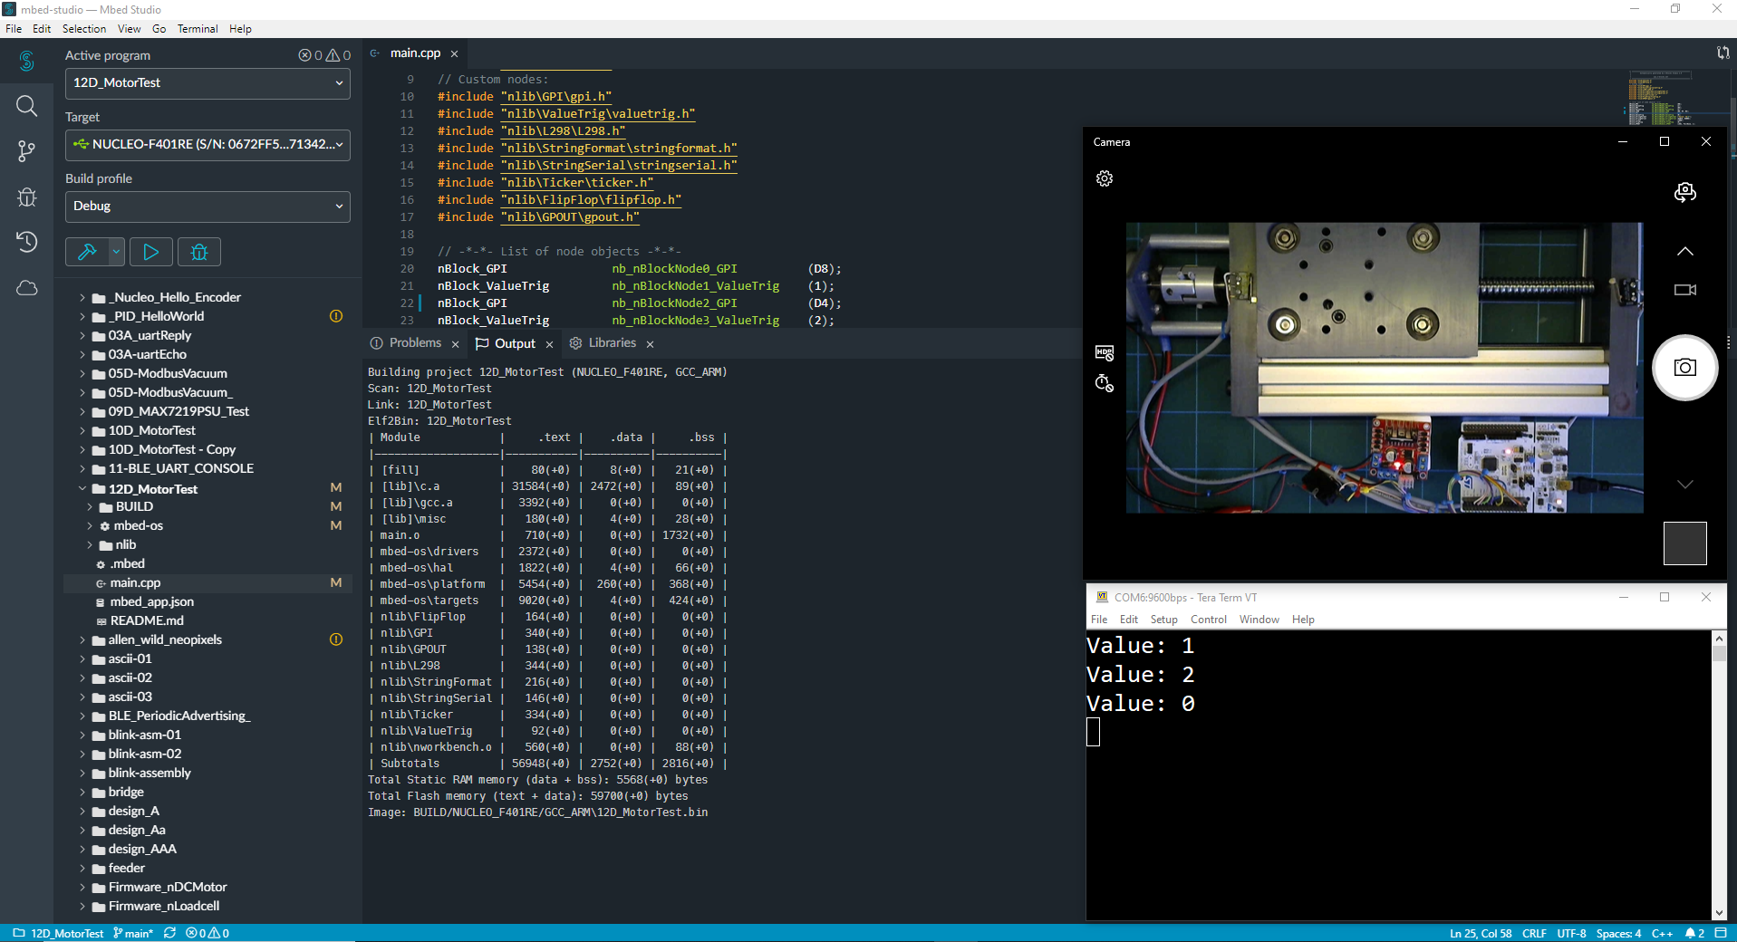
Notes:
After the microprocessor is programmed, we are ready for the testing.
We initiate the movement, pressing the start Switch
And
We can see the motion executed.

Slide 10
Next nBlocksStudio Example
Motion Control
Incremental Encoder
Reading
Notes:
Next
Our next nBlocksStudio Motion control example will read the Motor Incremental Encoder to have precise indication of the motor and carriage position

