Slide 1
Code Refactoring

Slide 2
Agenda
Day 1
Code Refactoring presentation
Tennis problem
Start of Gilded rose
Day 2
Gilded Rose

Slide 3
What you will learn
Code Refactoring strategies
Unit testing
Maybe some Python

Slide 4
Why is code refactoring important?
Readability
Maintainability and bug fixing
Performance improvement
Consistency
Team collaboration

Slide 5
Typical Refactoring strategies

Slide 6
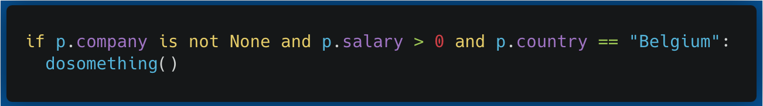
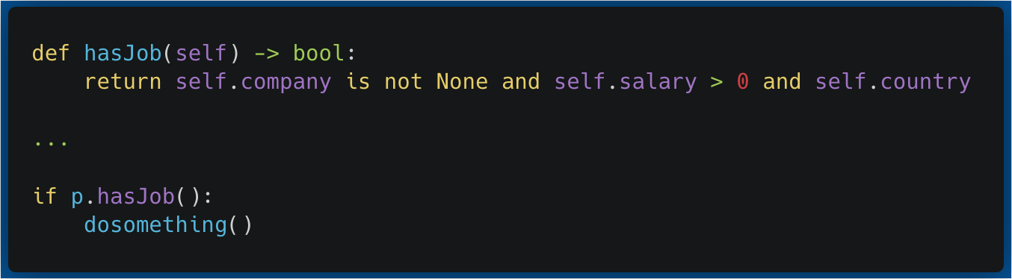
Extract methods
Concerns
Fragment of code (repeated or not) that can be grouped together
Becomes
Method with a self-explanatory name

Slide 7
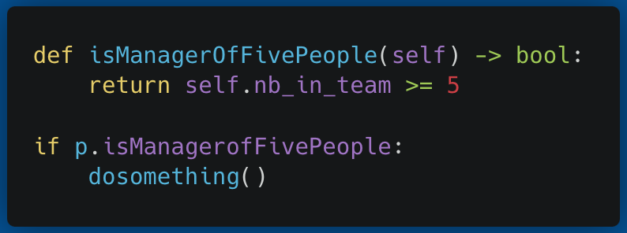
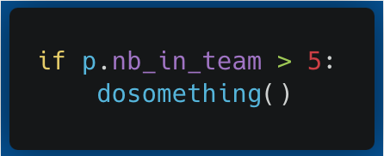
Inline methods
Concerns
Methods whose name is as simple as its body
Becomes
Inline code

Slide 8
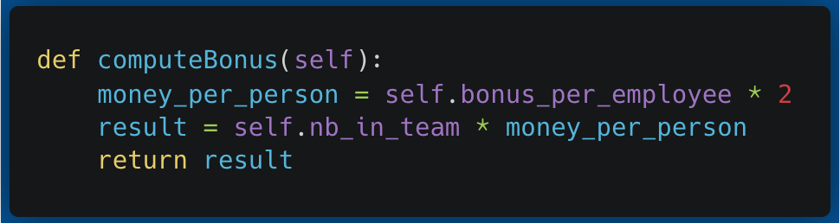
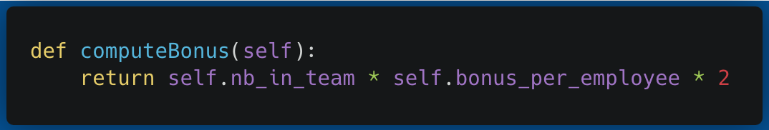
Redundant variables
Concerns
Variables whose content is irrelevant
Becomes
Removed and incorporated in another line

Slide 9
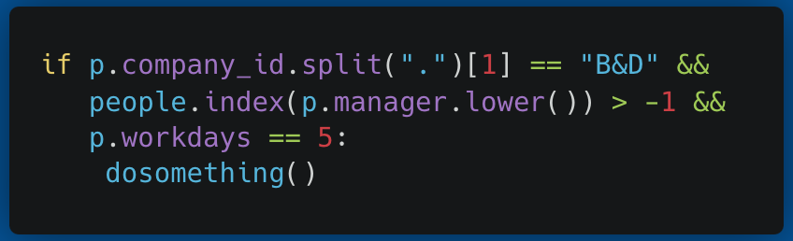
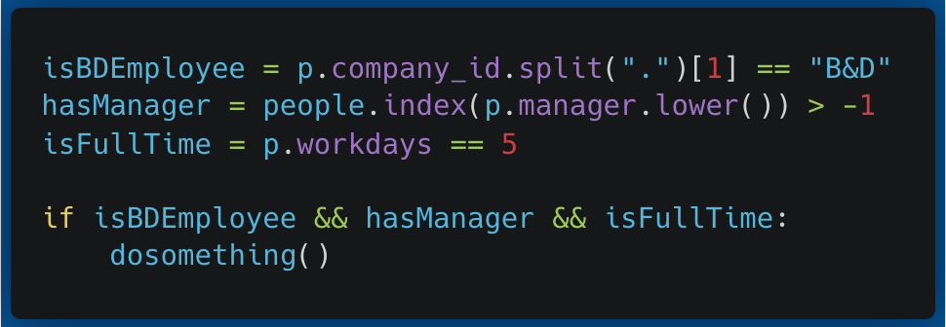
Introduce explaining variables
Concerns
Complex expressions
Becomes
Multiple explaining variables

Slide 10
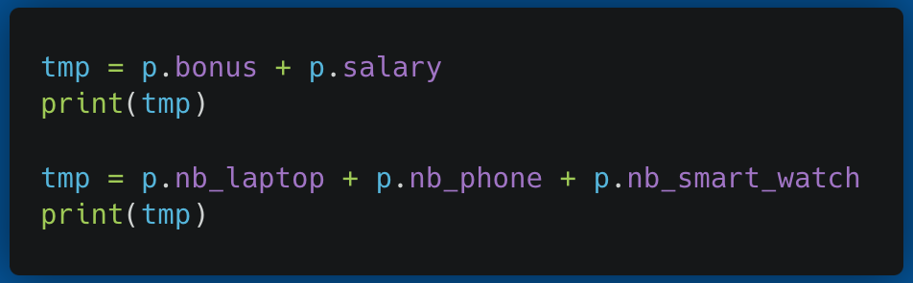
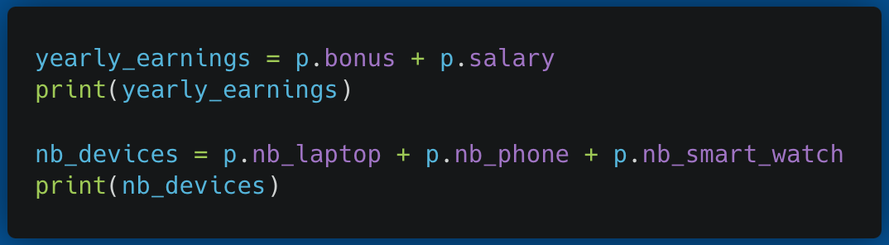
Clear temporary variables
Concerns
Temporary variables not explicitly named
Becomes
Named temporary variables

Slide 11
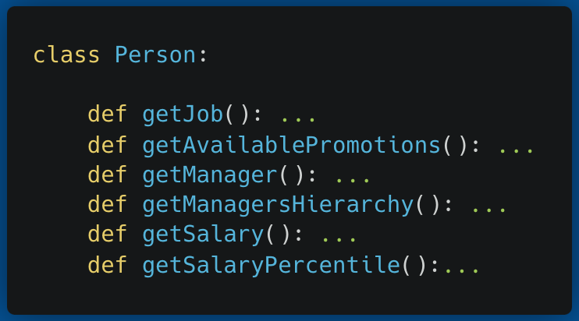
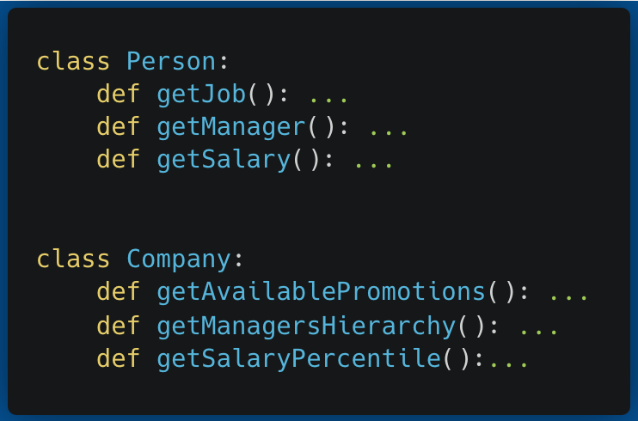
Managing class functionality
Concerns
Large classes with many functionalities
Becomes
Splits classes with 1 functionality

Slide 12
Python specific refactoring

Slide 13
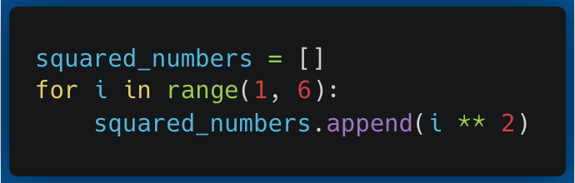
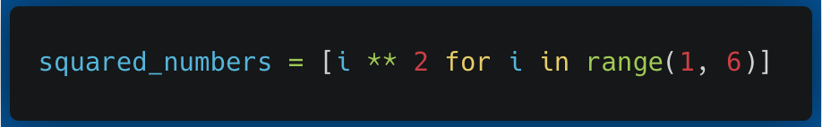
List comprehensions
Concerns
Loops that could be list comprehensions
Becomes
List comprehensions

Slide 14
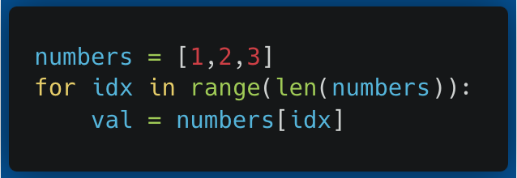
Terrible loops
Concerns
Non pythonic way of looping
Becomes
”For loop in Python”

Slide 15
Unit tests

Slide 16
Unit test
The goal of unit testing is to ensure that each unit of the software performs as designed.
Coverage allows developers to monitor the amount of code that is covered by the unit test.
Goal is to reach highest coverage value for the code being tested.
More on that with the tennis example

Slide 17
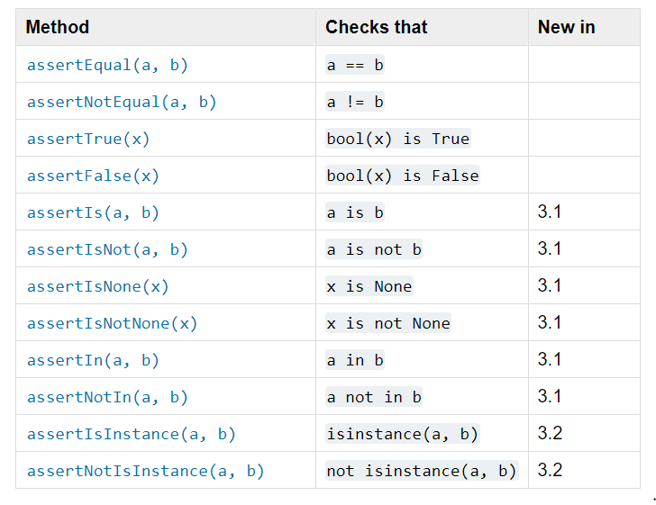
Unit test
Most unit test uses assert function to validate the result(s) tested
Assert function example from unittest package - Python

Slide 18
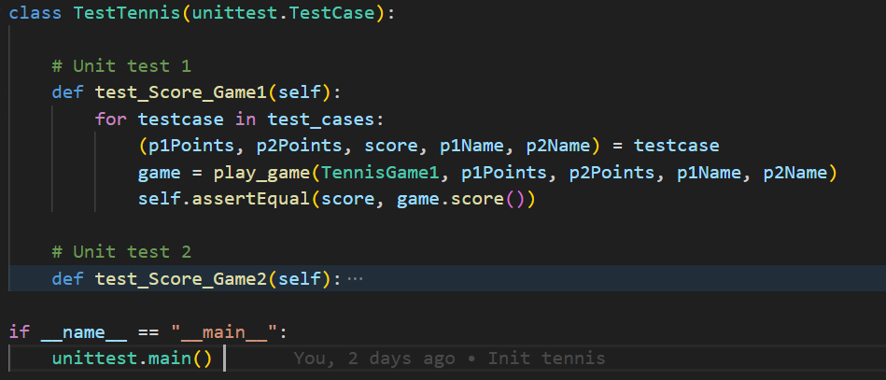
Unit test : example

Slide 19
Hands-on : Tennis
The goal of unit testing is to ensure that each unit of the software performs as designed.

Slide 20
Hands-on : tennis
Main goal of this first exercise
Refactor the code bit by bit
Versioning: Commit the changes as you go
For this exercise, the unit tests have already been created.
Make sure you understand how it works as you’ll need to create your own next !

Slide 21
Hands-on : Gilded Rose

Slide 22
Hands-on : Gilded Rose
Main goal of this second exercise :
Understanding the code and filing the documentation
Create unit tests to make sure your code works as expected
Reactor the code and check that it still works with your UTs
Don’t forget :
Refactor the code bit by bit
Versioning: Commit the changes as you go

Slide 23
Design patterns

Slide 24
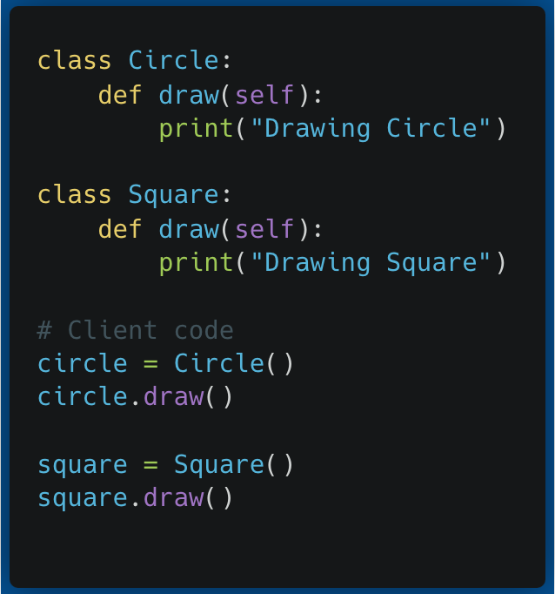
Item factory
This example can create a Circle or a Square. These two classes both draw() something, but are not linked in any way.
When used, adding a Triangle class would force us to change significantly the client-side code

Slide 25
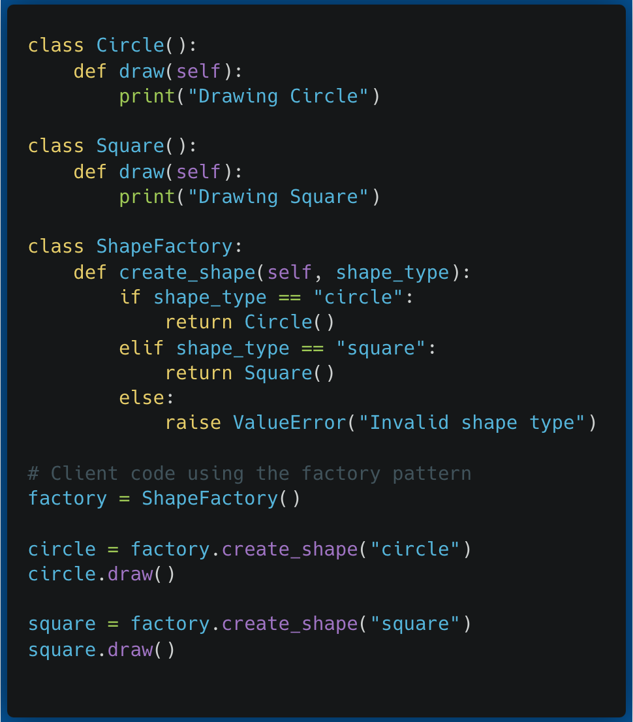
Item factory
The ShapeFactory class is responsible for creating instances of different shapes based on the input provided (in this case, a string specifying the shape type).
To add a triangle, simply edit the backend ShapeFactory and add your class

Slide 26
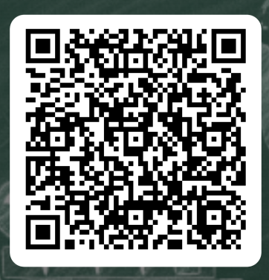
Thank you !
If you have any questions, feel free to ask or to ping us on Teams later
Please take the time to give feedback about the training

