Slide 1
nat-os
An operating system written from scratch for the ESP32
No ESP-IDF · No Arduino · No FreeRTOS · No C library ESP32-2432S028R (Cheap Yellow Display) · 39 engineering reports · 138 commits
Project analysis — generated from source tree and docs/
nat-os project overview | Used Medias LLC — Embedded Systems Division
1 / 16

Slide 2
Executive summary
- nat-os is a freestanding kernel for the ESP32 that owns scheduling, memory, drivers, and application execution. Every instruction from the image entry point onward is project code except a replaceable bootloader and partition table.
- Two decisions shape everything: compile the kernel with -mabi=call0 (no register windows — context switch is a conventional save/restore), and run applications in a bounds-checked bytecode VM (hardware has no MMU paging, so software isolation is the only option).
- Milestones M0–M5 completed in one day (2026-08-14): boot, tick, preemptive scheduler, heap/arenas, bytecode interpreter, multi-app shell. A week of driver work followed: display, touch, 3D raycaster, persistence, SD, audio, device model, custom bootloader, flash-executable code, and integration of Espressif's closed WiFi/PHY blob.
- The project is unusually well documented: 39 numbered engineering reports (UM-NATOS-001 through 039), a 31-chapter book synthesis, and standing rules extracted from every embarrassing defect.
- Current frontier: vendor WiFi stack runs from flash under nat-os's own bootloader; init-time windowed/call0 bridging bugs are being closed one measurement at a time. Nothing has been on air yet.
nat-os project overview | Used Medias LLC — Embedded Systems Division
2 / 16

Slide 3
Target hardware
ESP32-2432S028R — the only board every measurement was taken on
Property | Value | Design consequence
SoC | ESP32-D0WD, dual Xtensa LX6 @ up to 240 MHz | Real SMP possible; deferred — single-core kernel for now
Internal SRAM | 520 KB total, no PSRAM on stock CYD | Tight once graphics + WiFi blob writable state are reserved
Flash | 4 MB, execute-in-place via cache/MMU | .rodata in flash since M11; .text in flash since UM-NATOS-037
MMU | Flash-cache translation only | No per-process address spaces — isolation is VM + arenas
Display | ILI9341 240×320 + XPT2046 resistive touch | Board-specific code confined to board_cyd.h, display.c, touch.c
Image size | ~37 KB kernel (no WiFi) / larger with blob | ~145 KB DRAM left for heap, stacks, and app arenas
nat-os project overview | Used Medias LLC — Embedded Systems Division
3 / 16

Slide 4
Two decisions that constrain everything
- call0 ABI — Xtensa's windowed ABI (call8/call12) makes context switch require spilling live register windows — where from-scratch Xtensa kernels usually stall. call0 removes windows entirely. Cost: ROM routines (windowed) cannot be called directly — irrelevant until WiFi, when hand-written bridges in kernel/window.S become the integration layer.
- Bytecode VM for applications — The ESP32 MMU does not implement page tables. Any native code can write any address. Running apps in an interpreter whose loads/stores are bounds-checked recovers protection in software and makes preemption at instruction boundaries trivial. An app deliberately written to escape its arena is in the test suite — it cannot.
- L2 start — Writing L1 (clock trees, SPI calibration) is silicon bring-up, not OS design. Borrowing L1 yielded a running CPU quickly; L1 was later replaced entirely (UM-NATOS-035). Clock config moved to kernel/clock.c after the half-speed board defect (UM-NATOS-036).
nat-os project overview | Used Medias LLC — Embedded Systems Division
4 / 16

Slide 5
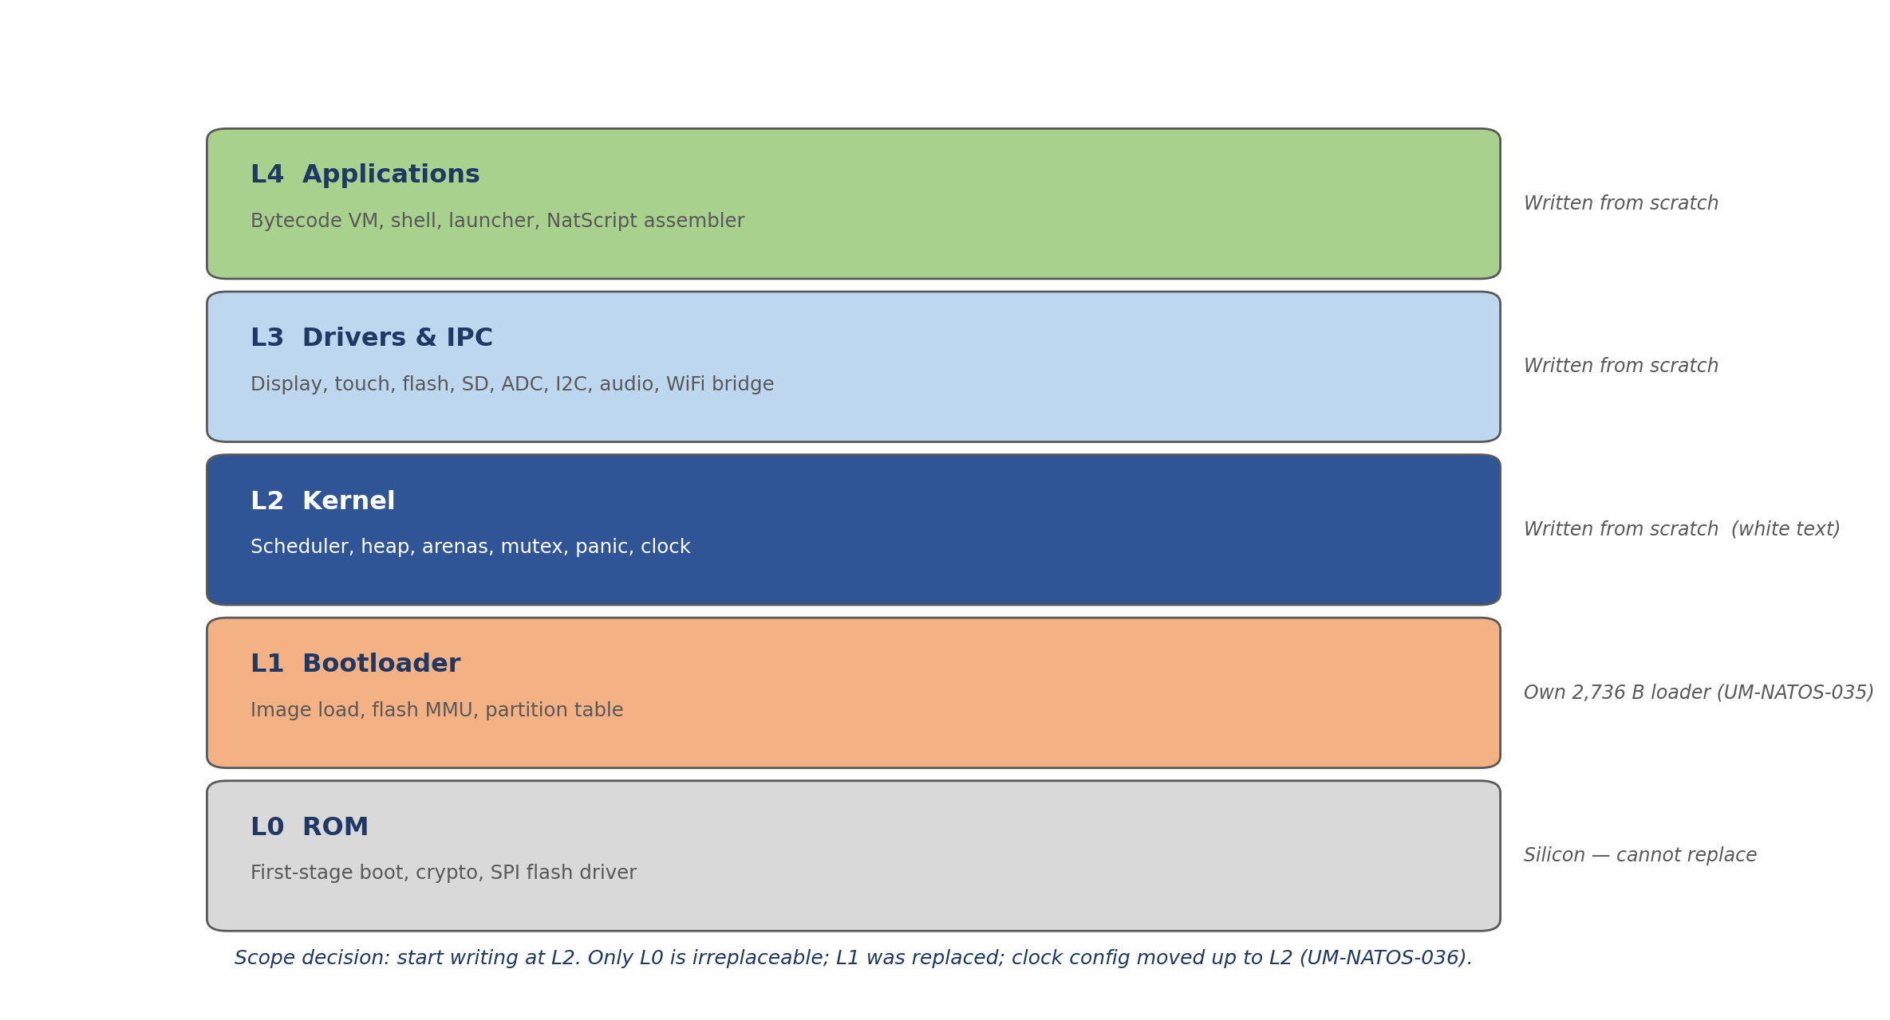
Layer model and project scope
nat-os project overview | Used Medias LLC — Embedded Systems Division
5 / 16

Slide 6
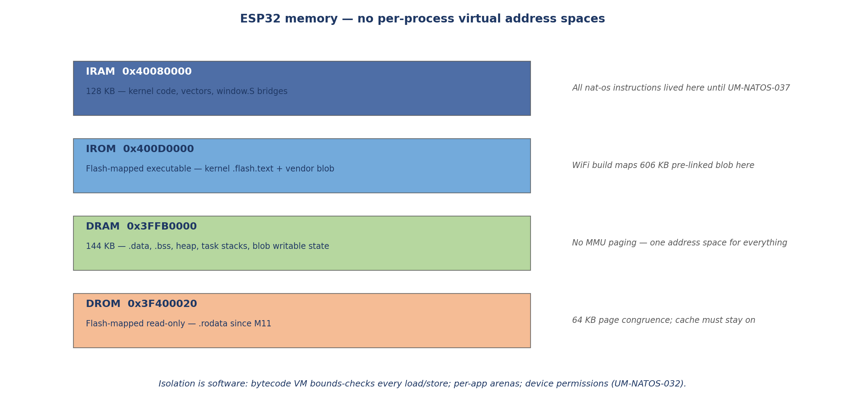
Memory map and the isolation problem
nat-os project overview | Used Medias LLC — Embedded Systems Division
6 / 16

Slide 7
Kernel: scheduler and tasks
- Preemptive, three priority levels with ageing — no ready task waits more than ~600 ms regardless of what sits above it.
- Task states: READY, RUNNING, BLOCKED (mutex), SLEEPING (WAITI in idle). Up to 12 native task slots; context switch saves/restores a fixed frame in task.c / vectors.S.
- Tick: CCOMPARE1 level-3 interrupt. Critical standing rules emerged here: clear PS.EXCM before calling C from handlers (zero-overhead loops break otherwise); yield must never defer the tick deadline; shared register shadows need one writer or synchronized bookkeeping.
- Stack guards checked on every switch; worst task uses 444 B of 2,048 (78% margin measured). Panic dumps EXCCAUSE/EPC to serial, flash, and panel.
- WiFi build adds windowed vendor code via phy_stack_call, rom_callN, win_spill_all — the call0 kernel must bridge into -mabi=windowed blob code safely (kernel/window.S, vendor/windowed/wifi_osi_stubs.c).
nat-os project overview | Used Medias LLC — Embedded Systems Division
7 / 16

Slide 8
Applications: bytecode VM and containment
- Register-based VM: 35 opcodes, 14 syscalls, NatScript assembler in tools/. Programs compiled to .vasm, assembled to headers in kernel/generated/.
- Every memory access bounds-checked against the app's arena. Six fault classes contained (bad opcode, OOB load/store, stack overflow, etc.). 3.3M instructions across 450 preemptions with zero accounting drift.
- Syscalls: display (FILL/TEXT/DIMS/BLIT confined to viewport), touch (confined), messaging (copied through kernel mailbox — never shared memory), device model (light, speaker, persistence, I2C, keypad, SD — with per-app permissions, UM-NATOS-032).
- Launcher: 3×3 icon grid, hybrid cursor, double-tap to run. On-screen shell reaches the real serial shell via UART tee — one command set, not two.
- Sample apps: pong, paint, rogue, raycast demo, note pad, spin, blit test.
nat-os project overview | Used Medias LLC — Embedded Systems Division
8 / 16

Slide 9
Drivers and peripherals — verified state
Subsystem | Hardware | Status
Display | ILI9341 via SPI2 + DMA | 43 ms full-screen fill; DMA bit-30 bug fixed (UM-NATOS-030)
Touch | XPT2046 + PENIRQ | Calibrated on-device; X was inverted 3 months
Audio | LEDC PWM on GPIO26 | Tones work; 440 Hz inaudible, 3 kHz clear
ADC | SAR ADC1, 8 ch | Light sensor on GPIO34 confirmed (+265 counts)
I2C | Bit-bang GPIO22/27 | Bus electrically verified; no device attached
Flash store | SPI flash @ 2 MB | Checksummed record survives power cycle
microSD | SPI mode | FAT16 header read; per-stage error codes
Interrupts | Matrix routing | Peripheral IRQ routable; PENIRQ never fired from finger
WiFi/PHY | Espressif blob in flash | PHY init OK; driver init in progress; not on air
3D view | Software raycaster | 16 fps grid dungeon; optional framebuffer
nat-os project overview | Used Medias LLC — Embedded Systems Division
9 / 16

Slide 10
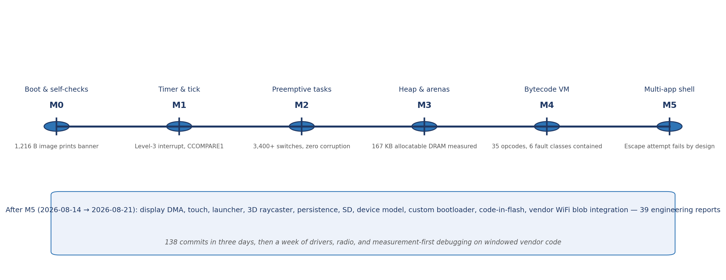
Development timeline
138 commits · 2026-08-14 through 2026-08-21
nat-os project overview | Used Medias LLC — Embedded Systems Division
10 / 16

Slide 11
Build pipeline
- Toolchain: xtensa-esp32-elf-gcc from PlatformIO packages only — not PlatformIO as a build system. build.ps1 compiles, links, packages natos.bin.
- Key flags: -mabi=call0, -ffreestanding, -fno-builtin, -Os. WiFi build adds -DBOARD_WIFI_OVERRIDE=1 and links vendor blob + window bridges.
- Flash layout: stage-2 boot @ 0x1000, partition table @ 0x8000, kernel @ 0x10000. Custom bootloader is 2,736 bytes (boot/); vendor boot available via -VendorBootloader for A/B recovery.
- Board targets: cyd (default, verified) and lora32 (pin map not yet verified).
- Host tools: NatScript assembler (tools/vasm.py), serial command sender (tools/serial/send_cmd.py), bytecode program sources (*.vasm).
nat-os project overview | Used Medias LLC — Embedded Systems Division
11 / 16

Slide 12
Documentation culture
what makes this project unusual
- 39 engineering reports (UM-NATOS-001–039): each states what was decided, what was measured, and what remains unverified. Every report ends with what it does NOT establish.
- Measured vs assumed is always separated. Several standing rules exist because plausible-looking numbers were believed while an instrument declared its own reading invalid.
- docs/book/: 31-chapter synthesis with appendices (ISA reference, register map, timeline, measurements). Reports remain primary; book is continuity.
- Defects are recorded honestly: tick deadline racing into the future, touch axis inverted behind a calibration that could only give one answer, DMA_OUTLINK_START defined as bit 30 (RESTART not START), idle task that silently failed to be created.
- AGENTS.md codifies debugging discipline: reproduce first, one variable at a time, preserve known-good git state, treat linker maps and register dumps as primary evidence.
nat-os project overview | Used Medias LLC — Embedded Systems Division
12 / 16

Slide 13
Standing rules (sample)
each rule constrains future code — extracted from a specific defect
Rule | Origin | One-line statement
EXCM | M2 / UM-NATOS-009 | Clear PS.EXCM before calling C from any IRQ handler
Tick yield | Display freeze / UM-NATOS-016 | Yield must only move CCOMPARE1 earlier, never later
Shadow registers | 183 ms stall / UM-NATOS-008 | One writer, or every writer maintains the shadow
Instruments | Touch cal / UM-NATOS-017 | When an instrument says its reading is invalid, believe it
Experiments | Flash debug / UM-NATOS-018 | A negative result is informative only if the experiment ran
Existence ≠ proof | Shell RX / UM-NATOS-019 | Trigger the mechanism on purpose, or treat as untested
Lock contention | Mutex timing / UM-NATOS-014 | Cost is number of blocking events, not hold time
Fix scope | Launcher chrome / UM-NATOS-021 | Correct diagnosis does not license arbitrary blast radius
nat-os project overview | Used Medias LLC — Embedded Systems Division
13 / 16

Slide 14
Recent frontier work (reports 027–039)
- UM-NATOS-028–030: WiFi receive path, seven instruments caught lying, display DMA dead since boot — root cause one wrong bit (RESTART vs START).
- UM-NATOS-031–032: Device model — peripherals as table entries with per-app permissions; ~70 lines, explicitly not security.
- UM-NATOS-034: Second receiver negative result — nothing demodulable on air; fault is RF/PHY path, not frame construction.
- UM-NATOS-035–037: Custom bootloader, half-speed clock defect, kernel code moved to flash (free IRAM 19 KB → 45 KB).
- UM-NATOS-038: 606 KB vendor blob mapped in three windows (code, rodata, writable DRAM); 118-entry OSI adapter table; struct layout off by 4 bytes found by asking real ESP-IDF to print offsets.
- UM-NATOS-039: Phantom WINDOWSTART bits root-caused — context switch wrote windowstart through rotated register view; fixed by instruction reorder. Exposed next failure: first multi-frame windowed task suspension.
nat-os project overview | Used Medias LLC — Embedded Systems Division
14 / 16

Slide 15
Current status and open problems
Area | State | Next / open
Core kernel M0–M5 | Complete, hardware-verified | Stable baseline
Display / touch / UI | Working on CYD | PENIRQ from finger unobserved
WiFi transmit | Not on air | PHY init OK; driver init fault under investigation
Windowed bridging | Partially closed | Multi-frame park machinery for blob task
lora32 board | Pin map unverified | Second receiver experiment used CYD only
Priority inheritance | Unwired | task_boost() exists; nothing calls it
DRAM budget | Unremeasured | 12 tasks + 3 drivers since last M3 figure
JTAG probe | Ordered, not in hand | Would change debug methodology
nat-os project overview | Used Medias LLC — Embedded Systems Division
15 / 16

Slide 16
Source tree at a glance
- kernel/ — ~125 files: start.S, vectors.S, window.S (entry/IRQ/window bridges); task.c, timer.c, heap.c, arena.c, vm.c, app.c, ipc.c; display.c, touch.c, raycast.c, flash.c, sd.c, audio.c, i2c.c, adc.c; blobcall.c, phyinit.c, wifi_osi_impl.c; shell.c, term.c, desktop.c (launcher); linker.ld.
- boot/ — custom second-stage loader (replaces 17 KB ESP-IDF boot).
- vendor/ — partition table, optional ESP-IDF boot recovery, windowed WiFi blob and OSI stubs; net80211/ probe tooling.
- tools/ — NatScript assembler, demo/program .vasm sources, serial helpers.
- docs/ — 39 reports, book/, debug/ investigation records, next_moves/ roadmap.
- Key shell commands: ps, run, kill, mem, stacks, 3d, fb, sd, wifiinit (WiFi build), wintorture, hang/fault/smash (failure paths exercised on purpose).
nat-os project overview | Used Medias LLC — Embedded Systems Division
16 / 16

