Slide 1

Epic Group

Slide 2

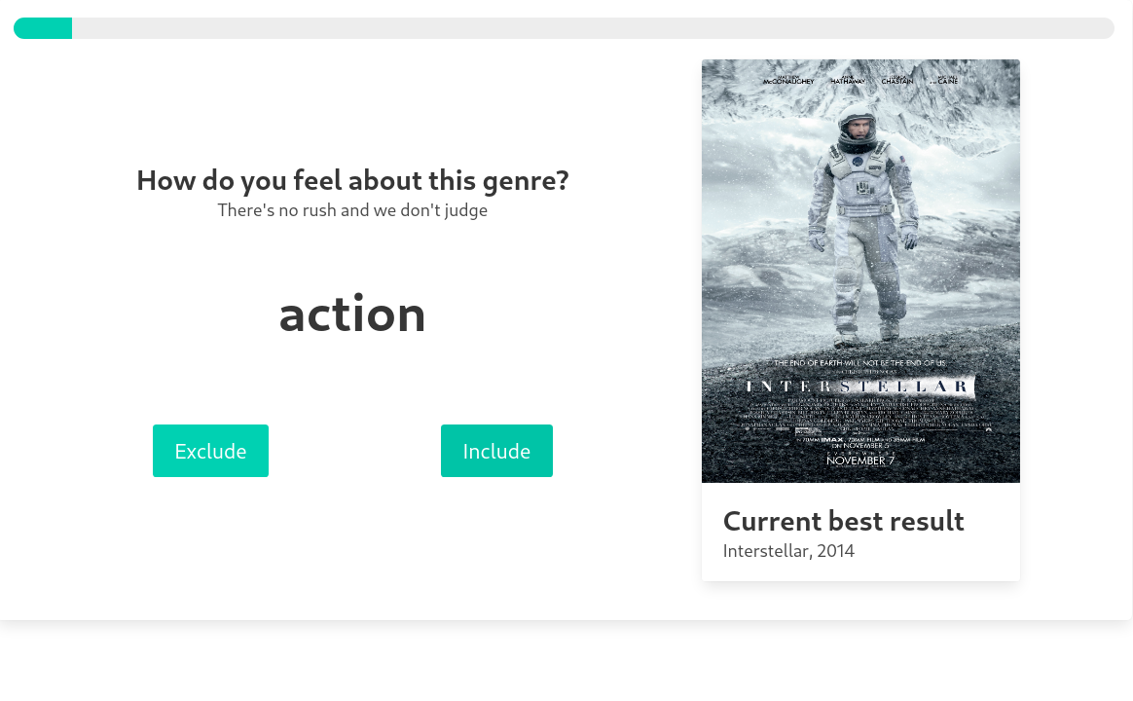

1. Data Storage
2. Movie Searching

Slide 3





Pastiche
RapidJSON
C++
HTTP, REST
database
backend
BULMA
Google test
css framework
unit test

Slide 4
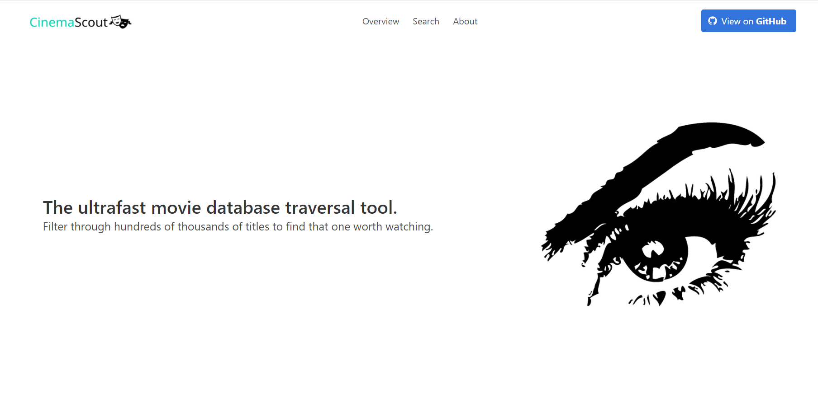
Web application Demo

